Slide 1
Camagru
Notes:
Hello, my name is Chanel and I will be speaking about Camagru

Slide 2
table of contents
01
02
03
04
05
06
Project Planning
Managing Data
Technologies
A project overview, and project’s target market, objectives and outline
Here you could describe the topic of the section
Here you could describe the topic of the section
Tools
Project Insights
Project Sources
Here you could describe the topic of the section
Here you could describe the topic of the section
Here you could describe the topic of the section

Slide 3
-01-
Project
Plannings

Slide 4
Project Overview What is Camagru?
Camagru is a website that allows users to post their best picture for other users to view, comment and like.
The target audience are companies that need image centred social media sites or any company that has a business problem that can be solved by a web application.
Notes:
Camagru is an image base, social media site, that allows people to take pictures using their webcam or upload them from their personal computers. Users can then add stickers to their images and save them to a timeline or gallery that other people can View, Like, or Comment on

Slide 5
Who is it for?
Notes:
The target audience for this application is any company that needs an image base social media application
Or
Any business / individual, that has a business problem that can be solve using a web application - as many of the skills learned during the process of this project.

Slide 6
Project Objectives
-01-
-02-
-03-
Basic web development skills
Database structures and Entity Relationships
Algorithm skills
Notes:
And that is because the skills learnt during this project are transferrable to any web application. Since the objective of this project was to teach basic web development skills,
Database structures and entity relationships, And algorithm skills.

Slide 7
Research Project Outline
Topics
Estimated Time
Web Technologies
Database Management System
HTML
CSS
JavaScript
PHP
MySQL
phpMyAdmin
MAMP
One day for each topic. Research will be done continuously.
Notes:
We had to do some research to bring this project to life. The internet was my primary source of information and I used a computer to collect this information and analyse it.
The focus of this research was to explore different backend and frontend web technologies
Such as,
HTML
CSS
Javascript
PHP
And MYSQL
The estimated time for each of these topics was a day, however research was done continuously through the application’s development.

Slide 8
-02-
Managing
Data

Slide 9

Data Management
Requirements
User Profile Data | E.g A We need to capture and persist the data provided by a user and store their images
Data Needs To Persist | E.g When a user creates an account their information needs to be stored over a long period of time
Data Needs To Be Accessible | E.g The public feed relies on the images uploaded by the different users
Data Needs To Be Updated and Deleted | User should be able to delete account or update their profile at any time
Notes:
My camagru had various data management problem needs.
For example, in order to use the application, a user needs to create an account, and provide certain data of theirs
such as
their email and
a username
Therefore there was a need to capture user profile data,
But it is pointless collecting this data and not storing it anywhere, imagine if the application and loses all the user data, photos etc when the client leaves site, so data needs to persist. There is also the need for data to be accessible by different parts of the application, especially the parts that have to do with the business logic - for example, associating a comment with the user that post it. Also it is important for the data to be able to be updated or deleted in the case that the user no longer wants the account, or needs to change their password because they have forgotten it.

Slide 10
But
How?

Slide 11
Roles of
Data Management
Persisting Data | Allows us to store data in a database and access it whenever we need it
Making Data Accessible | SQL language allows us to make queries needed for the functioning of our application
Allows For Relationships Between Data | Data stored in different tables can be joined when needed
Improves Security | Data is not easily accessed without some kind of authentication
Notes:
To solve these problems research was done on different data management systems and the roles they play within web applications
They are able to persist data, through the use of object or tables
Which is accessed through query languages such as sql
It also allows for relationships between different types of data through the use of joins or foreign keys.
Also, it adds a layer of security since there is some sort of authentication before accessing data

Slide 12
-03-
Technologies
Notes:
Which leads us into the technologies that were used for this project

Slide 13
Databases
Notes:
Since we were just looking at data management systems lets start off with databases

Slide 14
 |  | Advantages | Disadvantages
Non Relational NoSQL | Stores Data in Objects/Documents e.g MongoDB, CouchDB | Elastic scaling Bigger data handling capability Cheaper | Less support and Functionality
Relational SQL | Stores Data in Tables e.g MySQL, PostgreSQL | Identifies and utilizes relationships within datasets Schema and normalization helps you structure data better | Takes up a lot of memory
Notes:
There are many types of data storage/ database systems, but the research collected focused mostly on
Relational - like SQL and non relational databases such as NoSQL
Relational databases, are structurally stored in tables, - you can visualise as something similar to an excel spreadsheet.
And as mentioned before there can be relationships between different tables through the use of joins or foreign keys. - For example I don’t want all the comments in the same place as the user information, however we still want to know which user made the comment. so I can link the user information to a comment in the comment table.
Non relational databases
The data isn’t stored in a table, instead it is stored in more of a file format, or in objects
Which has the advantage of appending or removing ‘items’ from the object, which isn’t as simple in a relational databases since you have to take into consideration the relationship the data has in the table. Eg i want to get the age of my users, means I would have have to modify the user information table. Whereas in nonrelational databases you can add an age item to the object

Slide 15
Backend
Notes:
When referring to backend languages, we are referring to the languages that deals with the functionality of applications. - the business logic There are a number of backend languages that can be used to interact with the server
But for this project we looked at mainly

Slide 16
 | Advantages | Disadvantages
NodeJS | Easy to Learn Allows for full stack dev | No strong library support Knowledge of asynchronous programming model
Python | Extensive Support Libraries Open source | Memory consumption Limitations with python db access
PHP | Easy and Simple to learn Extremely flexible Open source | Not suitable for large applications Lack of options to modify core behaviour
Notes:
Python
Php
And in recent years, javascript has become a language that can now also interact on the server side in the form of Node.js. However some backend languages require frameworks in order to help build a web application, in this case, python would use the framework flask.

Slide 17
Front-End

Slide 18
HTML Hypertext Markup Language as a whole is the markup that creates the basic elements we view on a website. It has no basic intelligence that can affect the contents of the markup, it can only render the basic elements we view on a web page.
CSS Cascading Style Sheets are responsible for giving styling/visual appeal to HTML views. Stylesheets determine how the html elements will be rendered.
Javascript A runtime language for web browsers. Javascript can be used to perform actions and make decisions, in the browser as it is loaded in parallel with the website. Which differentiates it to back end languages as it is not compiled ahead of time and is accessible to the user.
Notes:
When we refer to front end or client end languages we are talking about the languages that help share the user graphical interface for our application - i.e the look and feel of the application. HTML is essentially the skeleton of the website, Css is the styling of the application - how it looks And javascript can add front end logic - like button clicks, redirecting pages etc

Slide 19
Requirements

Slide 20
SQL
Back End
Front End
MySQL
PHP
HTML | CSS | JS
- It is one open source
- Easy to use yet, still covers the learn curve of relational databases
- Includes sql commands and joins
- It is a low level language used for web development
- Essentially allows for variety of learning as many low level languages - Also a lack of frameworks/libraries allow to learning fundamentals
- Core building blocks of the Web - Help with creating a user interface and styling
- Also a lack of frameworks/libraries allow to learning fundamentals
Notes:
So what was the requirement for camagru, We required to use a relational database, using mysql Php as a server side / backend language since it is quite low level but is still an oop language unlike node.js Html css and javascript - no front end frameworks or libraries so to learn the fundamentals of frontend that libraries and frameworks are built on
Eg bootstrap makes responsive design seem like magic that works out of the box, but it actually uses css grids and flex boxes.

Slide 21
-04-
Tools

Slide 22
Text-Editors
Notes:
So where do we write all the code that builds the application - text editors

Slide 23
 | Advantages | Disadvantages
Visual Studio Code | Easy and Simple to learn Quick And Easy To Set-up Extensive Library Of Extension Integrated terminal | Requires installation Does not support all languages initially
Notepad++ | Extensive Support Basic and easy to get started | Requires installation Not easily extendible
Notes:
There are a lot of editors out there, but for the purpose of this project we will look at VS code And Notepad++ Nodepad++ is faster and supports multiple file formats - but is difficult to install external plugins Whereas even if visual studio doesn't support as many files it has a large variety of plugins

Slide 24
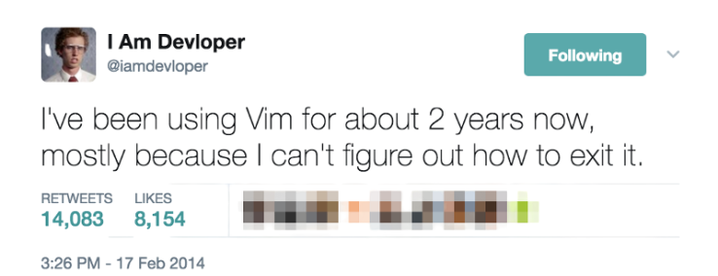
Or you know…
… good old fashioned VIM

Slide 25
Browser
Plugins

Slide 26

A plug in is a piece of software that manages content that a browser is not designed to process or adds on a specific feature to an existing program. Examples Flash, Java SE, Quick Time, Silverlight etc

Slide 27
-05-
Project
Insights

Slide 28
TimeLine

Slide 29
Week -01-
Week -02-
Week -03-
Week -04-
Server Side
Data Layer
Business Layer
Client Side
Research
Implementation
Testing
Integration
Research
Implementation
testing
Integration
Research
Implementation
testing
Integration
Research
Implementation
testing
Integration

Slide 30
UML Diagram

Slide 31
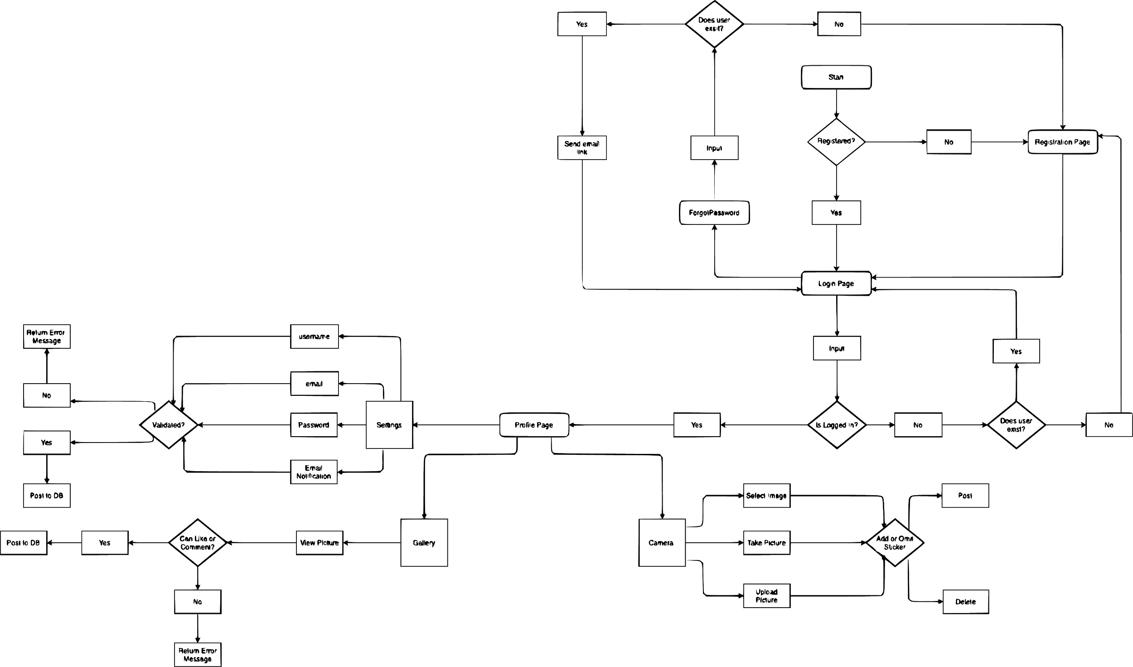
Notes:
Jump over to paint to doodle over

Slide 32
ER Diagram

Slide 33
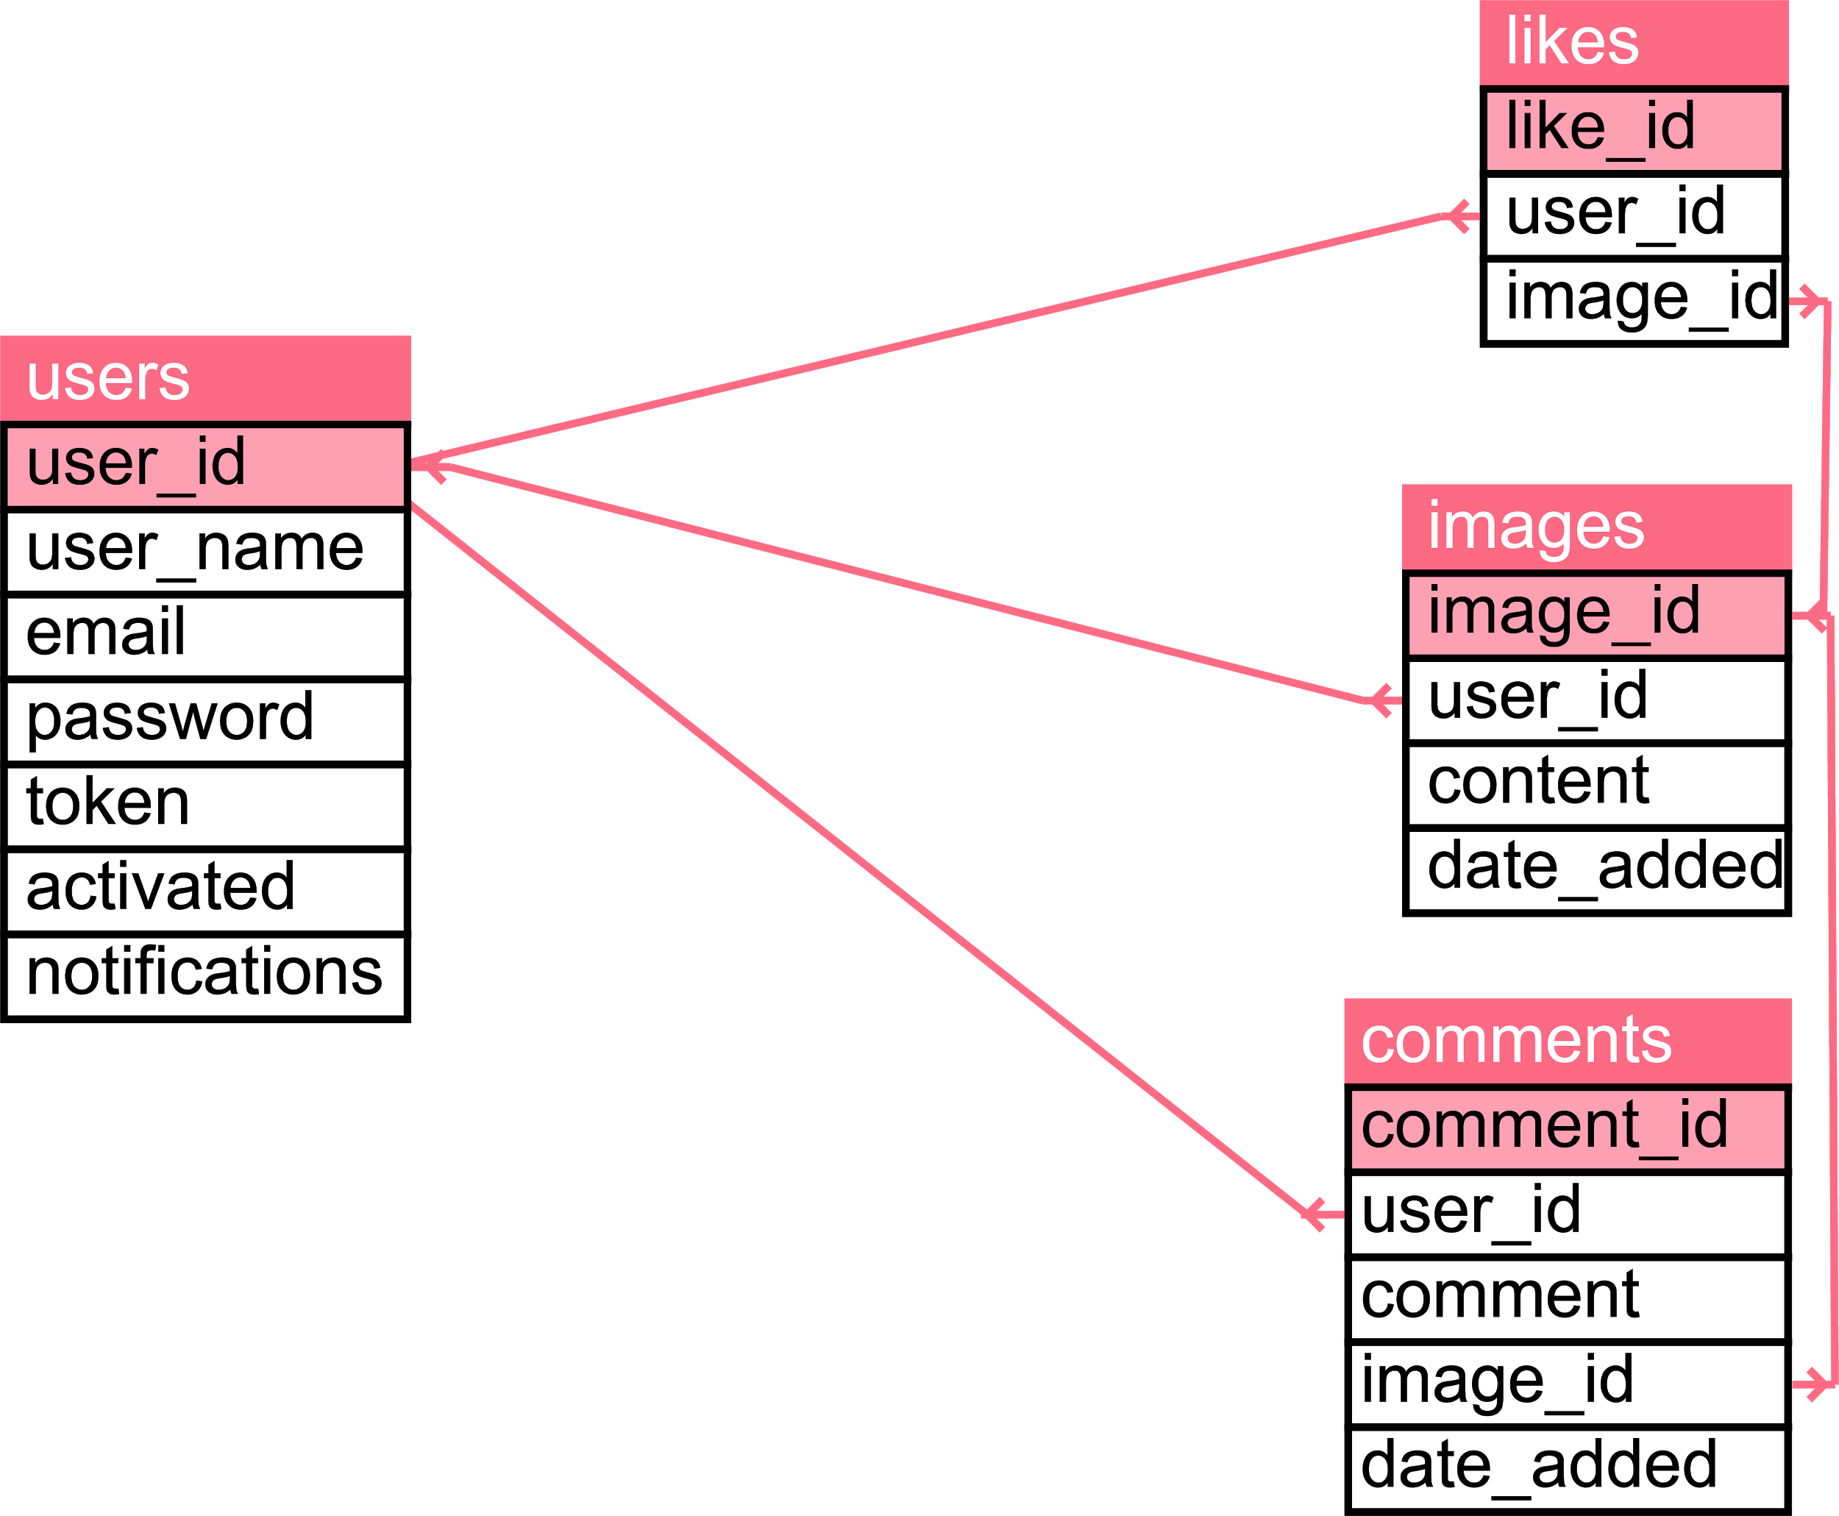

Slide 34
Cost Breakdown

Slide 35
Server
Side
Data
Layer
Business
Layer
Client
Side
In
Browser
PHP
COST R 0.00
MySQL
COST R 0.00
Javascript
COST R 0.00
HTML
COST R 0.00
Postman
COST R 0.00
Apache
COST R 0.00
PhpMyAdmin
COST R 0.00
PHP
COST R 0.00
CSS
COST R 0.00
DevTools
COST R 0.00
Javascript
COST R 0.00

Slide 36
-06-
Project
Sources

Slide 37
W3 Schools
https://www.w3schools.com/html/
https://www.w3schools.com/css/default.asp
https://www.w3schools.com/php/DEFAULT.asp
https://www.w3schools.com/sql/sql_ref_mysql.asp
Official Documentation
https://developer.mozilla.org/en-US/
https://developer.mozilla.org/en-US/docs/Web/API/MediaDevices/getUserMedia
https://developer.mozilla.org/en-US/docs/Web/API/File/Using_files_from_web_applications
https://developer.mozilla.org/en-US/docs/Web/API/Canvas_API/Tutorial
https://www.php.net/
Other
https://www.formget.com/php-data-object/
https://www.kirupa.com/html5/accessing_your_webcam_in_html5.htm
https://css-tricks.com/scale-svg/
https://www.youtube.com/playlist?list=PL0eyrZgxdwhxhsuT_QAqfi-NNVAlV4WIP
https://www.youtube.com/watch?v=nCrQ1A2BEZ0

Slide 38
End!

