Slide 1
HyperTube Presentation
A Web Media Project

Slide 2
MEET THE TEAM
Chanel Letinić ← ME
Takalani Madau
Simbiso Marwise
Banele Mkhize
Pholosho (Dante) Motala

Slide 3
OVERVIEW: WHAT IS HYPERTUBE?
Hypertube is an online video streaming application, that uses the torrent p2p internet protocol to download and stream movies. Users can create profiles and keep track of their watch history as well as all related information.
The target audience would be any company/organisation that uses p2p technology or media streaming services.

Slide 4
WHAT ARE THE
PROJECTS OBJECTIVES?
Basic Web development Skills
Basic understanding of Internet Protocols
Database structures and entity relationships
Interaction with APIs and web resources

Slide 5
THE RESEARCH OUTLINE
Web Technologies
DBMS
Server Tech
BACK END
PHP
NodeJS
FRONT END
HTML
CSS
Javascript
MySql
PhpMyAdmin
MAMP
NodeJS
PHP
1 DAY + continuous
6 HOURS
6 HOURS

Slide 6
DATA NEEDS
User Profile Data:
Maintain persistent data about the users that can be used as account information on the site
Data Needs to Persist:
E.g When a user creates an account their information needs to be stored over a long period of time
Data Needs to be Accessible:
E.g The public feed relies on the images uploaded by the different users
Data Needs To Be Updated and Deleted:
User should be able to delete account or update their profile at any time

Slide 7
ROLES
OF DATABASE MANAGEMENT SYSTEMS
Improved Data Security:
A DBMS can ensure better enforcement of data privacy and security policies.
Stronger Relationships Between Data:
Allows different data sets to relate to one another.
Persistence:
Allow data to persist, and remain in any desired state for as long as it’s required.
Accessibility:
DBMS improve the accessibility, availability, and reusability of data.

Slide 8
Data
Management
Technologies
A systematic approach to the optimization, management, storage and retrieval of data from databases, via an interface/applications. An organized collection of data, stored and accessed from computer systems.

Slide 9
DATA MANAGEMENT
TOOLS AND PRODUCTS
TYPE OF DATABASE:
SQL
CHARACTERISTICS OF DATABASE:
Relational Database
Stores data in tables
OTHER DATABASE TYPE:
NoSQL
CHARACTERISTICS OF DATABASE:
Non-relational database
Can store information as objects/documents
High and scalable performance.
Wide variety of data models.

Slide 10
OUR CHOICE IN DBMS
We went with SQL
Why SQL over NoSQL:
The type of data we will be storing is relational, User credentials and what movies they watched is information that can be stored in a table easily without any deviation from the database blueprint
USER INFO TABLE
USER WATCHLIST TABLE

Slide 11
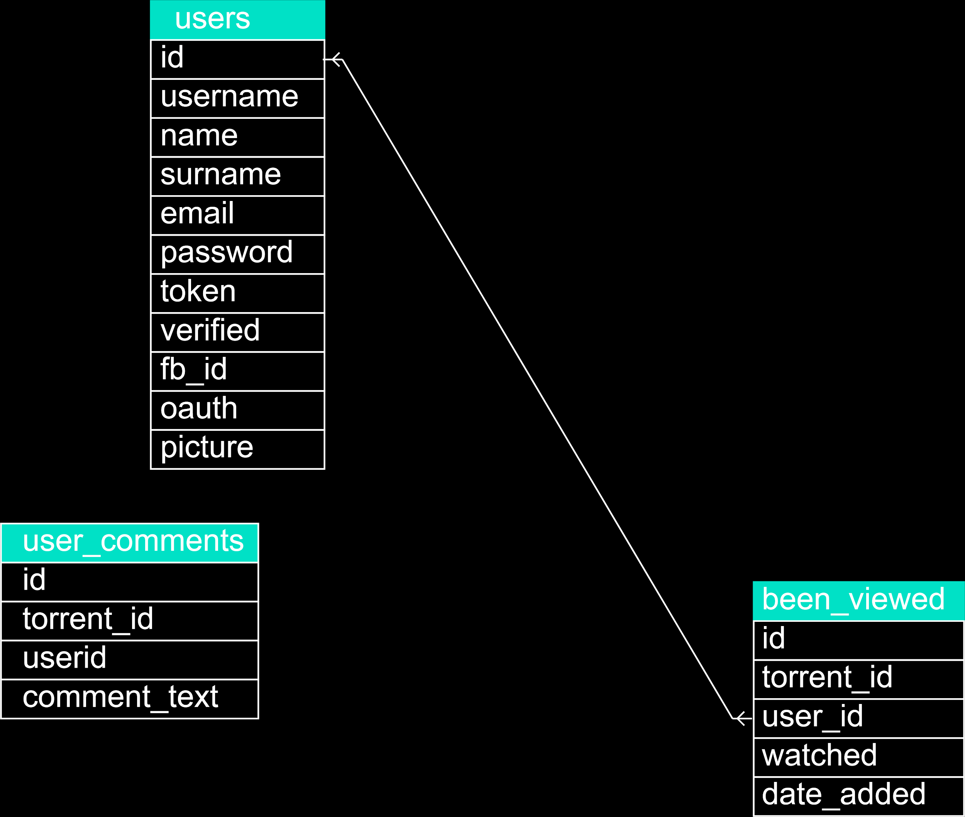
ER
diagram

Slide 12
Browser
Plugins
These are tools that extend the functionality of a browser, or improve existing functionality. Some of these are integratable and most operate independent of a web application.

Slide 13
FLASH:
A browser plugin that enables playback of video and audio media on websites and also Shock Wave Files (SWF)
POSTMAN:
Postman is a browser plugin that allows a user to make HTTP request. It is useful for testing communication between back end and front end, and as such allow for further refinement to a design
DEV TOOLS:
A set of tools built into the browser useful for monitoring the web applications network information, a console that display errors in the front end, as well as gives the user access to their HTML and CSS design, which is useful for making quick design changes in the front end when designing a website.

Slide 14
Back-End
Technologies
These are technologies that facilitate the communication between the server and the front end (What the User can See). They facilitate the client-sides/front-end interaction with the database. Usually located in the server of the web application.

Slide 15
TYPES:
TECHNOLOGY | ADVANTAGES | DISADVANTAGES
PHP | Easy and Simple to learn Extremely flexible Open source | Not suitable for large applications Lack of options to modify core behaviour
Python | Extensive Support Libraries Open source | Memory consumption Limitations with python db access
NodeJS | Easy to Learn Allows for full stack dev | No strong library support Knowledge of asynchronous programming model

Slide 16
REASONS:
FOR CHOOSING PHP:
Due to time constraints, having prior experience with the language, was an advantage.
It is relatively easy to understand, and is well documented.
FOR CHOOSING NODEJS:
Very robust with extensive npm packages that are useful for handling some of the Protocols core requirements.
Made creating a restful API service, easy and intuitive because of node libraries like express
We needed a seperate server dedicated to running a single heavy process that is isolated from the rest of the application.

Slide 17
Internet
Protocols
Data being sent through the internet is divided into smaller pieces called packets. So IP are set of rules, for routing and addressing packets of data, so that they can travel across networks and arrive at the correct destination.

Slide 18
TYPES:
PROTOCOL | ADVANTAGES | DISADVANTAGES
TCP/IP | Error-free Data Transmission Makes each device identifiable over the network, by assigning IP addresses | Fails to represent any other protocol stack either that TCP/IP
UDP | Establishes connectionless service Uses smaller packet sizes | Unreliable No flow control, or acknowledgement for received data
P2P - torrent | Highly efficient Ability to download and upload large files in a shorter amount of time | Old or unpopular files are hard to find Consumes computer resources.

Slide 19
REASONS:
FOR CHOOSING P2P - TORRENT PROTOCOL:
The project design requires the use of this protocol.
It is relatively easy to understand, and is well documented.
This is one of the most efficient P2P protocols available for streaming media, and it is widely used.

Slide 20
Web APIs
An Application programming Interface over the web which can be accessed using HTTP protocol.
They are typically based on HTTP methods such as GET and POST, to access resources via URL-encoded parameters and the use of JSON or XML to transmit data. Server-side web APIs are interfaces for the outside world to interact with the business logic.
Notes:
Web APIS, Well before getting into web API lets understand what an API is. An Application Programming interface - APIs for shot
It is an engine underhood
An api is an messenger that takes requests
and tells a system what you want to do
Then returns it back to you
So let’s talk about this in terms of Hypertube,
When a user signs up they fill in the fields required and it stores that information in the hypertube database. When they log in, it takes the users credentials, looks if they exist in the database and then returns them back to the application which allows them access.
We want to make it that users can look up movies, right?

Slide 21
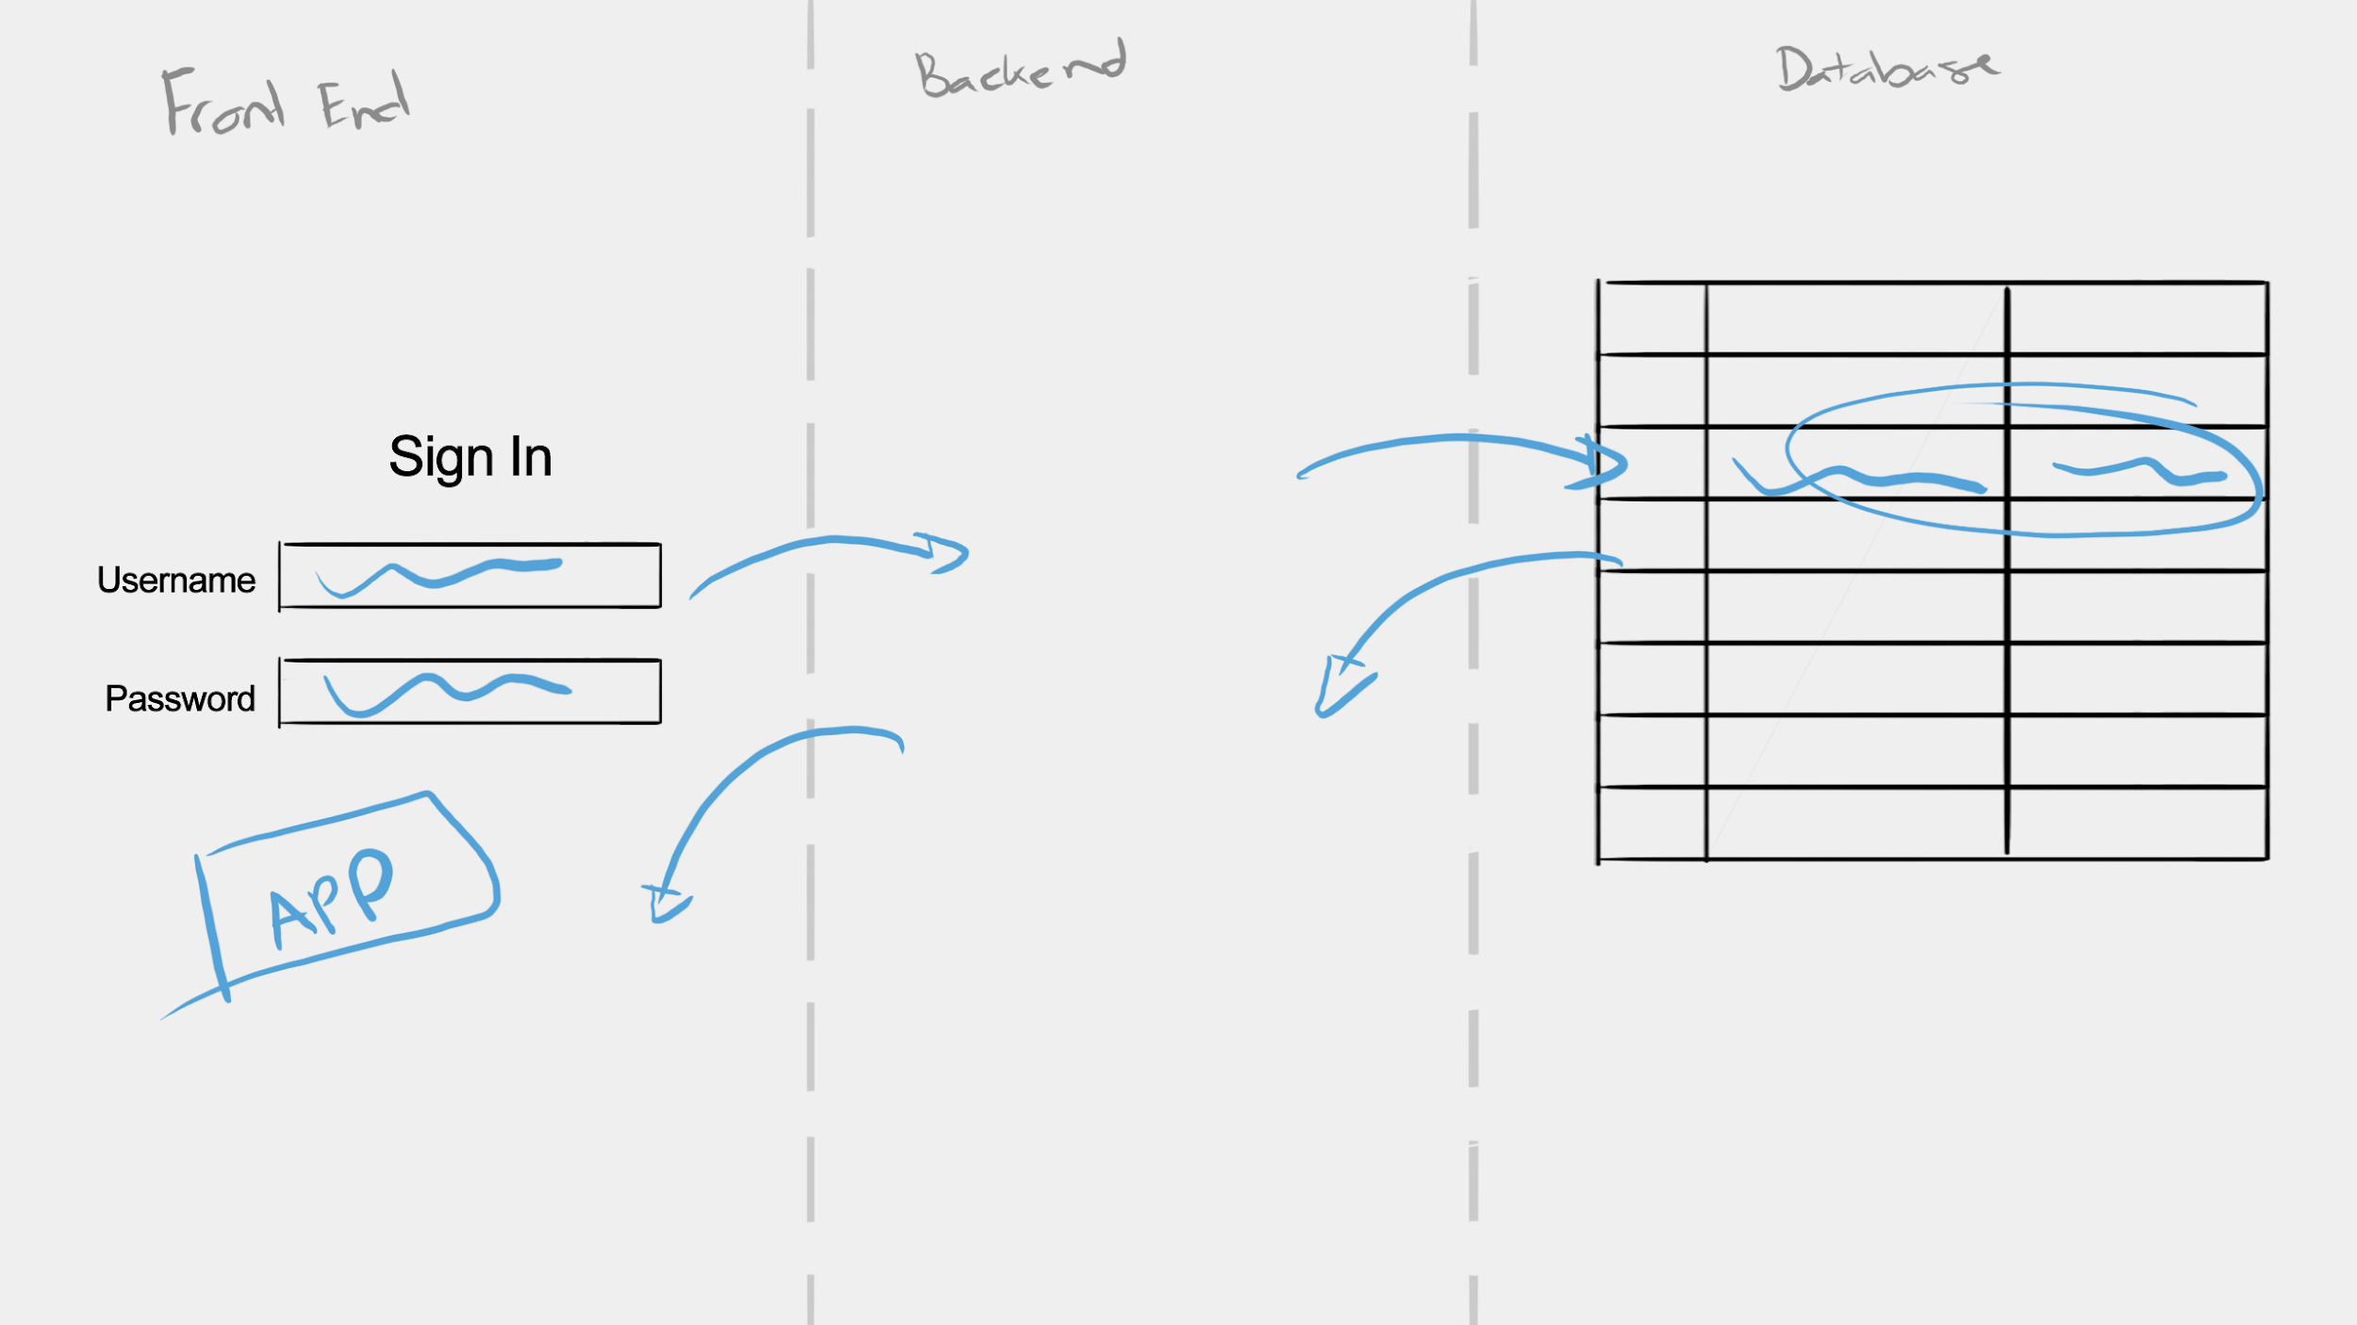
How they work: (without an API)

Slide 22
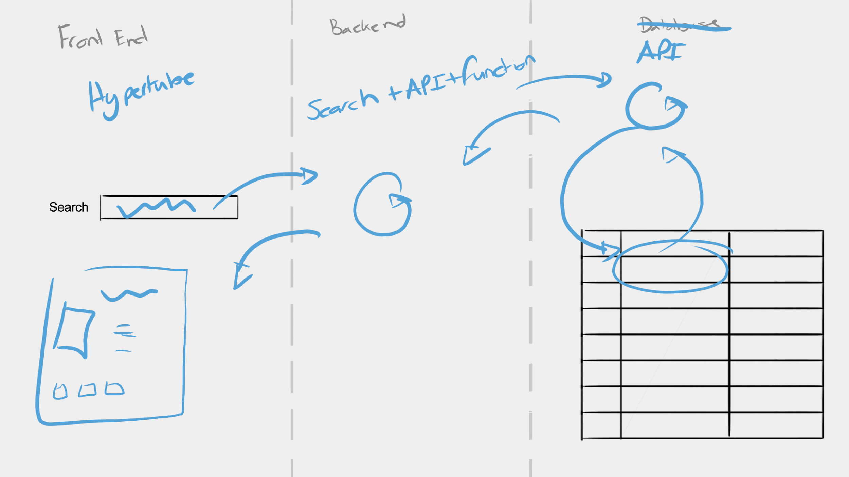
How they work: (with an API)

Slide 23
With that in mind...
...Let’s define it
Notes:
an API (Application Programming Interface) is essentially just a messenger / medium between a client (the developer) and the API’s Server. The client calls an endpoint The API takes that message to the API’s Server The Server processes it (and usually interacts with its internal database) The Server gives the processed response back to the API The API then gives that message back to the client And the way that WEB APIs do this is through the use of HTTP protocols, Where the client can call these endpoints through the use of HTTP verbs like GET and POST

Slide 24
Front-End
Technologies
These are technologies that are used to develop the user interface of web applications. It focuses on user experience as well as accessibility. These technologies are responsible for the design/look and feel of a web application.

Slide 25
HTML (Hypertext Markup Language):
HTML as a whole is the markup that creates the basic elements we view on a website. It has no basic intelligence that can affect the contents of the markup, it can only render the basic elements we view on a web page.
CSS (Cascading Style Sheets):
Responsible for giving styling/visual appeal to HTML views. Stylesheets determine how the html elements will be rendered.
JAVASCRIPT:
A runtime language for web browsers. Javascript can be used to perform actions and make decisions, in the browser as it is loaded in parallel with the website. Which differentiates it to back end languages as it is not compiled ahead of time and is accessible to the user.

Slide 26
Text Editors
These are tools used in the creation of applications. They are varying types of text editors and IDEs, which offer various advantages depending on the programming language you use as well as technologies you are working on.

Slide 27
TYPES:
TECH | ADVANTAGES | DISADVANTAGES
VS CODE | Easy and Simple to learn Quick And Easy To Set-up Extensive Library Of Extension Integrated terminal | Requires installation Does not support all languages initially
NOTEPAD++ | Extensive Support Basic and easy to get started | Requires installation Not easily extendible
VIM | Lightweight Installed on many unix systems | No strong library support Higher learning curve
REASON FOR CHOOSING VS CODE:
VS Code affords the user advantages such as code completion, high customizability and has many extensions that increase the efficiency of creating web applications.

Slide 28
PROJECT TIMELINE
WEEK 1 & 2
WEEK 3
WEEK 3
WEEK 4
Server Side
Research
Implementation
Testing
Integration
Data Layer
Research
Implementation
testing
Integration
Business Layer
Research
Implementation
Testing
Integration
Client Side
Research
Implementation
Testing
Integration
COST OF DELIVERING LATE:
?

Slide 29
COST BREAKDOWN
SERVER SIDE
DATA LAYER
BUSINESS LAYER
CLIENT SIDE
BROWSER
PHP
COST R 0.00
MySQL
COST R 0.00
Javascript
COST R 0.00
HTML
COST R 0.00
Postman
COST R 0.00
Apache
COST R 0.00
PhpMyAdmin
COST R 0.00
PHP
COST R 0.00
CSS
COST R 0.00
DevTools
COST R 0.00
NodeJS
COST R 0.00
Javascript
COST R 0.00
The tools and technologies used in this project are either free to use or open source, resulting in a total cost of R0.00.

Slide 30
SOURCES
https://www.php.net/docs.php
https://www.techopedia.com/definition/24361/database-management-systems-dbms#:~:text=A%20database%20management%20system%20(DBMS)%20is%20a%20software%20package%20designed,validate%20and%20manipulate%20this%20data.
https://documentation.mamp.info/
https://www.w3schools.com/sql/sql_ref_keywords.asp

