Slide 1
Tweet sentiment prediction
LAB FCSE Team 9
Chua Tze Wu (U2322760H)
Chin Linn Sheng (U2320052G)

Slide 2
Contents
01 | Problem statement
02 | Introduction to Kaggle dataset
03 | Data preprocessing
04 | Exploratory data analysis
05 | Predictive models
06 | Conclusion

Slide 3
01. Problem statement
To accurately and reliably predict and classify the sentiment of tweets into the six categories: sadness, joy, love, anger, fear or surprise using different models.

Slide 4
02. Introduction to Kaggle dataset
Each entry in this dataset consists of a text segment representing a Twitter message and a corresponding label indicating the predominant emotion conveyed. The emotions are classified into six categories: sadness (0), joy (1), love (2), anger (3), fear (4), and surprise (5)
Included in the datasets are two columns:
Text: A string feature representing the content of the Twitter message.
label: A classification label indicating the primary emotion, with values ranging from 0 to 5.

Slide 5
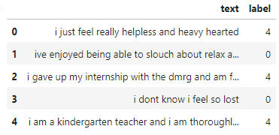
02. Introduction to Kaggle dataset

Slide 6
03
Data preprocessing

Slide 7

Common data preprocessing methods
Lower casing
Removal of Punctuations
Removal of Stopwords
Removal of Frequent words
Removal of Rare words
Stemming
Lemmatization
Removal of emojis
Removal of emoticons
Conversion of emoticons to words
Conversion of emojis to words
Removal of URLs
Removal of HTML tags
Chat words conversion
Spelling correction
Reference: https://www.kaggle.com/code/sudalairajkumar/getting-started-with-text-preprocessing

Slide 8
Data preprocessing
Data Preprocessing Techniques | Definition
Removing duplicates | Removal of duplicate data points from dataset
Deleting Stopwords | Filter words you want to ignore of your text when processing it
Removal of links | Removes links such as hyperlinks from the data
Removing frequent and rare words | Removal of words which may not be relevant to the dataset.
Stemming | A text processing task in which you reduce words to their root, which is the core part of a word.
Lemmatization | Reduce words to their core meaning, but it will give you a complete English word that make sense on its own instead of just a fragment of a word like 'discoveri'.
Handling of chat words | Converts common chat abbreviation to full words .

Slide 9
Data preprocessing
Most of the data do not need much cleaning eg. removing links as the data is quite clean
Feature Engineering
: Added a label_string column for more legibility to reading the data.
Stemming vs Lemmanization
1
2
3

Slide 10
Stemming vs Lemmanization
Stemming
Lemmanization
If there are two words in the corpus walks and walking, then stemming will stem the suffix to make them ‘walk’. But say in another example, we have two words console and consoling, the stemmer will remove the suffix and make them ‘consol’ which is not a proper english word.
Lemmatization is similar to stemming in reducing inflected words to their word stem but differs in the way that it makes sure the root word (also called as lemma) belongs to the language.

Slide 11
04
Exploratory data analysis

Slide 12
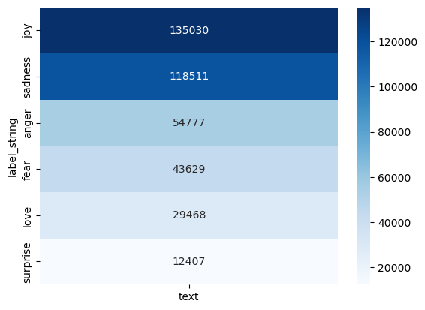
Exploratory data analysis
Seaborn heatmap
6 different types of sentiment:
Joy (Count: 135030)
Sadness (Count: 118511)
Anger (Count: 54777)
Fear (Count: 43629)
Love (Count: 29468)
Surprise (Count: 12407)

Slide 13
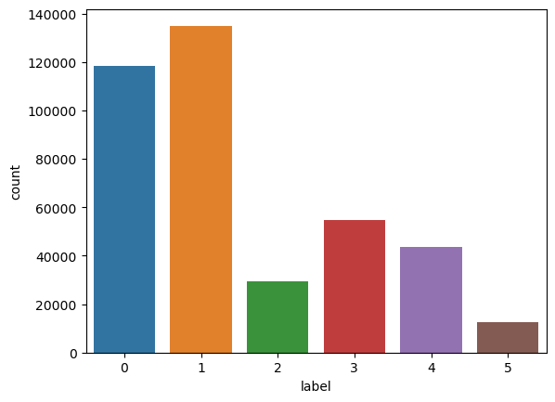
Exploratory data analysis
Seaborn count plot
Sadness (0)
Joy (1)
Love (2)
Anger (3)
Fear (4)
Surprise (5)

Slide 14
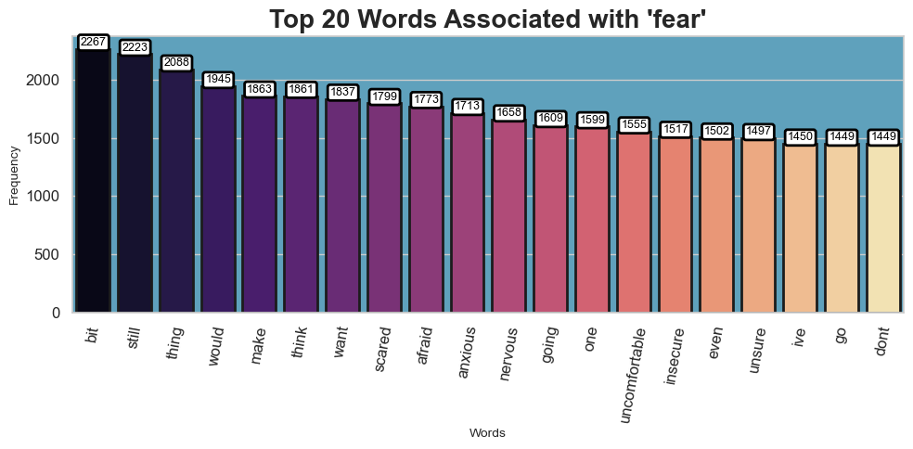
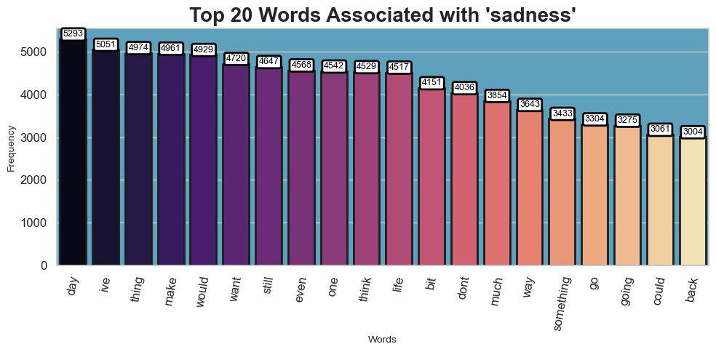
Exploratory data analysis
Word count: fear
Word count: sadness

Slide 15
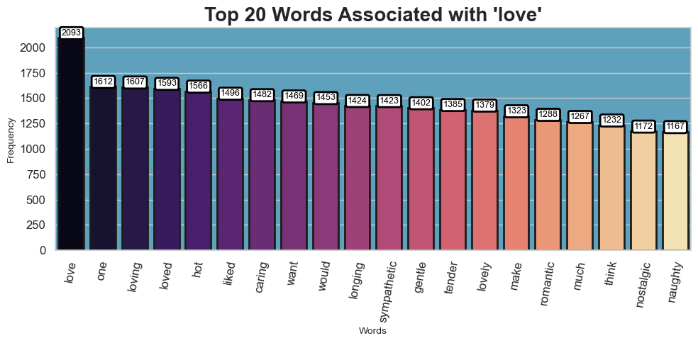
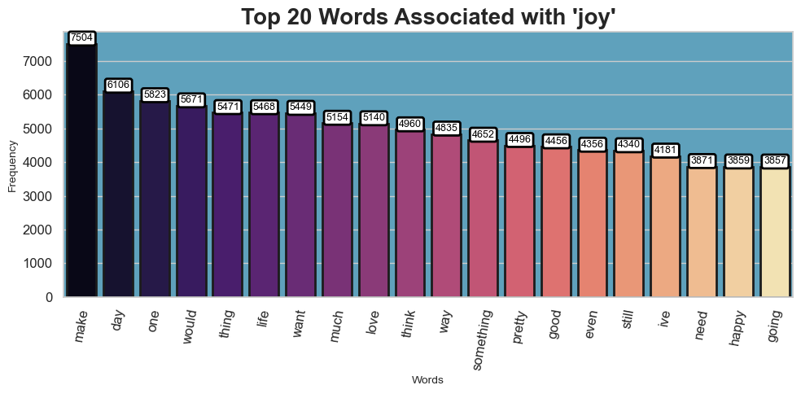
Exploratory data analysis
Word count: love
Word count: joy

Slide 16
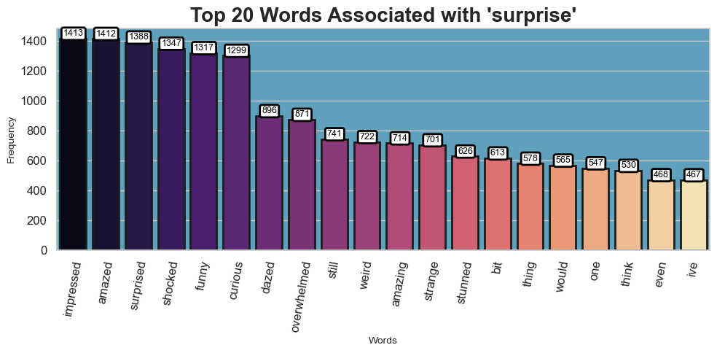
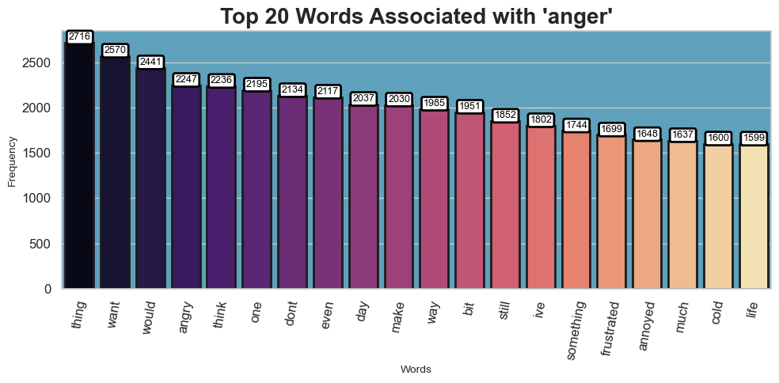
Exploratory data analysis
Word count: surprise
Word count: anger

Slide 17
05
PREDICTIVE MODEL

Slide 18
CLASSIFICATION
Accurately classify the sentiment of the tweet as sadness, love, joy, anger, fear and surprise by using 2 machine learning models

Slide 19
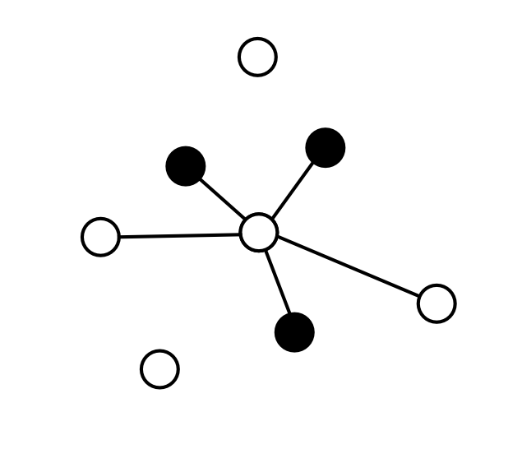

Machine Learning Models
K-Nearest Neighbor Classifier
Naive Bayes Classifier
Utilize Weighted F1 score from classification_report function.
Consider the most appropriate metric because it takes into account that class imbalance by weighting the F1-score of each class according to its frequency in the data.
More preferred for imbalanced datasets like the X's tweets due to the reason there are many more neutral tweets than those positive or negative ones. Other metrics can be misleading in such cases.

Slide 20
K-Nearest Neighbor Classifier (KNN)
Non-parametric, supervised learning classifier, which uses proximity to make classifications or predictions about the grouping of an individual data point. It is one of the popular and simplest classification and regression classifiers used in machine learning today.
KNN takes in data points, and uniquely categorizes them into clusters. When using KNN we first feed into it known data, to train and classify the algorithm. Afterwards we will be able to feed in a new tweet to test, KNN places this new tweet on a graph, and sees which other data points on the plot it is most closely associated with.
Count_Vectorizer function from scikit-learn library transforms the text data of tweets into numerical data

Slide 21
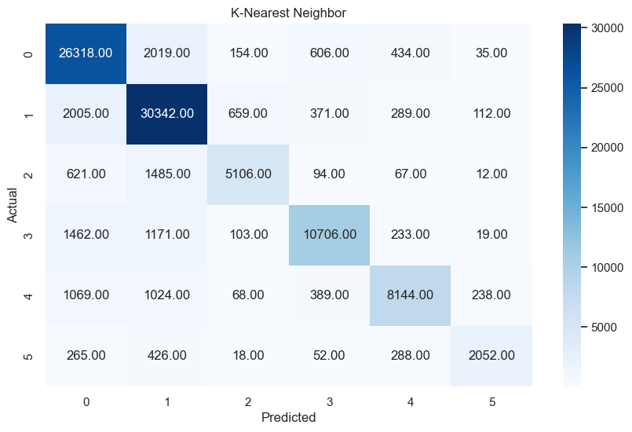
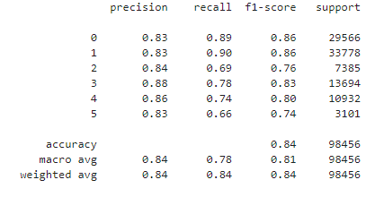
Evaluation for KNN

Slide 22
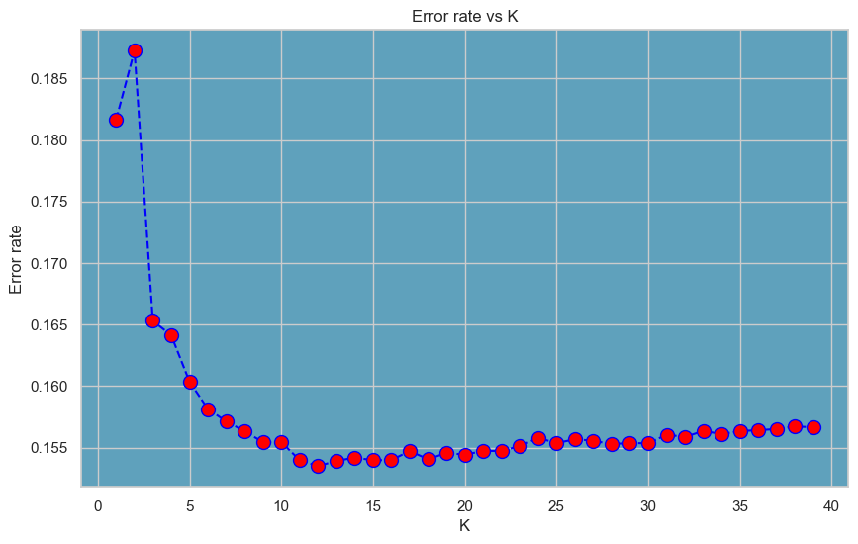
K-Value
defines how many neighbors will be checked to determine the classification of a specific query point.
For example, if k=1, the instance will be assigned to the same class as its single nearest neighbor. Lower values of k can have high variance, but low bias, and larger values of k may lead to high bias and lower variance. Here we train and test the KNN Classifier with k values from 1 to 40, to see which k value will be the best suited for our model.
Notes:
Hence based on this graph, we can tell that the most suitable for K-value for KNN model according to our dataset is between 1- to 15 as it has the lowest error rate.

Slide 23
Naive Bayes Classifier
Widely used algorithm in machine learning for classification tasks. It leverages Bayes' theorem to predict the likelihood of an instance belonging to a particular class.
Excel with text data classification and also performs well on large datasets.
Represent tweet as a collection of features where these features are individual words, presence or absence of specific words. In the sentiment analysis for the data we have, the classes are the 6 classes that we had mentioned above. Naive Bayes assumes independence between words in a tweet given the class. For a new tweet, this model calculates the probability of each word appearing in each class. Using Bayes theorem, it predicts the class with the highest probability based on the tweet's features.
MultinomialNB implement the Naive Bayes algorithm with specifically designed for text data.

Slide 24
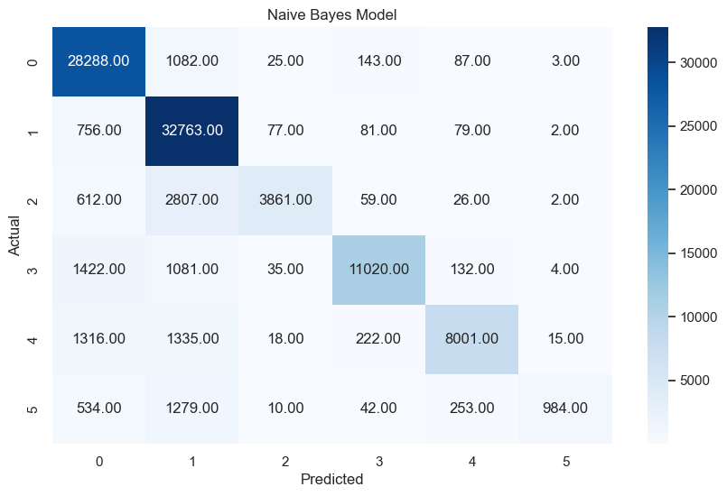
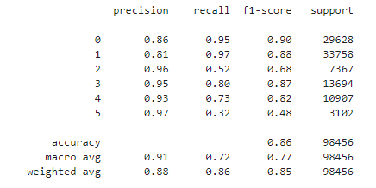
Evaluation for Naive Bayes Model

Slide 25
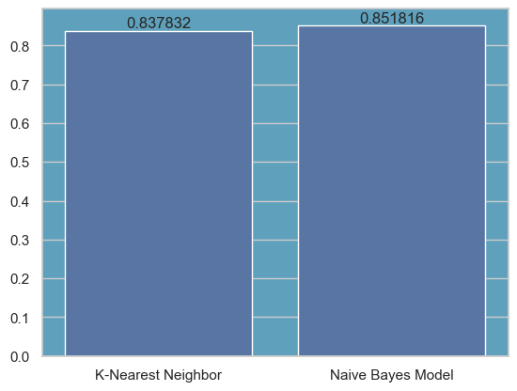
Conclusions
The 2 models almost achieved the same F1 - score
Naive Bayes model is a better model when analyzing sentiment in our X's tweet dataset.
Naive Bayes model exhibited a significant advantage in training time, making it computationally faster for processing large volumes of tweets.
These findings suggest that Naive Bayes is a more favorable option for sentiment analysis on X's tweet which has a large dataset due to its efficiency and effectiveness.

Slide 26
Thank you!

