Slide 1
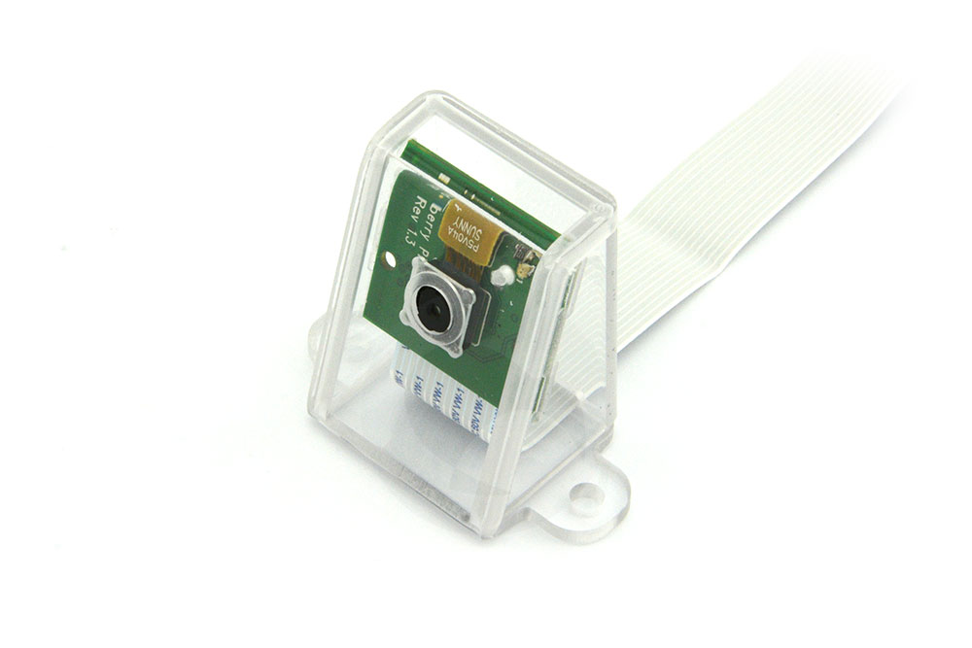
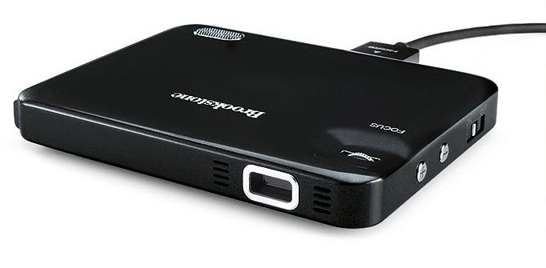
Gesture Detection and Zooming Process
Capture a frame
Perform image transformations on frame
Gather data and make a decision
Send the decision through a pipe to other script
Receive data through pipe from other script
Zoom in/out or reset according to the data received
Project the image onto the board using keystone correction

