Slide 1

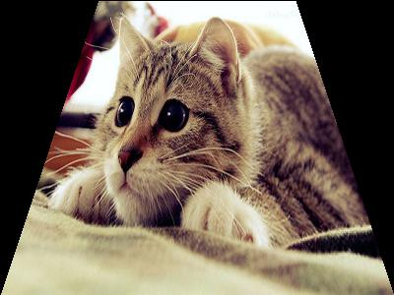
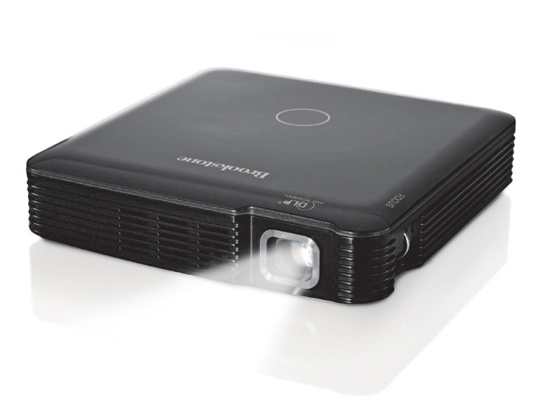
The Process of Keystone Correction
Original Image
Projected Image
Perspective Transformation Equation
Perspective Transformation Script
Compression Factors

Slide 2
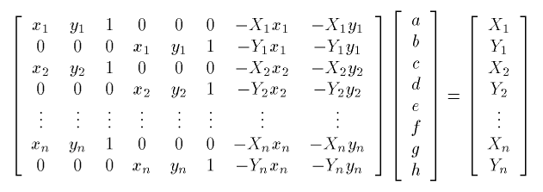
Perspective Transformation Equation
4 Coordinates of Image
Matrix Equation
8 Coefficients for Perspective Transformation Script
Compression Factors
4 Coordinates of End Result Image

