Slide 1

Top 2000 Hits from 2000’s and 2010’s
By: Brian, Christian, and Rachelle
Notes:
Christian/all

Slide 2
What We Predict
Higher correlation= popularity with high tempo
Low correlation= popularity and high acousticness
Hypothesis: Hip Hop and Pop will be the dominant music genres among popular songs in this dataset
Notes:
Christian

Slide 3
Visualization
03
We opted for a scatter plot, pie chart and bar graph to showcase our data! :)

Slide 4

Tempo Vs Popularity
My conclusion/thoughts?
What Was interesting?
What would I change?
Notes:
Tempo is the speed in which a song a played and is measured by Beats Per Minute (BPM)
There are generally 4 types of tempo: First is called :”Andante” aka walking pace with a BPM of (73-77), next level is “Moderato” which is a moderate level with a bpm of (98-109) , where as the third level is called “Allegretto” which is just moderately faster with a BPM of 98-109 and lastly, the last level is called “Allegro” which is a fast quick past with a BPM of 109-132.
# find examples of songs for each level
Most of today's popular songs are written in a tempo range of 100 to 140 BPM. For example, "Beat It" by Michael Jackson clocks in at 138 BPM while "Dancing Queen" by ABBA is exactly 100 BPM. Now it's a thing to where many songwriters consider 120 BPM to be the perfect tempo for crafting a hit.
With this statement, according to my graph,
Examples include the following: what was interesting about this visual, what conclusions are you drawing from it, what would you change about it, what other visuals would you do if you had more time, etc.

Slide 5
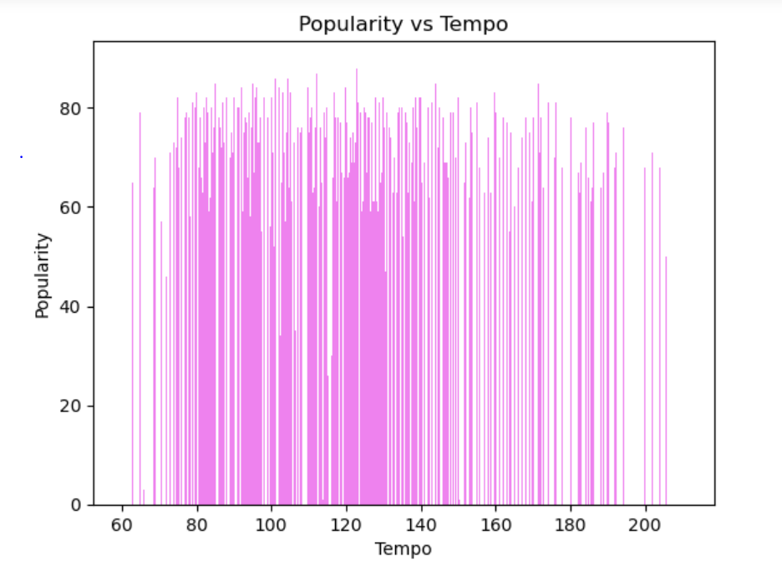
Popularity vs Tempo
Notes:
The conclusion I drew from that is, there are so many elements that play a factor into generating a popular hit. However, according to my table it shows that you can have a high tempo song, but doesn’t guarantee that it will have a high popularity rate. I also concluded that there are higher popularity rates in the “sweet spot” of BPM range but just having that ideal tempo alone again doesn’t’ guarantee a high popularity rate. Thus, there isn’t a correlation between tempo and popularity but rather, an association.

Slide 6
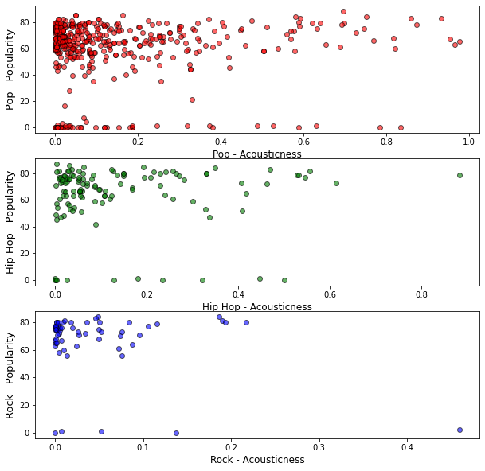
Popularity vs Acousticness

Slide 7
Popularity vs Acousticness
Among the most popular songs, Pop is the dominant genre
No correlation between popularity and acousticness
Outlier songs with high acousticness and high popularity are pop songs.
Dataset skews towards high popularity and low acousticness

Slide 8
The top 20 genres
2000 songs
Spotify defines genres based on info from listener playlists (title, description, etc.) and their music curation teams.
They recognize genres constantly evolve and songs can cross different genres
We will analyze the top 2000 spotify songs in our dataset (2000-2019)
What are the two most prevalent genres?

Slide 9
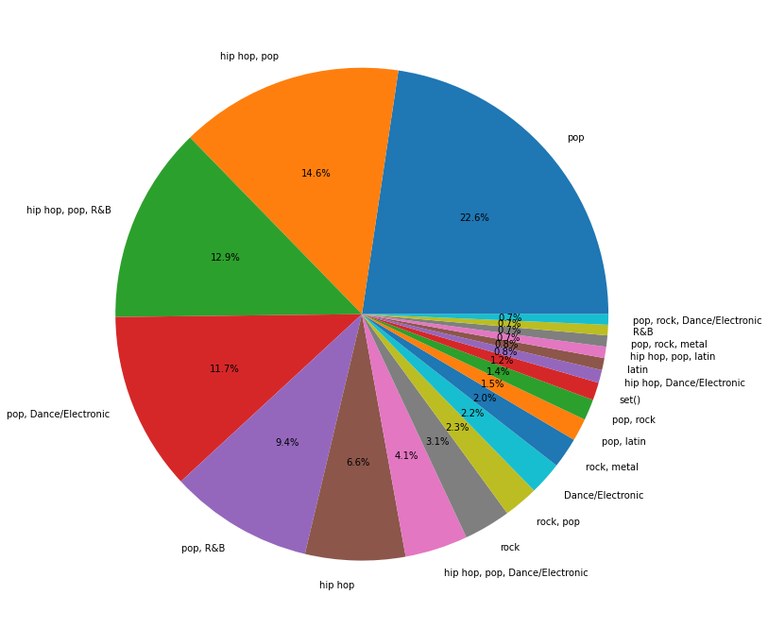
Top 20 Genres
Pop is the most popular genre
Pop is present the most throughout the pie chart
Hip-hop is 2nd best genre or next market leader
Data could be subjective as spotify determines the genre of each track
Alternative - bar graph
The Neighborhood - Sweater Weather
Post Malone - Circles
Eminem - Without Me
Eminem - The Real Slim Shady
Notes:
Making a pie chart was tricky as i had to adjust the size of the chart and the font size of the labels.
My recommendation before making another plot like this would be to clean and manipulate data. Ex. Use metadata and categorize songs into one genre (Ex. Drake can be multiple genres)
The importance of of how to customize the appearance of plots (Ex. Changing colors, labels, titles, etc)
The decision making behind choosing the right plotting libraries (Ex. Pandas, Matplotlib, Numpy)

Slide 10
Conclusion
What did you learn about this dataset?
What recommendation would you make for further research?
What did you learn in Python that you didn't expect to?
What did you find that you need more practice with?
Notes:
We learned that to which this dataset was acquired and categorized was through the users of spotify’s playlist and how they categorized their songs on their personal devices. We have also learned that to generate a great hit song the elements needed for the best recipe are…
We recommend cleaning the data set, utilizing a standardized way to classify the songs in order to see the impact it could have on the analysis
What we learned in Python that we didn't expect was
We found we need more practice in all of it lol

