Slide 1
Review

Slide 2
Cryptography

Slide 3
The typical setting for cryptography
.., Alice and Bob, who wish to communicate in private.
.. Eve, an eavesdropper, will go to great lengths to find out what Alice and Bob are saying.
Alice wants to send a specific message x , written in binary, to her friend Bob.
Alice encodes it as e (x), sends it over.
Bob applies his decryption function d ·) to decode it: d (e (x)) = x .
Eve, will intercept e (x): for instance, she might be a sniffer on the network.
Ideally the encryption function e (·) is so chosen that without knowing d (·), Eve cannot do anything with the information she has picked up.
In other words, knowing e (x) tells her little or nothing about what x might be.

Slide 4
The Rivest-Shamir-Adelman (RSA) cryptosystem
An example of public-key cryptography:
Anybody can send a message to anybody else using publicly available information, rather like addresses or phone numbers.
Each person has a public key known to the whole world and a secret key known only to him- or herself.
When Alice wants to send message x to Bob, she encodes it using his public key.
Bob decrypts it using his secret key, to retrieve x.
Eve is welcome to see as many encrypted messages for Bob as she likes, but she will not be able to decode them, under certain simple assumptions.

Slide 5
RSA in a nutshell
Pick any two primes p and q and let N = pq. For any e relatively prime to (p − 1)(q − 1):
The mapping x 1→ x^{e} (mod N) is a bijection on {0, 1, . . . , N − 1}.
The inverse mapping is easily realized: let d be the inverse of e modulo (p − 1)(q − 1). Then for all x ∈ {0, 1, . . . , N − 1},
(x^{e} )^{d} ≡ x (mod N).
. The mapping x 1→ x^{e} (mod N) is a reasonable way to encode messages x; no information is lost. So, if Bob publishes (N, e) as his public key, everyone else can use it to send him encrypted messages.
. Bob should retain the value d as his secret key, with which he can decode all messages that come to him by simply raising them to the d th power modulo N.

Slide 6
Security assumption for RSA
The security of RSA hinges upon a simple assumption:
Given N, e, and y = x^{e} (mod N), it is computationally intractable to determine x.

Slide 7
Universal Hashing

Slide 8
Motivation
We will give a short “nickname” to each of the 2³² possible IP addresses.
You can think of this short name as just a number between 1 and 250 (we will later adjust this range very slightly).
Thus many IP addresses will inevitably have the same nickname; however, we hope that most of the 250 IP addresses of our particular customers are assigned distinct names, and we will store their records in an array of size 250 indexed by these names.
What if there is more than one record associated with the same name?
Easy: each entry of the array points to a linked list containing all records with that name. So the total amount of storage is proportional to 250, the number of customers, and is independent of the total number of possible IP addresses.
Moreover, if not too many customer IP addresses are assigned the same name, lookup is fast, because the average size of the linked list we have to scan through is small.

Slide 9
Hash tables
How do we assign a short name to each IP address?
This is the role of a hash function: A function h that maps IP addresses to positions in a table of length about 250 (the expected number of data items).
The name assigned to an IP address x is thus h(x), and the record for x is stored in position h(x) of the table.
As described before, each position of the table is in fact a bucket, a linked list that contains all current IP addresses that map to it.
Hopefully, there will be very few buckets that contain more than a handful of IP addresses.

Slide 10
How to choose a hash function?
.. There is nothing inherently wrong with any single function. If our 250 IP addresses were uniformly drawn from among all N = 2³² possibilities, then these functions would behave well.
The problem is we have no guarantee that the distribution of IP addresses is uniform.
.. Conversely, there is no single hash function, no matter how sophisticated, that behaves well on all sets of data.
Since a hash function maps 2³² IP addresses to just 250 names, there must be a collection of at least
2³² /250 ≈ 2²⁴ ≈ 16, 000, 000
IP addresses that are assigned the same name (or, in hashing terminology,
collide).
Solution: let us pick a hash function at random from some class of functions.

Slide 11
Families of hash functions
Let us take the number of buckets to be not 250 but n = 257. a prime number!
We consider every IP address x as a quadruple x =
(x1 , x2 , x3 , x4)
of integers modulo n.
We can define a function h from IP addresses to a number mod n as follows:
Fix any four numbers mod n = 257, say 87, 23, 125, and 4. Now map the IP address (x1 , . . . , x4) to h(x1 , . . . , x4) = (87x1 + 23x2 + 125x3 + 4x4) mod 257.
In general for any four coefficients a1 , . . . , a4 ∈ {0, 1, . . . , n − 1} write
a = (a1 , a2 , a3 , a4) and define ha to be the following hash function:
ha (x1 , . . . , x4) = (a1 · x1 + a2 · x2 + a3 · x3 + a4 · x4) mod n.

Slide 12
Property
Consider any pair of distinct IP addresses x = (x1 , . . . , x4) and y = (y1 , . . . , y4). If the coefficients a = (a1 , . . . , a4) are chosen uniformly at random from
{0, 1, . . . , n − 1}, then
.
Pr [ha (x1 , . . . , x4) = ha (y1 , . . . , y4)] =
n

Slide 13
Universal families of hash functions
Let
H = {ha | a ∈ {0, 1, . . . , n − 1}⁴}.
It is universal:
For any two distinct data items x and y, exactly |H|/n of all the hash functions in H map x and y to the same bucket, where n is the number of buckets.

Slide 14
Chapter 2. Divide-and-conquer algorithms

Slide 15
The divide-and-conquer strategy solves a problem by:
Breaking it into subproblems that are themselves smaller instances of the same type of problem.
Recursively solving these subproblems.
Appropriately combining their answers.

Slide 16
Multiplication

Slide 17
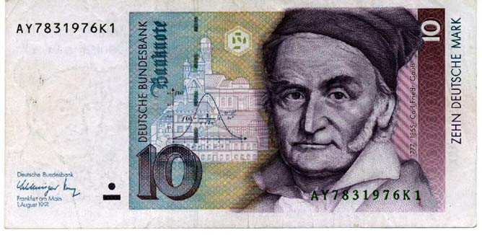
Johann Carl Friedrich Gauss
1777 - 1855
1 + 2 + · · · + 100 =
100 · (1 + 100)
2
= 5050.

Slide 18
Gauss once noticed that although the product of two complex numbers
(a + bi )(c + di ) = ac − bd + (bc + ad )i
seems to involve four real-number multiplications, it can in fact be done with just three: ac , bd , and (a + b)(c + d ), since
bc + ad = (a + b)(c + d ) − ac − bd.
In our big-O way of thinking, reducing the number of multiplications from four to three seems wasted ingenuity. But this modest improvement becomes very significant when applied recursively.

Slide 19
Lemma
For every n there exists an n' with n ≤ n' ≤ 2n such that n' a power of 2.
Suppose x and y are two n-bit integers, and assume for convenience that n is a power of 2.
As a first step toward multiplying x and y , we split each of them into their left and right halves, which are n/2 bits long:
x = | xL | xR | = 2^{n/2} xL + xR
y = | yL | yR | = 2^{n/2} yL + yR .
xy = (2^{n/2} xL + xR )(2^{n/2} yL + yR ) = 2^{n}xLyL + 2^{n/2}(xLyR + xR yL) + xR yR .
The additions take linear time, as do the multiplications by powers of 2. The significant operations are the four n/2-bit multiplications; these we can handle by four recursive calls.

Slide 20
Our method for multiplying n-bit numbers starts by making recursive calls to multiply these four pairs of n/2-bit numbers, and then evaluates the preceding expression in O(n) time.
Writing T (n) for the overall running time on n-bit inputs, we get the recurrence relation:
T (n) = 4T (n/2) + O(n)
Solution: O(n²).
By Gauss’s trick, three multiplications, xLyL, xR yR , and (xL + xR )(yL + yR ), suffice, as
xLyR + xR yL = (xL + xR )(yL + yR ) − xLyL − xR yR .

Slide 21
A divide-and-conquer algorithm for integer multiplication
multiply(x, y )
// Input: positive integers x and y , in binary
// Output: their product
n = max(size of x , size of y ) rounded as a power of 2.
if n = 1 then return xy .
xL, xR = leftmost n/2, rightmost n/2 bits of x
yL, yR = leftmost n/2, rightmost n/2 bits of y
P1 = multiply(xL, yL)
P2 = multiply(xR , yR )
P3 = multiply(xL + xR , yL + yR )
8. return P₁ × 2^{n} + (P₃ − P₁ − P₂) × 2^{n/2} + P₂.

Slide 22
The time analysis
The recurrence relation:
T (n) = 3T (n/2) + O(n)
. The algorithm’s recursive calls form a tree structure.
. At each successive level of recursion the subproblems get halved in size.
At the (log n)^{th} level, the subproblems get down to size 1, and so the recursion ends.
. The height of the tree is log₂ n.
. The branching factor is 3: each problem recursively produces three smaller ones, with the result that at depth k in the tree there are 3^{k} subproblems, each of size n/2^{k} .
For each subproblem, a linear amount of work is done in identifying further subproblems and combining their answers. Therefore the total time spent at depth k in the tree is

Slide 23
The time analysis (cont’d)
At the very top level, when k = 0, we need O(n). At the bottom, when k = log₂ n, it is
（₃log₂ n ＼ _{= O} （_{n}log₂ 3＼
Between these two endpoints, the work done increases geometrically from O(n) to O(n^{log2 3}), by a factor of 3/2 per level.
The sum of any increasing geometric series is, within a constant factor, simply the last term of the series. Therefore the overall running time is
O(n^{log2 3}) ≈ O(n^{1.59}).
We can do even better!

Slide 24
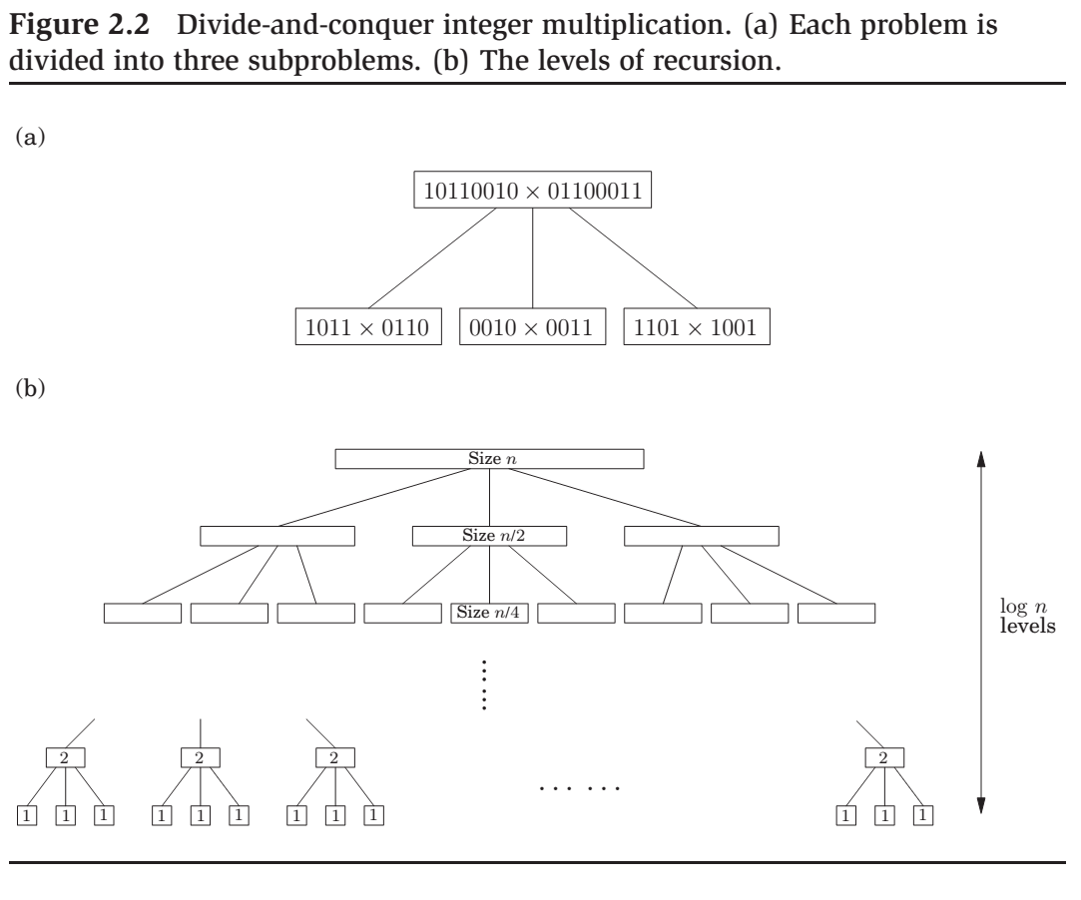

Slide 25
Recurrence relations

Slide 26
Solving recurrences
Recurrences are a major tool for analysis of algorithms
--Today: Learn a few methods.
>> Substitution method
>> Recursion - tree method
>> Master method
The most general method:
-- Guess the form of the solution
-- Verify by induction
-- Solve for constants

Slide 27
Master theorem
If
T (n) = aT (In bl ) + O(n^{d} )
for some constants a > 0, b > 1, and d ≥ 0, then
T (n) =
O(n^{d} log n)
if d > log_{b} a
if d = log a
b
if d < log_{b} a.

Slide 28
Proof of Master Theorem
Assume that n is a power of b. This will not influence the final bound in any important way: n is at most a multiplicative factor of b away from some power of b.
Next, notice that the size of the subproblems decreases by a factor of b with each level of recursion, and therefore reaches the base case after log_{b} n levels. This is the height of the recursion tree.
The branching factor of the recursion tree is a, so the kth level of the tree is made up of a^{k} subproblems, each of size n / b^{k} .
The total work done at this level is

Slide 29
Proof of Master Theorem
The total work done is
It’s the sum of a geometric series with ratio a/b^{d} .
The ratio is less than 1. Then the series is decreasing, and its sum is just given by its first term, O(n^{d} ).
The ratio is greater than 1. The series is increasing and its sum is given by its last term, O(n^{logb a} ):
log n (log n)(log a)
b .
= a = a = n
log a
b a b
3. The ratio is exactly 1. In this case all O(log n) terms of the series are equal to O(n^{d} ).

Slide 30
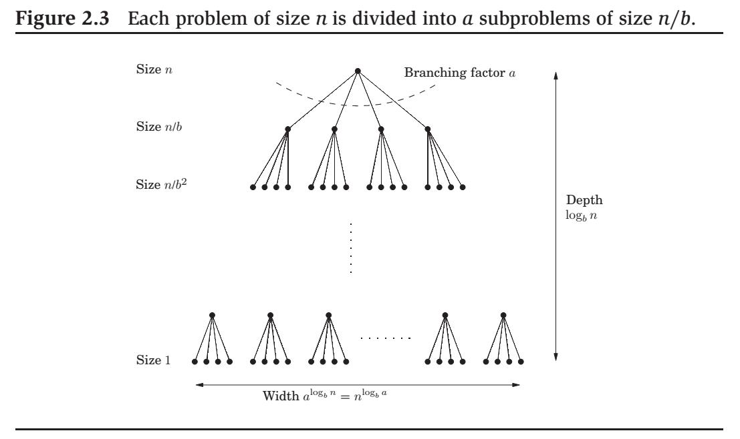

Slide 31
Merge sort

Slide 32
The algorithm
mergesort(a[1 . . . n])
// Input: an array of numbers a[1 . . . n]
// Output: A sorted version of this array
if n > 1 then
return merge(mergesort(a[1 . . . ln/2 ]),
mergesort(a[ n/2 + 1 . . . n]),
else return a.
merge(x [1 . . . k], y [1 . . . f])
// Input: two sorted arrays x and y
// Output: A sorted version of the union of x and y
if k = 0 then return y [1 . . . f]
if f = 0 then return x [1 . . .k] 3. if x [1] ≤ y [1]
then return x [1]◦merge(x [2 . . . k], y [1 . . . f])
else return y [1]◦merge(x [1 . . . k], y [2 . . . f]).

Slide 33
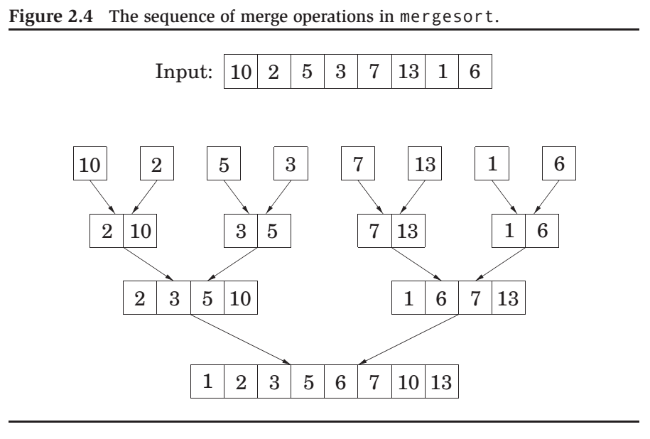

Slide 34
The time analysis
The recurrence relation:
T (n) = 2T (n/2) + O(n);
By Master Theorem
T (n) = O(n log n).

Slide 35
An n log n lower bound for sorting
Sorting algorithms can be depicted as trees.
The depth of the tree – the number of comparisons on the longest path from root to leaf, is exactly the worst-case time complexity of the algorithm.
Consider any such tree that sorts an array of n elements. Each of its leaves is labeled by a permutation of {1, 2, . . . , n}.
every permutation must appear as the label of a leaf.
This is a binary tree with n! leaves. So, the depth of our tree – and the complexity of our algorithm – must be at least
log(n!) ≈ log π (2n + 1/3) · n^{n} · e^{−n} = Ω(n log n),
where we use Stirling’s formula.

Slide 36
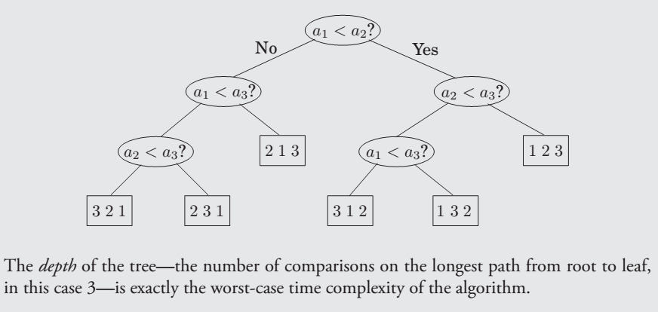
A decision Tree for sorting

Slide 37
Median

Slide 38
Median
The median of a list of numbers is its 50th percentile : half the numbers are bigger than it, and half are smaller.
If the list has even length, there are two choices for what the middle element could be, in which case we pick the smaller of the two, say.
The purpose of the median is to summarize a set of numbers by a single, typical value.
Computing the median of n numbers is easy: just sort them. The drawback is that this takes O(n log n) time, whereas we would ideally like something linear.
We have reason to be hopeful, because sorting is doing far more work than we really need – we just want the middle element and don’t care about the relative ordering of the rest of them.

Slide 39
Selection
Input: A list of numbers S ; an integer K .
Output: The kth smallest element of S .

Slide 40
A randomized divide-and-conquer algorithm for selection
For any number v , imagine splitting list S into three categories:
elements smaller than v , i.e., SL;
those equal to v , i.e., Sv (there might be duplicates);
. and those greater than v , i.e., SR respectively.
selection(SL, k)
selection(S, k) = v
if k ≤ |SL|
if |SL| < k ≤ |SL| + |Sv
if k > |SL| + |Sv |.
selection(SR , k − |SL| − |Sv |)

Slide 41
How to choose v ?
It should be picked quickly, and it should shrink the array substantially, the ideal situation being
If we could always guarantee this situation, we would get a running time of
|SL|, |SR | ≈ .
T (n) = T (n/2) + O(n) = O(n).
But this requires picking v to be the median, which is our ultimate goal! Instead, we follow a much simpler alternative: we pick v randomly from S .

Slide 42
How to choose v ? (cont’d)
Worst-case scenario would force our selection algorithm to perform
n + (n − 1) + (n − 2) + · · · + 1 = Θ(n²)
Best-case scenario: O(n).
Where, in this spectrum from O(n) to Θ(n²), does the average running time lie? Fortunately, it lies very close to the best-case time.

Slide 43
The efficiency analysis
v is good if it lies within the 25th to 75th percentile of the array that it is chosen from.
A randomly chosen v has a 50% chance of being good.
Lemma
On average a fair coin needs to be tossed two times before a “heads” is seen.
Proof.
E := expected number of tosses before head is seen.
We need at least one toss, and it’s heads, we’re done.
If it’s tail (with probability 1/2), we need to repeat. Hence
whose solution is E = 2

Slide 44
The efficiency analysis (cont’d)
Let T (n) be the expected running time on an array of size n, we get
T (n) ≤ T (3n/4) + O(n) = O(n).

Slide 45
Matrix multiplication

Slide 46
The product of two n × n matrices X and Y is a third n × n matrix Z = XY , with (i, j)th entry
That is, Zij is the dot product of the i th row of X with the j th column of Y .
In general, XY is not the same as YX ; matrix multiplication is not commutative.
The preceding formula implies an O(n³) algorithm for matrix multiplication.

Slide 47

Volker Strassen (1936 – )
In 1969, the German mathematician Volker Strassen announced a surprising O(n^{2.81}) algorithm.

Slide 48
Divide and conquer
X =
,
Y =
Then
XY =
=
To compute the size-n product XY , recursively compute eight size-n/2 products AE , BG , AF , BH, CE , DG , CF , DH and then do some O(n²)-time addition.
The recurrence is
T (n) = 8T (n/2) + O(n²)
with solution O(n³).

Slide 49
Strassen’s trick
XY =
where P1 | = | A(F − H) | P5 | = | (A + D)(E + H)
P2 | = | (A + B)H | P6 | = | (B − D)(G + H)
P3 | = | (C + D)E | P7 | = | (A − C )(E + F )
P4 | = | D(G − E )
The recurrence is
T (n) = 7T (n/2) + O(n²)
with solution O(n^{log2 7}) ≈ O(n^{2.81}).

Slide 50
上机练习
编号 204 题目：Count primes
编号 104 题目：Maximum Depth of Binary Tree
编号 121 题目：Best Time to Buy and Sell Stock

