Slide 1
Chapter 4. Paths in graphs

Slide 2
Distances
DFS does not necessarily find the shortest paths.
Definition
The distance between two nodes is the length of the shortest path between them.

Slide 3
Breadth-First Search

Slide 4
The Algorithm
bfs(G, s)
Input:
Output:
Graph G = (V,E), directed or undirected; vertex
s ∈ V
For all vertices u reachable from s, dist(u) is set
to the distance from s to u.
1.
2.
3.
4.
5.
6.
7.
8.
9.
10.
for all u ∈ V do
dist(u) = ∞
dist(s) = 0
Q = [s] (queue containing just s)
while Q is not empty do
u = eject(Q)
for all edge (u,v) ∈ E do
if dist(v) = ∞ then
inject(Q,v)
dist(v) = dist(u) + 1

Slide 5
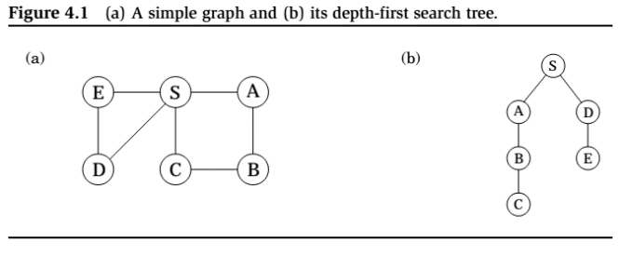
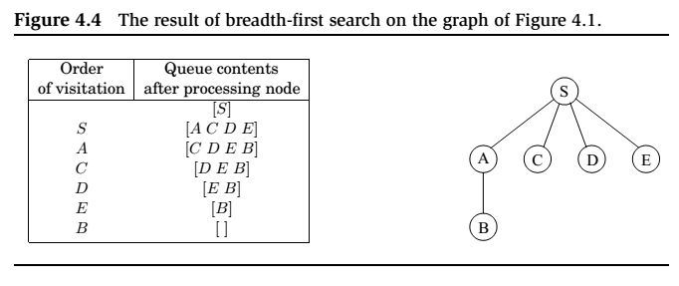

Slide 6
Correctness and Efficiency
Lemma
For each d = 0,1,2,..., there is a moment at which (1) all nodes at distance ≤ d from s have their distances correctly set; (2) all other nodes have their distances set to ∞; and (3) the queue contains exactly the nodes at distance d.
Lemma
BFS has a running time of O(|V| + |E|).

Slide 7
Lengths on Edges
BFS treats all edges as having the same length, which is rarely true in applications where shortest paths are to be found.
Every edge e ∈ E with a length l_{e} .
If e = (u,v), we will sometimes also write (u,v) or l_{uv} .

Slide 8
Dijkstra’s Algorithm

Slide 9

An adaption of breadth-first search
BFS ﬁnds shortest paths in any graph whose edges have unit length.
Can we adapt it to a more general graph G = (V, E) whose
edge lengths l_{e} are positive integers?
A simple trick:
For any edge e = (u,v) of E, replace it by l_{e} edges of length 1, by adding l_{e} − 1 dummy nodes between u and v.
It might take time
which is bad in case we have edges with high length.

Slide 10
Alarm Clocks
Set an alarm clock for node s at time 0.
Repeat until there are no more alarms:
Say the next alarm goes off at time T, for node u. Then:
The distance from s to u is T.
for each neighbor v of u in G :
if there is no alarm yet for v, set one for time T + l(u,v).
if v’s alarm is set for later than T + l(u,v),
then reset it to this earlier time.

Slide 11
Priority Queue
Priority queue is a data structure usually implemented by heap.
Insert. Add a new element to the set.
Decrease-key. Accommodate the decrease in key value of a particular element.
Delete-min. Return the element with the smallest key, and remove it from the set.
Make-queue. Build a priority queue out of the given elements, with the given key values. (In many implementations, this is signiﬁcantly faster than inserting the elements one by one.)

Slide 12
Dijkstra’s shortest-path algorithm
dijkstra(G, l, s)
Input: Graph G = (V,E), directed or undirected;
positive edge length {l_{e} | e ∈ E}; vertex s ∈ V
Output: For all vertices u reachable from s, dist(u) is set
to the distance from s to u.
1.
2.
3.
4.
5.
6.
7.
8.
9.
10.
11.
12.
for all u ∈ V do
dist(u) = ∞
prev(u) = nil
dist(s) = 0
H = makequeue(V) (using dist-values as keys)
while H is not empty do
u = deletemin(H)
for all edge (u,v) ∈ E do
if dist(v) > dist(u) + l(u,v) then
dist(v) = dist(u) + l(u,v)
prev(v) = u
decreasekey(H,v)

Slide 13

An Alternative Derivation
1. Initialize dist(s) = 0, other dist(·) to ∞
2. R = { } (the “known region”)
3. while R $≠$ V do
4.
5.
6.
7.
8.
Pick the node v R with smallest dist(·)
（指从原点开始的最小路径）
Add v to R
for all edge (v,z) ∈ E do
if dist(z) > dist(v) + l(v,z) then
dist(z) = dist(v) + l(v,z)

Slide 14
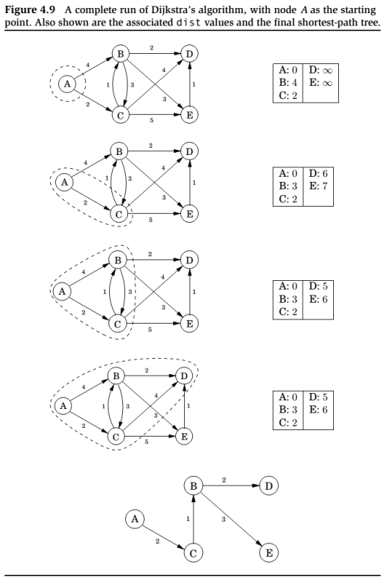
这里的距离是从原点A到该点的距离

Slide 15
Key Property
At the end of each iteration of the while loop, the following conditions hold:
(1) there is a value d such that all nodes in R are
at distance ≤ d from s and all nodes outside
R are at distance ≥ d from s;
for every node u, the value dist(u) is the length of the shortest path from s to u whose intermediate nodes are constrained to be in R (if no such path exists, the value is ∞).

Slide 16
Running Time
Since makequeue takes at most as long as |V| insert operations, we get a total of |V| deletemin and |V| + |E| insert/decreasekey operations.
The time needed for these varies by implementation; for instance, a binary heap gives an overall running time of
O((|V| + |E|)log|V|).

Slide 17
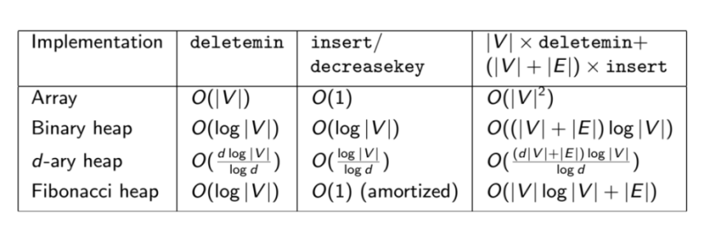
Which heap is best?

Slide 18
Priority Queue Implementations
优先队列实现

Slide 19
Array
The simplest implementation of a priority queue is as an unordered array of key values for all potential elements (the vertices of the graph, in the case of Dijkstra’s algorithm).
Initially, these values are set to ∞.
An insert or decreasekey is fast, because it just involves adjusting a key value, an O(1) operation.
To deletemin, on the other hand, requires a linear-time scan of the list.

Slide 20
Binary Heap
完全二叉树
Here elements are stored in a complete binary tree.
In addition, a special ordering constraint is enforced:
the key value of any node of the tree is less than or equal
to that of its children. （最小堆）
In particular, therefore, the root always contains the smallest
element.（根最小，插入的时候放在最下面，然后往上比较并移动）
To insert, place the new element at the bottom of the tree
(in the first available position), and let it “bubble up.”
The number of swaps is at most the height of the tree log₂ n. when there are n element.
A decrease key is similar, except the element is already in
the tree, so we let it bubble up from its current position.
To deletemin, return the root value. Then remove this element
from the heap, take the last node in the tree (in the rightmost
position in the bottom row) and lace it at the root.
Then let it “sit down.” Again this takes O(log n) time.

Slide 21
D元堆
d-ary Heap
A d-ary heap is identical to a binary heap, except that
nodes have d children.
This reduces the height of a tree with n elements to
Θ(logd n) = Θ((log n)/(log d))
Inserts are therefore speeded up by a factor of Θ(log d).
Deletemin operations, however, take a little longer,
namely O(d logd n).（合并的时间长了）

Slide 22
Shortest paths in the presence of negative edges

Slide 23
Negative Edges
Dijkstra’s algorithm works in part because the shortest path from the starting point s to any node v must pass exclusively through nodes that are closer than v.
This no longer holds when edge lengths can be negative.
What needs to be changed in order to accommodate
this new complication?
A crucial invariant of Dijkstra’s algorithm is that
the dist values it maintains are always either overestimates
or exactly correct.
They start off at ∞, and the only way they ever change is
by updating along an edge:
update((u,v) ∈ E)
dist(v) = min{dist(v), dist(u) + l(u,v)}

Slide 24
Update
update((u,v) ∈ E)
dist(v) = min{dist(v), dist(u) + l(u,v)}
It gives the correct distance to v in the particular case
where u is the second-last node in the shortest path to v,
and dist(u) is correctly set.
It will never make dist(v) too small, and in this sense
it is safe. For instance, a slew of extraneous update’s can’t hurt.
Let
s → u₁ → u₂ → u₃ → ··· → u_{k} → t
be a shortest path from s to t.
This path can have at most |V| − 1 edges (why?). If the sequence
of updates performed includes (s, u₁),(u₁, u₂),...,(u_{k},t),
in that order (though not necessarily consecutively),
then by 1 the distance to t will be correctly computed.
It doesn’t matter what other updates occur on these edges,
or what happens in the rest of the graph, because updates are safe.

Slide 25
Bellman-Ford Algorithm
But still, if we don’t know all the shortest paths beforehand,
how can we be sure to update the right edges in the right order?
We simply update all the edges, |V| − 1 times!

Slide 26
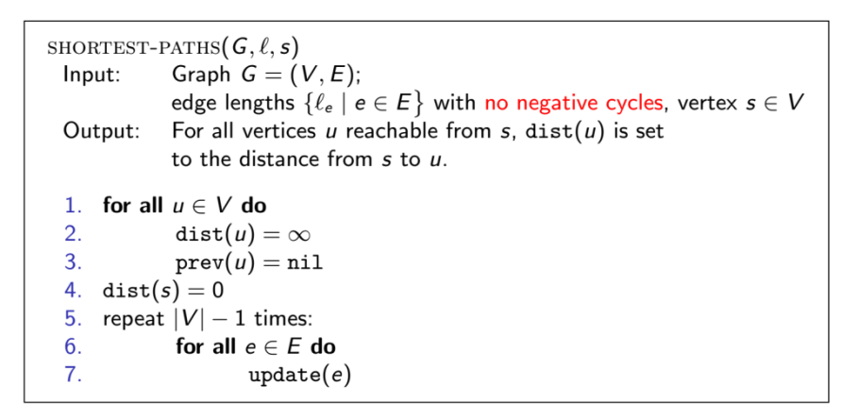
Bellman-Ford Algorithm
But still, if we don’t know all the shortest paths beforehand, how can we be sure to update the right edges in the right order?
We simply update all the edges, |V| − 1 times!
edge lengths { e | e ∈ E
Output: For all vertices u reachable from s, dist(u) is set
to the distance from s to u.
1. for all u ∈ V do
2.
3.
dist(u) = ∞
prev(u) = nil
4. dist(s) = 0
5. repeat |V| − 1 times:
6.
7.
for all e ∈ E do
update(e)
Running time: O(|V| · |E|).

Slide 27
Negative Cycles
If the graph has a negative cycle, then it doesn’t make sense to even ask about shortest path.
How to detect the existence of negative cycles:
Instead of stopping after |V| − 1 iterations, perform
one extra round.（做V次）
There is a negative cycle if and only if some dist value
is reduced during this final round.（不稳定->存在负环）

Slide 28
Shortest Paths in Dags
有向图最短路径

Slide 29
There are two subclasses of graphs that automatically exclude the possibility of negative cycles:
graphs without negative edges, and graphs without cycles.
We already know how to efficiently handle the former.
We will now see how the single-source shortest-path problem can be solved in just linear time on directed acyclic graphs.
As before, we need to perform a sequence of updates that
includes every shortest path as a subsequence.
In any path of a dag, the vertices appear in increasing
linearized order.

Slide 30
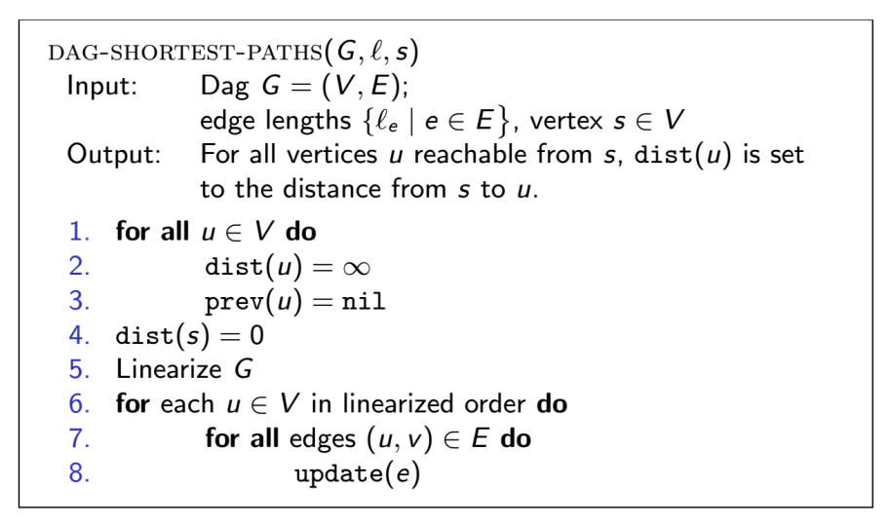
A single-source shortest-path algorithm for DAG
dag-shortest-paths(G, ,s)
Input: Dag G = (V,E);
edge lengths { e | e ∈ E , vertex s ∈ V
Output: For all vertices u reachable from s, dist(u) is set
to the distance from s to u.
1.
2.
3.
4.
5.
6.
7.
8.
for all u ∈ V do
dist(u) = ∞
prev(u) = nil
dist(s) = 0
Linearize G
for each u ∈ V in linearized order do
for all edges (u,v) ∈ E do
update(e)
Notice that our scheme doesn’t require edges to be positive.
In particular, we can find longest paths in a dag by the same
algorithm: just negate all edge lengths.（>=改成<=）

