Slide 1
Chapter 5. Greedy Algorithms

Slide 2
Minimum spanning trees

Slide 3
Graphs (review)
111 A wide range of problems can be expressed with clarity and precision in the concise pictorial language of graphs.
� Graph coloring.
� Graph connectivity and reachability.
� Flow.
111 Formally, a graph is specified by a set of vertices (also called nodes) V
and by edges E between select pairs of vertices.
� Undirected graphs, i.e., E is a symmetric relation.
� Directed graphs.

Slide 4
How is a graph represented? (review)
We can represent a graph by an adjacency matrix: if there are n = |V| vertices
v1, . . . , vn , this is an n × n array whose (i, j)th entry is
₁
aij =
if there is an edge from vi to vj
otherwise.
For undirected graph, the matrix is symmetric since an edge {u, v} can be taken in either direction.
Pros: the presence of a particular edge can be checked in constant time, with just one memory access.
Cons: Takes up O(n²) space, which is wasteful if the graph does not have very many edges.

Slide 5
How is a graph represented? (cont’d)
We can represent a graph by an adjacency list: It consists of |V| linked lists, one per vertex.
The linked list for vertex u holds the names of vertices to which u has an outgoing edge – that is – vertices v for which (u, v) ∈ E .
Therefore, each edge appears in exactly one of the linked lists if the graph is directed or two of the lists if the graph is undirected.
Pros: The total size of the data structure is O(|E|).
Cons: Checking for a particular edge (u, v) is no longer constant time.

Slide 6
Building a network
Suppose you are asked to network a collection of computers by linking selected pairs of them.
This translates into a graph problem in which
.. nodes are computers,
.. undirected edges are potential links, each with a maintenance cost.
The goal is to
.. pick enough of these edges that the nodes are connected,
. the total maintenance cost is minimum.

Slide 7
Properties of the optimal solutions
Lemma (1)
Removing a cycle edge cannot disconnect a graph.
So the solution must be connected and acyclic: undirected graphs of this kind are called trees. A tree with
minimum total weight, is a minimum spanning tree.(最小生成树)
Input: Output:
An undirected graph G = (V , E ); edge weights w_{e}
A tree T = (V , E' ) with E' ⊆ E that minimizes
weight(T ) = w_{e} .

Slide 8
Trees
Lemma (2)
A tree on n nodes has n − 1 edges.
Lemma (3)
Any connected, undirected graph G = (V , E) with |E | = |V | − 1 is a tree.
Lemma (4)
An undirected graph is a tree if and only if there is a unique path between any pair of nodes.

Slide 9
A greedy approach
Kruskal’s minimum spanning tree algorithm starts
with the empty graph and then selects edges from E according to the following rule.
Repeatedly add the next lightest edge that
doesn’t produce a cycle.
The correctness of Kruskal’s method follows from
a certain cut property.

Slide 10
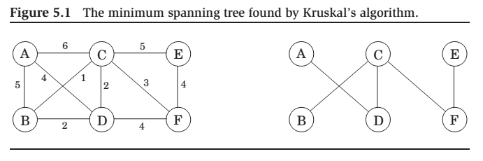
Example: A minimum spanning tree

Slide 11
The cut property 割集
Lemma (Cut property)
Suppose edges X are part of a minimum spanning tree (MST) of G = (V , E ). Pick any subset of nodes S for which X does not cross between S and V \ S, and let e be the lightest edge across this partition. Then
X ∪ {e}
is part of some MST.
A cut is any partition of the vertices into two groups,
S and V \ S .
The cut property says that it is always safe to add the lightest edge across any cut (that is, between a vertex in S and one in V \ S ), provided X has no edges across the cut.

Slide 12
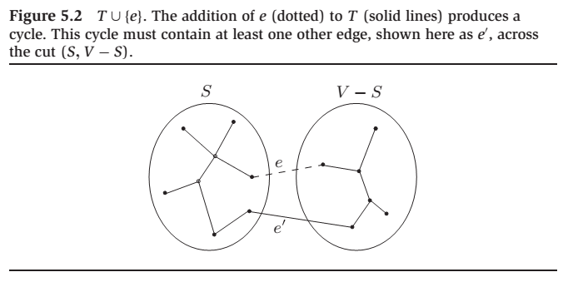
Cut property

Slide 13
Proof of the cut property
Edges X are part of some MST T (X是MST的一部分边); if the new edge e also happens to be part of T , then there is nothing to prove.
So assume e is not in T . We will construct a different MST T’ containing
by altering T slightly, changing just one of its edges.
Add edge e to T . Since T is connected, it already has a path between the endpoints of e , so adding e creates a cycle. This cycle must also have some other edge e’ across the cut (S, V \ S ).
If we now remove e’
which we will show to be a tree.
is connected by Lemma (1), since is a cycle edge. And it has the same number of edges as T ; so by Lemmas (2) and (3), it is also a tree.

Slide 14
Proof of the cut property (cont’d)
T’ is a minimum spanning tree:
weight(T’ ) = weight(T ) + w (e ) − w ( e’).
Both e and e’ cross between S and V \ S , and e is the lightest edge of this type. Therefore w (e ) ≤ w (e’ ), and
weight( T’ ) ≤ weight(T ).
Since T is an MST, it must be the case that weight( T’) = weight(T)
and that T’ is also an MST.

Slide 15
Kruskal’s algorithm
KRUSKAL(G, w)
Input: A connected undirected graph G = (V , E) with edge weight we
Output: A minimum spanning tree defined by the edges X .
for all u ∈ V do
makeset(u) (每个节点都弄成一个集合)
X = { }
Sort the edges E by weight
for all edge {u, v } ∈ E in increasing order of weight do
if find(u) find(v) then(u\v不属于同一个集合)
add edge {u, v } to X
union(u, v )
|V | | makeset(x) | create a singleton set containing x
2 · |E | | find(x) | find the set that x belongs to(无向边，check 2次)
|V | − 1 | union(x, y) | merge the sets containing x and y

Slide 16
A data structure for disjoint sets (并查集)
Union by rank
We store a set is by a directed tree(用有向树来存储集合). Nodes of the tree are elements of the set, arranged in no particular order, and each has parent pointers that eventually lead up to the root of the tree.
This root element (根节点表示集合)is a convenient representative, or name, for the set. It is distinguished from the other elements by the fact that its parent pointer is a self-loop(根节点的父节点指向自己).
In addition to a parent pointer π, each node also has a rank that, for the time being, should be interpreted as the height of the subtree hanging from that node.

Slide 17
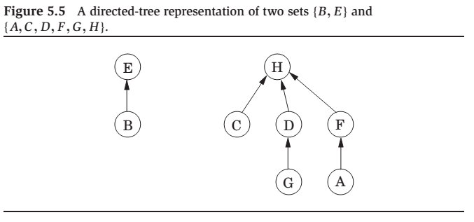
Directed-tree representation of set

Slide 18
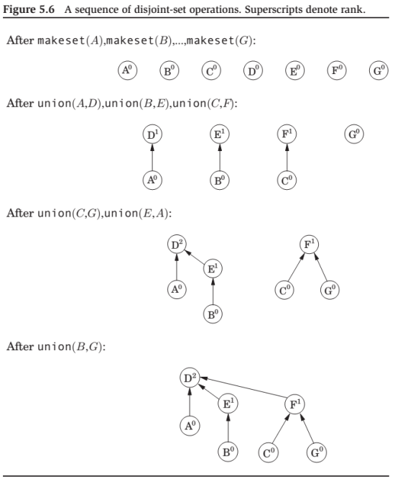
Disjoint-set operations with rank
这里表示的结构和原图不一定是一样的！
由于find可以找到根节点，所以如果两个找出来的根节点是一样的话，则 说明这两个点本来就在同一棵树中，所以不可以将这条边连起来；相反，则说明在不同树中，可以加到同一个集合中。

Slide 19
Union by rank
MAKESET(x)
π(x) = x
rank(x) = 0
FIND(x)
while x π(x) do x =π(x) return x
Makeset is a constant-time operation.
find follows parent pointers to the root of the tree and therefore takes time proportional(成比例的) to the height of the tree.
The tree actually gets built via the third operation, union, and so we must make sure that this procedure keeps trees shallow.（要做优化，使得树的高度比较小）

Slide 20
Union
UNION(x, y)
rx = find(x)
ry = find(y)
if rx = ry then return (本身就在同一个集合中)
if rank(rx ) > rank(ry ) (rx的高度>ry的高度)
then π(ry ) = rx (ry父节点为rx)
else
π(rx ) = ry
if rank(rx ) = rank(ry ) then rank(ry ) = rank(ry ) + 1

Slide 21
Properties
Lemma (1)
For any non-root x, rank(x) < rank(π(x))
Lemma (2)
Any root node of rank k has least 2^{k} nodes in its tree.
Lemma (3)
If there are n elements overall, there can be at most
n/2^{k} nodes of rank k.

Slide 22
With the data structure as presented so far, the total time for Kruskal’s algorithm becomes
1 O(|E | log |V |) for sorting the edges,
1 O(|E | log |V |) for the union and find operations that dominate the rest of the algorithm.
But what if the edges are given to us sorted? Or if the weights are small (say, O(|E |)) so that sorting can be done in linear time?
Then the data structure part becomes the bottleneck!
The main question:
How can we perform union’s and find’s faster than log n (n= |V |)?

Slide 23
Path compression(路径压缩)
FIND(x)
if then (x ) = return π(x )
return
The benefit of this simple alteration is long-term rather than instantaneous and thus necessitates a particular kind of analysis:
we need to look at sequences of find and union operations, starting from an empty data structure, and determine the average time per operation.(分摊成本)
This amortized cost turns out to be just barely more than O(1), down from the earlier O(log n).

Slide 24
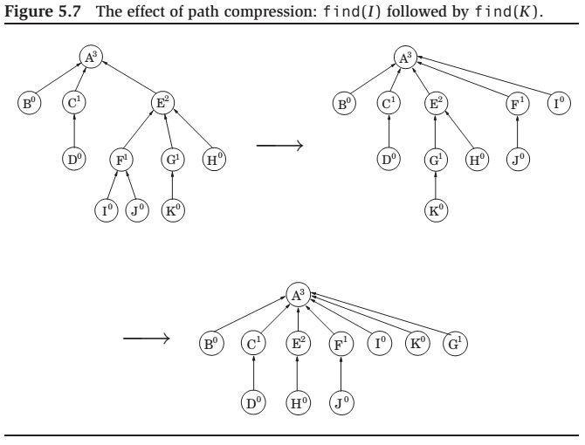
The effect of path compression

Slide 25
Time analysis(考试不考)
Think of the data structure as having a “top level” consisting of the root nodes, and below it, the insides of the trees.
There is a division of labor:
find operations (with or without path compression) only touch the insides of trees,
union’s only look at the top level.
Thus path compression has no effect on union operations and leaves the top level unchanged.

Slide 26
Time analysis (cont’d)
We now know that the ranks of root nodes are unaltered(数字不改变，但意义变了), but what about nonroot nodes?
The key point here is that once a node ceases to be a root, it never resurfaces, and its rank is forever fixed.
Therefore the ranks of all nodes are unchanged by path compression, even though these numbers can no longer be interpreted as tree heights.
In particular,(前面的3个lemma)
For any x that is not a root, rank(x ) < rank( )
Any root node of rank k has least 2^{k} nodes in its tree.
If there are n elements overall, there can be at most n/2^{k} nodes of rank k.

Slide 27
Time analysis (cont’d)
If there are n elements, their rank values can range from 0 to log n. Divide the nonzero part of this range into the following intervals:
{1}, {2}, {3, 4}, {5, 6, . . . , 16},{17, 18, . . . , 2¹⁶ = 65536},
{65537, 65538, . . . , 2⁶⁵⁵³⁶}, . . .
Each group is of the form {k + 1, k + 2, . . . , 2^{k} } where k is a power of 2.
The number of groups is log∗ n, which is defined to be the number of successive log operations that need to be applied to n to bring it down to 1 (or below 1).
For instance, log∗ 1000 = 4 since log log log log 1000 ≤ 1. In practice there will just be the first five of the intervals shown; more are needed only if n > 2⁶⁵⁵³⁶, in other words never.

Slide 28
Time analysis (cont’d)
In a sequence of find operations, some may take longer than others. We’ll bound the overall running time using some creative accounting.
We will give each node a certain amount of pocket money, such that the total money doled out is at most n log∗ n dollars.
We will then show that each find takes O(log∗ n) steps, plus some additional amount of time that can be paid for using the pocket money of the nodes involved – one dollar per unit of time.
Thus the overall time for m find’s is O(m log∗ n) plus at most O(n log∗ n).

Slide 29

Time analysis (cont’d)
A node receives its allowance as soon as it ceases to be a root, at which point its rank is fixed.
If this rank lies in the interval {k + 1, . . . , 2^{k} }, the node receives 2^{k} dollars. By Property 3, the number of nodes with rank > k is bounded by
Therefore the total money given to nodes in this particular interval is at most n dollars, and since there are log∗ n intervals, the total money disbursed to all nodes is n log∗ n.

Slide 30
Time analysis (cont’d)
Now, the time taken by a specific find is simply the number of pointers followed.
Consider the ascending rank values along this chain of nodes up to the root. Nodes x on the chain fall into two categories:
either the rank of (x is in a higher interval than the rank of x ,
or else it lies in the same interval.
There are at most log∗ n nodes of the first type, so the work done on them takes O(log∗ n) time.
The remaining nodes – whose parents’ ranks are in the same interval as theirs – have to pay a dollar out of their pocket money for their processing time.

Slide 31
Time analysis (cont’d)
This only works if the initial allowance of each node x is enough to cover all of its payments in the sequence of find operations.
Here’s the crucial observation: each time x pays a dollar, its parent changes to one of higher rank.
Therefore, if x ’s rank lies in the interval {k + 1, . . . , 2^{k} }, it has to pay at most 2^{k} dollars before its parent’s rank is in a higher interval; whereupon it never has to pay again.

Slide 32
Set cover

Slide 33
The problem
A county is in its early stages of planning and is deciding where to put schools. There are only two constraints:
each school should be in a town,
and no one should have to travel more than 30 miles to reach one of them.
What is the minimum number of schools needed?
This is a typical set cover problem. For each town x, let S_{x} be the set of towns within 30 miles of it. A school at x will essentially“cover” these other towns. The question is then, how many sets S_{x} must be picked in order to cover all the towns in the county?

Slide 34
Set cover problem
SET COVER
Input: Output: Cost:
A set of elements B. sets S₁ , . . . , S_{m} ⊆ B
A selection of the Si whose union is B. Number of sets picked.
This problem lends itself immediately to a greedy solution:
Repeat until all elements of B are covered: Pick the set Si with the largest number of uncovered elements.
The greedy algorithm doesn’t always find the best solution!(找不到最优解！)

Slide 35
Performance ratio
Lemma
Suppose B contains n elements and that the optimal cover consists of k sets. Then the greedy algorithm will use at most k ln n sets.
Proof.
Let n_{t} be the number of elements still not covered after t iterations of the greedy algorithm (so n₀= n).
Since these remaining elements are covered by the optimal k sets, there must be some set with at least n_{t}/k of them. Therefore, the greedy strategy will ensure that
which by repeated application implies

Slide 36
Performance ratio (cont.)
Note that 1- x ≤ e^{-x} , for all x, with equality
if and only if x =0.
Therefore, we have:
n_{t} ≤ n₀(1-1/k)^{t} < n₀ (e ^{-1/k})^{t} = n e^{-t/k}
At t = k lnn, n_{t} < n e^{-ln n} = 1,
Which means no elements remain to be covered.

