Slide 1
Chapter 6. Dynamic programming

Slide 2
Optimization Problems
A design technique, like divide-and-conquer.
Works bottom-up rather than top-down.(自底向上)
Useful for optimization problems.
Four-step method:
1. Characterize the structure of the optimal solution.
2. Recursively define the value of the optimal solution.
3. Compute the value of the solution in a bottom-up fashion.
4. Construct the optimal solution using the computed information.

Slide 3
Manufacturing Problem
Assembly-Line Scheduling
* Two parallel assembly lines in a factory, lines 1 and 2
* Each line has n stations S_{i,1}…S_{i,n} , i =1, 2
* For each j, S_{1, j} does the same thing as S_{2, j} , but it may take a different amount of assembly time a_{i, j}
* Transferring away from line i after stage j costs t_{i, j} , i=1, 2 and j =1, 2, … , n-1(运输需要成本)
* Also entry time e_{i} and exit time x_{i} at beginning and end
（进去一个装配线或出去一个装配线：都有成本）

Slide 4
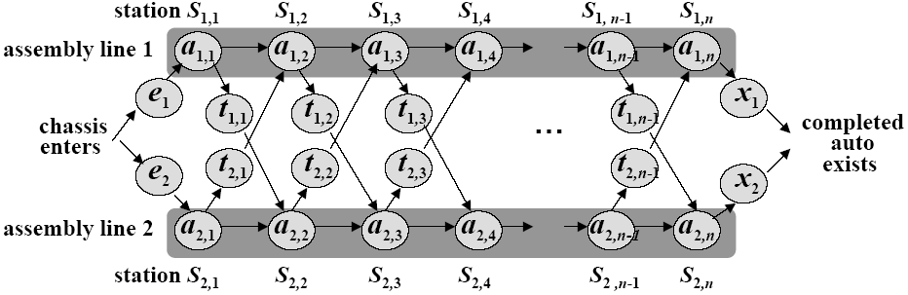
Assembly Lines
n stations on each line: S_{1,1}…S_{1,n} and S_{2,1}…S_{2,n} .
a_{i, j} : time required on line i at station j.
Transferring times: t_{i, j} .
Entry and exit time: e₁ , e₂ , x₁ , x₂.
Goal: Find the fastest path through the factory.
(Trying all possibilities is not tractable.)

Slide 5
Assembly Lines
Properties of the optimal solution: consider the fastest way of exiting station S_{1,j}.
if j = 1, then there’s only one way;
if j ≥2, then in order to exit station j, we must have
1. either gone through station S_{1,j-1}, or
2. gone through station S_{2,j-1} and transferred to S_{1,j}.
In the first case, we must have used the fastest way of exiting S_{1,j-1}.
In the second case, we must have used the fastest way of exiting S_{2,j-1}.

Slide 6
Assembly Lines
Key observation. An optimal solution to the problem (fastest way through S_{1,j}) contains within it an optimal solution to subproblems (fastest way through S_{1,j-1} or S_{2,j-1}). [Optimal substructure](并不是万金油，是要在子问题有最优解的时候才可以用的)
It’s easy to write a recursive solution to the problem now.

Slide 7


Recursive Formula
Let f_{i}[j] denote the fastest possible time (which is the values of optimal solution, optimal substructure) to get the chassis through S_{i,j}
Have the following formulas:
Using symmetric reasoning, we can get the fastest way through station S_{2,j}
Total time:
x1和x2是出去的成本

Slide 8
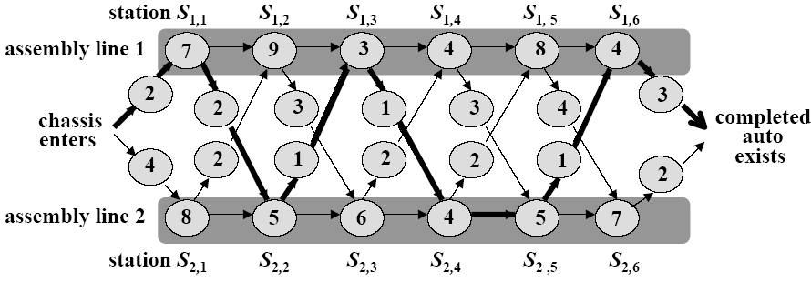
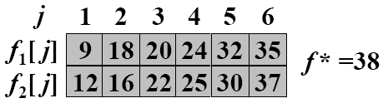
A better computation
We can do much better if we compute the f_{i}[j] values in a different order from the recursive way.
-- By computing the f_{i}[j] values in order of increasing station numbers j – left to right in the figure.

Slide 9
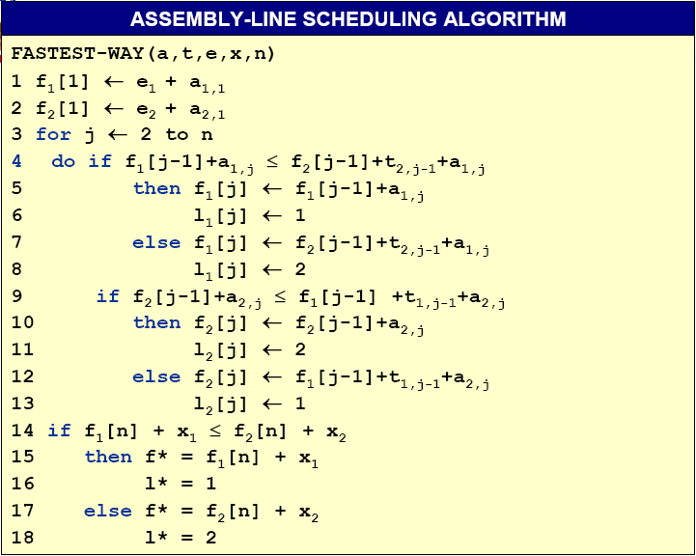
-- Define l_{i}[j] to be the line number 1 or 2, whose station j–1 is used in a fastest way through station S_{i,j}, for i = 1, 2 and j = 2,3,…,n
--Define l* to be the line whose station n is used in a fastest way through the entire factory.
A better computation
l_{i}[j]: keep track of how to construct an optimal solution
Θ(n)

Slide 10
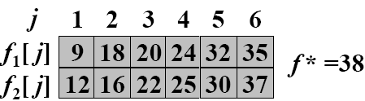
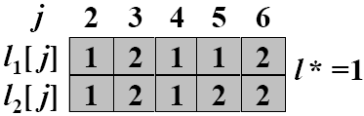
Construct an optimal solution
Can we avoid some computations?
记录来源（上一步）

Slide 11
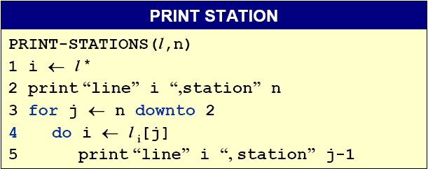
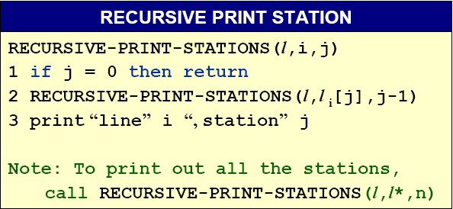
Constructing the fastest way
In the example described above, PRINT-STATIONS would produce the output
line 1, station 6
line 2, station 5
line 2, station 4
line 1, station 3
line 2, station 2
line 1, station 1

Slide 12
Chain matrix multiplication （链矩阵乘法）

Slide 13
The problem
Suppose that we want to multiply four matrices, A, B, C , D, of dimensions 50 × 20, 20 × 1, 1 × 10, and 10 × 100, respectively.
Multiplying an m × n matrix by an n × p matrix takes m · n · p multiplications.
相对顺序不可变，但结合的顺序可以变
Parenthesization | Cost computation | Cost
A × ((B × C ) × D) | 20 · 1 · 10 + 20 · 10 · 100 + 50 · 20 · 100 | 120,200
(A × (B × C )) × D | 20 · 1 · 10 + 50 · 20 · 10 + 50 · 10 · 100 | 60,200
(A × B) × (C × D) | 50 · 20 · 1 + 1 · 10 · 100 + 50 · 1 · 100 | 7,000
How do we determine the optimal order, if we want to compute
A1 × A2 × · · · × An , where the Ai ’s are matrices with dimensions m0 × m1, m₁ × m₂, . . . , m_{n−1} × m_{n} , respectively?

Slide 14
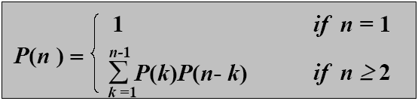

Brute force method(暴力算法)
What if we check all possible ways of multiplying? How many ways of parenthesizing are there?
P(n): number of way of parenthesizing. Then P(1) =1 and for n≥2
Fact
These numbers are called Catalan numbers. There are about 65 combinatorial interpretations,
in Stanley, Enumerative Combinatorics, Vol. 2
Notes:
Enumerative Combinatorics ：《计数组合学》

Slide 15
Subproblems
For 1 ≤ i ≤ j ≤ n let
C (i, j) = minimum cost of multiplying
Ai × Ai +1 × · · · × Aj
C (i, j) = min ｛C (i, k) + C (k + 1, j) + mi −1 · mk · mj }
i ≤k<j

Slide 16
The program
for i = 1 to n do C (i, j) = 0
for s = 1 to n − 1 do
for i = 1 to n − s do
j = i + s
C (i, j) = mini ≤k<j ｛C (i, k)+C (k + 1, j) + mi −1 · mk · mj }
return C (1, n)
The over running time is O(n³).

Slide 17
Optimal substructure
Notation. A_{i..j} represents A_{i}…A_{j}.
Any parenthesization of A_{i..j} where i < j must split into two products of the form A_{i..k} and A_{k+1..j}.
Optimal substructure. If the optimal parenthesization splits the product as A_{i..k} and A_{k+1..j}, then parenthesizations within A_{i..k} and A_{k+1..j} must each be optimal.
--We apply cut-and-paste argument to prove the optimal substructure property.

Slide 18
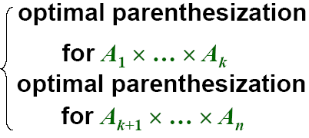
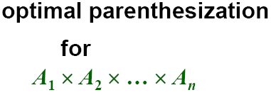
An optimal parenthesization’s structure
If the optimal parenthesization of A₁ * A₂ * … * A_{n} is split between A_{k} and A_{k+1}, then
The only uncertainty is the value of k
--Try all possible values of k. The one that returns the minimum is the right choice.

Slide 19
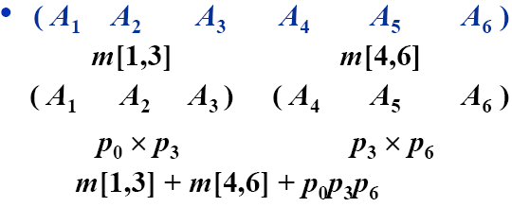
A recursive solution 递归算法
Define m[i,j] as the minimum number of scalar multiplications needed to compute the matrix product A_{i..j} (We want the value of m[1,n].)
--If i = j, there is nothing to do, so that m[i,j] = 0;
--Otherwise, suppose that the optimal parenthesization split the product as A_{i..k} and A_{k+1..j}.

Slide 20
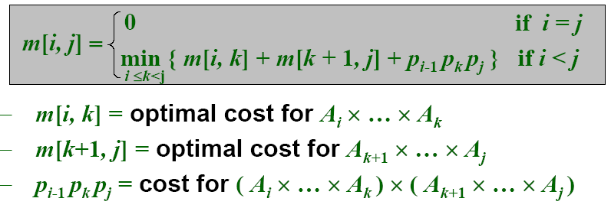
A recursive formulation
We would like to find the split that uses the minimum number of multiplications. Thus,
To obtain the actual parenthesization, keep track of the optimal k for each pair (i,j) as s[i,j].

Slide 21

Computing the Optimal Costs
--The recursive solution takes exponential time. (Easy proof by induction.)(递归计算包含太多重复计算)
1 | 2 | 3 | 4 | 5 | 6
0 |  |  |  |  |  | 1
 | 0 |  |  |  |  | 2
 |  | 0 |  |  |  | 3
 |  |  | 0 |  |  | 4
 |  |  |  | 0 |  | 5
 |  |  |  |  | 0 | 6
Instead, use a dynamic program to fill in a table m[i,j]:
--Start by setting m[i,i]=0 for i = 1,…,n.
--Then compute m[1,2], m[2,3],…,m[n-1,n].
--Then m[1,3], m[2,4],…,m[n-2,n],…
--… so on till we can compute m[1,n].
The input is a sequence p=<p₀,p₁,…,p_{n}>, we use an auxiliary table s[1..n,1..n] that records which index of k achieved the optimal cost in computing m[i,j].

Slide 22
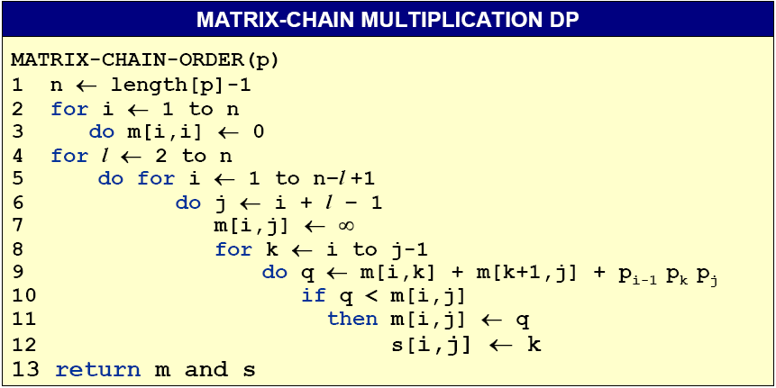
Matrix-Chain Multiplication DP Algo.
O(n³)

Slide 23
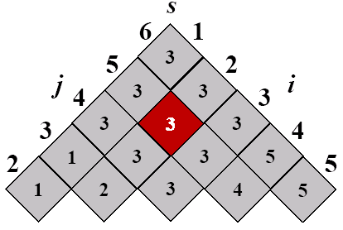
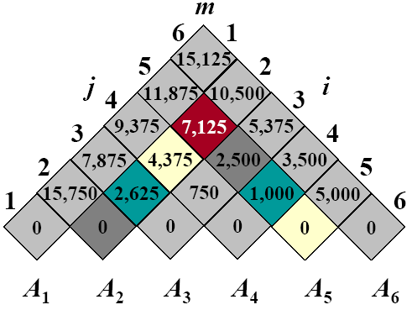
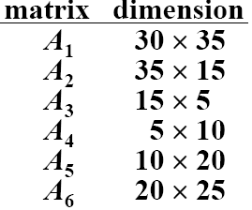
Example: DP for CMM
The optimal solution is ((A₁(A₂A₃))((A₄A₅)A₆)
Notes:
m[2,5]
m[2,2] + m[3,5] + 35*15*20 = 0 + 2500 + 10500 = 13000
m[2,3] + m[4,5] + 35*5*20 = 2625 + 1000 + 3500 = 7125
m[2,4] + m[5,5] + 35*10*20 = 4375 + 0 + 7000 = 11375

Slide 24
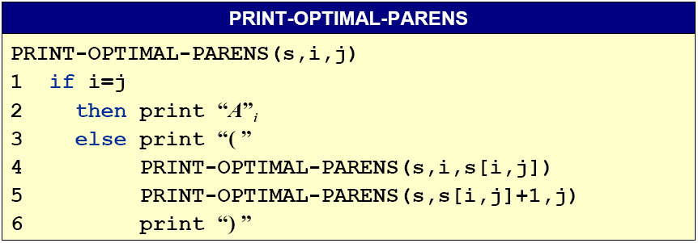
Construct an Optimal Solution
The final matrix multiplication in computing A_{1..n} optimally is A_{1..s[1,n]}A_{s[1,n]+1..n}. s[1,s[1,n]] determines the last matrix multiplication in computing A_{1..s[1,n]} and s[s[1,n]+1,n] determines the last matrix multiplication in computing A_{s[1,n]+1..n}.

Slide 25
Knapsack 背包问题

Slide 26
The problem
每个商品取部分：已由贪心解决
During a robbery, a burglar finds much more loot than he had expected and has to decide what to take. His bag (or “knapsack”) will hold a total weight of
at most W pounds. There are n items to pick from, of weight w1 , . . . , wn and dollar value v1 , . . . , vn . What’s the most valuable combination of items he can put into his bag?
There are two versions of this problem:
.., there are unlimited quantities of each item available;
.., there is one of each item.
We shall see in Chapter 8, neither version of this problem is likely to have a polynomial time algorithm. 不可用多项式算法求解
However, using dynamic programming they can both be solved in O(n · W ) time, which is reasonable when W is small, but is not polynomial since the input size is proportional to log W rather than W .
本质上这两种情况是一样的

Slide 27
Knapsack with repetition
For every w ≤ W let
K (w ) = maximum value achievable with a knapsack of capacity w .
We express this in terms of smaller subproblems:
K (w ) = max ｛ K (w − wi ) + vi };
i :w_{i} ≤w
K (0) = 0
for w = 1 to W do
K (w ) = maxi :w_{i} ≤w ｛K (w − wi ) + vi }
return K (W )
The over running time is O(n · W ).

Slide 28
Knapsack without repetition
For every w ≤ W and 0 ≤ j ≤ n, let
K ( w , j ) = maximum value achievable with a knapsack of capacity w and items 1, . . . , j.
We express this in terms of smaller subproblems:
K (w, j) = max { K (w − wj , j − 1) + vj , K (w, j − 1) } .
Initialize all K (0, j) = 0 and all K (w, 0) = 0
for j = 1 to n do
for w = 1 to W do
if wj > w then K (w, j) = K (w, j − 1)
K (w, j) = max {K (w − wj , j − 1) + vj , K (w, j − 1)} return K (W , n)
The over running time is O(n · W ).

Slide 29
Edit distance
编辑距离

Slide 30
The problem
拼写检查器
When a spell checker encounters a possible misspelling, it looks in its dictionary for other words that are close by.
What is the appropriate notion of closeness in this case?
A natural measure of the distance between two strings is the extent to which they can be aligned对齐, or matched up.
Technically, an alignment is simply a way of writing the strings one above the other.
The cost of an alignment is the number of columns in which the letters differ. And the edit distance(编辑距离：最小的对齐开销) between two strings is the cost of their best possible alignment.
Edit distance is so named because it can also be thought of as the minimum number of edits – insertions, deletions, and substitutions of characters(编辑可以增、删、替换) – needed to transform the first string into the second.

Slide 31
A dynamic programming solution
When solving a problem by dynamic programming, the most crucial question is, What are the subproblems?
Our goal is to find the edit distance between two strings
x [1, . . . , m] and y [1, . . . , n].
For every i , j with 1 ≤ i ≤ m and 1 ≤ j ≤ n let
E (i, j): the edit distance between some prefix of the first string,
x [1, . . . , i ], and some prefix of the second, y [1, . . . , j].
E (i, j) = min ｛1 + E (i − 1, j)添/删, 1 + E (i, j − 1)添/删, diff(i, j) + E (i − 1, j − 1)修改 } where diff(i, j) is defined to be 0 if x [i ] = y [ j] and 1 otherwise.

Slide 32
The algorithm
for i = 0 to m do
E (i, 0) = i
for j = 1 to n do
E (0, j) = j
for i = 1 to m do
for j = 1 to n do
E (i, j) = min ｛1 + E (i − 1, j), 1 + E (i, j − 1),
diff(i, j) + E (i − 1, j − 1)}
return E (m, n)
The over running time is O(m · n).

Slide 33
Shortest paths
最短路径

Slide 34
Shortest reliable paths
从s到v：最多使用k条边
Suppose then that we are given a graph G with lengths on the edges, along with two nodes s and t and an integer k, and we want the shortest path from s to t that uses at most k edges.
For each vertex v and each integer i ≤ k, let
dist(v, i ) = the length of the shortest path from s to v that uses i edges.
The starting values dist(v, 0) are ∞ for all vertices except s , for which it is 0.
dist(v, i ) = min ｛dist(u, i − 1) + }.
(u,v )∈E

Slide 35
All-pairs shortest paths
What if we want to find the shortest path not just between s and t but
between all pairs of vertices?
One approach would be to execute our general shortest-path algorithm from Section 4.6.1 (since there may be negative edges) |V | times, once for each starting node. The total running time would then be O(|V |²|E |).
We’ll now see a better alternative, the O(|V |³) dynamic programming-based
Floyd-Warshall algorithm.
DP：更优(cause|E|的级别是|V|^2)

Slide 36
The subproblems 子问题
Floyd-Warshall algorithm.
从i到j，使用最多k个节点
Number the vertices in V as {1, 2, . . . , n}, and let dist(i, j, k) denote the length of the shortest path from i to j in which only nodes {1, 2, . . . , k} can be used as intermediates.
Initially, dist(i, j, 0) is the length of the direct edge between i and j, if it exists, and is ∞ otherwise.
For k ≥ 1
dist(i, j, k) = min ｛dist(i, j, k − 1), dist(i, k, k − 1) + dist(k, j, k − 1) }
不用k作为中间节点
用k作为中间节点

Slide 37
The program
for i = 1 to n do
for j = 1 to n do
dist(i, j, 0) = ∞
for all (i, j) ∈ E do
dist(i, j, 0) =
for k = 1 to n do
for i = 1 to n do
for j = 1 to n do
dist(i, j, k) = min ｛dist(i, j, k − 1),
dist(i, k, k − 1) + dist(k, j, k − 1)}

Slide 38
The traveling salesman problem
旅行商人问题
A traveling salesman is getting ready for a big sales tour. Starting at his hometown, he will conduct a journey in which each of his target cities is visited exactly once before he returns home. Given the pairwise distances between cities, what is the best order in which to visit them, so as to minimize the overall distance traveled?
Denote the cities by 1, . . . , n, the salesman’s hometown being 1, and let
D = (dij ) be the matrix of intercity distances. The goal is to design a tour that starts and ends at 1, includes all other cities exactly once, and has minimum total length去每一个城市，用最短的距离.
The brute-force approach is to evaluate every possible tour and return the best one. Since there are (n − 1)! possibilities, this strategy takes O(n!) time.

Slide 39
The subproblems
注意：在旅行商问题，可以把图看成是完全图
For a subset of cities S ⊆ {1, 2, . . . , n} that includes 1, and j ∈ S, let C (S, j) be the length of the shortest path visiting each node in S exactly once, starting at 1 and ending at j 终点为j，访问子集S中的每个节点1次的最短距离.
When |S | > 1, we define C (S, 1) = ∞. For j 1 with j ∈ S we have
C (S, j) = min C (S \ { j }, i ) + dij .
i ∈S:i /=j
考察子集S中，除了j之外的所有节点

Slide 40
The program
C ({1, }, 1) = 0
for s = 2 to n do
for all subsets S ⊆ {1, . . . , n} of size s and containing 1 do
C (S, 1) = ∞
for all j ∈ S and j 1 do
C (S, j) = mini ∈S: C (S \ { j }, i ) + dij
return minj C ({1, . . . , n}, j) + dj1
There are at most 2^{n} ·n subproblems, and each one takes linear time to solve. The total running time is therefore O(n² ·2^{n} ).
比起O(n!)，复杂度改善很多

