Slide 1
Chapter 7. Linear programming and reductions

Slide 2
An introduction to linear programming

Slide 3
In a linear programming problem we are given a set of variables, and we want to assign real values to them so as to
satisfy a set of linear equations and/or linear inequalities involving these variables, and
maximize or minimize a given linear objective function.
实数
最大化/最小化线性目标方程

Slide 4
Example: profit maximization
There are two products:
.., its flagship assortment of triangular chocolates, called Pyramide,
.., and the more decadent and deluxe Pyramide Nuit.
How much of each should it produce to maximize profits?
.., Every box of Pyramide has a a profit of $1.
.. Every box of Nuit has a profit of $6.
.. The daily demand is limited to at most 200 boxes of Pyramide and 300 boxes of Nuit.
.. The current workforce can produce a total of at most 400 boxes of chocolate per day.

Slide 5
LP formulation
Objective function
Constraints
max x₁ + 6x₂
x₁ ≤ 200
x₂ ≤ 300
x₁ + x₂ ≤ 400
x₁ , x₂ ≥ 0
A linear equation in x₁ and x₂ defines a line in the two-dimensional (2D) plane, and a linear inequality designates a half-space, the region on one side of the line.
Thus the set of all feasible solutions可行解 of this linear program, that is, the points (x₁ , x₂) which satisfy all constraints, is the intersection of five half-spaces.
It is a convex polygon.

Slide 6
The optimal solution 最优解
We want to find the point in this polygon at which the objective function – the profit – is maximized.
The points with a profit of c dollars lie on the line x₁ + 6x₂ = c, which has a slope of -1/6.
As c increases, this “profit line” moves parallel to itself, up and to the right. Since the goal is to maximize c , we must move the line as far up as possible, while still touching the feasible region.
The optimum solution will be the very last feasible point that the profit line sees and must therefore be a vertex of the polygon.

Slide 7
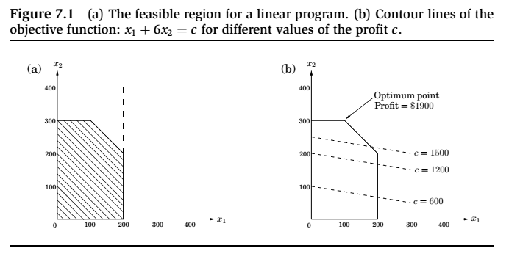
Thus the set of all feasible solutions of this linear program, that is, the points (x₁ , x₂) which satisfy all constraints, is the intersection of five half-spaces. It is a convex polygon.

Slide 8
The optimal solution (cont’d)
It is a general rule of linear programs that the optimum is achieved at a vertex of the feasible region.
The only exceptions are cases in which there is no optimum; this can happen in two ways:
The linear program is infeasible; that is, the constraints are so tight that it is impossible to satisfy all of them. For instance,
x ≤ 1, x ≥ 2.
The constraints are so loose that the feasible region is unbounded, and it is possible to achieve arbitrarily high objective values. For instance,
max x₁ + x₂, x₁ , x₂ ≥ 0

Slide 9
Solving linear programs
单纯形的方法
Linear programs (LPs) can be solved by the simplex method, devised by George Dantzig in 1947.
This algorithm starts at a vertex, and repeatedly looks for an adjacent vertex (connected by an edge of the feasible region) of better objective value.
In this way it does hill-climbing爬山法 on the vertices of the polygon, walking from neighbor to neighbor so as to steadily increase profit along the way.

Slide 10
Solving linear programs, cont.
Upon reaching a vertex that has no better neighbor, simplex declares it to be optimal and halts.
Why does this local test imply global optimality? By simple geometry – think of the profit line passing through this vertex. Since all the vertex’s neighbors lie below the line, the rest of the feasible polygon must also lie below this line.

Slide 11
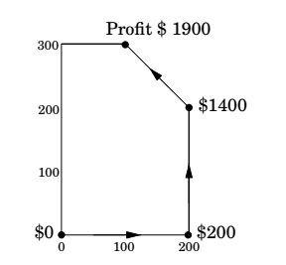

Slide 12
More products
The chocolatier decides to introduce a third and even more exclusive line of chocolates, called Pyramide Luxe. One box of these will bring in a profit of $13.
Let x₁, x₂, x₃ denote the number of boxes of each chocolate produced daily, with x₃ referring to Luxe.

Slide 13
More products, cont.
The old constraints on x₁ and x₂ persist, although the labor restriction now extends to x₃ as well: the sum of all variables can be at most 400.
What’s more, it turns out that Nuit and Luxe require the same packaging包装 machinery, except that Luxe uses it three times as much, which imposes another constraint: x₂ + 3x₃ ≤ 600.

Slide 14
LP: Linear Programming
max x1 + 6x2 + 13x3
x1 ≤ 200
x2 ≤ 300
x1 + x2 + x3 ≤ 400 x2 + 3x3 ≤ 600
x1 , x2 , x3 ≥ 0

Slide 15
The space of solutions is now three-dimensional.
Each linear equation defines a 3D plane, and each inequality a half-space on one side of the plane. The feasible region is an intersection of seven half-spaces, a polyhedron多边体.
A profit of c corresponds to the plane x₁ + 6x₂ + 13x₃ = c, as c increases, the profit-plane moves parallel to itself, further and further into the positive orthant until it no longer touches the feasible region.

Slide 16
The point of final contact is the optimal vertex: (0, 300, 100), with total profit $3100.
How would the simplex algorithm behave on this modified problem? A possible trajectory:
(0,0,0)
$0
(200,0,0)
$200
→
(200,200,0)
$1400
→
(200,0,200)
$2800
→
(0,300,100)
$3100
→

Slide 17
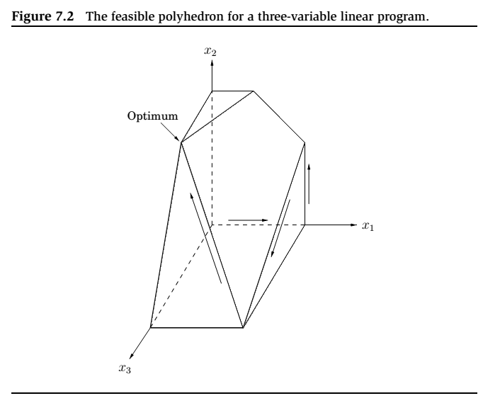
考察邻点，看最大利润是否大于自己的max。如果有，则爬去最大的那个邻点；否则，得到最优解。

Slide 18
A magic trick called duality
Here is why you should believe that (0, 300, 100), with a total profit of $3100, is the optimum:
Recall
max x1 + 6x2 + 13x3
x1 ≤ 200
x2 ≤ 300
x1 + x2 + x3 ≤ 400 x2 + 3x3 ≤ 600
x1 , x2 , x3 ≥ 0
Add the second inequality to the third, and add to them the fourth multiplied by 4.
The result is the inequality
x1 + 6x2 + 13x3 ≤ 3100.

Slide 19
Example: production planning
The company makes handwoven carpets, a product for which the demand is extremely seasonal(需求量是季节性的).
Our analyst has just obtained demand estimates for all months of the next calendar year: d₁ , d₂ , . . . , d_{12 ,} ranging from 440 to 920.
We currently have 30 employees, each of whom makes 20 carpets per month and gets a monthly salary of $2000. We have no initial surplus of carpets.

Slide 20
Example: production planning
How can we handle the fluctuations in demand? There are three ways:
Overtime加班, but this is expensive since overtime pay is 80% more than regular pay. Also, workers can put in at most 30% overtime(只能最多加正常上班时间的30%).
Hiring and firing多雇佣和解雇, but these cost $320 and $400, respectively, per worker.
Storing surplus production(存储产品), but this costs $8 per carpet per month. We currently have no stored carpets on hand, and we must end the year without any carpets stored.

Slide 21
LP formulation
i表示月份，因此每个变量都有12个。
wi | = | number of workers during i th month; w0 = 30.
xi | = | number of carpets made during i th month.
oi | = | number of carpets made by overtime in month i .
hi , fi | = | number of workers hired and fired, respectively,
at beginning of month i .
number of carpets stored at end of month i ; s0 = 0.
si =
First, all variables must be nonnegative:
wi , xi , oi , hi , fi , si ≥ 0, i = 1, . . . , 12.
The total number of carpets made per month consists of regular production plus overtime:
xi = 20wi + oi
(one constraint for each i = 1, . . . , 12).

Slide 22
LP formulation (cont’d)
The number of workers can potentially change at the start of each month:
wi = wi −1 + hi − fi .
The number of carpets stored at the end of each month is what we started with, plus the number we made, minus the demand for the month:
si = si −1 + xi − di .
And overtime is limited:
oi ≤ 6wi .
The objective function is to minimize the total cost:
min 2000 、 wi + 320 、 hi + 400 、 fi + 8 、 si + 180 、 oi

Slide 23
Integer linear programming 整数线性规划：NP难
The optimum solution might turn out to be fractional(结果是分数); for instance, it might involve hiring 10.6 workers in the month of March.
This number would have to be rounded to either 10 or 11 in order to make sense, and the overall cost would then increase correspondingly.
In the present example, most of the variables take on fairly large (double-digit) values, and thus rounding is unlikely to affect things too much.

Slide 24
Integer linear programming, cont.
There are other LPs, however, in which rounding decisions have to be made very carefully in order to end up with an integer solution of reasonable quality.
In general, there is a tension in linear programming between the ease of obtaining fractional solutions and the desirability of integer ones.
As we shall see in Chapter 8, finding the optimum integer solution of an LP is an important but very hard problem, called integer linear programming.

Slide 25
Reductions 规约
We want to solve Problem P.
We already have an algorithm that solves Problem Q.
If any subroutine for Q can also be used to solve P(Q的解决方法也可以用来解决P的解), we say P reduces to Q(P规约到Q). Often, P is solvable by a single call to Q’s subroutine, which means any instance x of P can be transformed into an instance y of Q such that P(x) can be deduced from Q(y).
注意：这种转换一定要是效率高的，也就是通过多项式复杂度的时间进行规约

Slide 26
Variants of linear programming
A general linear program has many degrees of freedom:
It can be either a maximization or a minimization problem.
Its constraints can be equations and/or inequalities.
The variables are often restricted to be nonnegative, but they can also be unrestricted in sign.
We will now show that these various LP options can all be reduced to one another via simple transformations.

Slide 27
Variants of linear programming (cont’d)
1. To turn a maximization problem into a minimization(最大化->最小化) (or vice versa), just multiply the coefficients of the objective function by −1.(乘-1)
2a. To turn an inequality constraint like ^{n} ai xi ≤ b into an equation,
introduce a new variable s and use(不等变等：加松弛变量)
ai xi + s = b
s ≥ 0.
This s is called the slack variable(松弛变量) for the inequality.
2b. To change an equality constraint into inequalities(等变不等) is easy: rewrite ax = b
as the equivalent pair of constraints ax ≤ b and ax ≥ b.
3. Finally, to deal with a variable x that is unrestricted in sign, do the
following:
� Introduce two nonnegative variables, x ⁺, x ⁻ ≥ 0.
� Replace x , wherever it occurs in the constraints or the objective function, by
x ⁺ − x ⁻.

Slide 28
Standard form标准形式
Therefore, we can reduce any LP (maximization or minimization, with both inequalities and equations, and with both nonnegative and unrestricted variables) into an LP of a much more constrained kind that we call the standard form:
the variables are all nonnegative,
the constraints are all equations,
and the objective function is to be minimized.
max x1 + 6x2 |  | min −x1 − 6x2
x1 ≤ 200 |  | x1 + s1 = 200
x2 ≤ 300 | ⇒ | x2 + s2 = 300
x1 + x2 ≤ 400 |  | x1 + x2 + s3 = 400
x1 , x2 , x3 ≥ 0 |  | x1 , x2 , s1 , s2 , s3 ≥ 0

