Slide 1
Flows in networks 网络流问题

Slide 2
Shipping oil
We have a network of pipelines along which oil can be sent. The goal is to ship as much oil as possible from the source s and the sink t.(从起点到终点运送油)
Each pipeline has a maximum capacity it can handle, and there are no opportunities for storing oil en route(在途中).
(即：在中间节点不能存储油)

Slide 3
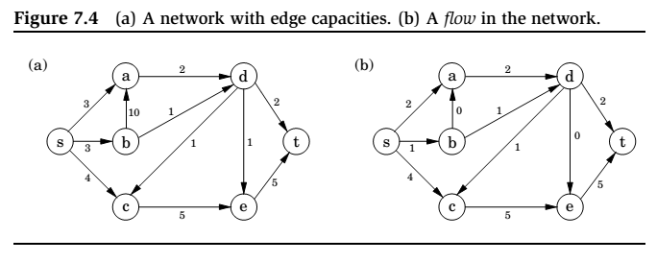
A Flow in Network
(b)是一种可能的解flow
需要满足：除了s\t，每一个节点进和出的量相同

Slide 4
Maximizing flow
The networks consist of a directed graph G = (V , E ); two special nodes s, t ∈ V , which are, respectively, a source and sink of G ; and capacities ce > 0 on the edges.
We would like to send as much oil as possible from s to t without exceeding the capacities of any of the edges.
A particular shipping scheme is called a flow and consists of a variable fe for each edge e of the network, satisfying the following two properties:
1. It doesn’t violate edge capacities: 0 ≤ fe ≤ ce for all e ∈ E .
2. For all nodes u except s and t, the amount of folw entering u equals the amount leaving
(w,u )∈E
fwu = fuz
(u,z )∈E
In other words, flow is conserved 流是守恒的.

Slide 5
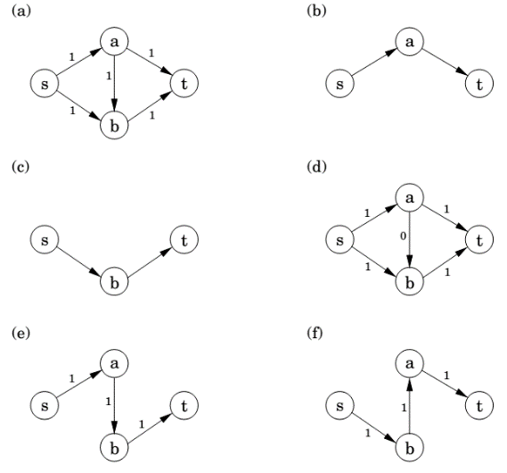
Max-flow algorithm: example

Slide 6
Maximizing flow (cont’d)
The size of a flow is the total quantity sent from s to t and, by the conservation principle, is equal to the quantity leaving s :
size(f ) =
fsu (s,u)∈E
In short, our goal is to assign values to {f_{e} | e ∈ E } that will satisfy a set of linear constraints and maximize a linear objective function.
But this is a linear program! The maximum-flow problem reduces to linear programming.

Slide 7
A closer look at the algorithm
All we know so far of the simplex algorithm is the vague geometric intuition that it keeps making local moves on the surface of a convex feasible region, successively improving the objective function until it finally reaches the optimal solution.
The behavior of simplex has an elementary interpretation:
Start with zero flow.
Repeat: choose an appropriate path from s to t, and increase flow along the edges of this path as much as possible.

Slide 8
A closer look at the algorithm (cont’d)
There is just one complication.
What if we choose a path that blocks all other paths?
Simplex单纯形方法(also called爬山法) gets around this problem by also allowing paths to cancel existing flow.
To summarize, in each iteration simplex looks for an s -t path whose edges (u, v ) can be of two types:
(u, v ) is in the original network, and is not yet at full capacity.(没用完所有容量)
The reverse edge (v, u) is in the original network, and there is some flow along it.(反过来的边在原来的图中，且该正边已经由流)
If the current flow is f , then in the first case, edge (u, v ) can handle up to cuv − fuv additional units of flow, and in the second case, up to fvu additional units (canceling all or part of the existing flow on (v, u)).

Slide 9
A closer look at the algorithm (cont’d)
These flow-increasing opportunities can be captured in a residual network (剩余网络：点不变，边改变，且是动态的) G^{f} = (V , E ^{f} ), which has exactly the two types of edges listed, with residual capacities c^{f} :
cuv − fuv if (u, v ) ∈ E and fuv < cuv
fvu
if (v, u) ∈ E and fvu > 0.
Thus we can equivalently think of simplex as choosing an s -t path in the residual network.
By simulating the behavior of simplex, we get a direct algorithm for solving max-flow.
It proceeds in iterations, each time explicitly constructing G^{f} , finding a suitable s -t path in G^{f} by using, say, a linear-time breadth-first search(通过BFS), and halting if there is no longer any such path along which flow can be increased(直到该路径的flow不能再增大).

Slide 10
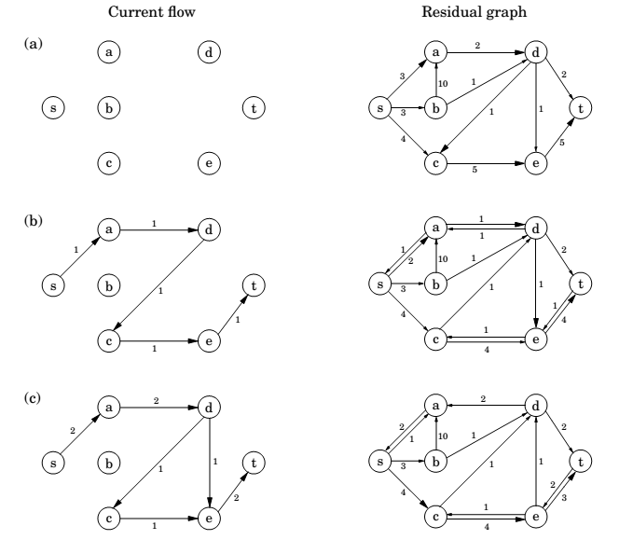
初始残量图就是原图

Slide 11
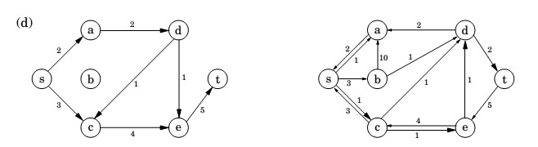
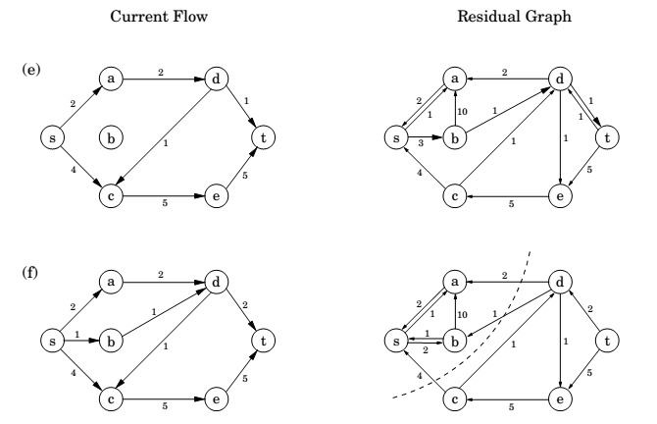

Slide 12
Cuts 割
A truly remarkable fact:
not only does simplex correctly compute a maximum flow, but it also generates a short proof of the optimality of this flow!
An (s, t)-cut割 partitions the vertices into two disjoint(互不相交) groups L and R such that s ∈ L and t ∈ R . Its capacity is the total capacity of the edges from L to R , and as argued previously, is an upper bound on any flow(总和是任何流的上界):
Pick any flow f and any (s, t)-cut (L, R ),
then size(f ) ≤ capacity(L, R ).

Slide 13
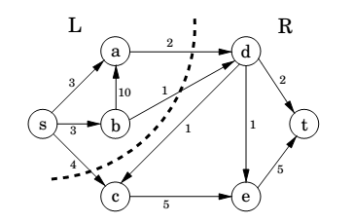
Cut

Slide 14
A certificate of optimality
Theorem (Max-flow min-cut)
The size of the maximum flow in a network equals the capacity of the smallest (s, t)-cut.(最大流对应最小割)
Proof.
Suppose f is the final flow when the algorithm terminates.
We know that node t is no longer reachable from s in the residual network G^{f} . Let L be the nodes that are reachable from s in G^{f} , and let R = V \ L be the rest of the nodes. We claim that
size(f ) = capacity(L, R )
To see this, observe that by the way L is defined, any edge going from L to R must be at full capacity (in the current flow f ), and any edge from R to L must have zero flow.
Therefore the net flow across (L, R ) is exactly the capacity of the cut.

Slide 15
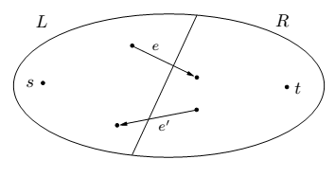
Max-flow min-cut

Slide 16
Efficiency
Each iteration of our maximum-flow algorithm is efficient, requiring O(|E |) time if a DFS or BFS is used to find an s -t path.
But how many iterations are there?
Suppose all edges in the original network have integer capacities ≤ C .
Then on each iteration of the algorithm, the flow is always an integer and increases by an integer amount(每次增加至少一个单位). Therefore, since the maximum flow is at most C |E |, the number of iterations is at most this much.
If paths are chosen in a sensible manner – in particular, by using a BFS, which finds the path with the fewest edges – then the number of iterations is at most O(|V | · |E |), no matter what the capacities are.
This latter bound gives an overall running time of O(|V | · |E |²) for maximum flow.

Slide 17
Bipartite matching

Slide 18
The problem
A graph with nodes on the left representing boys and nodes on the right representing girls.
There is an edge between a boy and girl if they like each other.
Is it possible to choose couples so that everyone has exactly one partner, and it is someone they like?
In graph-theoretic jargon, is there a perfect matching?
一个boy可以喜欢几个girls，相反亦然。

Slide 19
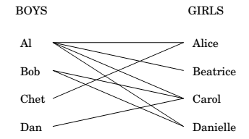
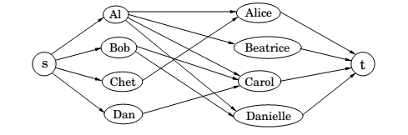
Bipartite matching
引入s,t，边的权重为1

Slide 20
LP formulation
This matchmaking game can be reduced to the maximum-flow problem, and thereby to linear programming!
Create a new source node s with outgoing edges to all the boys;
a new sink node t, with incoming edges from all the girls;
and direct all the edges in the original bipartite graph from boy to girl.
Finally, give every edge a capacity of 1.

Slide 21
LP formulation
Then there is a perfect matching if and only if this network has a flow whose size equals the number of couples.
The maximum-flow problem has the following property: if all edge capacities are integers, then the optimal flow found by our algorithm is integral.
We can see this directly from the algorithm, which in such cases would increment the flow by an integer amount on each iteration.

Slide 22
Duality
对偶性

Slide 23
Recall:
max x₁ + 6x₂
x₁ ≤ 200
x₂ ≤ 300
x₁ + x₂ ≤ 400
x₁ , x₂ ≥ 0
Simplex declares the optimum solution to be (x₁,x₂) = (100,300), with objective value 1900.
Can this answer be checked somehow?
We take the first inequality and add it to six times the second inequality:
x₁ + 6x₂ ≤ 2000.
Multiplying the three inequalities by 0, 5, and 1, respectively, and adding them up yields
x₁ + 6x₂ ≤ 1900.
界更紧了

Slide 24
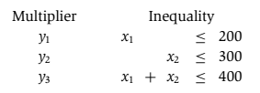
Let’s investigate the issue by describing what we expect of
these three multipliers, call them y_{1,} y₂ ,y₃.
These y_{i}’s must be nonnegative, for otherwise they are unqualiﬁed to multiply inequalities. After the multiplication and addition steps, we get the bound:
(y₁ + y₃)x₁ + (y₂ + y₃)x₂ ≤ 200y₁ + 300y₂ + 400y_{3.}
We want the left-hand side to look like our objective function x₁ + 6x₂ so that the right-hand side is an upper bound on the optimum solution.

Slide 25



We can easily find y’s that satisfy the inequalities on the right by simply making them large enough, for example
(y1, y2, y3) = (5, 3, 6). But these particular multipliers would tell us that the optimum solution of the LP is at most
200 · 5 + 300 · 3 + 400 · 6 = 4300,（上界太松散）
a bound that is far too loose to be of interest.
What we want is a bound that is as tight as possible, so we should minimize 200y₁ + 300y₂ + 400y₃
subject to the preceding inequalities.
And this is a new linear program!

Slide 26
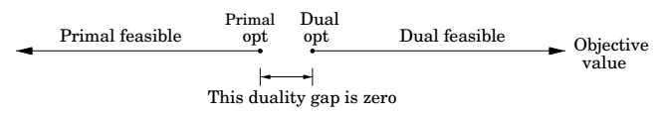
The dual program
min 200 y₁ + 300 y₂ + 400 y₃
y₁ + y₃ ≥ 1
y₂ + y₃ ≥ 6
y₁, y₂, y₃ ≥ 0
By design, any feasible value of this dual(对偶LP!) LP is an upper bound on the original primal LP. So if we somehow find a pair of primal and dual feasible values that are equal, then they must both be optimal. Here is just such a pair:
Primal: (x₁, x₂) = (100, 300);
Dual: (y₁, y₂, y₃ ) = (0, 5, 1).
They both have value 1900, and therefore they certify each other’s optimality.

Slide 27

A generic primal LP in matrix-vector form
and its dual
Primal LP: Dual LP:
max c^{T}x min y^{T}b
Ax $≤$ b y^{T} A $≥$ c^{T}
x $≥$ 0 y $≥0$
Theorem (Duality)
If a linear program has a bounded optimum, then so does its dual, and the two optimum values coincide.

Slide 28
Zero-sum games
零和问题

Slide 29
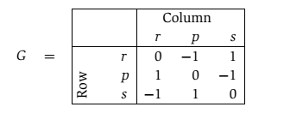
Rock-paper-scissors game石头剪刀布
We can represent various conflict situations in life by matrix
games.
The schoolyard rock-paper-scissors game is specified by the
payoﬀ matrix G: the Row player vs. the Column player

Slide 30
Mixed strategy
We play this game repeatedly.
If Row always makes the same move, Column will quickly catch on and will always play the countermove, winning every time. Therefore Row should mix things up: we can model this by allowing Row to have a mixed strategy, in which on each turn she plays r with probability x₁, p with probability x₂, and s with probability x₃.
This strategy is speciﬁed by the vector x = (x₁,x₂,x₃), positive numbers that add up to 1.
Similarly, Column’s mixed strategy is some y = (y₁,y₂,y₃).
i,j

Slide 31
Mixed strategy (cont.)
On any given round of the game, there is an x_{i}y_{j} chance that Row
and Column will play the ith and jth moves, respectively.
Therefore the expected (average) payoﬀ is
Row wants to maximize this, while Column wants to minimize it.

Slide 32


Completely random strategy
Suppose Row plays the “completely random” strategy
x = (1/3,1/3,1/3).
If Column plays r, then the average payoff will be
This is also true if Column plays p, or s.
And since the payoﬀ of any mixed strategy (y₁, y₂, y₃) is
just a weighted average of the individual payoffs for
playing r, p, and s, it must also be zero.

Slide 33
Completely random strategy (cont’d)
Thus by playing the “completely random” strategy, Row forces an expected payoﬀ of zero, no matter what Column does.
This means that Column cannot hope for a negative expected
payoff (remember that he wants the payoﬀ to be as small
as possible).
Symmetrically, if Column plays the completely random strategy, he also forces an expected payoff of zero, and thus Row cannot hope for a positive expected payoff.
The best each player can do is to play completely randomly, with an expected payoff of zero.

Slide 34
Two scenarios
1. First Row announces her strategy, and then Column picks his.
2. First Column announces his strategy, and then Row chooses hers.
We’ve seen that the average payoff is the same (zero) in either case if both parties play optimally.
But this might well be due to the high level of symmetry in rock-paper-scissors.
In general games, we’d expect the first option to favor Column, since he knows Row’s strategy and can fully exploit it while choosing his own.

Slide 35
Two scenarios (cont.)
In general games, we’d expect the first option to favor Column, since he knows Row’s strategy and can fully exploit it while choosing his own.
Likewise, we’d expect the second option to favor Row.
Amazingly, this is not the case: if both play optimally, then it doesn’t hurt a player to announce his or her strategy in advance!
What’s more, this remarkable property is a consequence of and in fact –equivalent to – linear programming duality.(一个希望最大化，一个希望最小化，两者对偶)

Slide 36
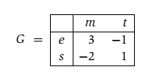
Presidential election
There are two candidates for office, and the moves they make correspond to campaign issues on which they can focus (the initials stand for economy, society, morality, and tax cut).
The payoff entries of G are millions of votes lost by Column.
(列损失的票数)

Slide 37
Pure strategy
Suppose Row announces that she will play the mixed strategy x = (1/2,1/2). What should Column do?
Move m will incur an expected loss of 1/2, while t will incur an expected loss of 0. The best response of Column is therefore the pure strategy y = (0,1).
More generally, once Row’s strategy x = (x₁, x₂) is fixed, there is always a pure strategy that is optimal for Column:
either move m, with payoﬀ 3x₁ − 2x₂, or t, with payoﬀ −x₁ + x₂, whichever is smaller.

Slide 38
Pure strategy (cont.)
Therefore, if Row is forced to announce x before Column plays, she knows that his best response will achieve an expected payoff of min{3x₁−2x₂, −x₁+x₂}.
She should choose x defensively to maximize her payoff最大化自己的 against this best response:
Pick (x₁,x₂) that maximizes min{3x₁ − 2x₂, −x₁ + x₂}.

Slide 39
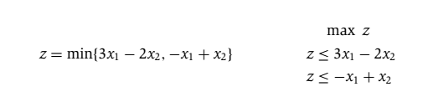
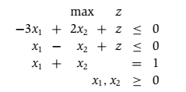
LP formulation
Row needs to choose x₁ and x₂ to maximize this z.

Slide 40
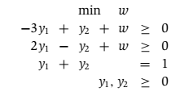
LP formulation (cont’d)
Symmetrically, if Column has to announce his strategy first, his best bet is to choose the mixed strategy y that minimizes his loss under Row’s best response:
Pick (y₁, y₂) that minimizes max{3y₁ − y₂, −2y₁ + y₂}.
In LP form:
These two LPs are dual to each other (see Figure 7.11)! Hence, they have the same optimum, call it V.

Slide 41
Value of the game
By solving an LP, Row (the maximizer) can determine a strategy for herself that guarantees an expected outcome of at least V no matter what Column does.
And by solving the dual LP, Column (the minimizer) can guarantee an expected outcome of at most V, no matter what Row does.
It follows that this is the uniquely defined optimal play: a priori it wasn’t even certain that such a play existed. V is known as the value of the game
In our example, it is 1/7 and is realized when Row plays her optimum mixed strategy (3/7,4/7) and Column plays his optimum mixed strategy (2/7,5/7).

Slide 42

Min-max theorem of games
最优解是一样的。
This is surprising, because the left-hand side, in which Row has to announce her strategy first, should presumably be better for Column than the right-hand side, in which he has to go first.
Duality equalizes the two.

