Slide 1
- Quizter - Test yOur knOwledge
Czibik Lóránt, Kerényi Tamás, Nagy Gergő

Slide 4
We made a Quiz website
as Our prOject.

Slide 5
COntent
We broke it down to two parts.
I.
Structure of the site
We’ll analyze the different
elements of the pages, their task and operation
II.
Development of the site
In this section we tell you about the process of development, the languages ​​and technologies used

Slide 6
I. Structure Of the site

Slide 7
We’ll begin the presentatiOn Of the pages with
the navigatiOn bar and fOOter because
they can be fOund On every page.
I.

Slide 8
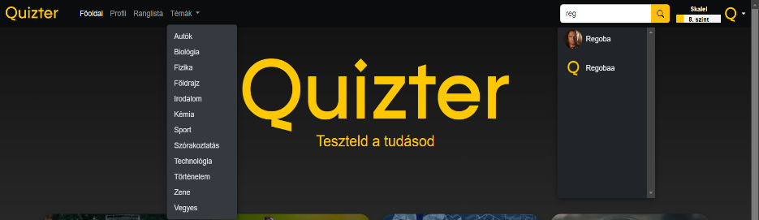
NavigatiOn bar
Top of every page
Contains:
Quizter logo
Buttons leading to pages
Topic dropdown menu
Search bar
Profile component
I.

Slide 9
FOOter
1
2
3
4
Bottom of every page
Contains:
Quizter logo
Buttons leading to pages
Copyright logo
Github logo
Our email
I.

Slide 10
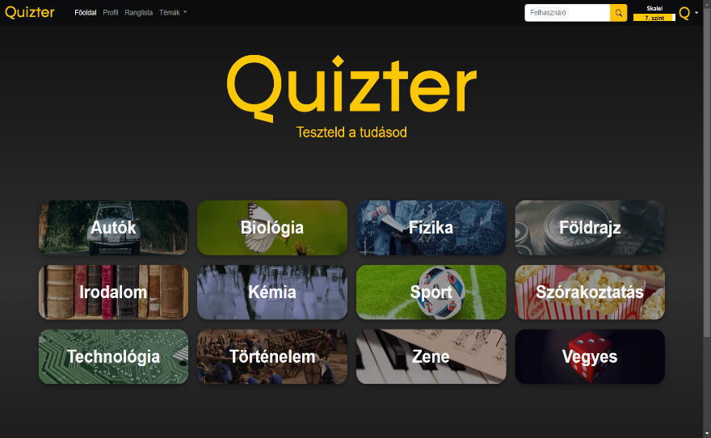
Main Page
1
2
3
4
Welcomes the user
Straightforward design
Every topic can be found
I.

Slide 11
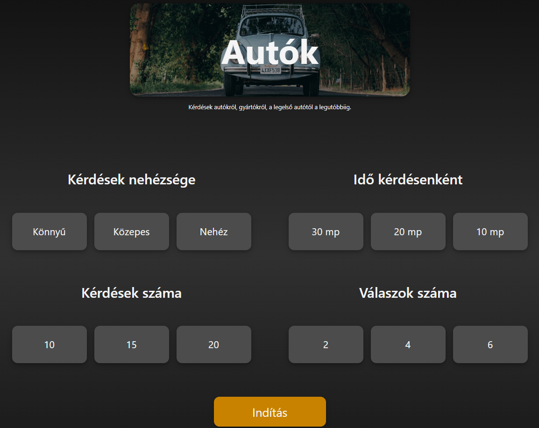
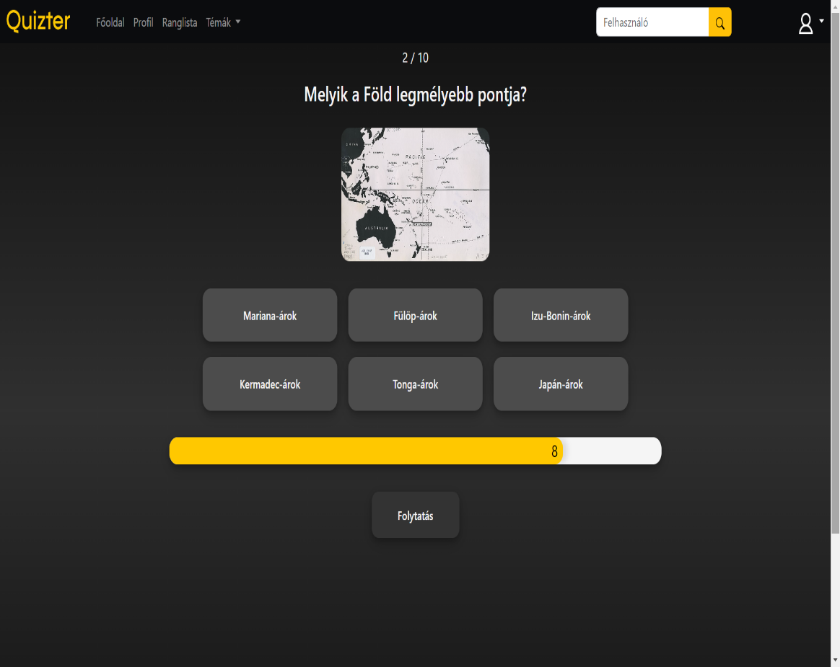
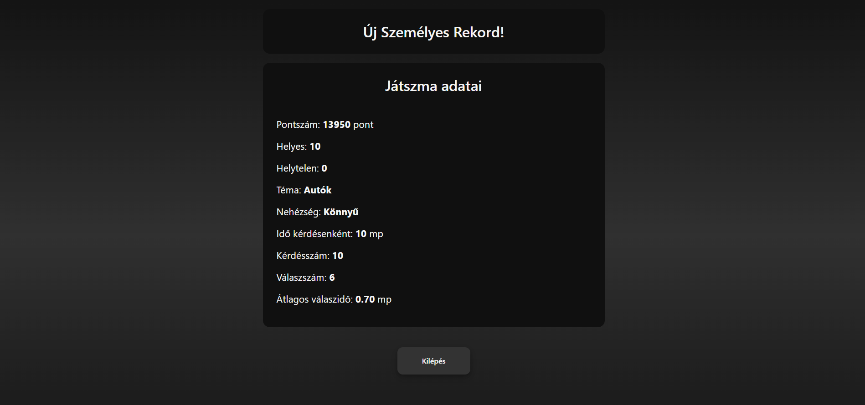
Gameplay
1
2
3
4
Choosing the topic
Setting the quiz
Answering the questions
Results
I.

Slide 12
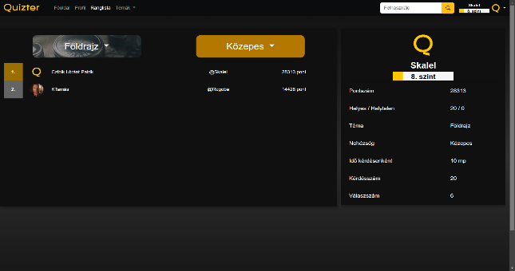
LeaderbOard
1
2
3
4
Based on players’ scores
Points are connected to
topics, difficulty, etc.
Data displayed can be filtered
Details of records
I.

Slide 13
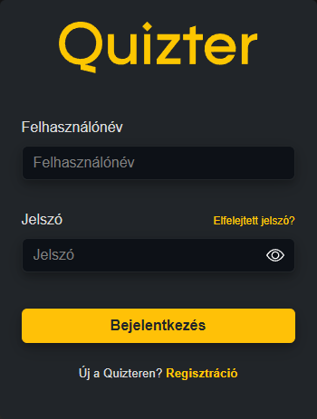
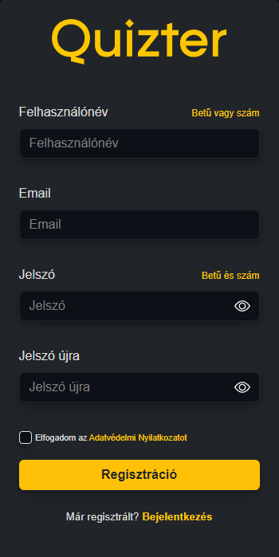
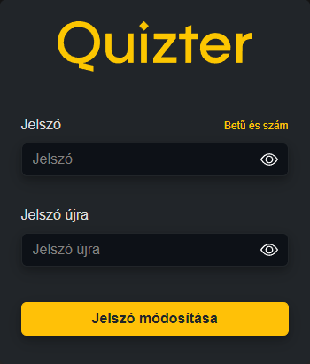
LOgin / Register
1
2
3
4
Regex
Unique email and username
Confirmation email
Reset password
I.

Slide 14
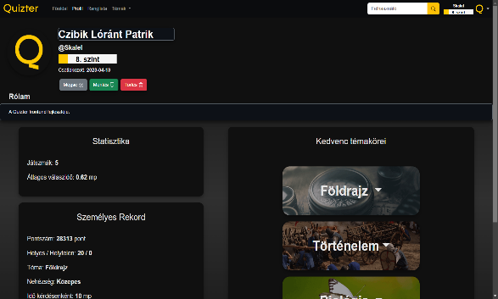
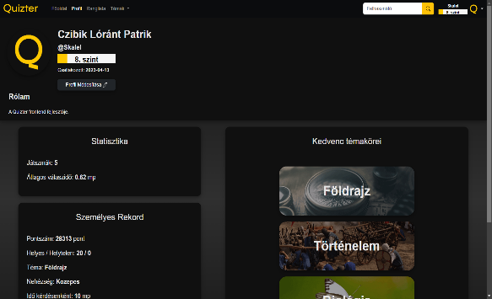
PrOfile
1
2
3
4
Base infos
Level
Statistics/record
Favorite topics
Edit profile
I.

Slide 15
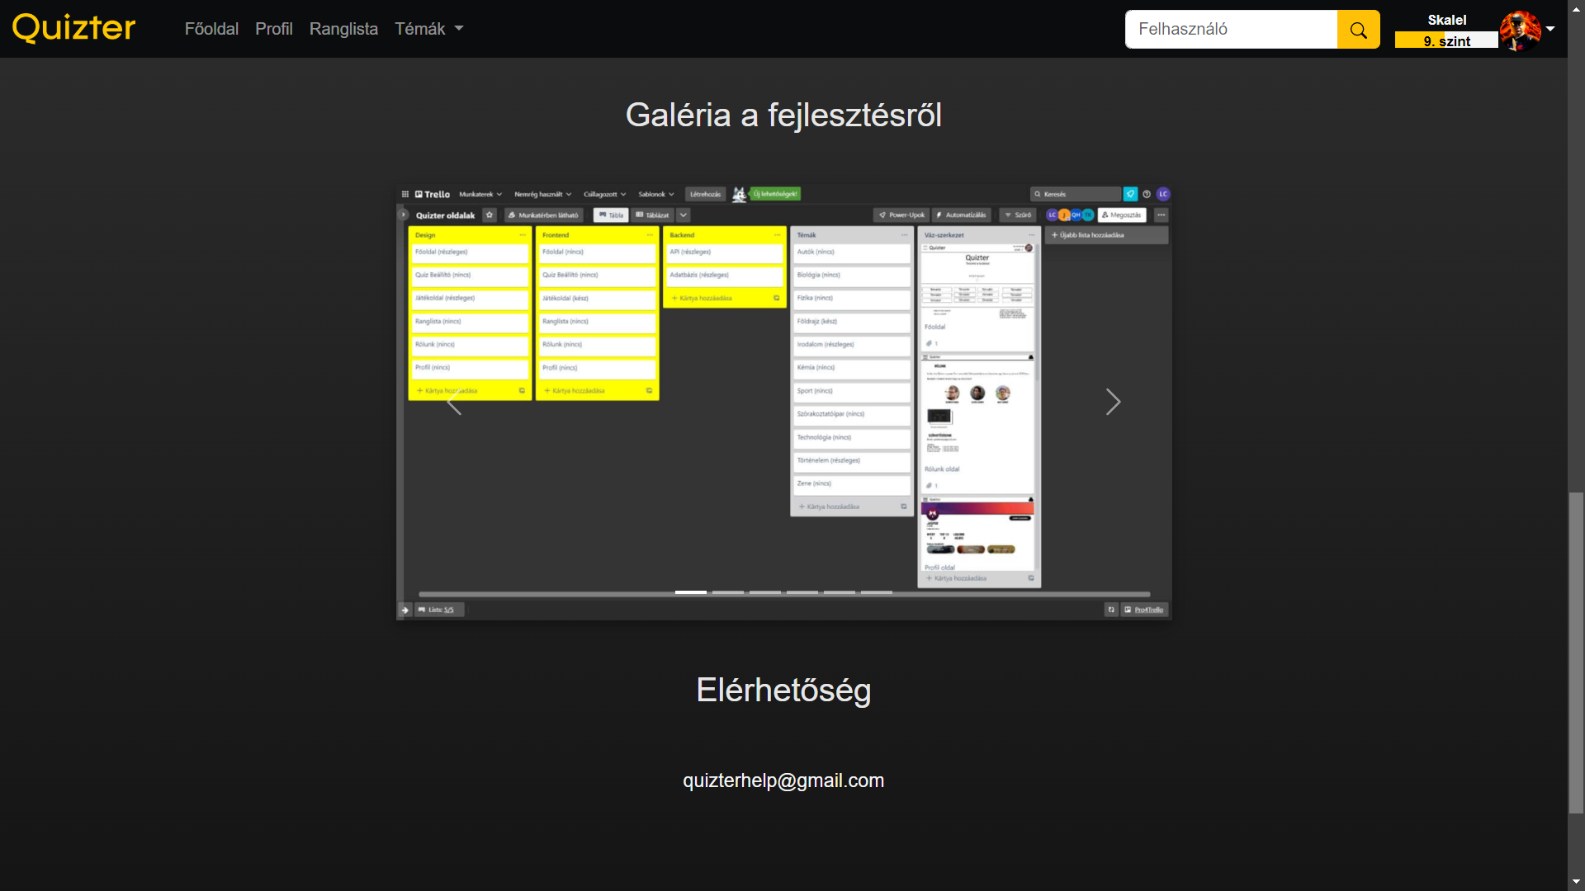
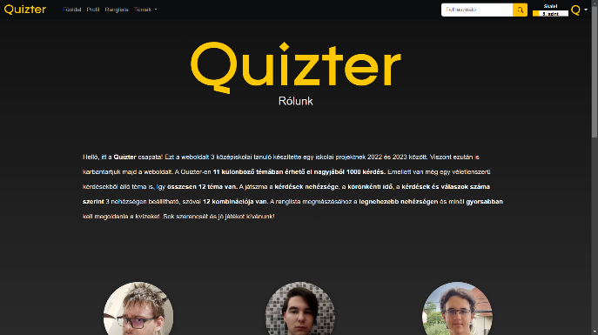
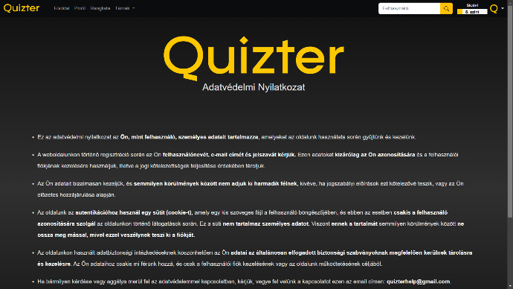
AbOut us
1
2
3
4
Message
We, the developers
Gallery
Privacy statement
I.

Slide 16
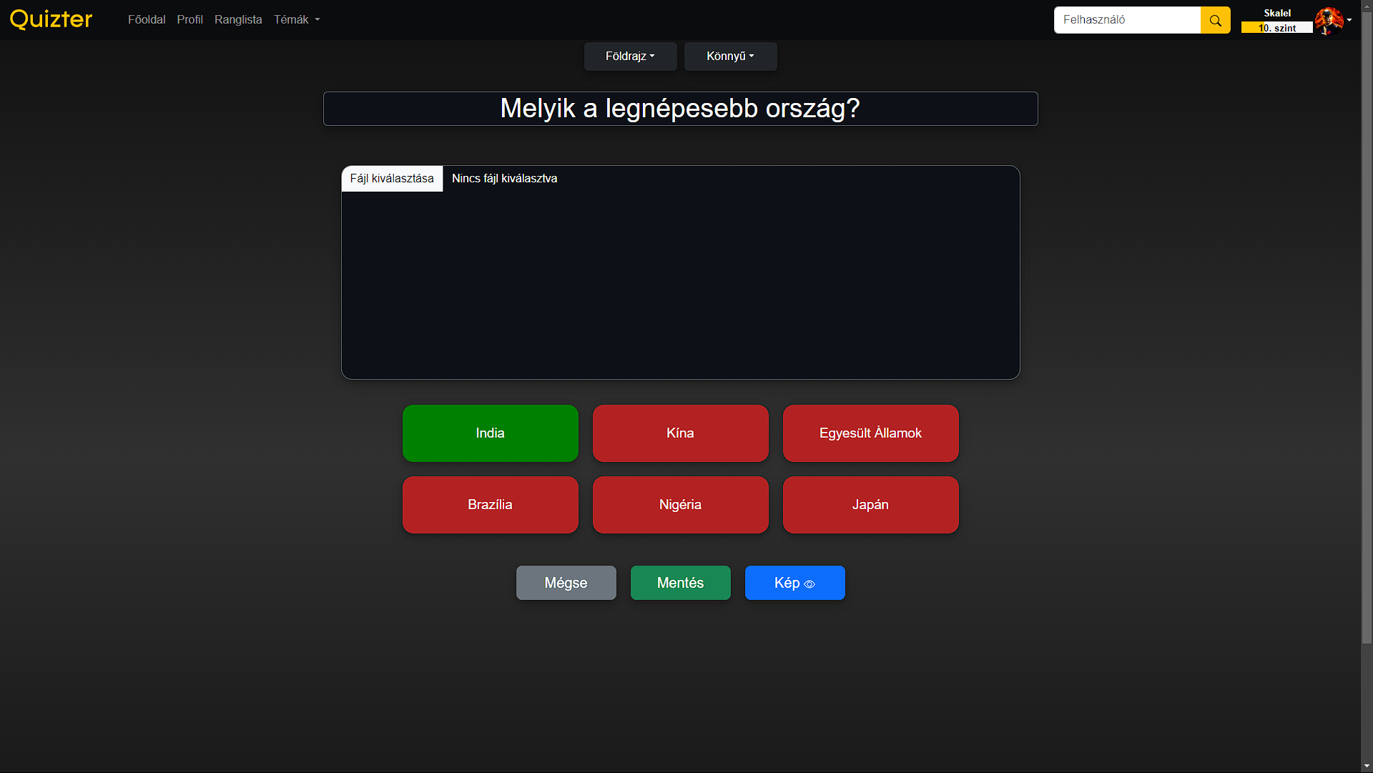
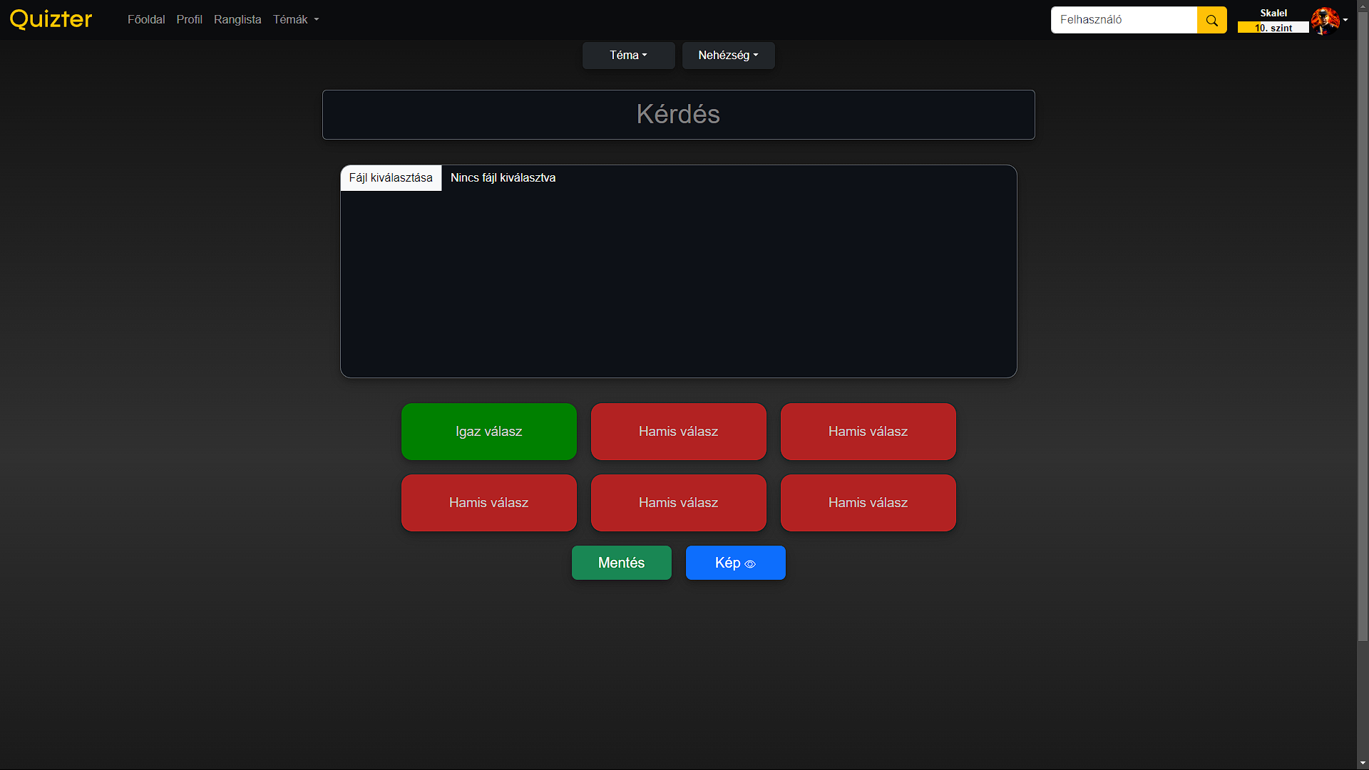
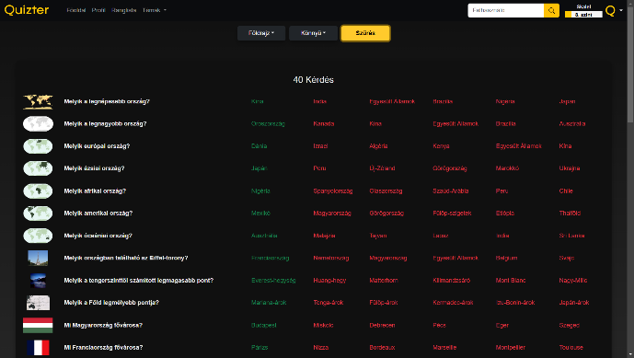
Admin Pages
Questions’ list
Add question
Edit question
I.

Slide 17
II. DevelOpment Of the site
I.
II.

Slide 18

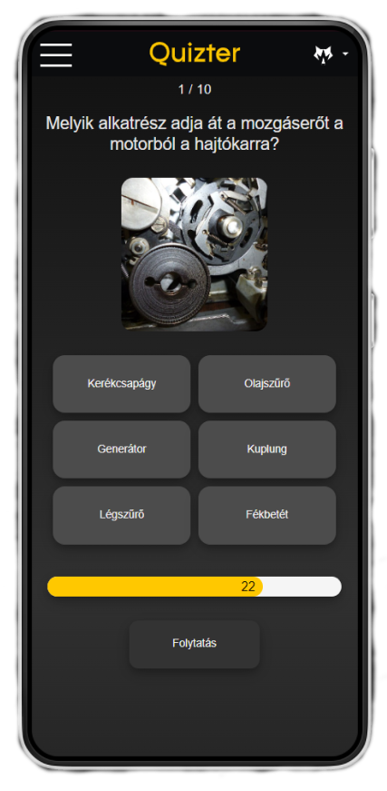


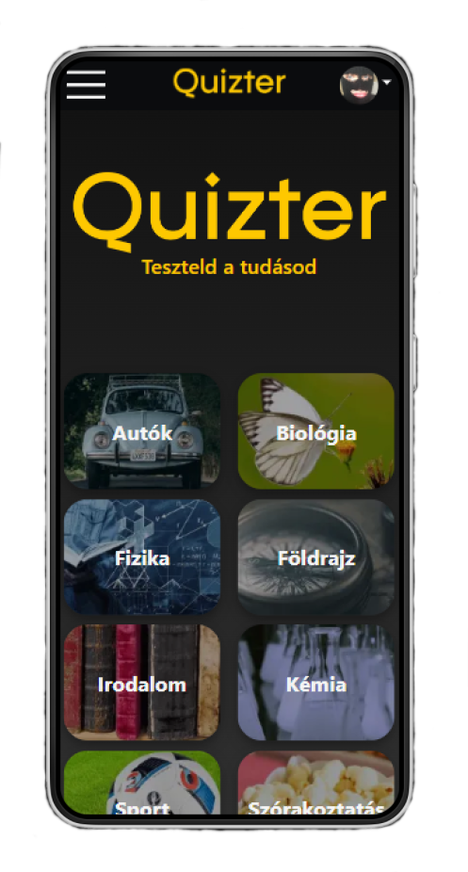


FrOntend
Vue
Single-File Component(SFC)
HTML
CSS
Javascript
API styles
Pinia
Responsive
II.

Slide 19



Backend
1
2
3
4
Node.js
Express.js
MongoDB
Docker
II.

Slide 20
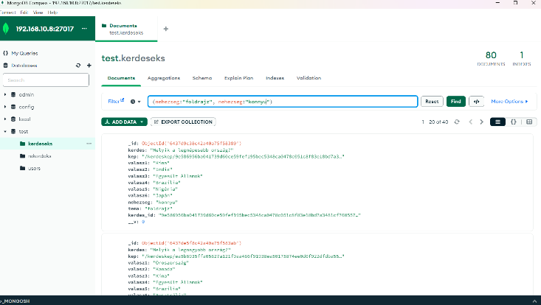
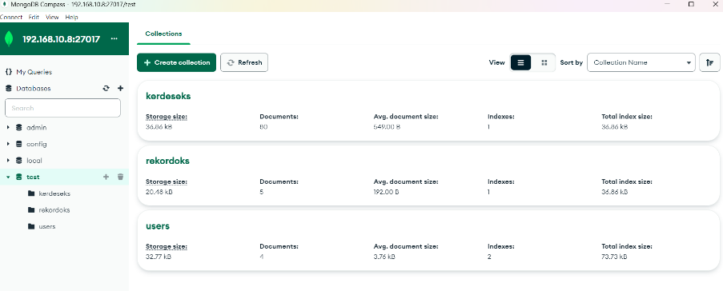
MOngODB
1
2
3
4
Record saves
Collections
Proactive queries
II.

Slide 21
DOcker
1
2
3
4
Containers
Stack
II.

Slide 22
II.
2.
II.

Slide 24
Thank yOu fOr yOur attentiOn!

