Slide 1
IL2233 Final Project Time-Series Prediction and Anomaly Detection
Conglei Xiang
2023.6.8

Slide 2
Task 1. Time-series prediction with neural networks

Slide 3
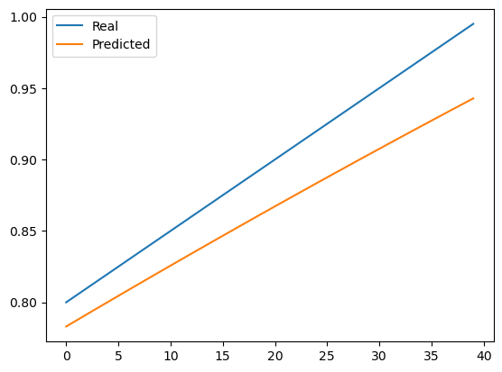
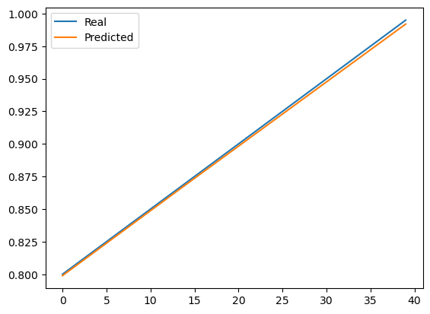
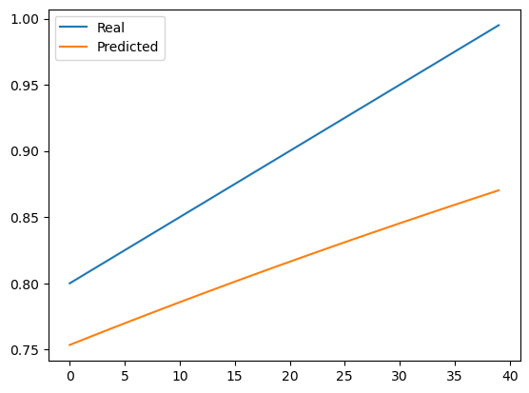
Task 1.1 Prediction with synthetic series using MLP, RNN, and LSTM
Epochs=100, batch_size=32, loss='mean_squared_error', optimizer='adam'
sigmoid
Relu
tanh

Slide 4
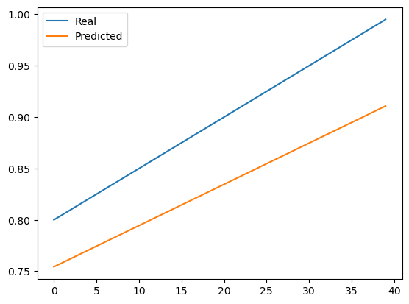
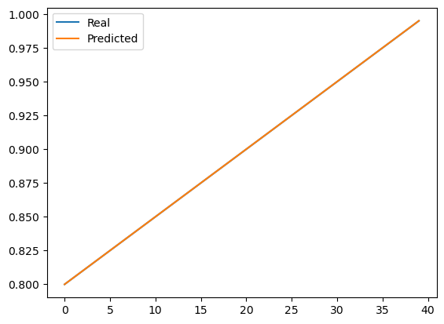
Task 1.1 Prediction with synthetic series using MLP, RNN, and LSTM
All the other parameters are same except for epochs
Epochs=50
Epochs=100
Epochs=300

Slide 5
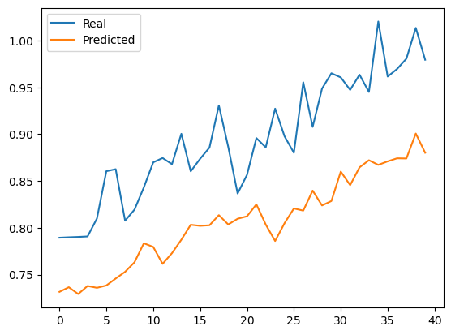
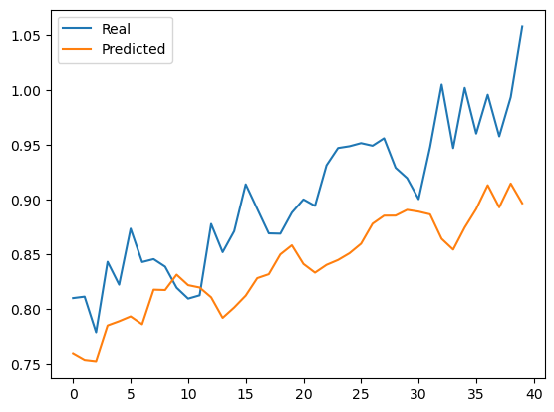
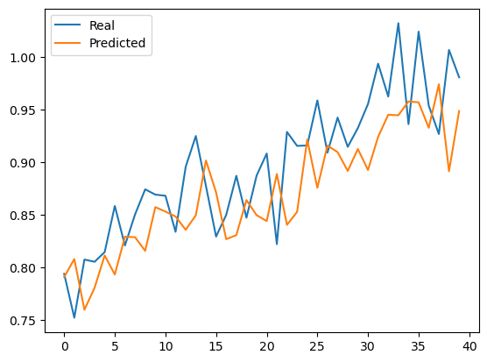
Task 1.1 Prediction with synthetic series using MLP, RNN, and LSTM
Epochs=50
Epochs=1000 (overfit)
Epochs=100
When variance^2=0.001, and all the other parameters are same, when using different epochs, the MSE are all close to 0.001

Slide 6
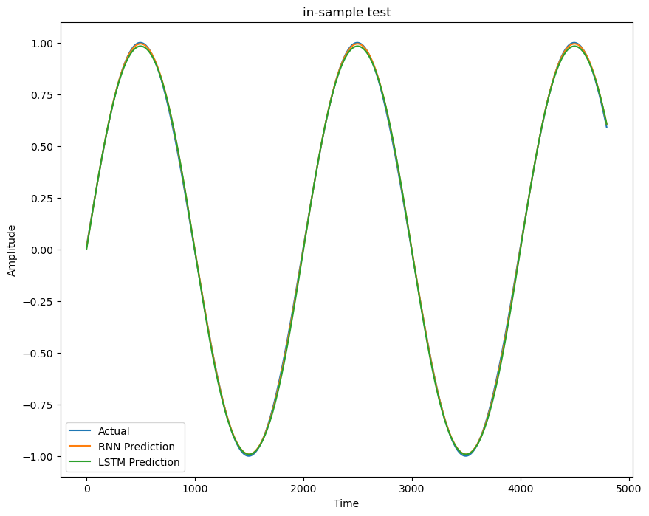
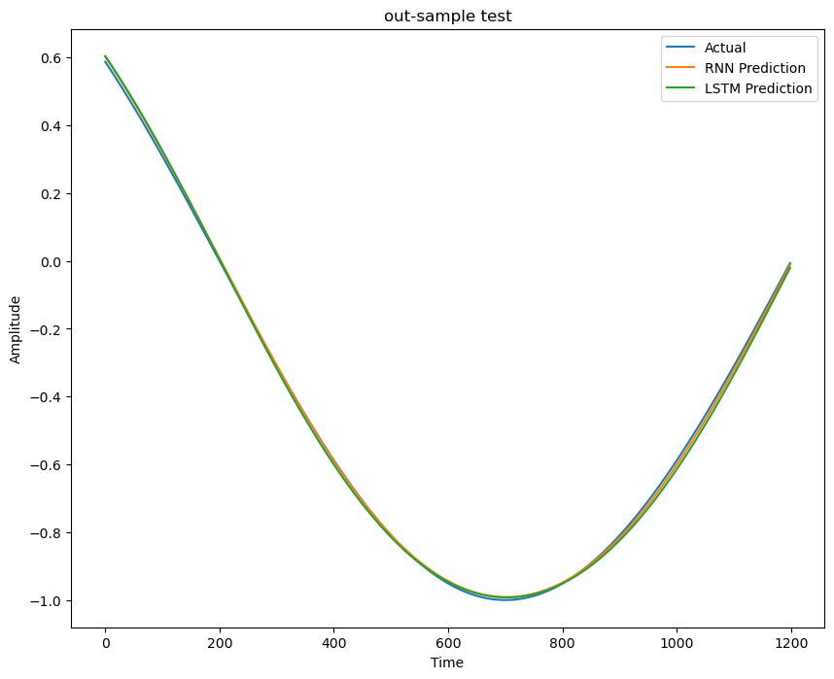
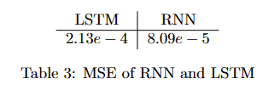
Task 1.1 Prediction with synthetic series using MLP, RNN, and LSTM
The hyper parameters used in RNN and LSTM are all number of units=64, optimizer=’adam’, loss=’mse’. The epochs is chosen to be 1 because it can achieve good accuracy in this situation.
RNN performs a little better than LSTM

Slide 7
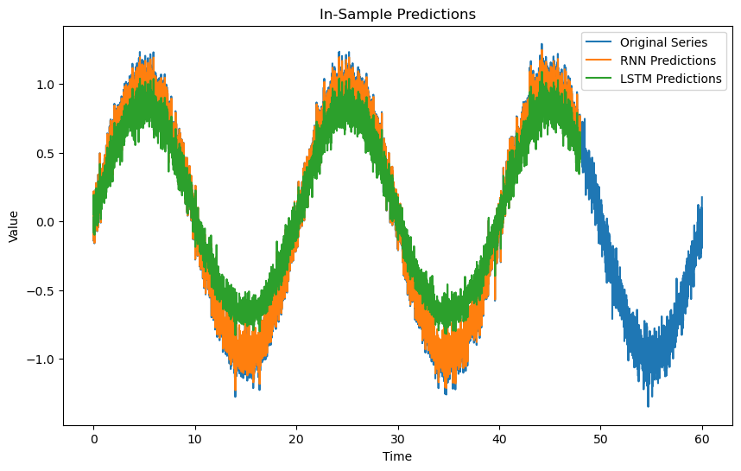
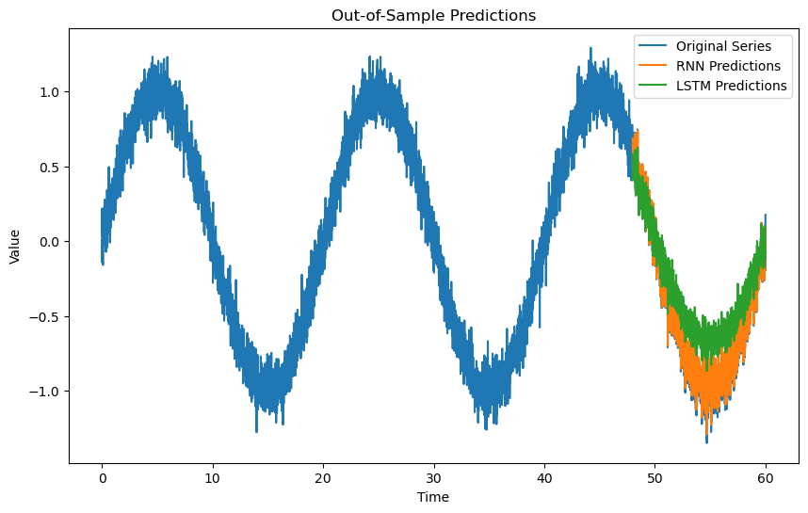
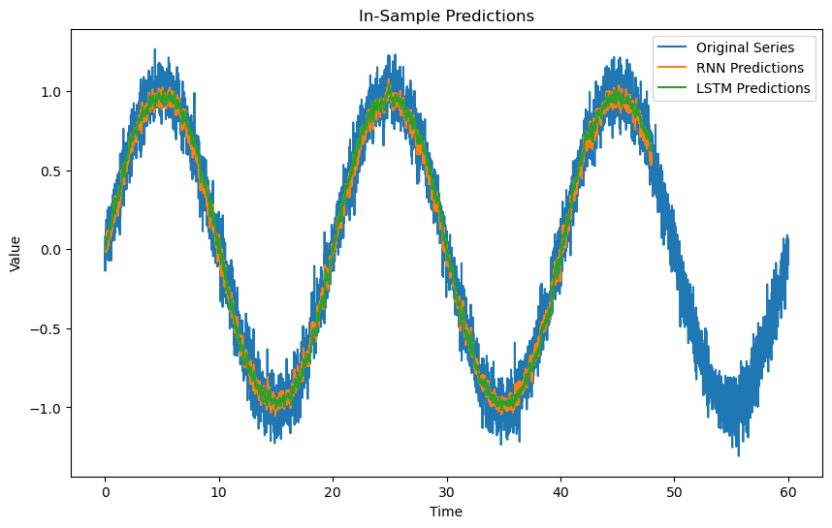
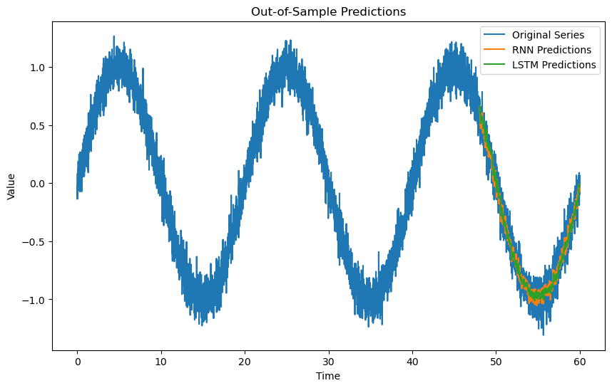
Task 1.1 Prediction with synthetic series using MLP, RNN, and LSTM
The input size is set to be 10 because the prediction plot illustrates that the performance of accuracy.
They all reach MSE < 0.5.

Slide 8
Task 1.1 Prediction with synthetic series using MLP, RNN, and LSTM
Can the neural network fit well to the specific series well? What are the accuracy merits?
In some cases they can fit well, for example, in question 1,3. But the MSE in question 2,4 shows that neural networks cannot fit well to the white noise signal because the MSE are always close to the variance * variance no matter what parameters are changed to make it more accurate. White noise is inherently unpredictable and lacks any specific information that a neural network can effectively capture. As a result, trying to fit white noise with a neural network is unlikely to yield meaningful results.

Slide 9
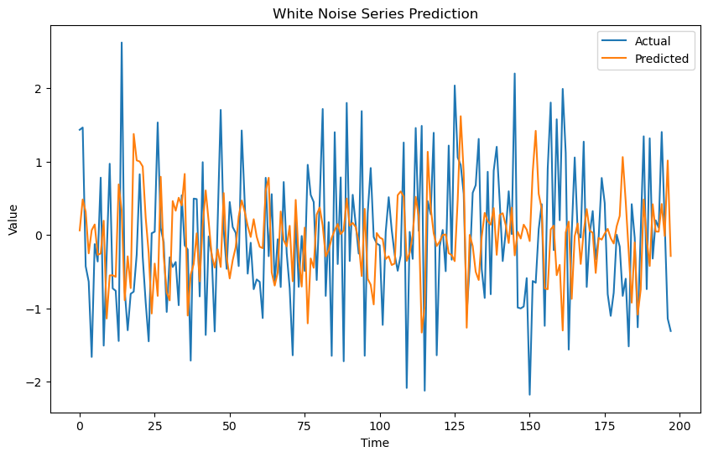
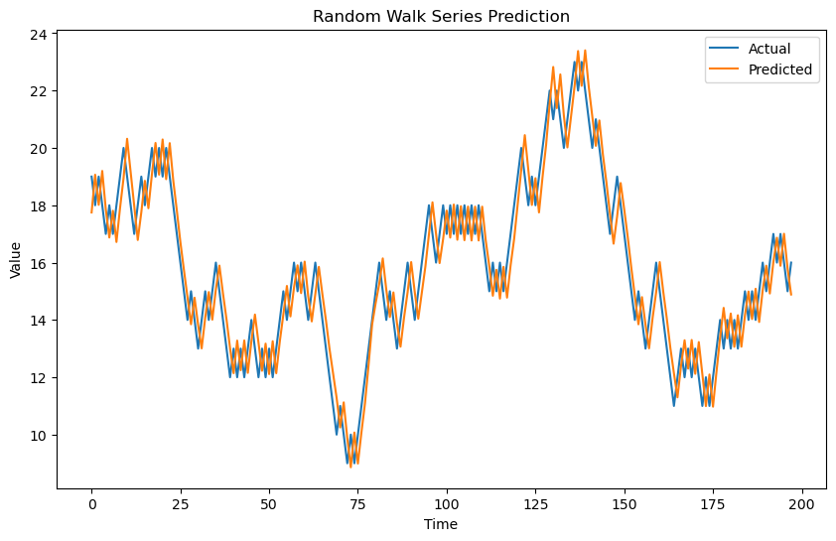
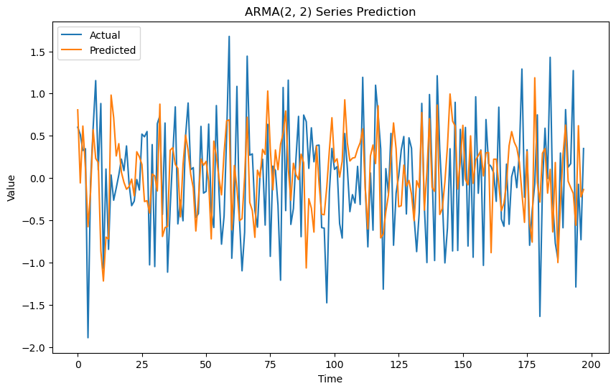
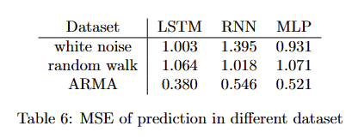
1.2 Predict white noise, random walk, an ARMA process using neural networks
Neural network can’t fit well to the white noise series, but it can fit random walk series well.
The main reason neural networks may not be the best choice for fitting ARMA processes is that neural networks are more commonly used for capturing complex patterns and nonlinear relationships in data, whereas ARMA models are specifically designed to capture linear
dependencies and autocorrelations in time series data.

Slide 10
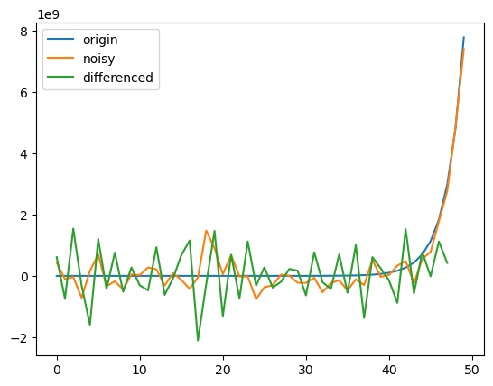
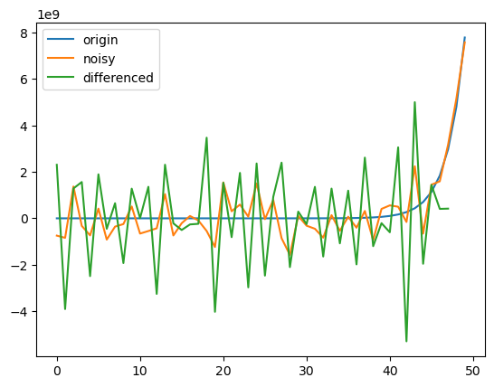
1.3 Comparison with ARIMA-based modeling and prediction
Noise ratio = 0.05
Noise ratio = 0.1

Slide 11
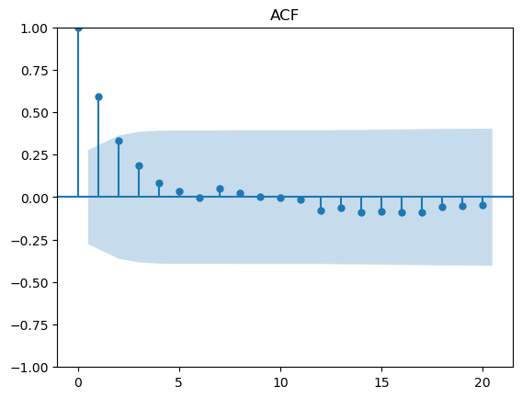
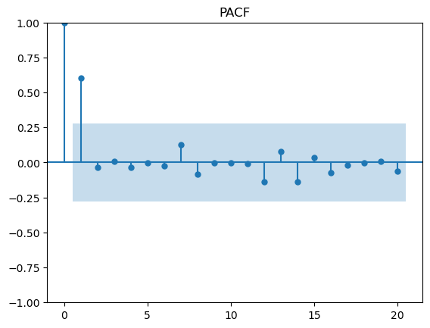
1.3 Comparison with ARIMA-based modeling and prediction
The (p,d,q) of ARIMA is set to be (1,2,1) because of the ACF, PACF plots and differencing results.

Slide 12
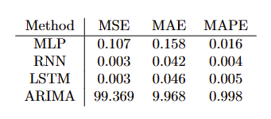
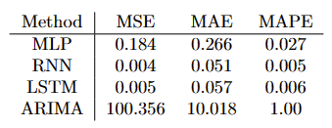
1.3 Comparison with ARIMA-based modeling and prediction
Noise ratio = 5%
Noise ratio = 10%
I think neural network is better. Because it has the ability to capture complex patterns, and it can handle various types of data and can be trained on a wide range of problems. However, neural networks typically require a large amount of training data to effectively learn complex patterns. If the Fibonacci series dataset is small, the neural network may struggle to generalize well and may overfit or underfit the data. ARIMA models provide statistical properties, such as confidence intervals and significance tests, which can be useful for interpreting the results and understanding the uncertainty in predictions. As for ARIMA's cons, they have limited memory of past observations. NN is more tolerant to noise.

Slide 13
Task 2. Decomposition-based anomaly detection

Slide 14
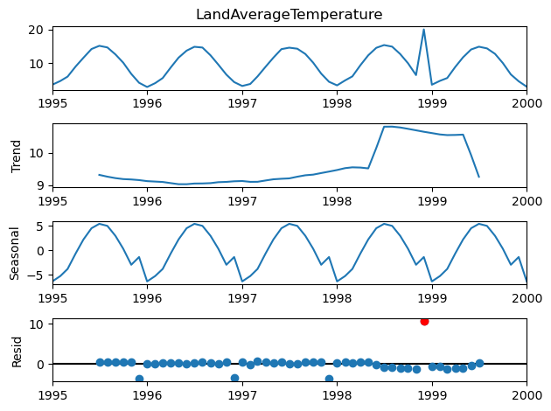
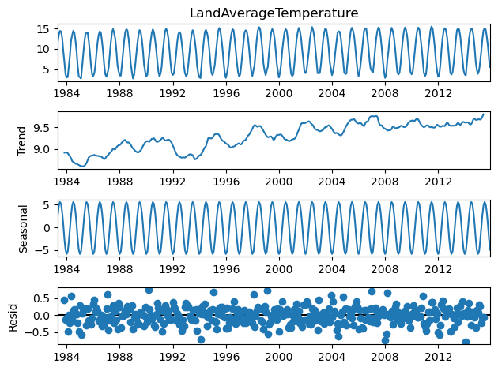
2. Decomposition-based anomaly detection
The anomaly is labeled as the red point which is inserted by the code "series.loc["1998-12-1"] = 20". To highlight better the anomaly, I chose only a part of the data, from 1995-01-01 to 2000-01-01 (61 data points).

Slide 15
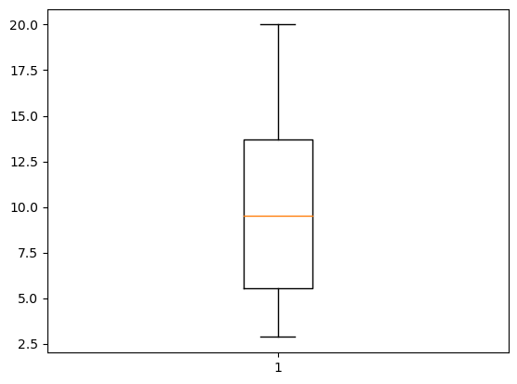
2. Decomposition-based anomaly detection
From the box-plot, it can be observed that there is no outliers identified with box-plot function because the output of lower_threshold, upper_threshold are -6.7115 and 25.9165. The inserted anomaly which is 20 is in the normal range.

Slide 16
2. Decomposition-based anomaly detection
Can the decomposition clearly separate the trend, season (constant period), and remainder components?
It can be observed that the method can clearly separate season, but the trend is not that clearly. Probably because noisy or irregularly sampled data may introduce additional challenges in accurately identifying and separating the components.
When decomposing the series, is there a general rule to determine which part belongs to a trend, a season, or a remainder? Or is it embedded in and thus dependent on each individual algorithm?
No. Different algorithms may have different rules or assumptions for identifying and separating these components. Generally, the trend component represents the long-term direction or overall pattern of the time series; the seasonality component captures regular, repeating patterns that occur within a fixed period; the residual component contains the random or unexplained fluctuations that cannot be attributed to the trend or seasonality.
It is obvious that there is a growing tendency.

Slide 17
Task 3. Prediction-based anomaly detection

Slide 18
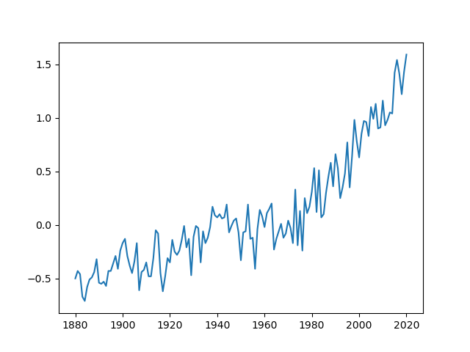
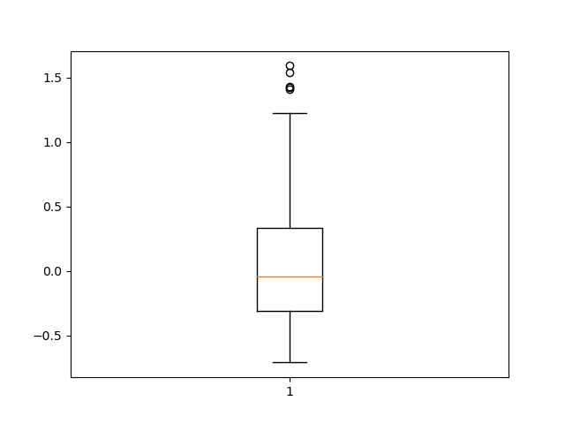
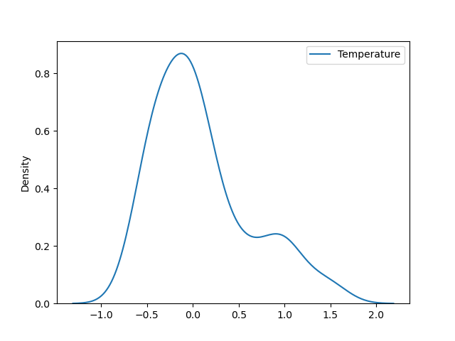
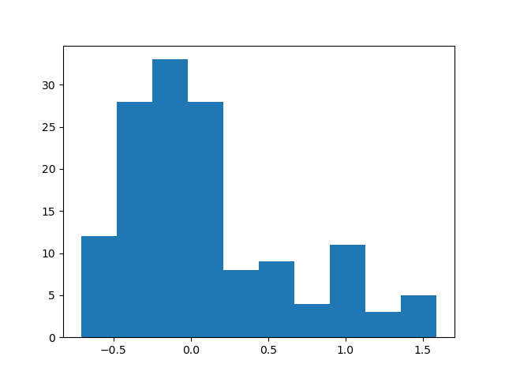
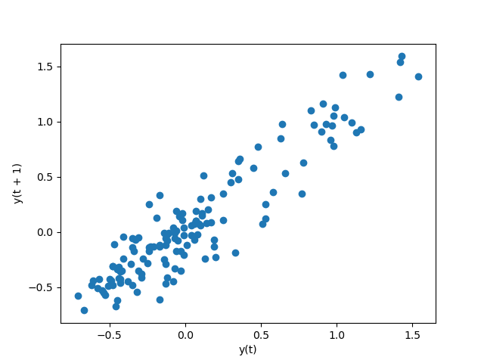
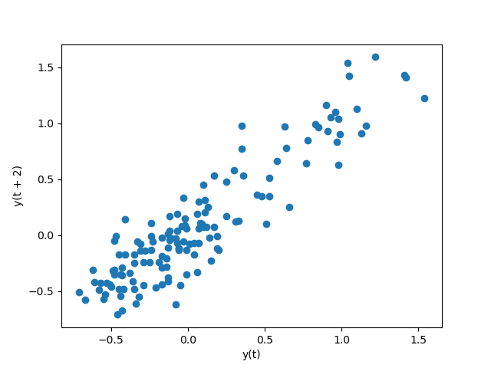
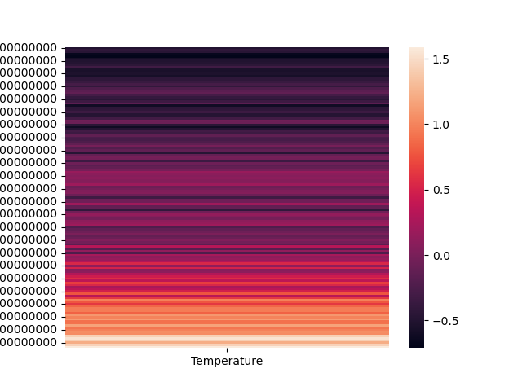
Task 3.1 Anomaly detection for uni-variate series with ARIMA
Lag-1
Lag-2

Slide 19
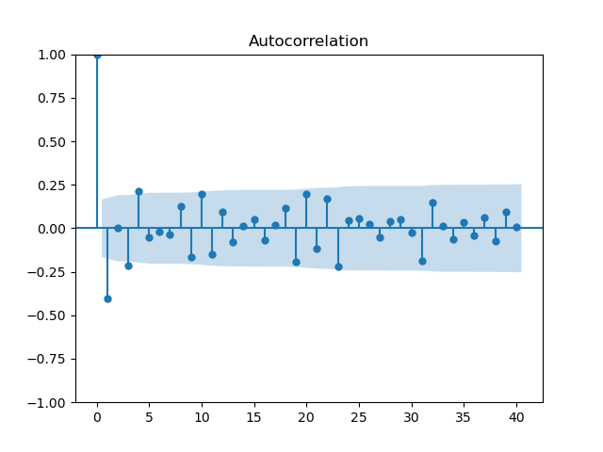
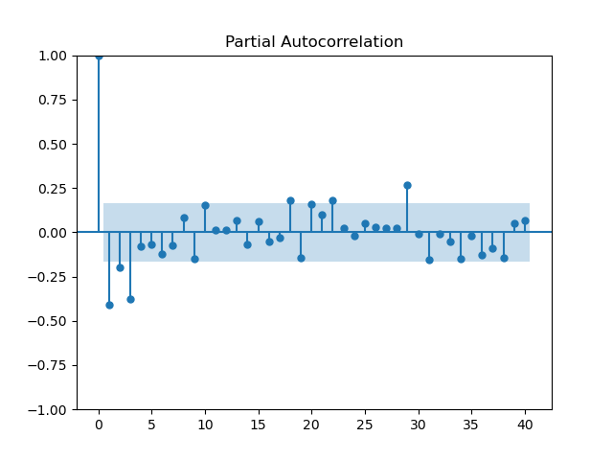
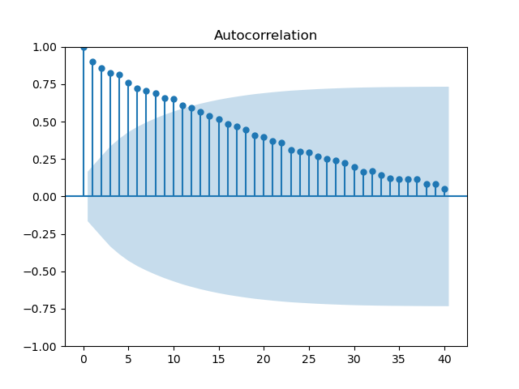
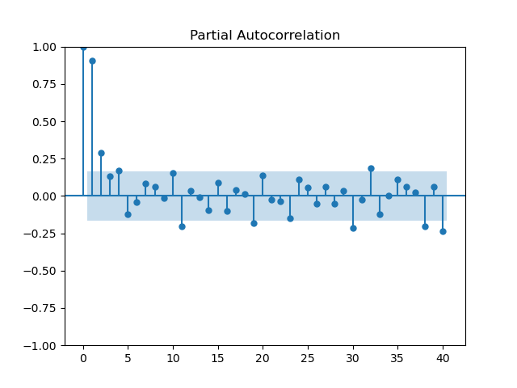
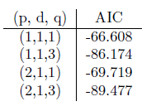
Task 3.1 Anomaly detection for uni-variate series with ARIMA
before differencing :
Mean : Temperature 0.090638
Standard Deviation : Temperature 0.535909
after differencing :
Mean : Temperature 0.014929
Standard Deviation : Temperature 0.199584
Base on the ACF of the differenced series, I choose p = 1 or 2. Base on the PACF of the differenced series, I choose q = 1 or 3. I choose d = 1 due to the first order differencing. I try different combinations (p, d, q) values and select an optimal model based on AIC.
With differencing
Without differencing

Slide 20
Task 3.1 Anomaly detection for uni-variate series with ARIMA
Since this task uses a different approach (prediction-based anomaly detection) from Task 2 which uses decomposition for anomaly detection, describe what the differences of the two methods are?
ARIMA models focus on capturing temporal dependencies and forecasting, while decomposition methods aim to separate the time series into interpretable components. Both approaches can be used for anomaly detection.
Anomaly detection with ARIMA models involves forecasting the future values based on the historical data and comparing the predicted values with the actual values. Decomposition methods can identify anomalies by examining the remainder component.
Do they achieve the same results? Why or Why not?
Not necessarily the same because of their different modeling approaches, assumptions, and treatment of components.
Given the anomaly ratio of 2%, what is the value of z-score?
The value of z-score threshold should be 2.48. Greater than that are the anomaly points, while less are the normal points.

Slide 21
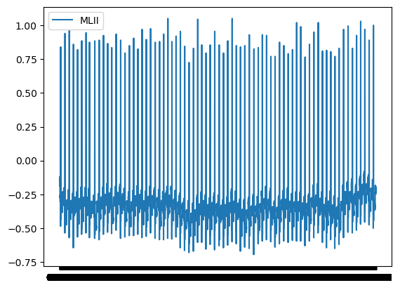
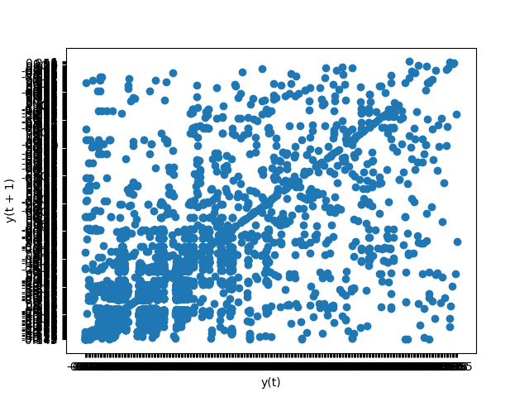
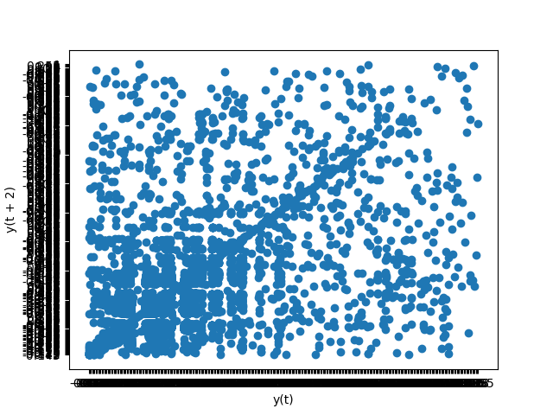
Task 3.2 Anomaly detection in ECG signals with LSTM
MLII line plot
Lag-1
Lag-2

Slide 22

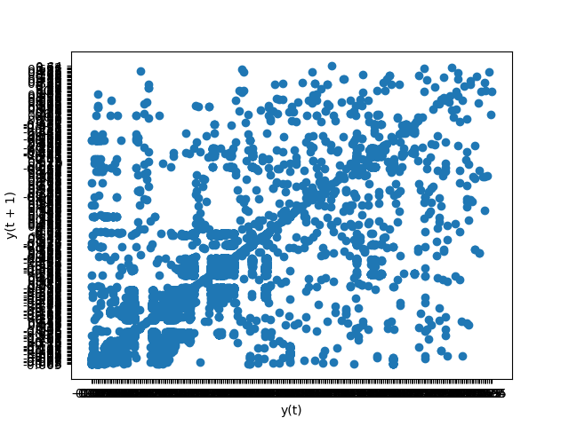
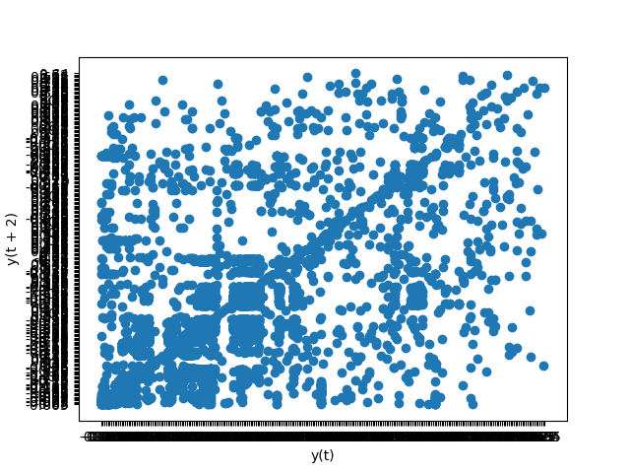
Task 3.2 Anomaly detection in ECG signals with LSTM
V5 line plot
Lag-1
Lag-2

Slide 23
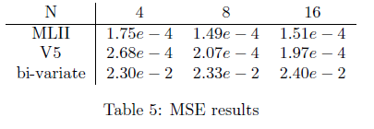
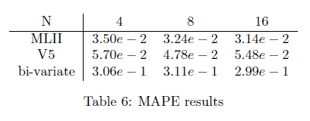
Task 3.2 Anomaly detection in ECG signals with LSTM
Validate the quality of the model. Calculate the MSE, MAPE etc. of the prediction model for the input size being 4, 8 and 16.
The data in the table shows that the accuracy increases with the increasement of vector size. Uni-variate series reach a better accuracy.
The performance doesn’t improve a lot when input size becomes larger, but the time used in training becomes much longer.
I use epochs=100. The training optimization algorithm is Adam which has a default learning rate of 0.001 and I didn't modify that.

Slide 24
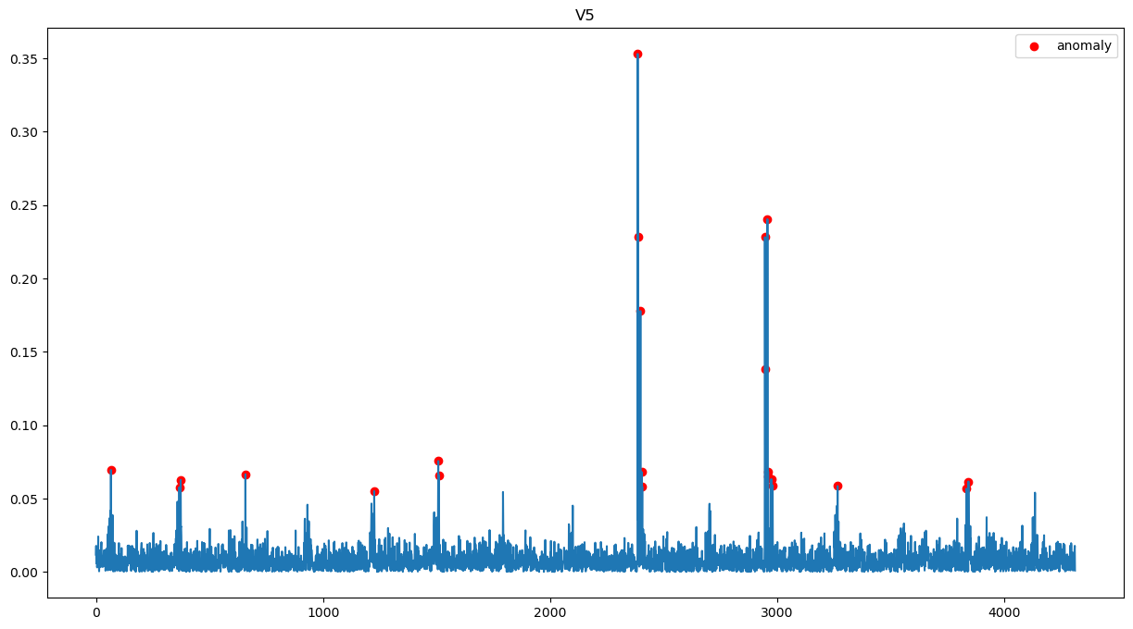
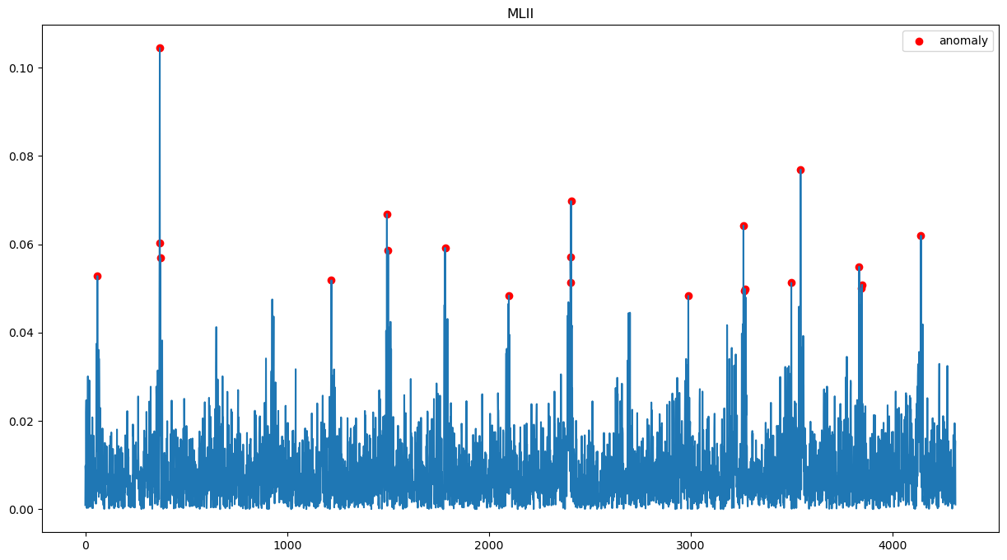
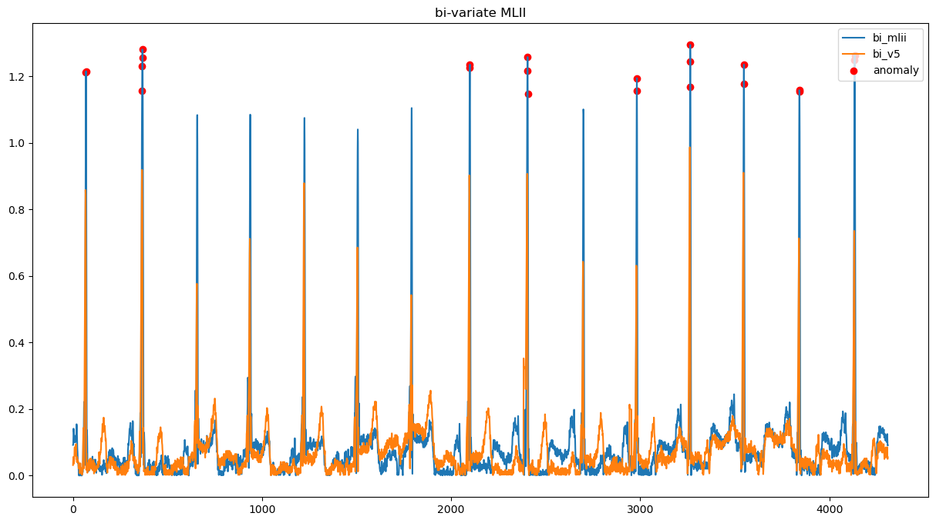
Task 3.2 Anomaly detection in ECG signals with LSTM
V5
MLII
The results of anomalies are not same when using uni-variate and bi-variate.
Bi-variate

Slide 25
Task 4. Clustering-based Anomaly detection

Slide 26


Task 4. Anomaly detection in a bivariate series
Line Plot by K-means
Scatter Plot by K-means
I set the number of clusters as 2 because I think from the scatter plot, there is no obvious clusters and the points all distributes in an average way, but may be the two variable may influence the clustering.

Slide 27


Task 4. Anomaly detection in a bivariate series

Slide 28

Task 4. Anomaly detection in a bivariate series
Line Plot by SOM
Scatter Plot by SOM
The anomaly ratio is 2%, so I got 4 anomaly in the dataset of 200. The results of anomaly locations are the same using K-means and SOM:[ 7 28 69 111]

Slide 29
Task 4. Anomaly detection in a bivariate series
Which distance metric do you use? Are there other distance metrics which might be useful for this task?
I used Euclidean distance metric, which measures the straight-line distance between two points in Euclidean space. Manhattan distance (also known as city block distance or L1 norm), Cosine distance, Mahalanobis distance, Minkowski distance
Do the two different clustering methods (K-means and SOM) achieve the same results? Discuss why or why not.
The results show that these 2 methods achieve the different clustering results, but seems really similar because they randomly initialize the centroid and even different time to execute the same cluster with the same dataset will lead to a different result. but the anomalies found in the 2 methods are the same.

Slide 30
Task 5. Summary

Slide 31
Two approaches to perform time-series modeling and prediction
NN: a computational model inspired by the structure and function of the human brain. It consists of interconnected nodes called neurons that work together to process and learn from input data.
Strengths of NN are its ability of Non-linear modeling, its flexibility to deal with many types of input, and its scalability to add more layers in the process. Weaknesses are its high computational complexity, and hard to interpret and hard to determine the hyper parameters.
ARIMA: a statistical modeling technique used for time series analysis and forecasting.
As for ARIMA, it's good because it is interpretable and well-suited for tasks involving trend, seasonality, and autocorrelation. But it has assumptions and limitations regarding linearity and memory.

Slide 32
Three method of anomaly detection
Decomposition-based: Anomalies are then detected by analyzing the residuals or the difference between the observed values and the estimated values based on the decomposed components.
Pros: Effective in detecting anomalies that exhibit patterns or deviations from expected trends and seasonal variations. Cons: Limited effectiveness in detecting anomalies that do not exhibit clear patterns or trends. Maybe sensitive to noise or outliers in the data.
Prediction-based: It predicts future values of the time series based on historical data and then compare the predicted values with the actual observations. When the difference is significant, the anomalies are detected.
Pros: Can detect anomalies in real-time or near real-time by continuously updating the predictions based on new observations. Cons: Performance heavily depends on the quality of the prediction model and the availability of sufficient training data.

Slide 33
Three method of anomaly detection
Clustering-based: Clustering-based anomaly detection approaches aim to group similar patterns or behaviors in the time series data and identify data points or clusters that deviate significantly from the majority.
Pros: Can handle complex data structures and capture anomalies that are not well-defined or follow non-linear patterns.It is suitable for unsupervised anomaly detection. Cons: May struggle with detecting anomalies in high-dimensional or sparse data.

Slide 34
Thank You!

