Slide 1
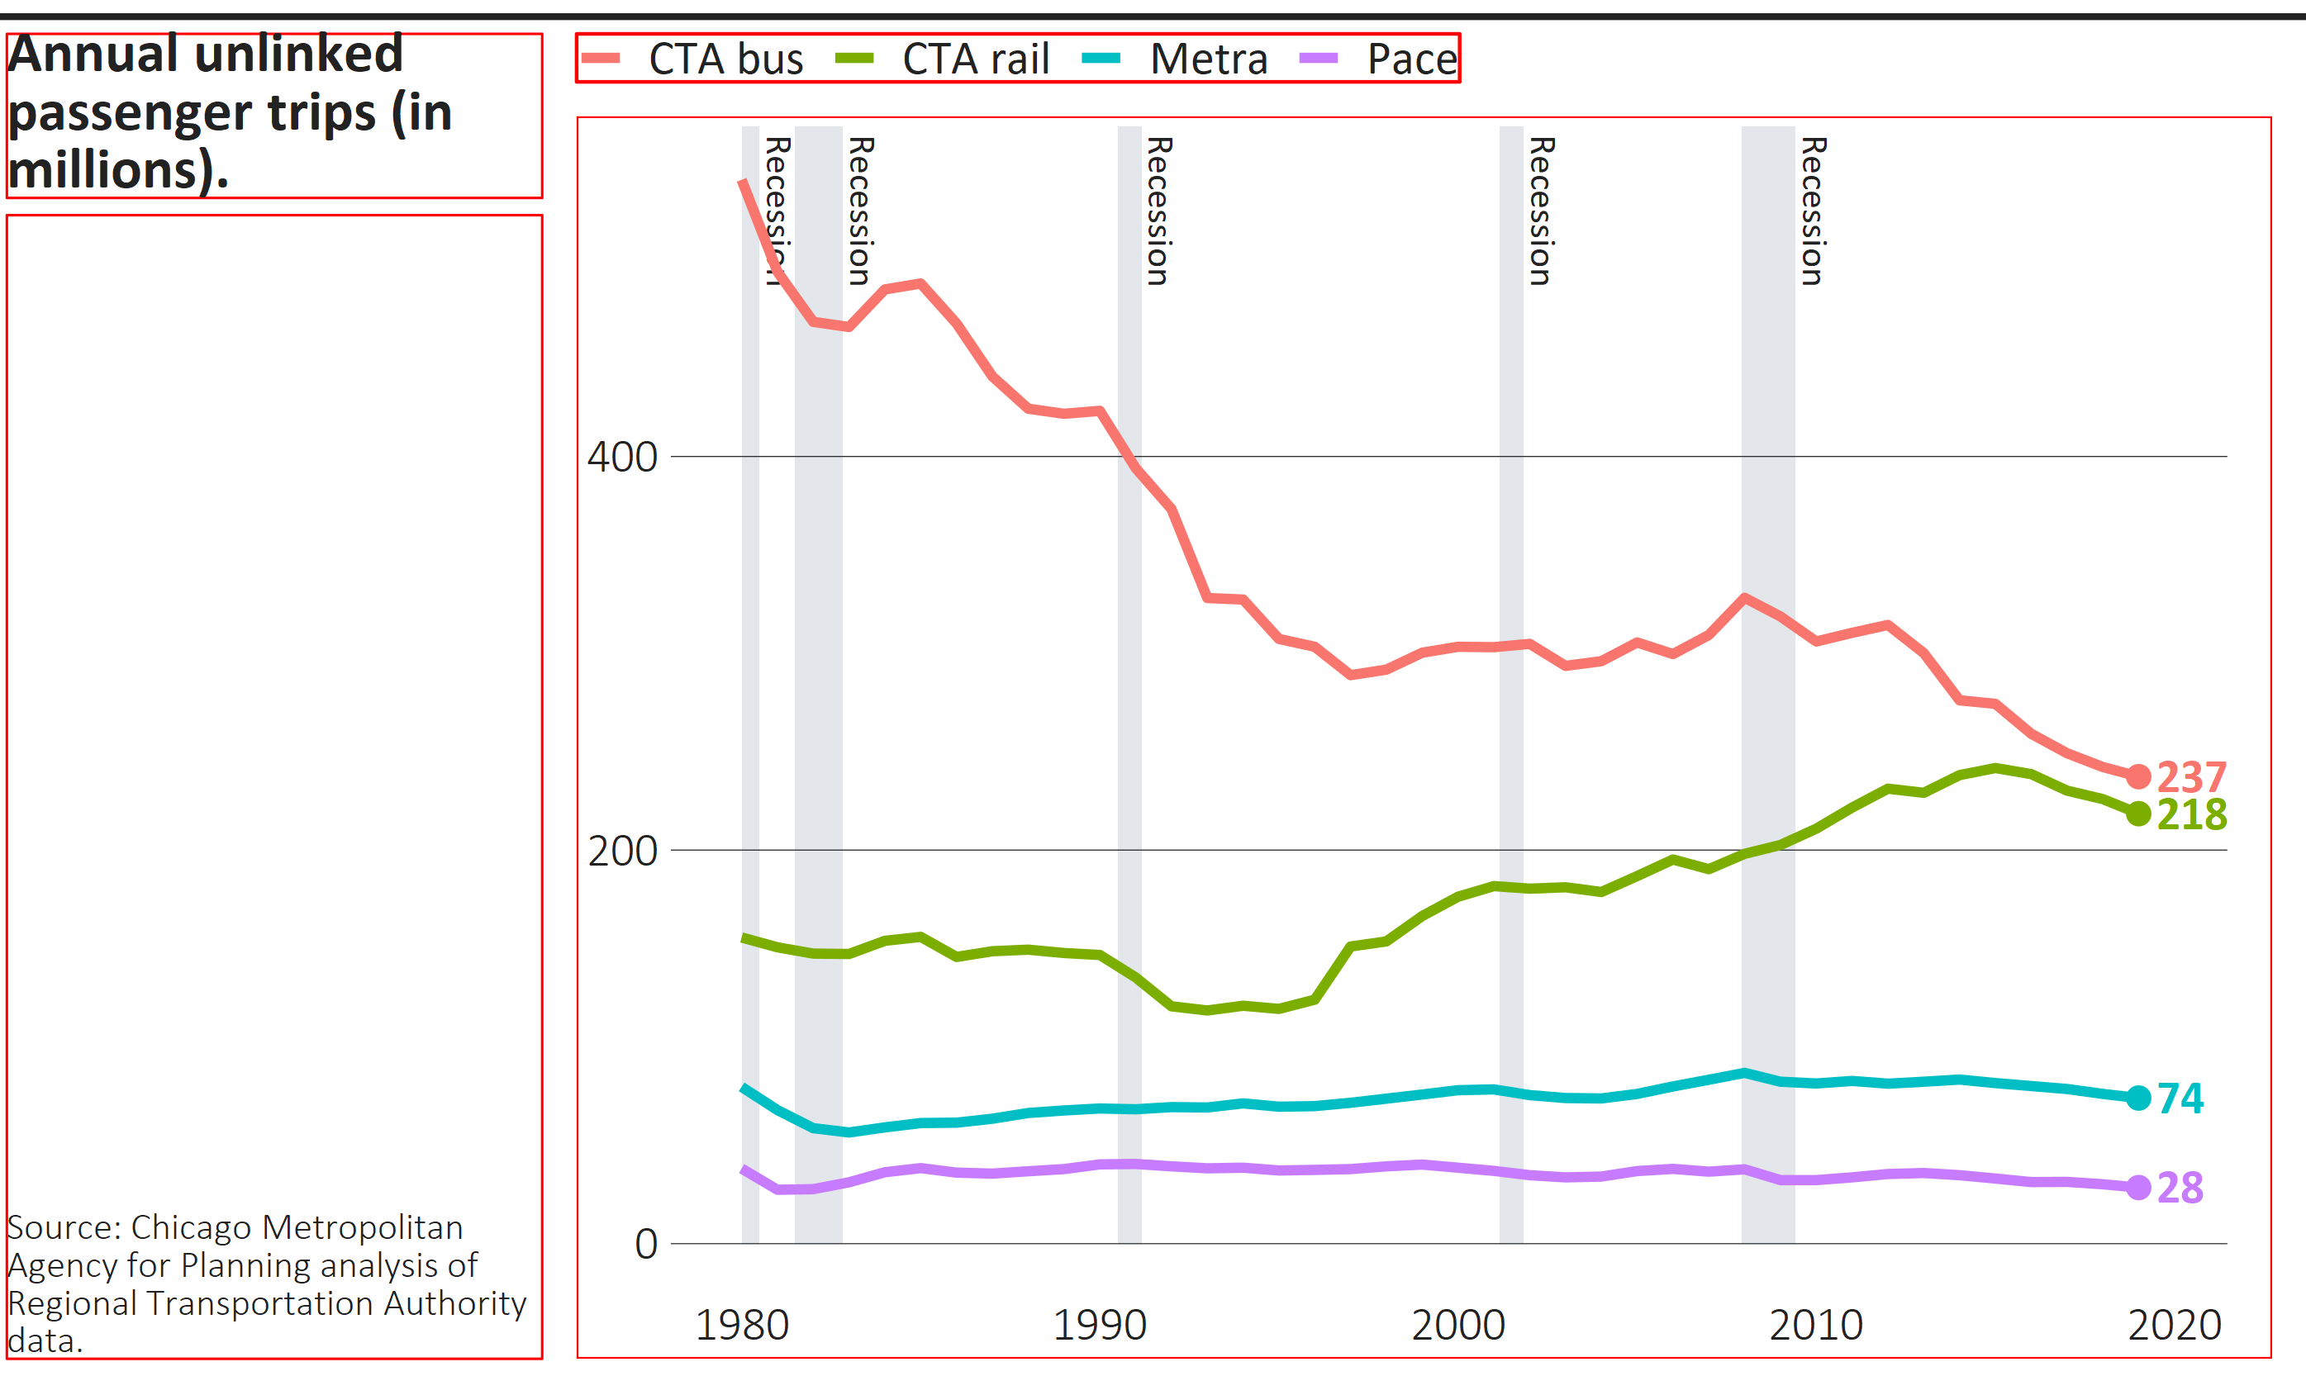
sidebar_width
width
margin_topline_t
margin_title_t
margin_legend_t
margin_legend_b
margin_title_b
margin_legend_i, not pictured, sets the vertical space between legends if there the plot contains more than one.
height
margin_caption_b
margin_plot_b
margin_sidebar_l margin_plot_l margin_panel_r margin_plot_r
Legend
Where to set: | finalize_plot() | finalize_plot() | either function | theme_cmap()
How to set: | Arguments | overrides | overrides | overrides
Units: | Inches | bigpoints | bigpoints | bigpoints

Slide 2
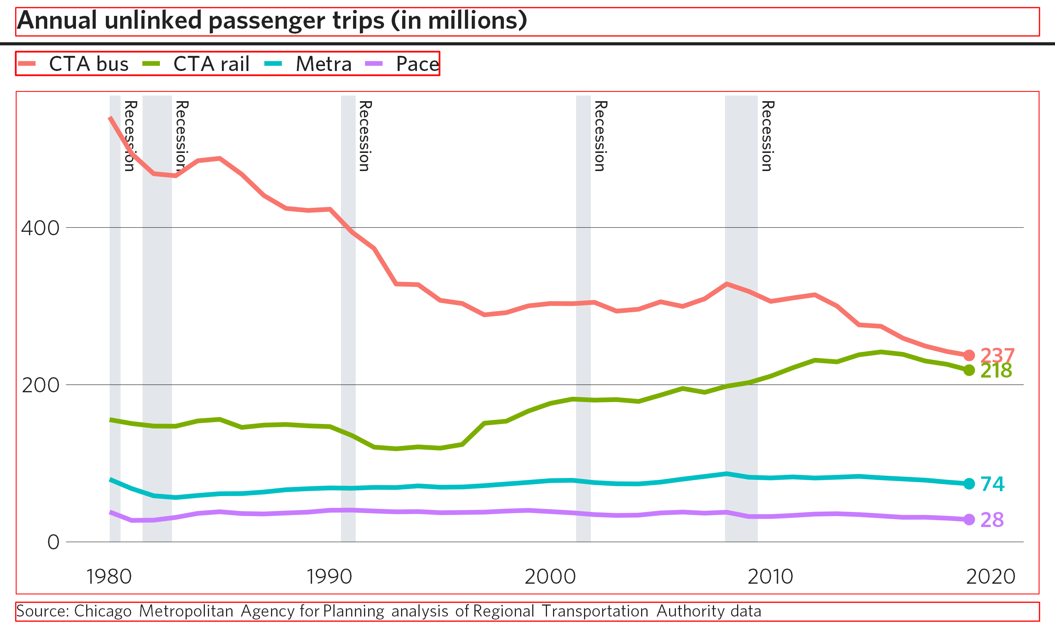
width
margin_title_t
margin_topline_t
margin_legend_t
margin_legend_b
margin_legend_i, not pictured, sets the vertical space between legends if there the plot contains more than one.
height
margin_plot_b
margin_caption_b
margin_sidebar_l margin_plot_l margin_panel_r margin_plot_r
Legend
Where to set: | finalize_plot() | finalize_plot() | either function | theme_cmap()
How to set: | Arguments | overrides | overrides | overrides
Units: | Inches | bigpoints | bigpoints | bigpoints

