Slide 1
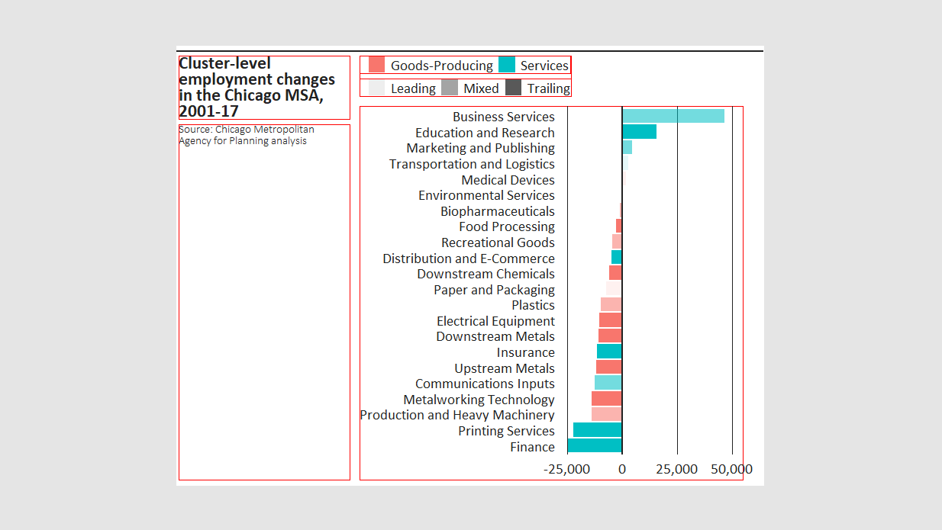
title_width
legend_bump
width
margin_topline_t
margin_title_t
margin_legend_t
margin_legend_i
margin_legend_b
margin_title_b
height
margin_caption_b
margin_plot_b
margin_title_l margin_title_r margin_plot_r

