Slide 1
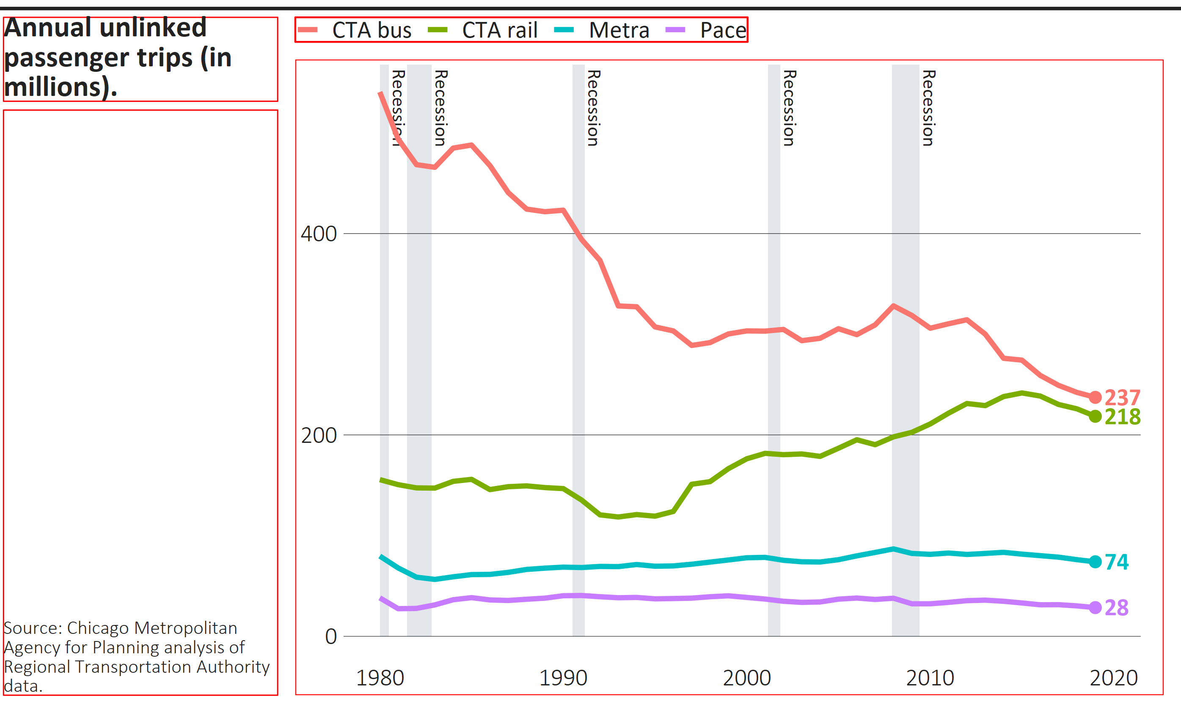
title_width
width
margin_topline_t
margin_title_t
margin_legend_t
margin_legend_b
margin_title_b
margin_legend_i, not pictured, sets the vertical space between legends if there the plot contains more than one.
height
margin_caption_b
margin_plot_b
margin_title_l margin_title_r margin_panel_r margin_plot_r
Legend
Where to set: | Finalize_plot() | Finalize_plot() | Either function | Theme_cmap()
How to set: | Arguments | Overrides | Overrides | Overrides
Units: | Inches | Bigpoints | Bigpoints | Bigpoints

