Slide 1
Topic: Implementation of Quantum k-means algorithm using Euclidean distance method
Presenter: Anshuman Banik
Dept. of Instrumentation and electronics, Jadavpur university

Slide 2
Contents
A brief over-view of the k-means algorithm and the Euclidean distance.
Step by step approach of implementing the k-means algorithm in the Quantum domain using the Euclidean distance method.
Python implementation of the k-means algorithm. (Code + De-bugging)

Slide 3
K-means algorithm
The k-means algorithm is an iterative un-supervised machine learning algorithm used for clustering data.
The data-sets fed as an input, are not pre-defined and do not have any fixed targets. Hence, it is un-supervised in nature.
Clustering is defined to be the process of partitioning a given data-set into K-distinct non-overlapping groups called Clusters. Each cluster contains those data points which are more similar to each other as compared to the outside data points.
Each cluster is represented by a central point called the centroid, the centroid is typically the mean or the average of all the data points in the cluster.
Mathematically, Euclidean distance is calculated as the square root of the sum of the squared differences between the two vectors with floating or integer values.

Slide 4
Working procedure of the algorithm
The k-means algorithm works back and forth based on a 2-fold approach.
Assign each data point of the cluster to the centroid closest to it using a distance metric like the Euclidean distance.
Recalculate the centroids for each cluster by averaging the positions of all data points assigned to that cluster.

Slide 5
Quantum approach to the k-means algorithm
It is quite important to infer that one of the key differences between the classical and quantum implementation of this algorithm is that, Euclidean distance between 2 Qubits can’t be calculated directly. This is mainly due to the fact that the distance between 2 vectors with probabilistic nature can’t be approximated by classical methods.
So, we use the properties of certain quantum circuits and swap test to approximate that parameter. This is the part where the application of quantum gates come into play.
Swap test is a widely used procedure to determine the extent of overlap between 2 quantum states.

Slide 6
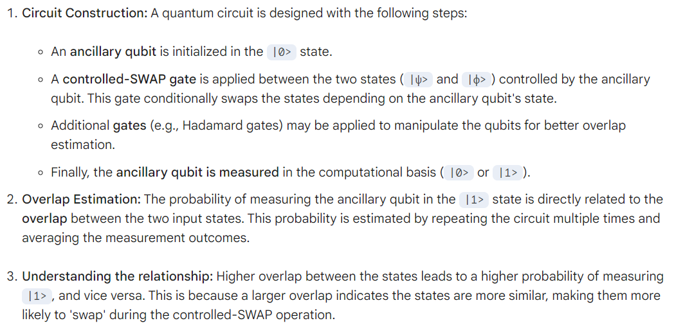
Swap test

Slide 7
Cirq code for implementation
import cirq import numpy as np # main code def euclidean_distance_circuit(qubit1, qubit2, ancilla): circuit = cirq.Circuit() # Apply X gates to qubit1 and qubit2 circuit.append(cirq.X(qubit1)) circuit.append(cirq.X(qubit2)) # Apply controlled-Ry gate for the Euclidean distance calculation controlled_ry_gate = cirq.ControlledGate(cirq.ry(np.pi), num_controls=2) circuit.append(controlled_ry_gate(qubit1, qubit2, ancilla)) # Apply X gates to undo the changes circuit.append(cirq.X(qubit1)) circuit.append(cirq.X(qubit2)) return circuit # Create qubits qubit1 = cirq.LineQubit(0) qubit2 = cirq.LineQubit(1) ancilla = cirq.LineQubit(2) # Create a circuit for Euclidean distance calculation distance_circuit = euclidean_distance_circuit(qubit1, qubit2, ancilla) # Display the circuit print("Euclidean Distance Circuit:") print(distance_circuit)

Slide 8
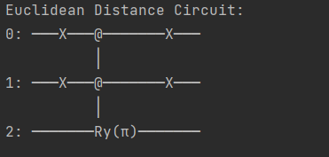
output

Slide 9
Qk-means implementation
# Import necessary libraries
import numpy as np
import pandas as pd
""" The q-means leverages quantum computing to calculate distances for the centroid assignment part of the k-means unsupervised learning algorithm """
from qmeans.qkmeans import *
# Main code
backend = Aer.get_backend("aer_simulator_statevector") #Sets the back-end for Aer state vector simulator
X = pd.DataFrame(np.array([[1,2],[1,4],[1,0],[2,4],[3,4],[4,5],[10,3],[10,2],[10,7]])) #Sets a simple dataframe with 2-D data sets
qk_means = QuantumKMeans(backend, n_clusters=3, verbose=True) #number of clusters chosen = 3 and verbose set to true means, each computation will be shown exclusively.
qk_means.fit(X) #The qmeans model is fitted to the data-frame X for implementation
print(qk_means.labels_)

