Slide 1
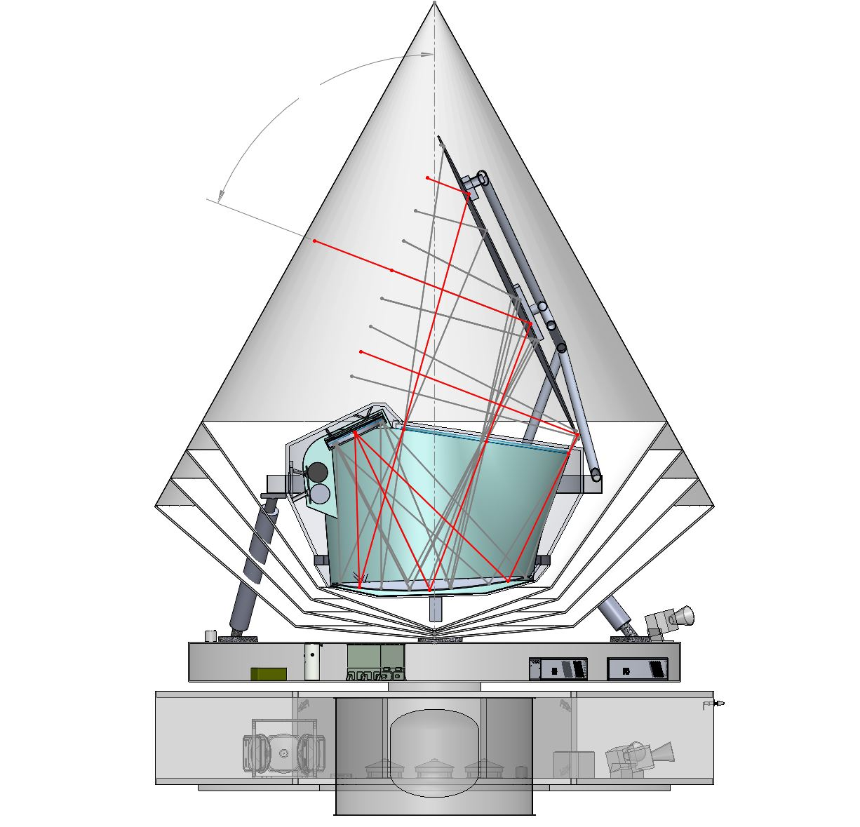
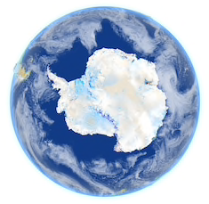
Telescope boresight
Spin axis
PICO
β
Anti-solar precession
To Sun
⍺
SPE
Earth
L2
Orbit
Moon

