Slide 1
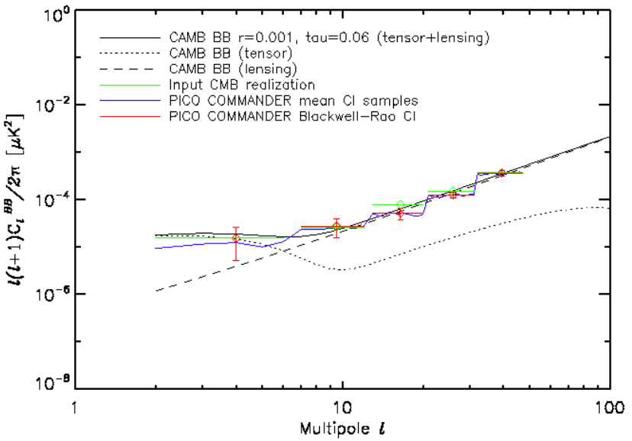
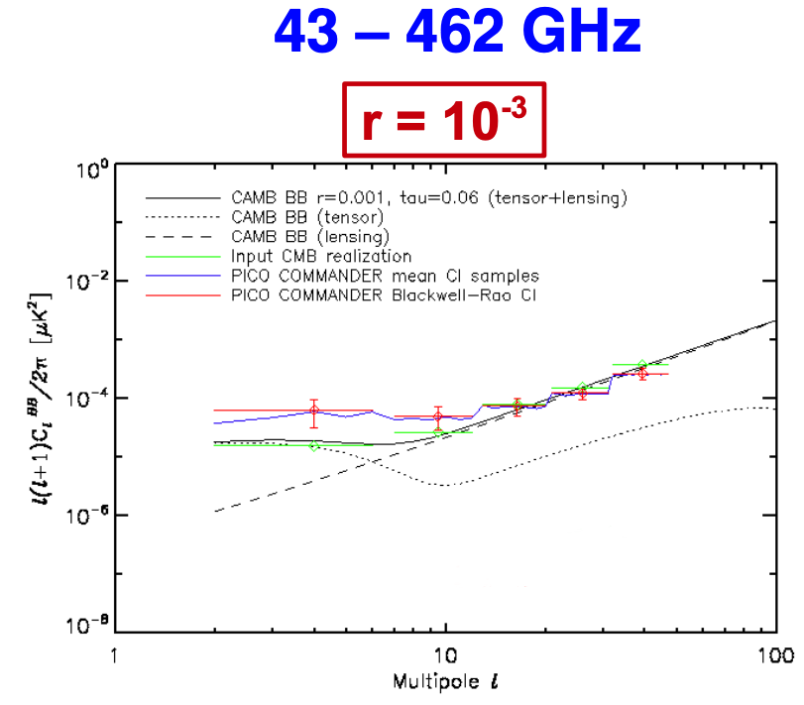
1. Please make fonts 5 times larger, for axes’ numbers, for axes’ labels, and for legend
2. lower vertical scale should start at 1e-6 (not 1e-8);
3. upper vertical scale should end at 1e-2
4. make dots, dash, solid bolder
5. for legend: say ‘Lensing’ ‘Gravity Waves’ ‘CMB BB’; green = CMB input; red = Recovered CMB
6. Use only red (or only blue), not both
7. Put frequency labels on top right, as shown
21 – 800 GHz
43 – 462 GHz

Slide 2
21 – 800 GHz
43 – 462 GHz

