Slide 1
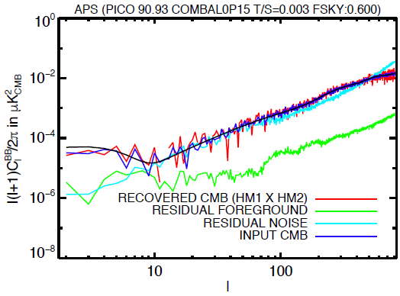
Please remove the top banner.
2. lower vertical scale should start at 5e-7 (not 1e-8);
3. upper vertical scale should end at 3e-2
4. remove cyan
5. for legend: say ‘Model CMB’, ’CMB input’, ‘CMB recovered’
6. Use only red (or only blue), not both
7. Increase font size by x2 everywhere.

