Slide 1
Q/U Pixel Layout for PICO
Shaul Hanany, Xin Zhi Tan,
Qi Wen, Karl Young

Slide 2
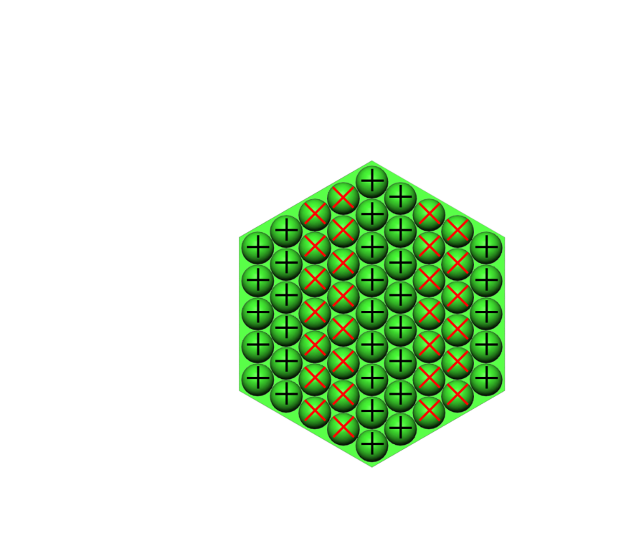
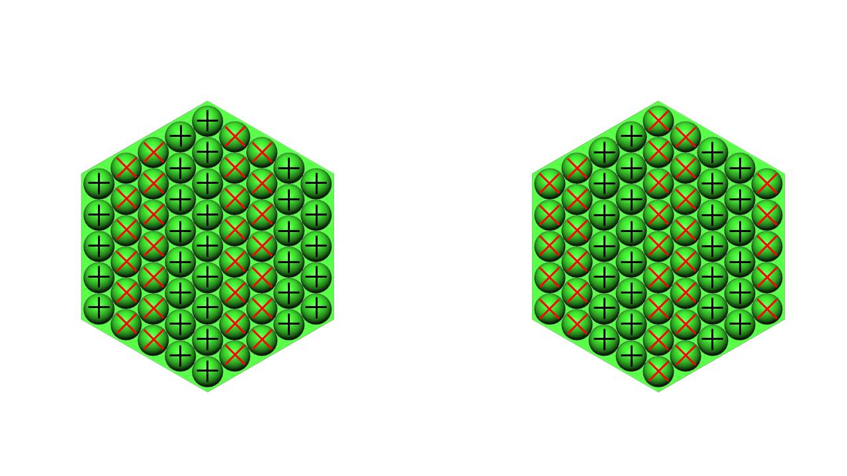
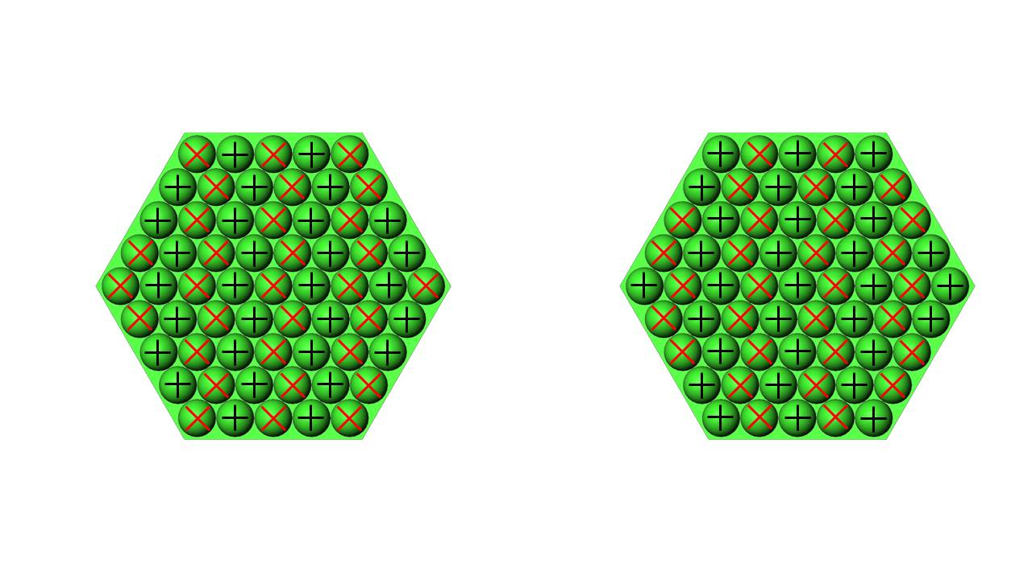
Two layouts for Q and U pixels were considered for PICO. Q pixels measure the horizontal and vertical components of the polarization while U pixels measure the components that are rotated by +- 45 degree relative to the Q. Both Q, and U orientations are relative to a focal plane-based reference frame.
Far Q/U pair
Close Q/U pair
Case 1
Left side of focal plane
Right side of focal plane
Scan direction
Close Q/U pair
Far Q/U pair
Case 2

Slide 3
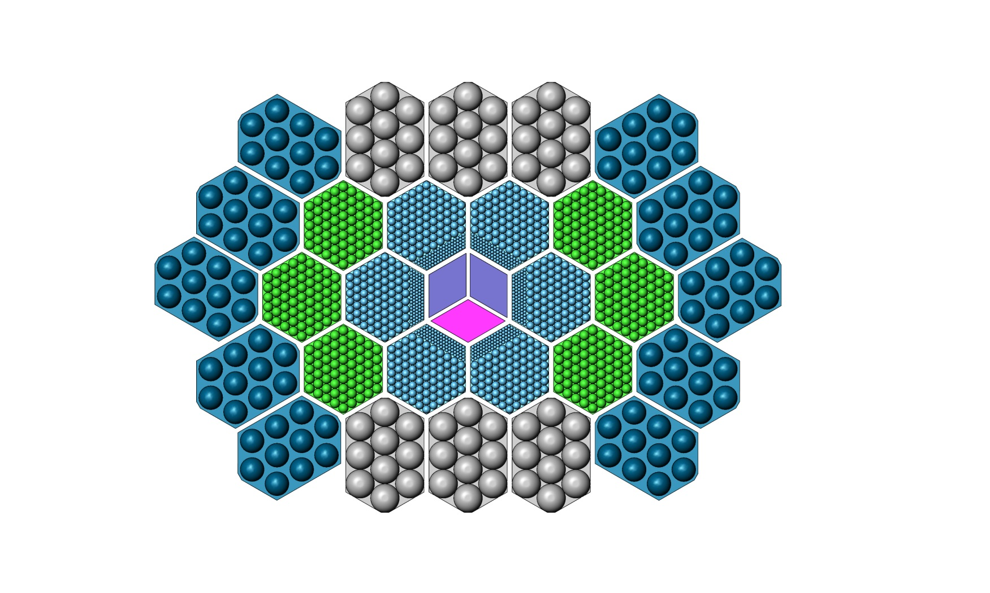
In both cases, Q and U are measured by pixels that are in close physical proximity in the focal plane in a direction along the scan. This ensures that a given sky pixel is observed by Q, U pixels that have similar beam patterns and similar focal plane thermal environment.
We determined there was no strong systematic argument for either pixel layout. Case 1 was chosen as baseline because it gave a somewhat better packing of the wafers on the focal plane, thus giving a slightly higher (~5%) detector count.
PICO focal plane layout
Scan direction

