Slide 1
Testing ΛCDM
Eleonora Di Valentino
University of Manchester

Slide 2
We can quantify the improvement on constraining the cosmological parameters of PICO with respect to Planck 2018 (or previous experiments), by considering the ratio of the Figure of Merit (FoM) for an extended parameter space:
where p_{i} are the extra parameters we considered.
The FoM is discussed in more detail in Di Valentino et al. (2018) JCAP Vol. 4 pg. 17
The FoMs in the next pages have been obtained with:
TT,TE,EE,BB
fiducial m_{ν}=0.06 eV, r=0 and cosmological parameters fixed to Planck 2018
multichannel approach using the 70-220 GHz specs for v4.1 and v4.0.
delensing 85% for PICO v4.0 and 81% for PICO v4.1, no delensing for Planck.
α₁ is the amplitude of correlated CDM isocurvature perturbations (see equation 43 in astro-ph/1502.01589)

Slide 3
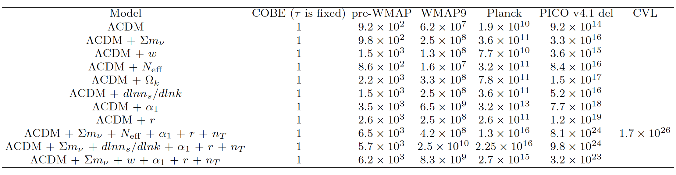
Here the FOMs for COBE, pre-WMAP, WMAP9 and Planck are obtained with the real data. COBE has one less parameter because tau is fixed.
We also calculated the cosmic variance limit (CVL) for one set of parameters (see last column in Table). The experimental configuration has a resolution that is twice PICO (representing a 2.8 m effective aperture) and the noise x9 lower per each frequency band compared to PICO, which should give
0.1 uK*arcmin across the sky, fsky=0.75, and lmax=10000.

Slide 4
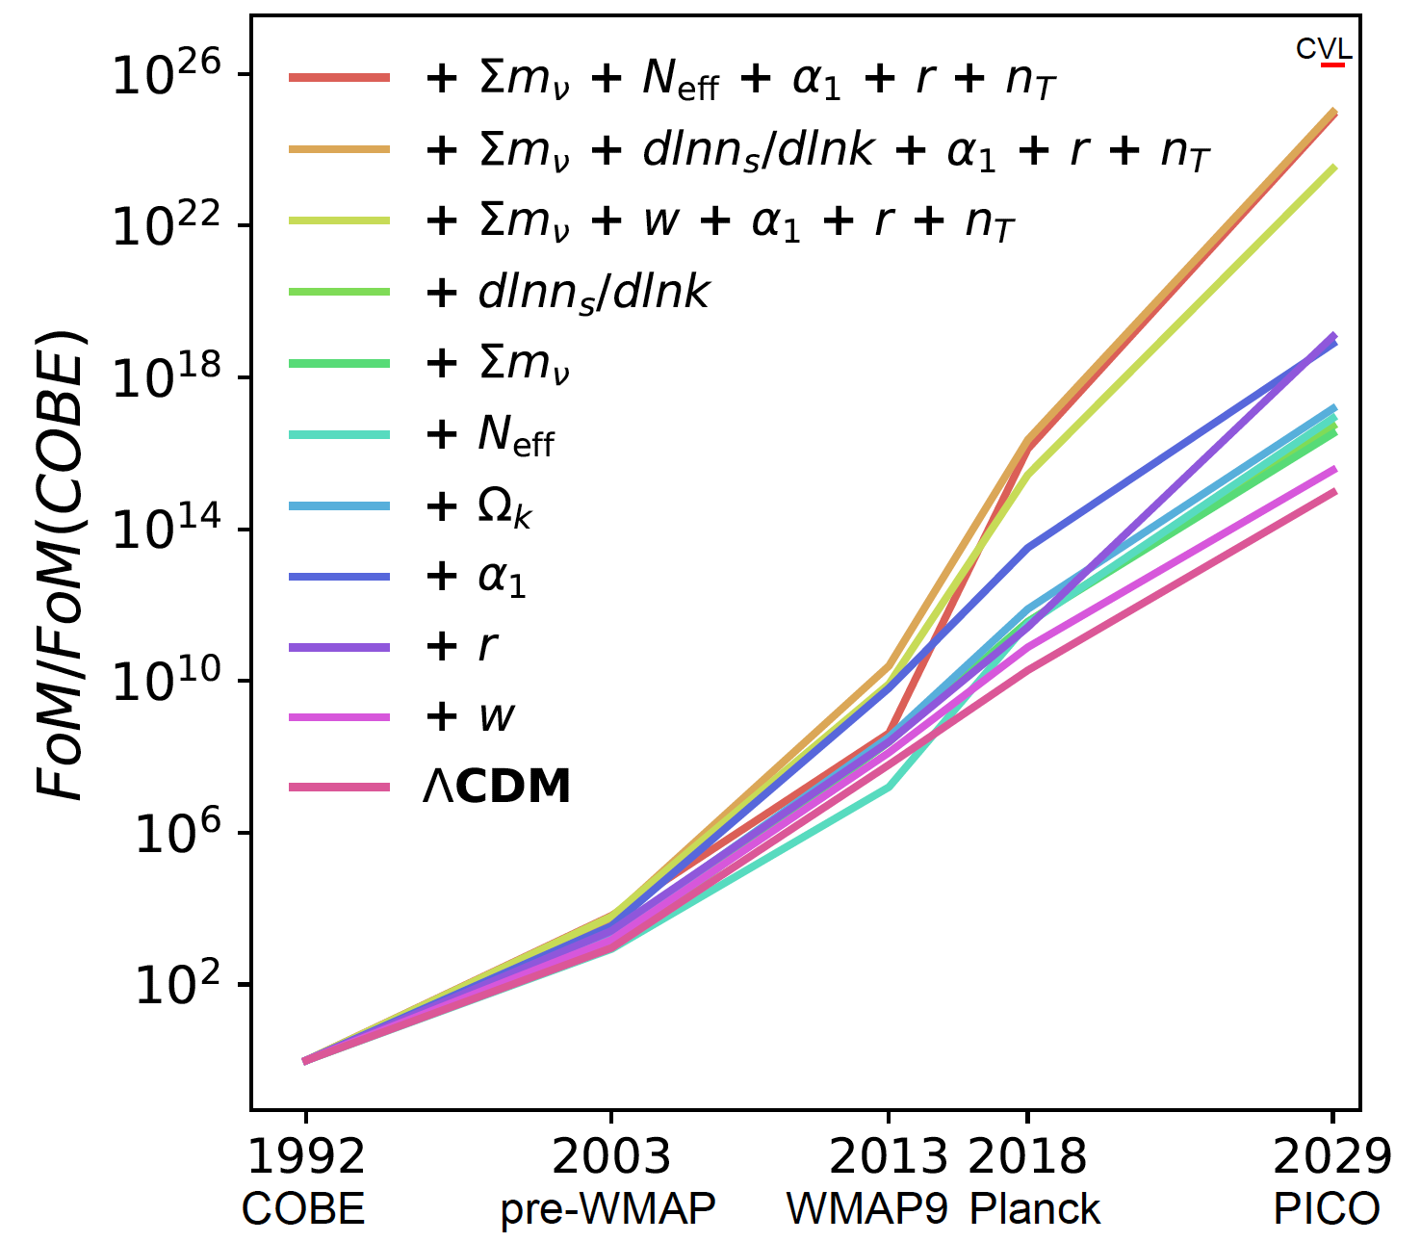

Slide 5
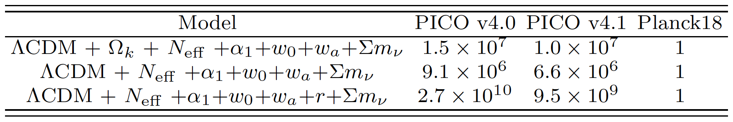
We also ran a comparison between PICO and Planck. In the Table below values are normalized to Planck 2018. Instead of using the Planck data, mission performance is simulated because the Planck2018 likelihood is not available for running extra extensions of the LCDM model.

Slide 6
Older Slides

Slide 7
We can quantify the improvement on constraining the cosmological parameters of PICO with respect to Planck 2018 (or previous experiments), by considering the ratio of the Figure of Merit (FoM) for an extended parameter space:
where p_{i} are the extra parameters we considered.
The FoM is discussed in more detail in Di Valentino et al. (2018) JCAP Vol. 4 pg. 17
The FoMs (given in the next pages) are normalized to the Planck value and has been obtained with:
TT,TE,EE,BB
fiducial m_{ν}=0.06 eV, r=0 and cosmological parameters fixed to Planck 2018
multichannel approach using the 70-220 GHz specs for v4.1 and v4.0.
delensing 85% for PICO v4.0 and 81% for PICO v4.1, no delensing for Planck.
α₁ is the amplitude of correlated CDM isocurvature perturbations (see equation 43 in astro-ph/1502.01589)

