Slide 1
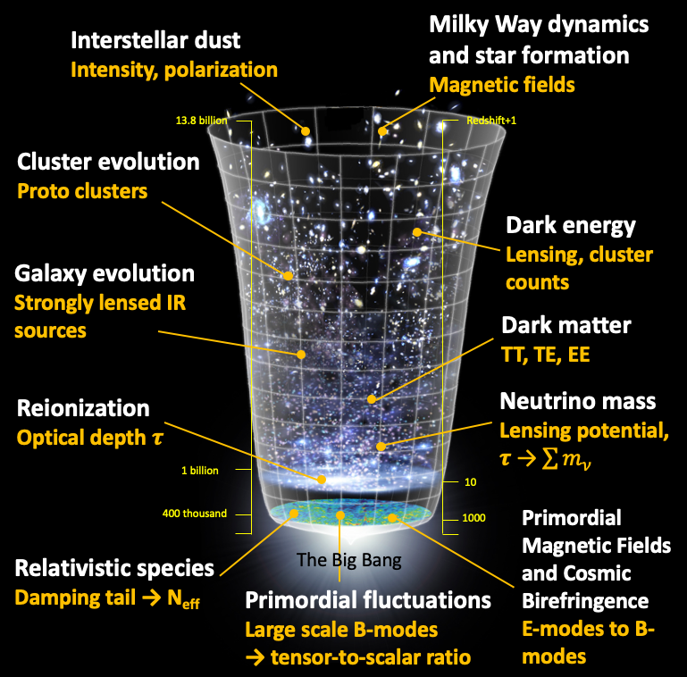
PICO
Probe of Inflation and Cosmic Origins
December 2018
Credit: NASA/WAMP
Dr., Shaul Hanany, Principal Investigator

Slide 2
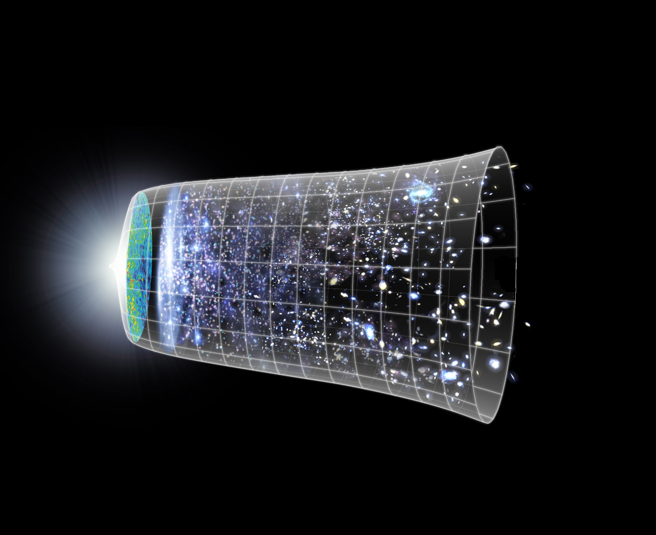

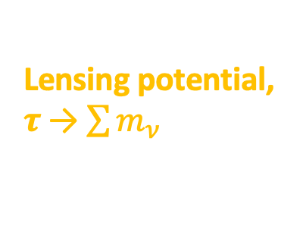
PICO
Probe of Inflation and Cosmic Origins
December 2018
Interstellar dust
Intensity, polarization
Milky Way dynamics and star formation
Magnetic fields
13.8 billion
Redshift+1
Cluster evolution
Proto clusters
Dark energy
Lensing, cluster counts
Galaxy evolution
Strongly lensed IR sources
Dark matter
TT, TE, EE
Reionization
Optical depth $τ$
Neutrino mass
Lensing potential, $τ$→ $\sum{m_{ν}}$
1 billion
10
400 thousand
1000
Primordial Magnetic Fields
and Cosmic Birefringence
E-modes to B-modes
Relativistic species
Damping tail → N_{eff}
The Big Bang
Primordial fluctuations
Large scale B-modes
→ tensor-to-scalar ratio

