Slide 1
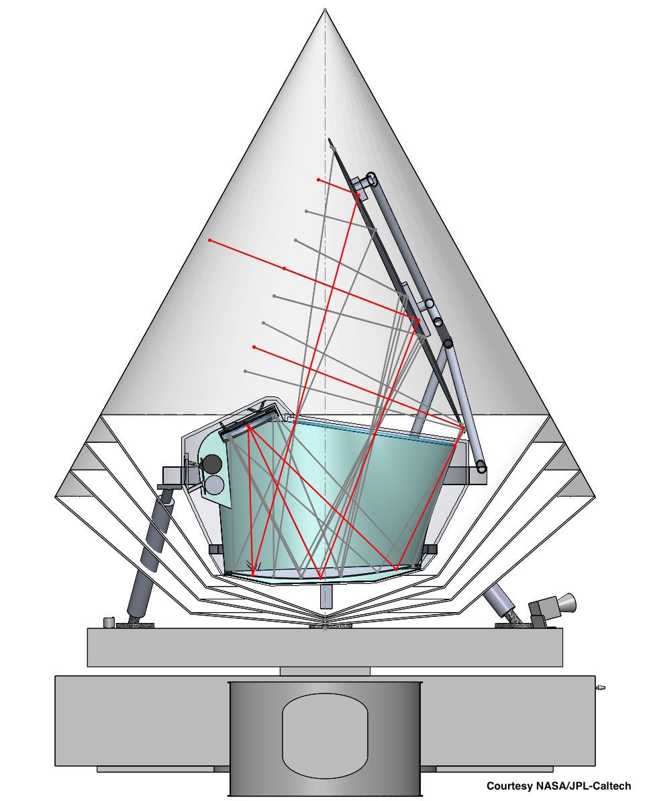
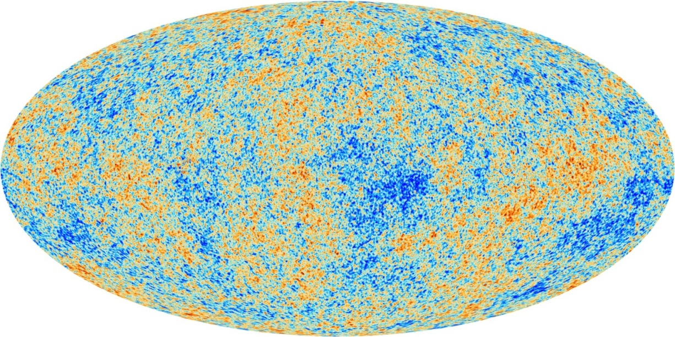
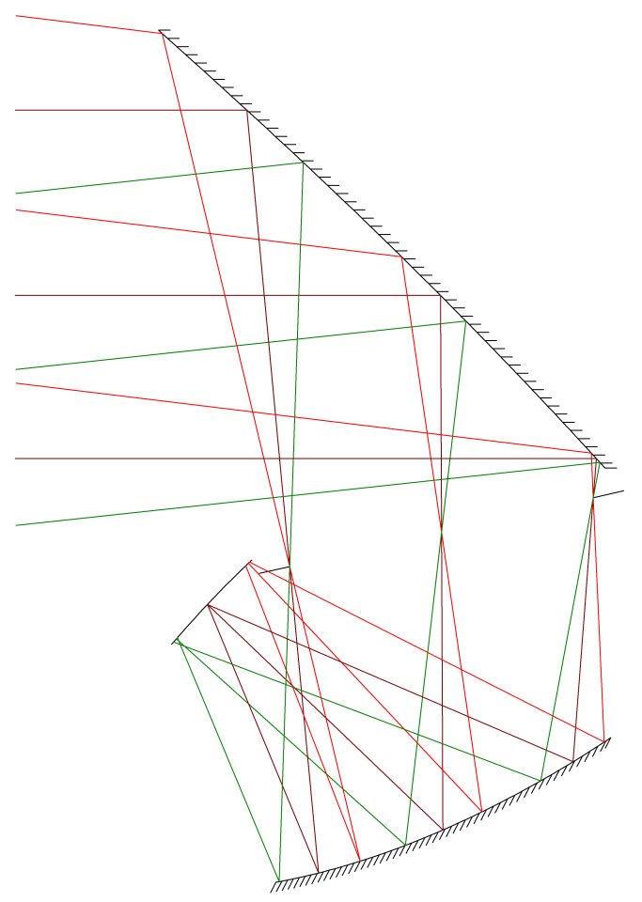
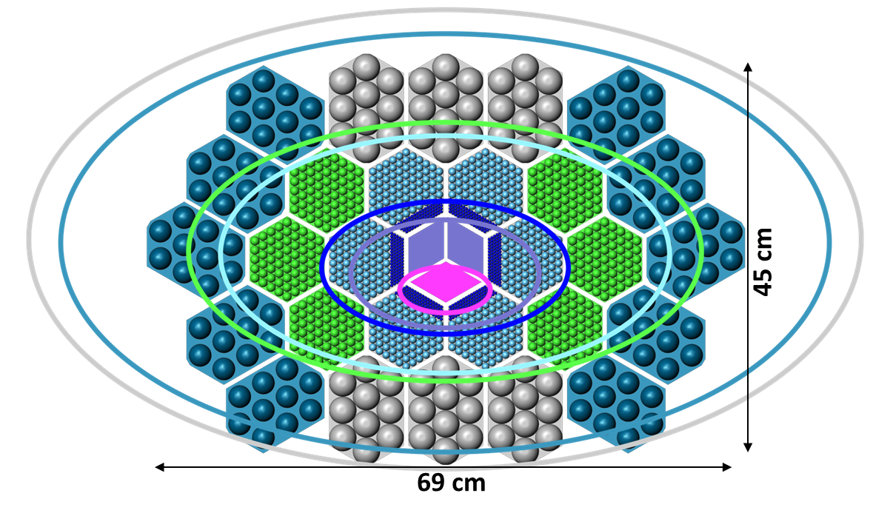
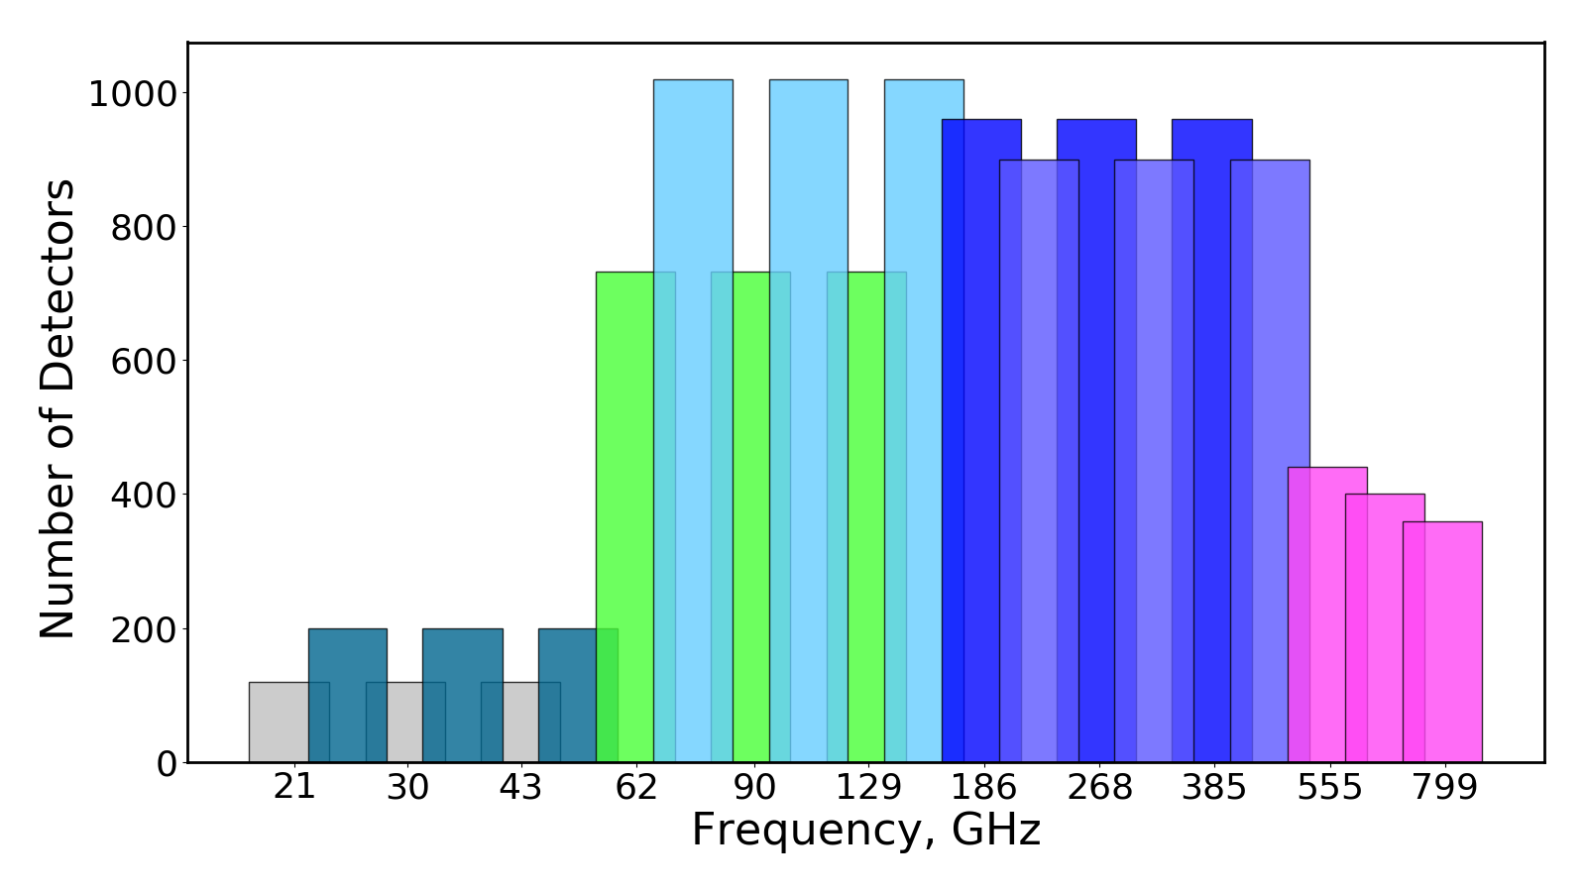
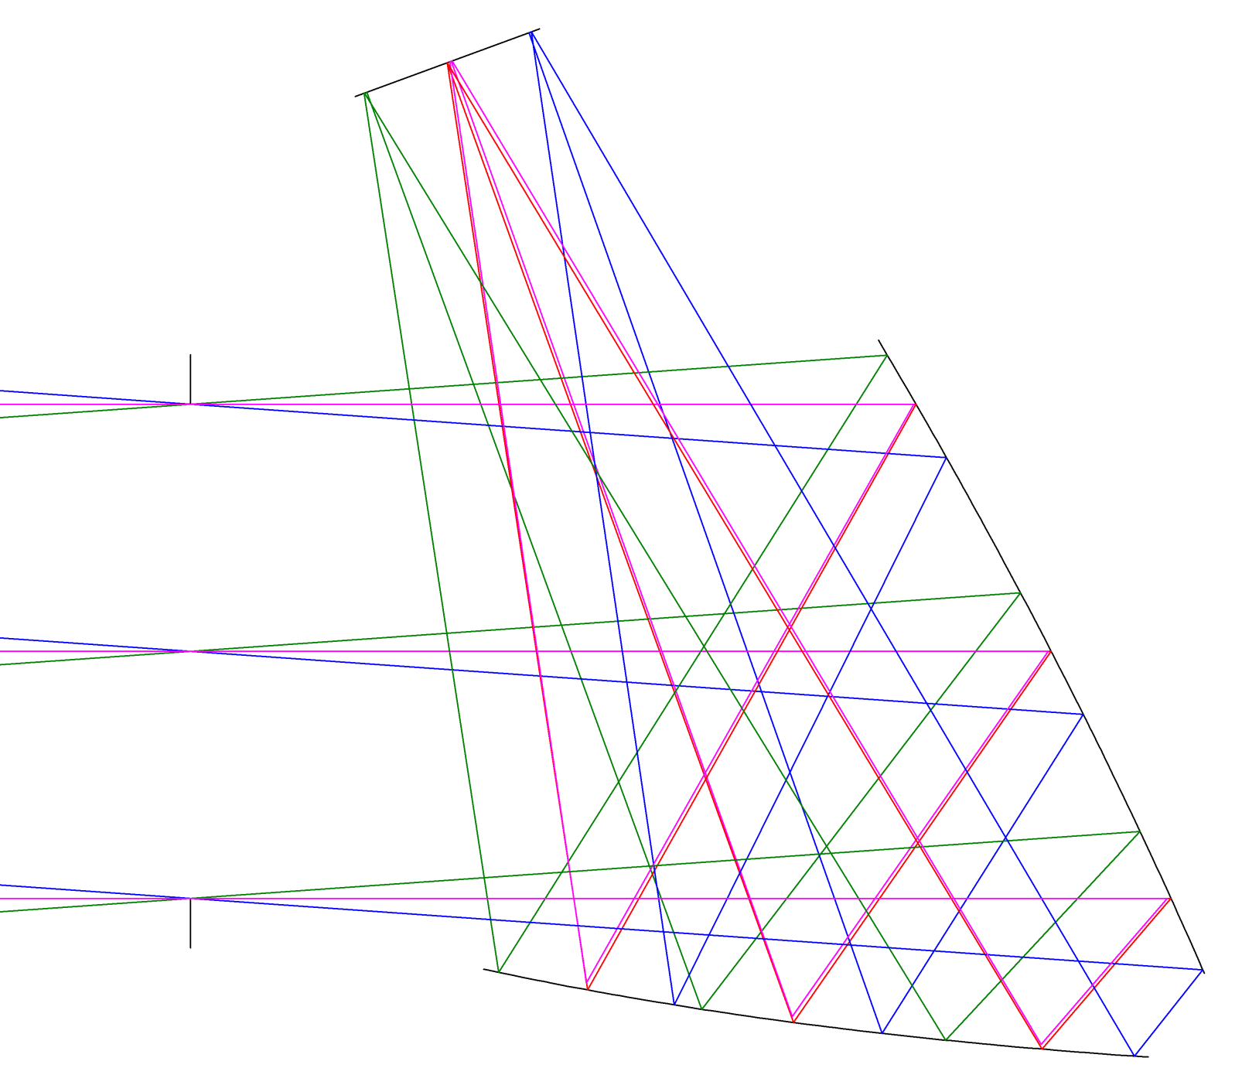
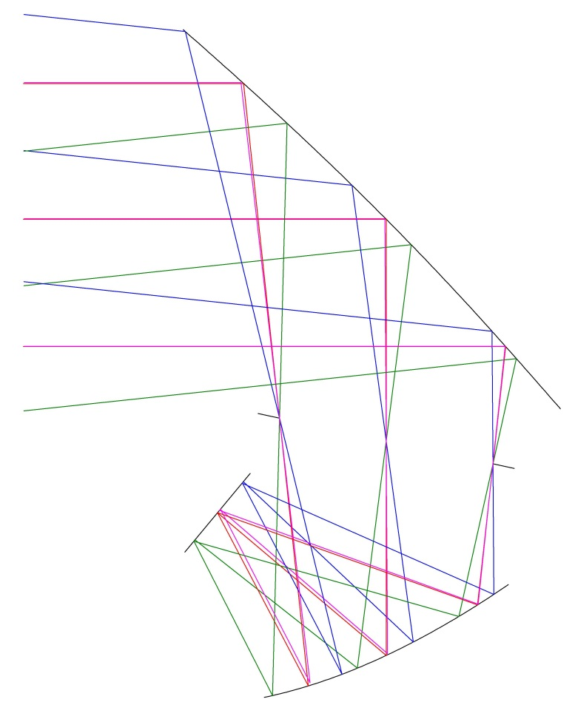
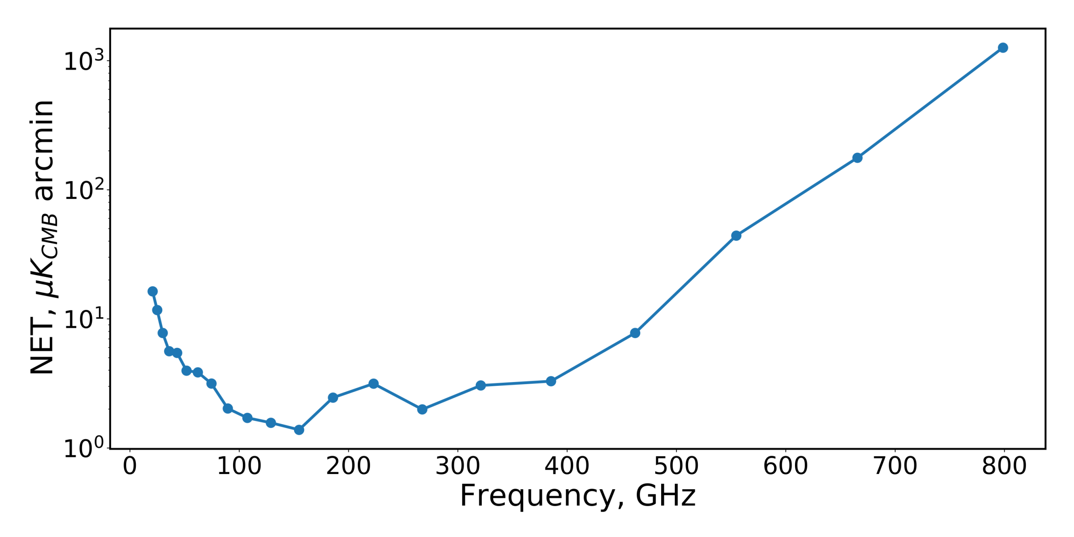


Optical Design of PICO, a Concept for a Space Mission to Probe Inflation and Cosmic Origins
image?
K. Young^{1†}, M. Alverez, N. Battaglia², J. Bock, J. Borrill⁴, D. Chuss⁵, B. Crill³, J. Delabrouille⁶, M. Devlin⁷, L. Fissel⁸, R. Flauger⁹, D. Green, K. Gorski, S. Hanany¹, R. Hills, J. Hubmayr, B. Johnson, B. Jones², L. Knox¹⁰, A. Kogut¹¹, C. Lawrence³, T. Matsumura, J. McGuire, J. McMahon¹², R. O’Brient, C. Pryke¹, X.Z. Tan¹, A. Trangsrud³, Q. Wen¹, G. de Zotti²⁰
¹University of Minnesota, Minneapolis, ²Princeton University, Princeton, ³Jet Propulsion Laboratory, Pasadena, ⁴Lawrence Berkeley National Laboratory, Berkeley, ⁵Villanova University, Villanova, ⁶Astroparticule et Cosmologie, Paris, ⁷University of Pennsylvania, Philadelphia, ⁸National Radio Astronomy Observatory, Charlottesville, ⁹University of California, San Diego, ¹⁰University of California, Davis, ¹¹Goddard Space Flight Center, Greenbelt, ¹²University of Michigan, Ann Arbor †Email: kyoung@astro.umn.edu
Scientific Objectives
Scientific Observations
Optical Design
Focal Plane
Detect or place limits on the energy scale of inflation
Determine the number of light relic particles, N_{eff}
Constrain Σm_{ν}, the sum of neutrino masses to 15 meV
Measure τ, the Thompson scattering optical depth to reionization to cosmic variance limits
Understand the role of Galactic magnetic fields in star formation and galactic evolution
… clusters, infrared galaxies, SZ effect, … ? background
Measure or set upper limits on primordial B-modes with σ(r) ∼ 10⁻⁵
Determine the number of light relic particles, N_{eff}, to σ(N_{eff}) = 0.03
Measure τ, the optical depth to reionization to cosmic variance limits, σ(τ) = 0.002
Along with DESI-BAO observations, measures Σm_{ν}, the sum of neutrino masses at ≥4σ
Map Galactic magnetic fields from large scales to 0.05 pc in 10 nearby molecular clouds
Discover 10,000s of protoclusters and clusters via the SZ effect
Map the CIB and dusty infrared galaxies across the full sky
Primary, 15 K
10 cm
Focal Plane,
100 mK
Aperture Stop, 6 K
Pixel Type | Upper Frequency (GHz) | Number
A | 48.6 | 68
B | 58.3 | 108
C | 145 | 360
D | 174 | 450
E | 433 | 546
F | 520 | 408
G | 624 | 135
H | 749 | 132
I | 899 | 91
50 cm
Secondary,
10 K
D
E
F
Satellite and Instrument
1.4 m Open Dragone, numerically optimized]
19 x 13 degree field of view
f/1.42 system gives compact focal plane
C
G
H
B
I
12,356 single polarization TES bolometers
Lens coupled tri-chroic pixels
FDM or TDM readout , > 100x multiplexing factor
70 times the polarization sensitivity of Planck
21 bands from 20 GHz to 800 GHz
12,996 polarization sensitive TES bolometers
1’ resolution at 800 GHz, 38’ at 20 GHz
Full-sky coverage
TDM readout: 128 rows, 100 columns
Launch vehicle is a Falcon 9, 4.6 meter fairing
Precession and spin based scan strategy from L2 with α = 26°, β = 69° ??
A
Alternative Design Considered
Focal Plane,
100 mK
Three color pixels, six polarization sensitive detectors per pixel
Aperture Stop, 40 K
Mirrors at 40K, 4K, emissivity,
Active cooling of stop and secondary
Stop at 4K
FDM/TDM readout system, > x100 multiplexing
Lens coupled broadband multichroic pixels
Edge taper of 5,10,20 dB
100 mK bath
Psat = 2x Pload
4 year mission at 95 % observing efficiency
Orbit at L2
White noise: photon, phonon, readout, Johnson
Details. . . .
Primary, 40 K
Sensitivity
Noise Assumptions
White noise only
Includes photon (dominates), phonon, readout, and Johnson noise terms
4 year mission at 95% observing efficiency
Mirrors at 40K, 4K, emissivity,
Active cooling of stop and secondary
Stop at 4K
FDM/TDM readout system, > x100 multiplexing
Lens coupled broadband multichroic pixels
100 mK bath
Psat = 2x Pload
4 year mission at 95 % observing efficiency
Orbit at L2
White noise: photon, phonon, readout, Johnson
Details. . . .
Replace this?
1.2 m Cross Dragone
Larger, difficult to baffle sidelobes
f/2.5 or greater increases focal plane size and mass
Large secondary difficult to actively cool
Lower optical aberrations
0.5 m Open Dragone
Lower resolution
Physically smaller focal plane reduces detector count
Smaller system reduces costs
Boresight
β
Spin axis
Solar
illumination
α
50 cm
Secondary, 40 K
1.2 m Cross Dragone
Larger, difficult to baffle sidelobes
f/2.5 or greater increases focal plane size and mass
Large secondary difficult to actively cool
Lower optical aberrations
Summary
50 cm
Sun
Precession axis
L2
With 70 times the polarization sensitivity of Planck, PICO will provide the next generation of full sky mm-wave observations. These data will allow the astronomical community to understand the universe across many scales from inflation and the growth of structure to galaxy evolution and star formation.
Total integrated polarization map depth of 0.63 µK_{CMB} arcmin
The PICO collaboration thanks the National Aeronautics and Space Administration (NASA) for supporting this study.
Reference
[1] C. Dragone, "First-order correction of aberrations in Cassegrainian and Gregorian antennas," in IEEE Transactions on Antennas and Propagation, vol. 31, September 1983.

