Slide 1
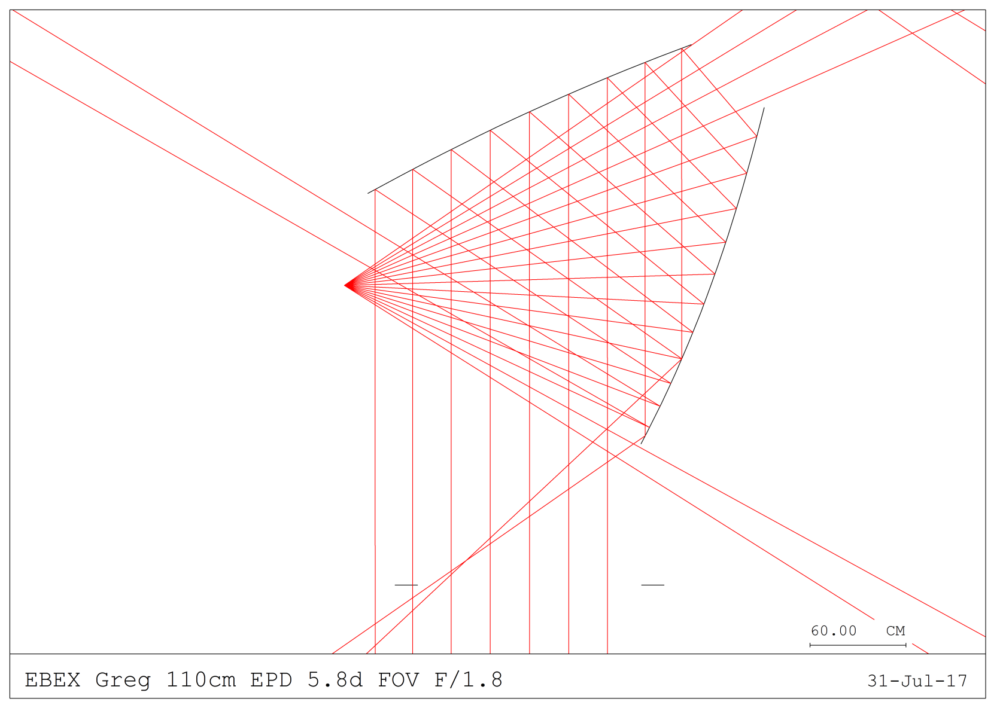
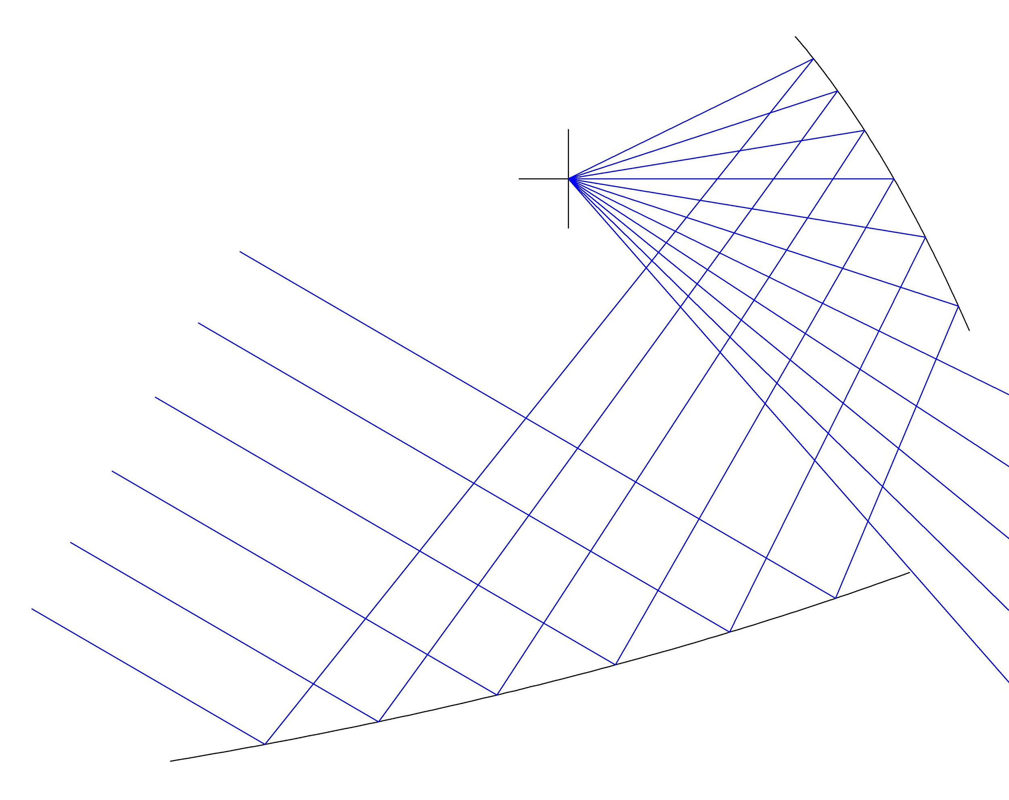
Sidelobe
Focal plane
Direct view to sky
Focal plane

