Slide 1
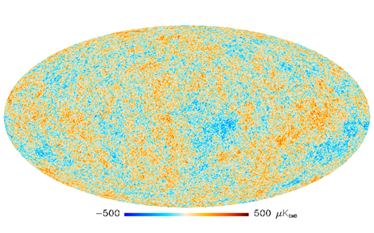
Primary mirror 15 K
Secondary mirror 10 K
Low pass filter 100 mK
CMB
ν_{low}
ν_{mid}
ν_{high}
Multichroic pixel
Cold stop and optics box 6 K

