Slide 1
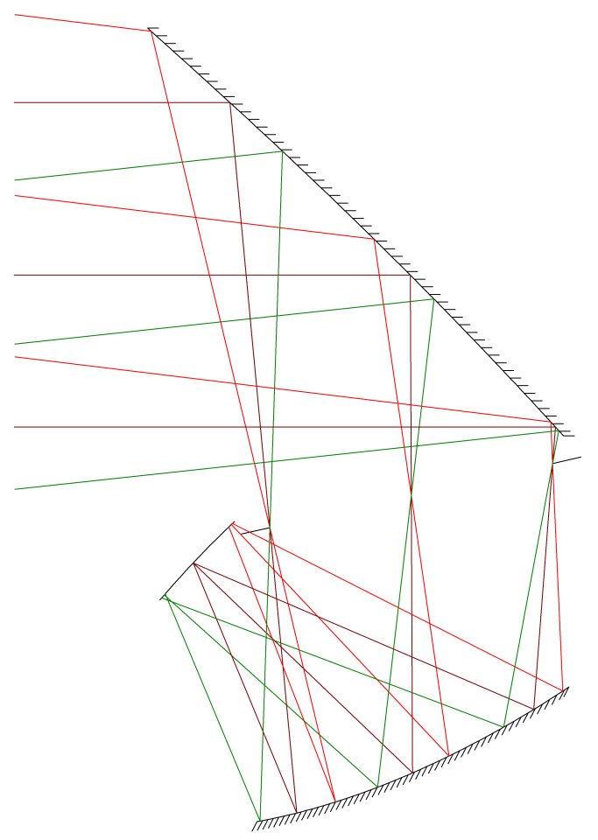
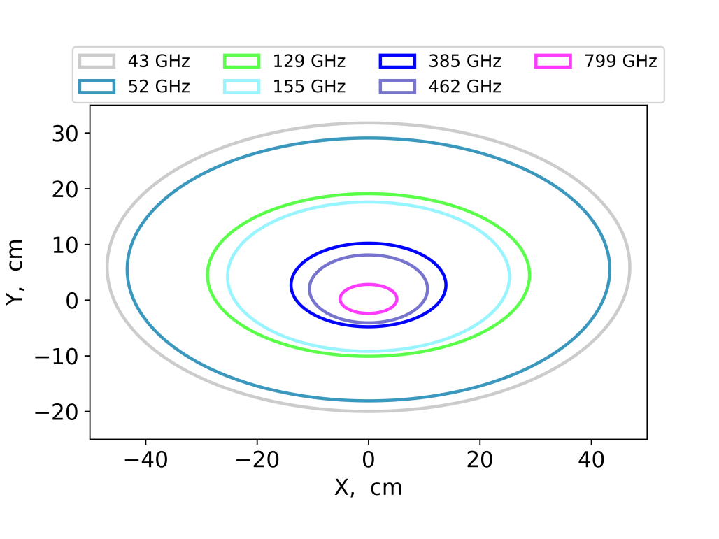
Primary, 40 K
Aperture
Stop, 4 K
Focal Plane, 100 mK
Z
Y
50 cm
Secondary, 4 K

Slide 2
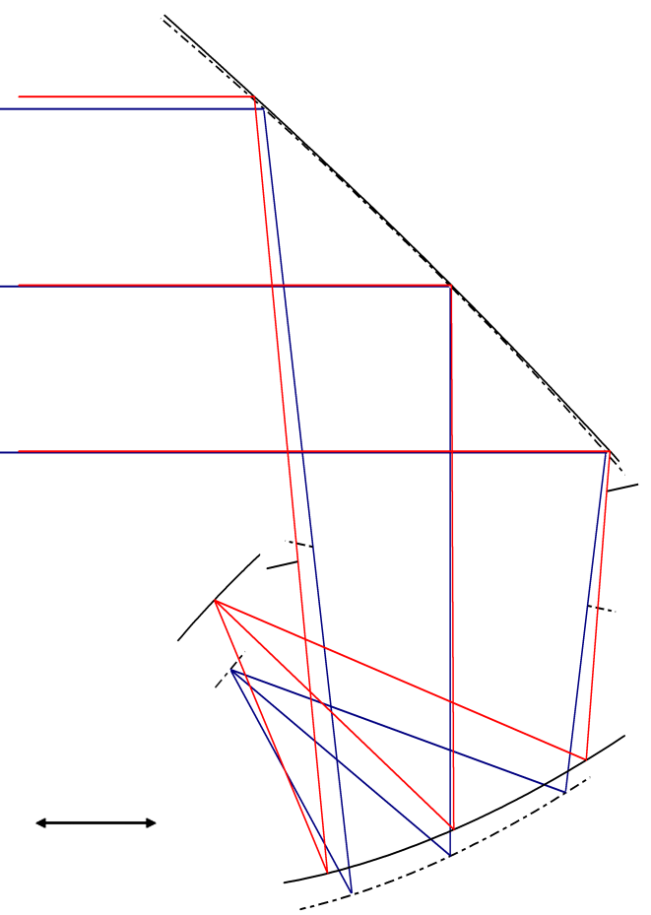
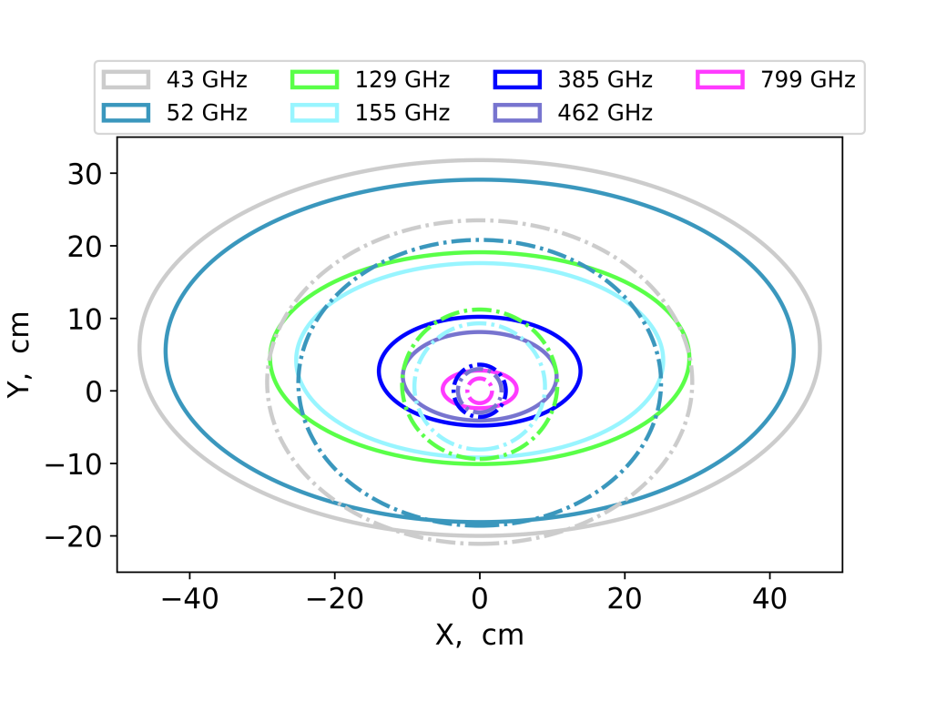
Z
Y
50 cm

