Slide 1
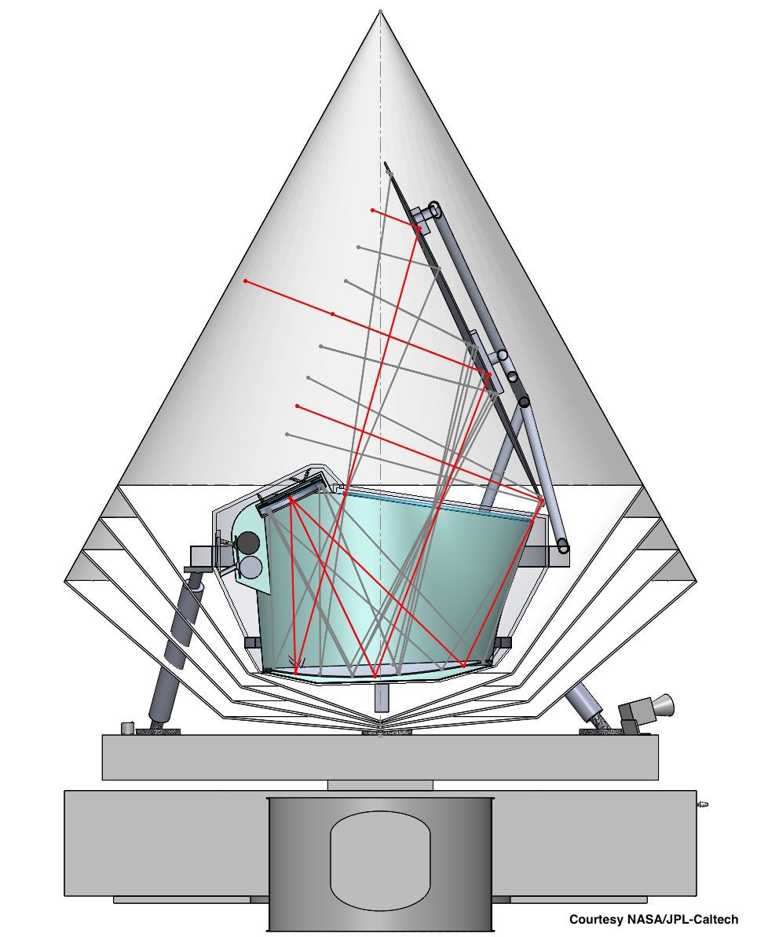
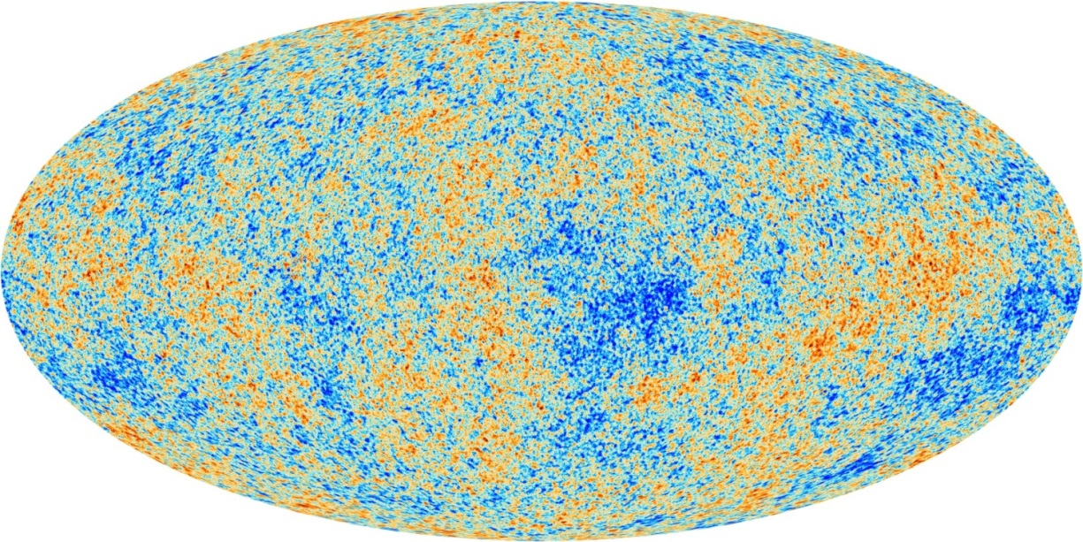
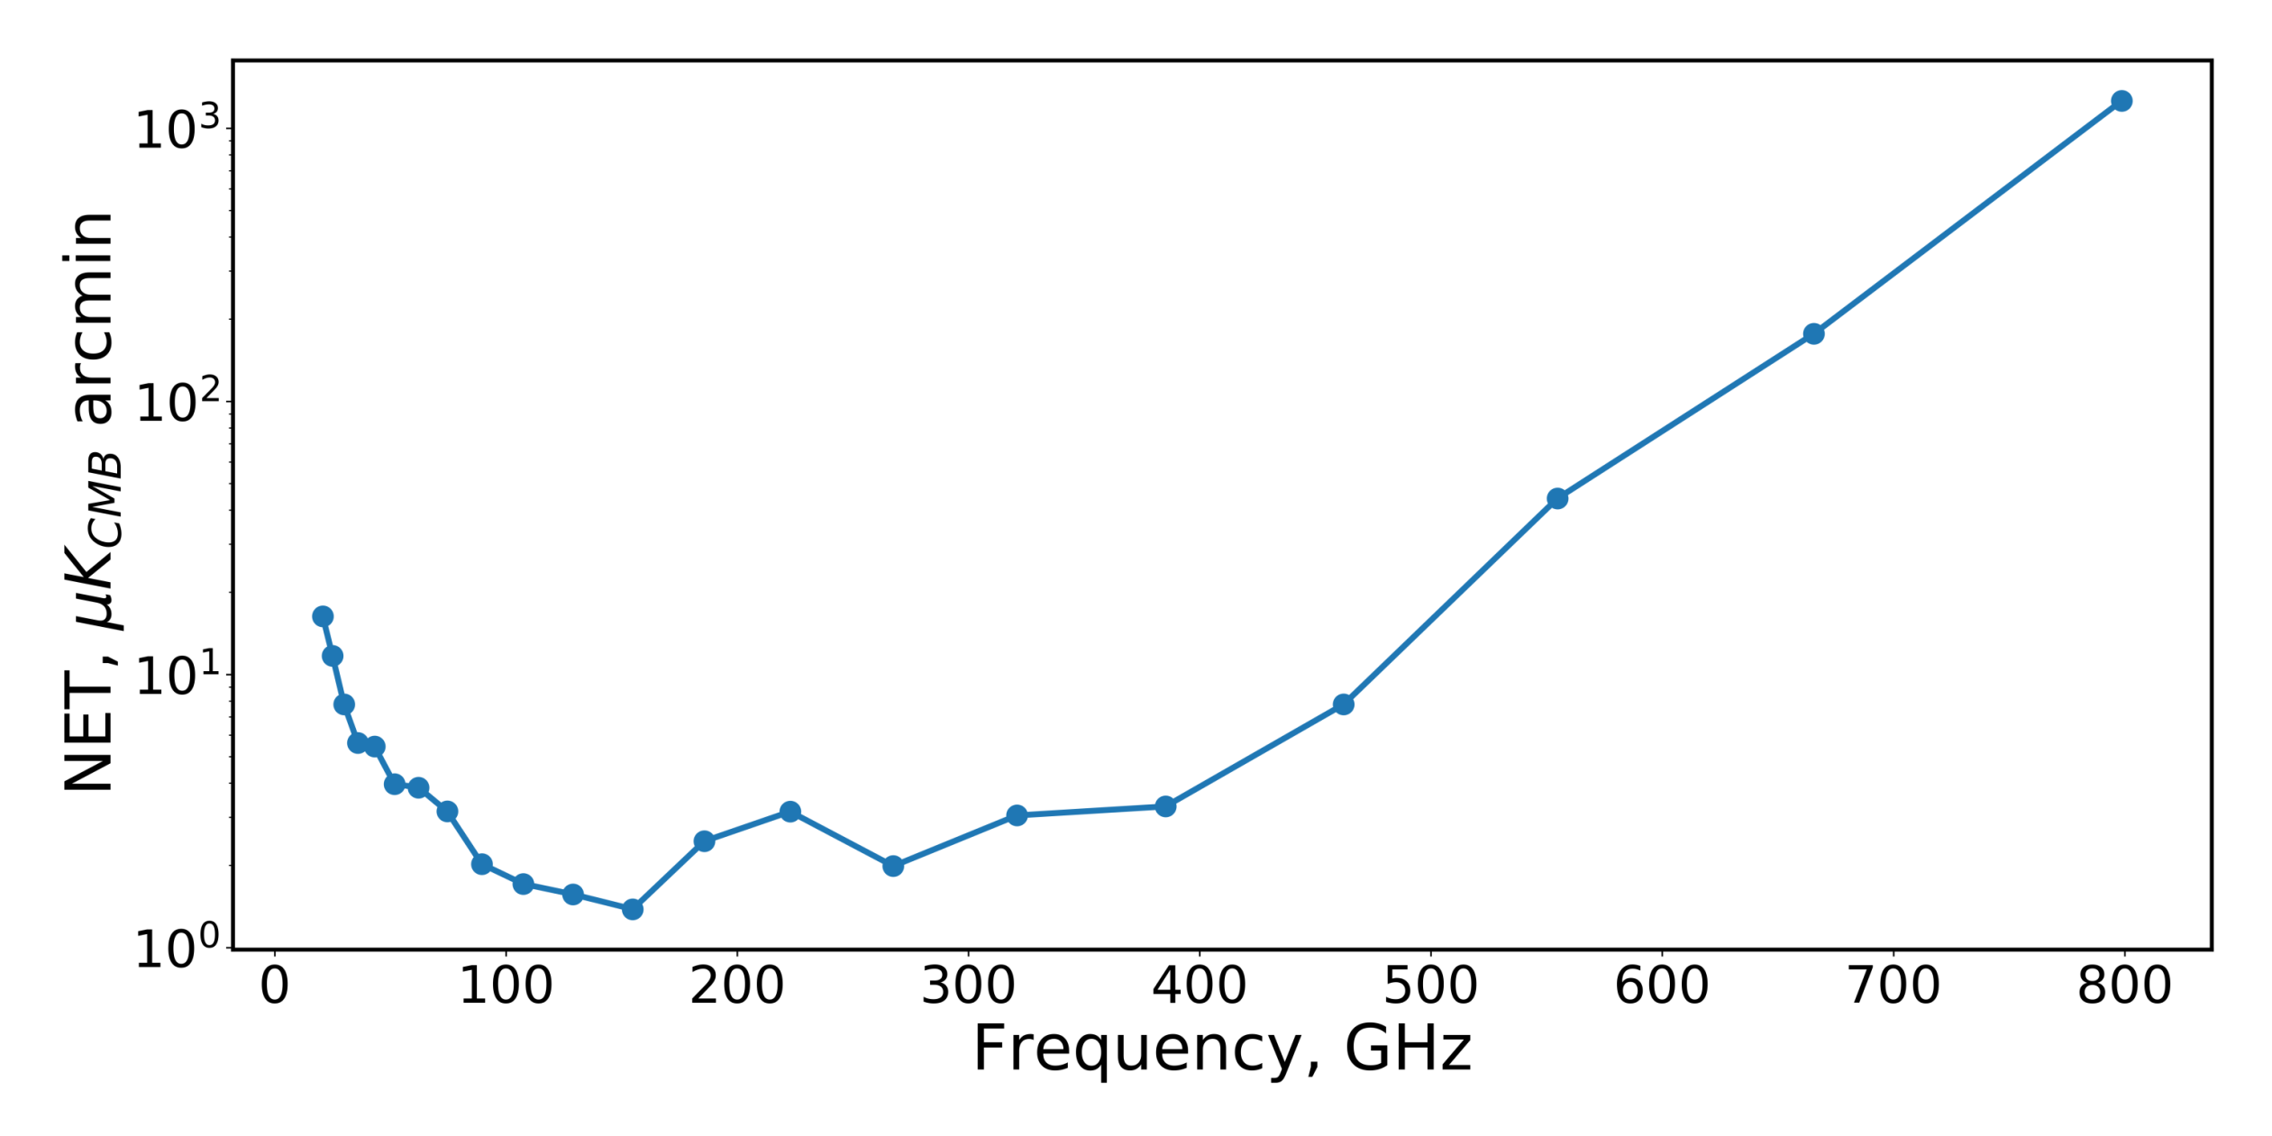
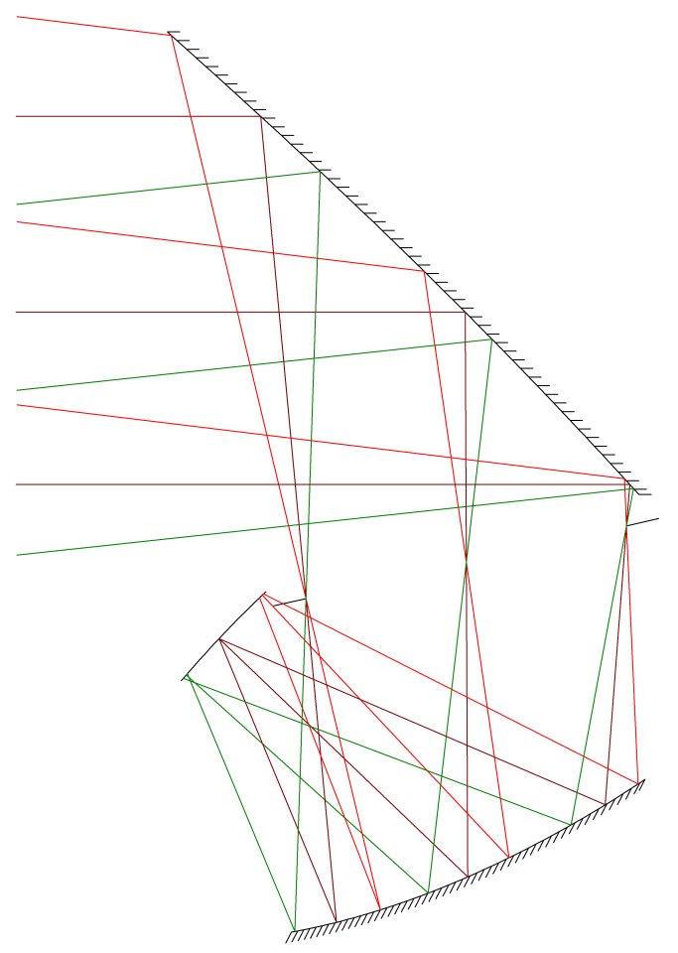
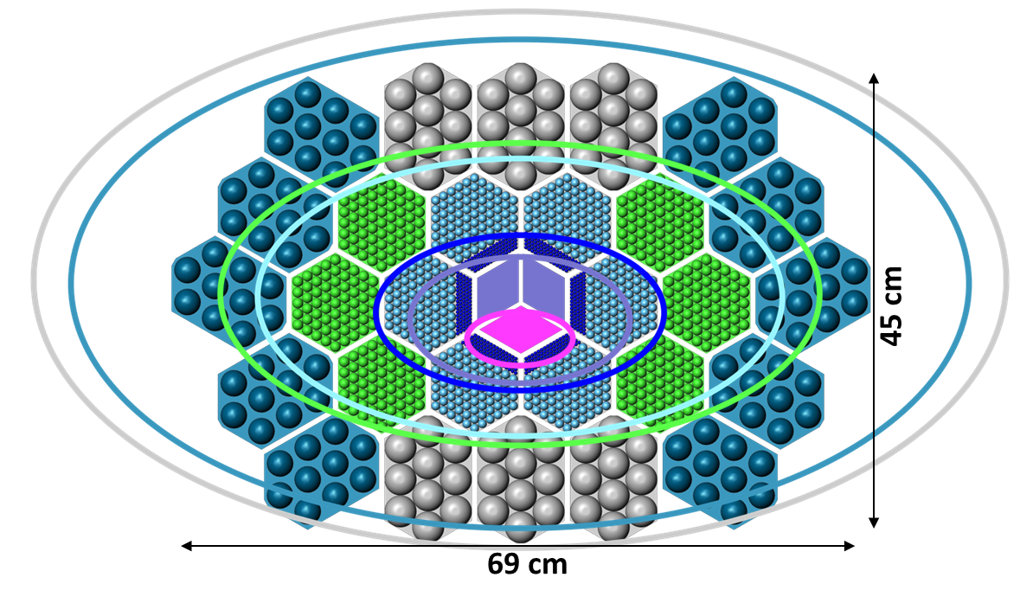
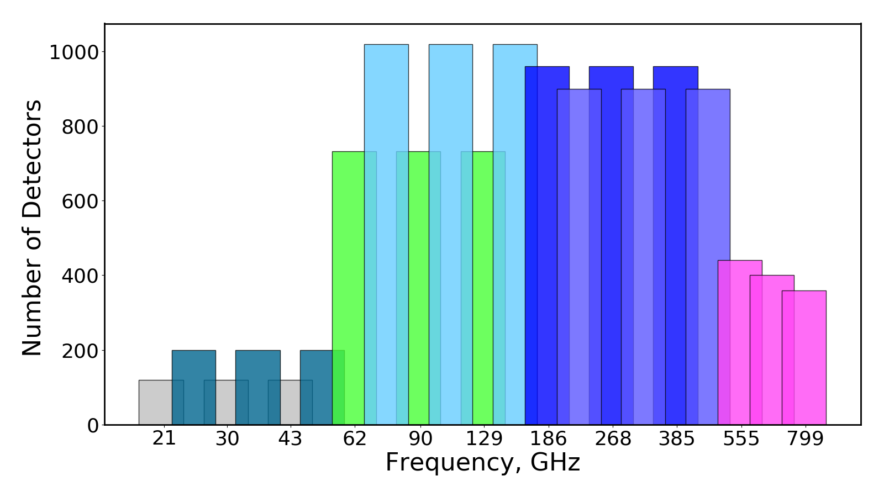
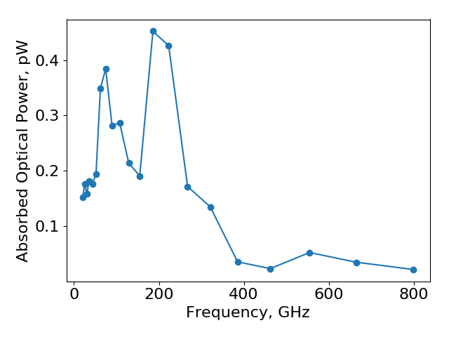
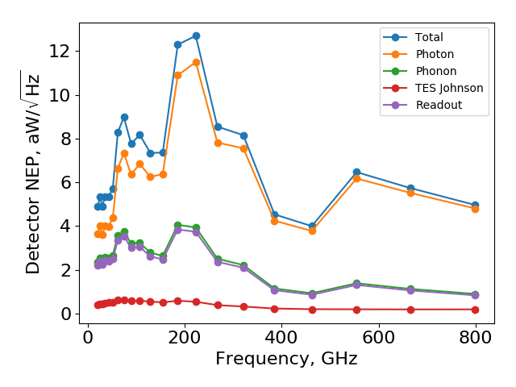
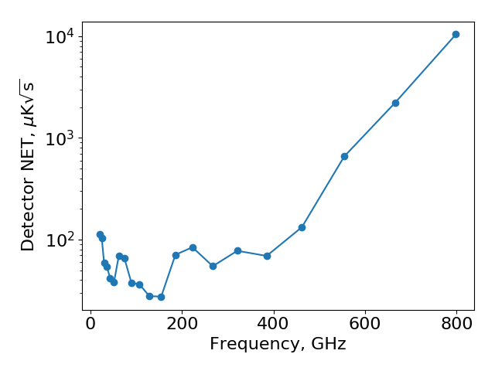
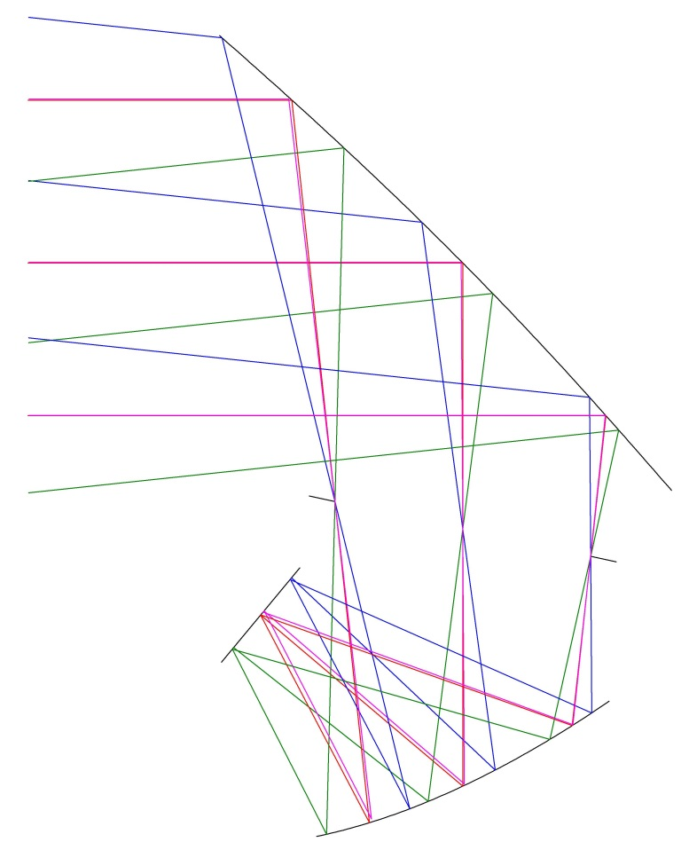
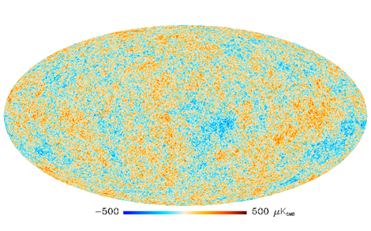

Optical Design of PICO, a Concept for a Space Mission to Probe Inflation and Cosmic Origins
image?
K. Young^{1†}, M. Alverez², N. Battaglia³, J. Bock⁴, J. Borrill⁵, D. Chuss⁶, B. Crill⁷, J. Delabrouille⁸, M. Devlin⁹, L. Fissel¹⁰, R. Flauger¹¹, D. Green¹², K. Gorski⁷, S. Hanany¹, R. Hills¹³, J. Hubmayr¹⁴, B. Johnson¹⁵, B. Jones³, L. Knox¹⁶, A. Kogut¹⁷, C. Lawrence³, T. Matsumura¹⁸, J. McGuire⁷, J. McMahon¹⁹, R. O’Brient⁷, C. Pryke¹, X.Z. Tan¹, A. Trangsrud⁷, Q. Wen¹, G. de Zotti²⁰
¹Univ. of Minnesota, ²Univ. of California Berkeley, ³Princeton Univ, ⁴California Institute of Technology, ⁵Lawrence Berkeley National Laboratory, ⁶Villanova Univ., ⁷Jet Propulsion Laboratory, ⁸Astroparticule et Cosmologie, ⁹Univ. of Pennsylvania, ¹⁰National Radio Astronomy Observatory, ¹¹Univ. of California San Diego, ¹²Univ. of Toronto, ¹³Cavendish Laboratory, Univ. of Cambridge, ¹⁴National Institute of Science and Technology,
¹⁵Columbia Univ., ¹⁶Univ. of California Davis, ¹⁷Goddard Space Flight Center, ¹⁸Kalvi IPMU, Univ. of Toyko, ¹⁹Univ. of Michigan, ²⁰Osservatorio Astronomico di Padova †Email: kyoung@astro.umn.edu
Scientific Objectives
Scientific Observations
Optical Design
Focal Plane
Focal Plane
Detect or place limits on the energy scale of inflation
Determine the number of light relic particles, N_{eff}
Constrain Σm_{ν}, the sum of neutrino masses to 15 meV
Measure τ, the Thompson scattering optical depth to reionization to cosmic variance limits
Understand the role of Galactic magnetic fields in star formation and galactic evolution
… clusters, infrared galaxies, SZ effect, … ? background
Measure or set upper limits on primordial B-modes with σ(r) ∼ 10⁻⁵
Determine the number of light relic particles, N_{eff}, to σ(N_{eff}) = 0.03
Measure τ, the optical depth to reionization to cosmic variance limits, σ(τ) = 0.002
Along with DESI-BAO observations measure Σm_{ν}, the sum of neutrino masses at ≥4σ
Map Galactic magnetic fields from Galactic scales to 0.05 pc in 10 nearby molecular clouds
Discover 10,000s of protoclusters and clusters via the SZ effect
Map the CIB and dusty infrared galaxies across the full sky
Primary, 17 K
10 cm
Aperture Stop, 6 K
Focal Plane,
100 mK
E
D
F
Pixel Type | Upper Frequency (GHz) | Number
A | 48.6 | 68
B | 58.3 | 108
C | 145 | 360
D | 174 | 450
E | 433 | 546
F | 520 | 408
G | 624 | 135
H | 749 | 132
I | 899 | 91
C
G
Secondary,
10 K
H
Satellite and Instrument
50 cm
B
I
1.4 m Open Dragone, numerically optimized
19 x 13 degree field of view
f/1.42 system gives compact focal plane
Low far sidelobes, largest 70 dB below main beam
Cold stop reduces detector load
A
70 times the polarization sensitivity of Planck
21 bands from 20 GHz to 800 GHz
25 % fractional bandwidth
12,996 polarization sensitive TES bolometers
1’ resolution at 800 GHz, 38’ at 20 GHz
Full-sky coverage
TDM readout: 128 rows, 100 columns
Launch vehicle is a Falcon 9, 4.6 meter fairing
L2 orbit, precession and spin based scan strategy with precession angle 26° and boresight angle 69°
12,356 single polarization TES bolometers
Lens coupled tri-chroic pixels
FDM or TDM readout , > 100x multiplexing factor
Three color pixels, six polarization sensitive detectors per pixel
Detector Noise Predictions
Mirrors at 40K, 4K, emissivity,
Active cooling of stop and secondary
Stop at 4K
FDM/TDM readout system, > x100 multiplexing
Lens coupled broadband multichroic pixels
Edge taper of 5,10,20 dB
100 mK bath
Psat = 2x Pload
4 year mission at 95 % observing efficiency
Orbit at L2
White noise: photon, phonon, readout, Johnson
Details. . . .
Noise Assumptions
CMB
Primary mirror
15 K
Secondary mirror 10 K
Low pass filter
1 K
Mirrors at 40K, 4K, emissivity,
Active cooling of stop and secondary
Stop at 4K
FDM/TDM readout system, > x100 multiplexing
Lens coupled broadband multichroic pixels
100 mK bath
Psat = 2x Pload
4 year mission at 95 % observing efficiency
Orbit at L2
White noise: photon, phonon, readout, Johnson
Details. . . .
ν_{low}
ν_{mid}
Multichroic pixel 100 mK
1.2 m Cross Dragone
Larger, difficult to baffle sidelobes
f/2.5 or greater increases focal plane size and mass
Large secondary difficult to actively cool
Lower optical aberrations
0.5 m Open Dragone
Lower resolution
Physically smaller focal plane reduces detector count
Smaller system reduces costs
ν_{high}
Cold stop and optics box 6 K
Model
White noise only
Includes photon (dominates), phonon, readout, and TES Johnson noise terms
5 year mission at 95% observing efficiency
Safety factor of 2, P_{sat} = 2 P_{opt}
70 % bolometer effeciency
100 % yield
Results
CMB and stop are the largest optical load in all bands
Maximum load from stop is at 223 GHz and is 4.7 times the CMB load
NEP_{phonon} / NEP_{photon} is 65% at 21 GHz and 19% at 800 GHz
Bose / Poisson photon noise is 1.5 at 21 GHz and drops below 10% at 321 GHz.
Full sky polarization map depth is 0.62 μK_{CMB}-arcmin
Few major assumptions.
Conclusions from paper:
Photon dominates,
TDM = FDM
Bunching fraction
Load sources?
Multichroic pixel make stop illumination dependent on band
Edge tapers are 4.8, 10, 20.7 dB for low, mid, high
Affects optical efficiency, optical load, and telescope beam size
50 cm
Summary
With 70 times the polarization sensitivity of Planck, PICO will provide the next generation of full sky mm-wave observations. These data will allow the astronomical community to understand the universe across many scales from inflation and the growth of structure to galaxy evolution and star formation.
Reference
[1] C. Dragone, "First-order correction of aberrations in Cassegrainian and Gregorian antennas," in IEEE Transactions on Antennas and Propagation, vol. 31, September 1983.
The PICO collaboration thanks NASA for supporting this study.
Sensitivity
White noise only
Includes photon (dominates), phonon, readout, and Johnson noise terms
4 year mission at 95% observing efficiency
Total integrated polarization map depth of 0.62 µK_{CMB} arcmin

