Slide 1
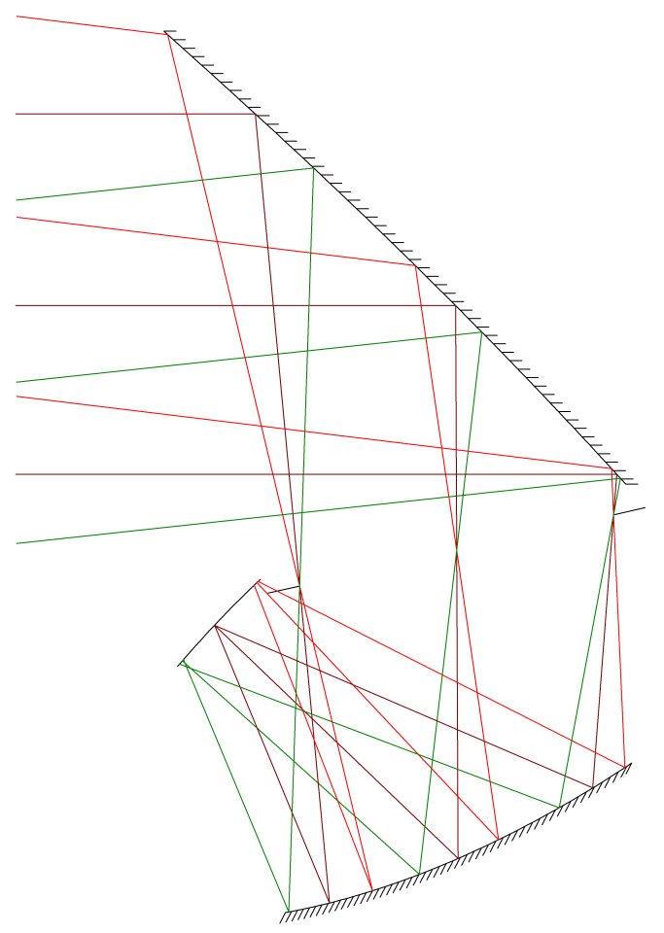
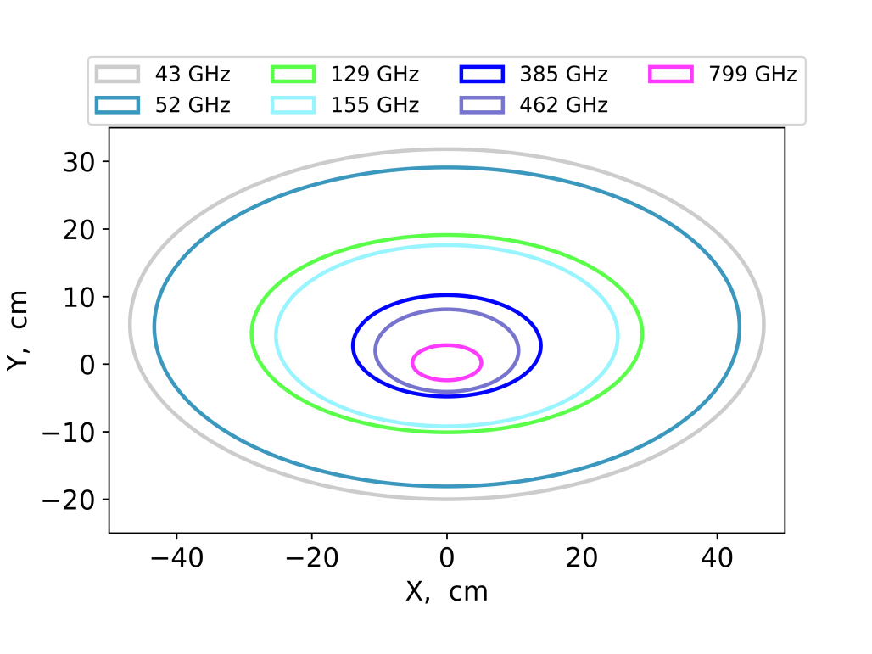
Primary, 15 K
Aperture
Stop, 6 K
Focal Plane, 100 mK
Z
Y
50 cm
Secondary, 10 K

Slide 2
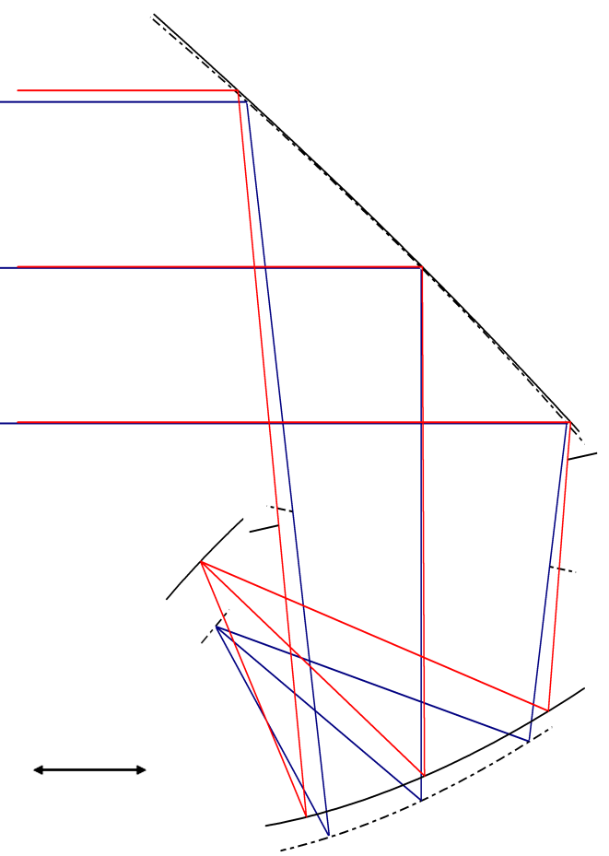
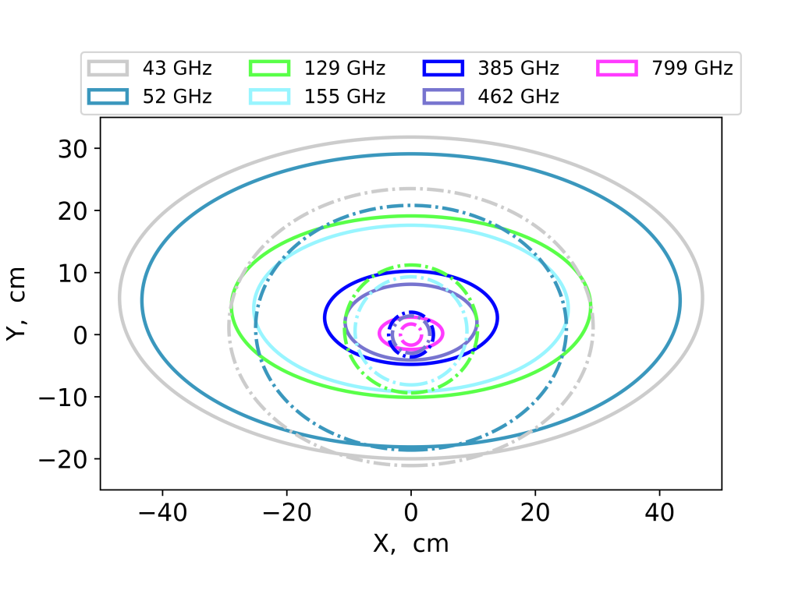
Z
Y
50 cm

