Slide 1
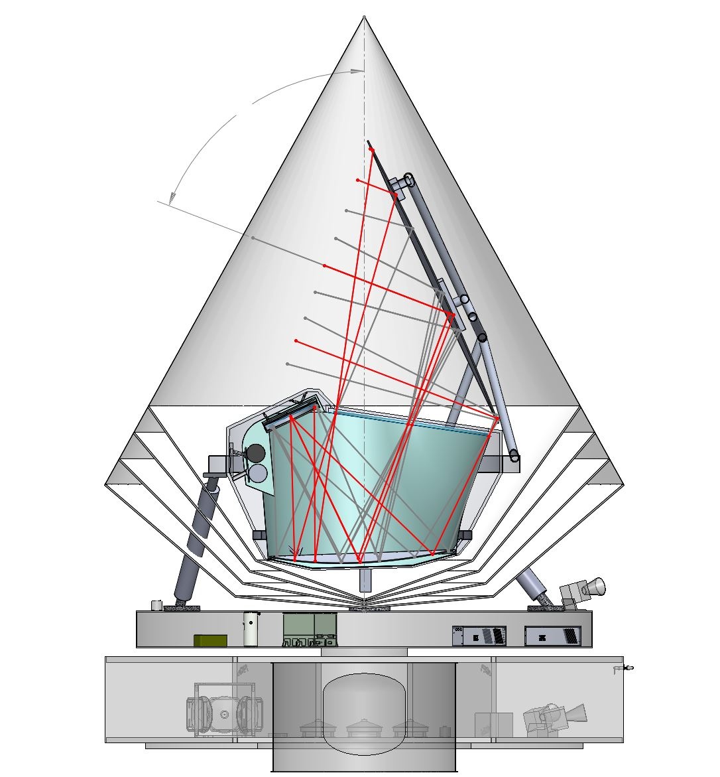
Primary Reflector, 20 K
β=69°
Aperture Stop, 6 K
Shadow Cone
Focal Plane, 100 mK
V-Groove Shields
Secondary Reflector, 10 K
Optics Box, 6 K

Slide 2
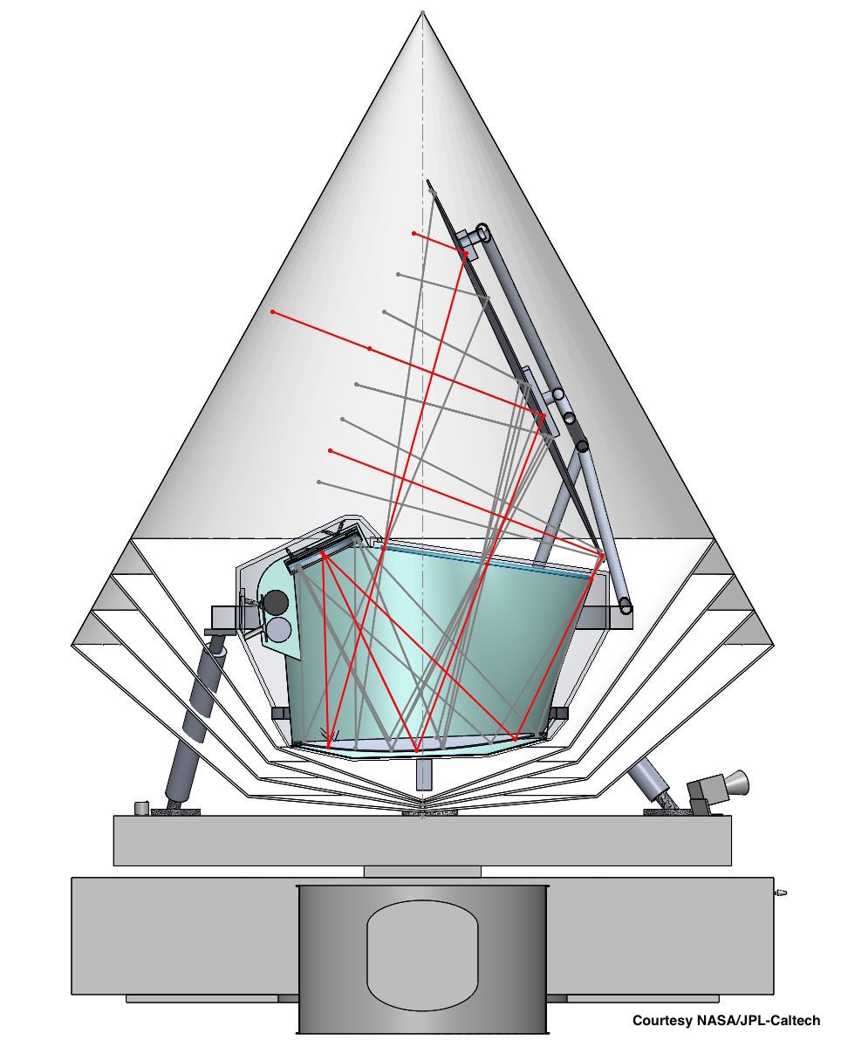
Spin Axis
Primary Reflector, 20 K
69°
26°
Boresight
Shadow Cone
Aperture Stop, 6 K
V-Groove Shields
Focal Plane, 100 mK
Secondary Reflector, 10 K
Optics Box, 6 K
Sun

Slide 3
Instrument Elements on Spacecraft Bus
4K Cryocooler Assembly (see figure, outlined by red box)
30 cm from bottom of plate to top of 18 K HX
15 cm widest point
12 cm depth, max
4 K Cryocooler drive electronics
Assume about the same volume as Cryocooler Assembly
Sub-K Cryocooler drive electronics
29.2 cm x 31.8 cm x 36.0 cm
Detector warm electronics
Redundant, so 2 boxes, each 15cm X 18cm X 48cm

