Slide 1
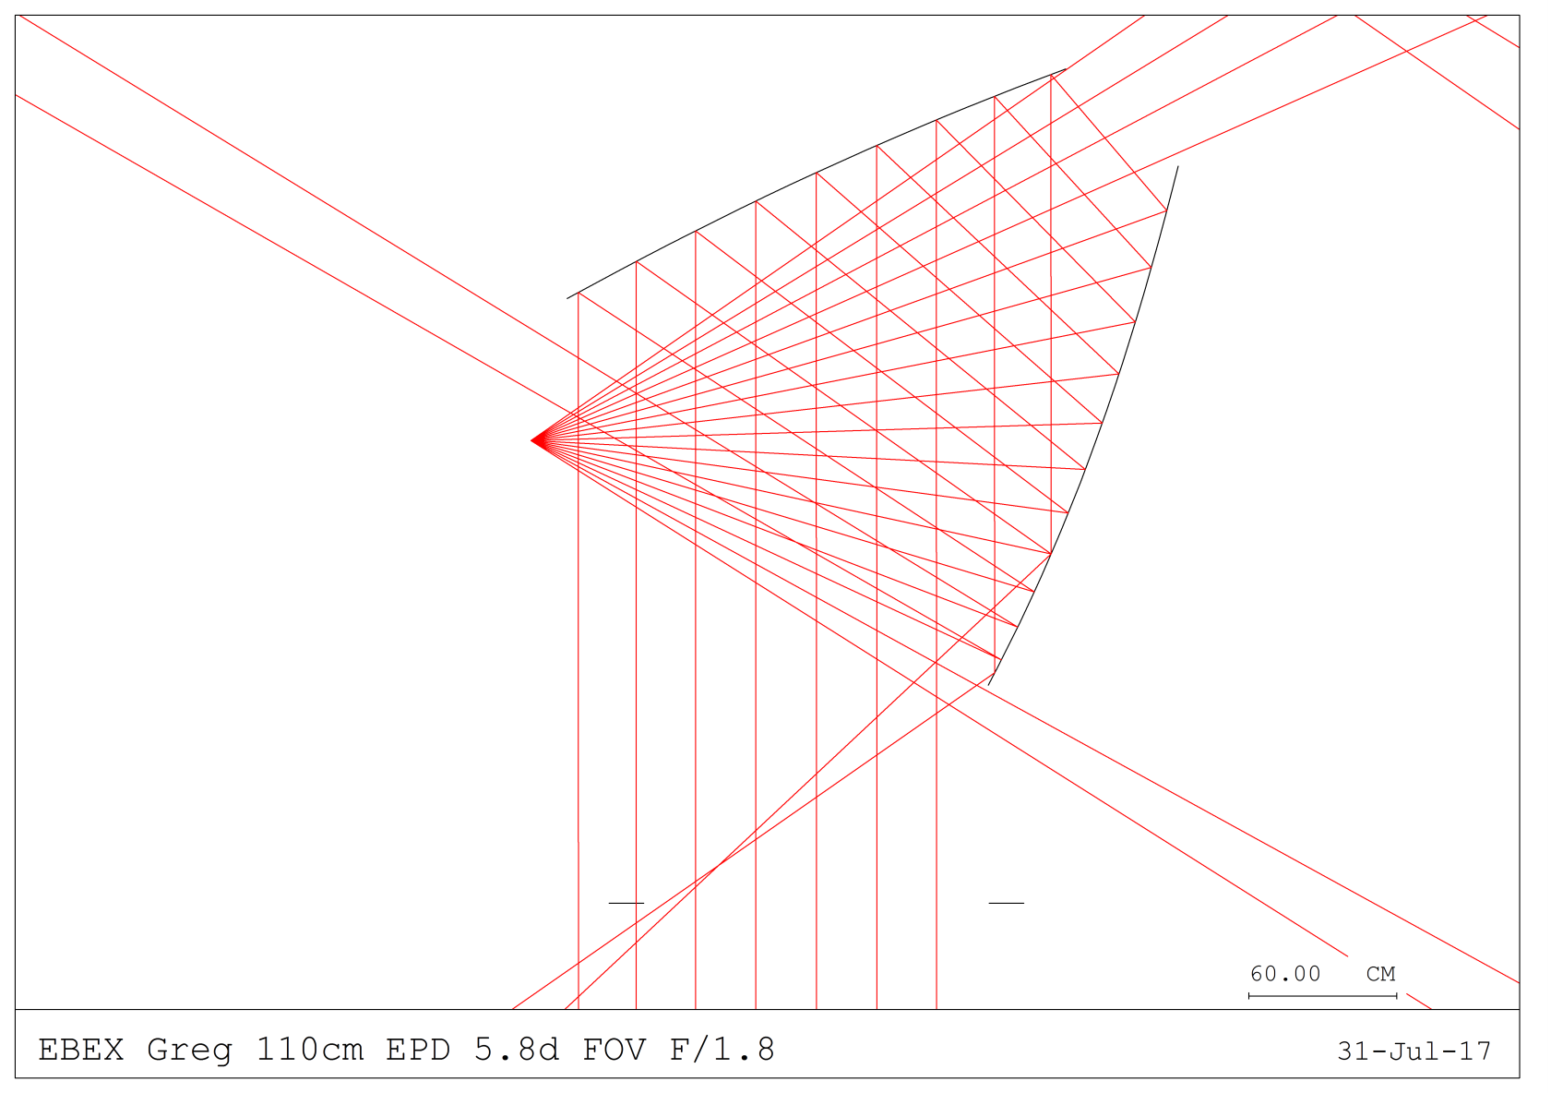
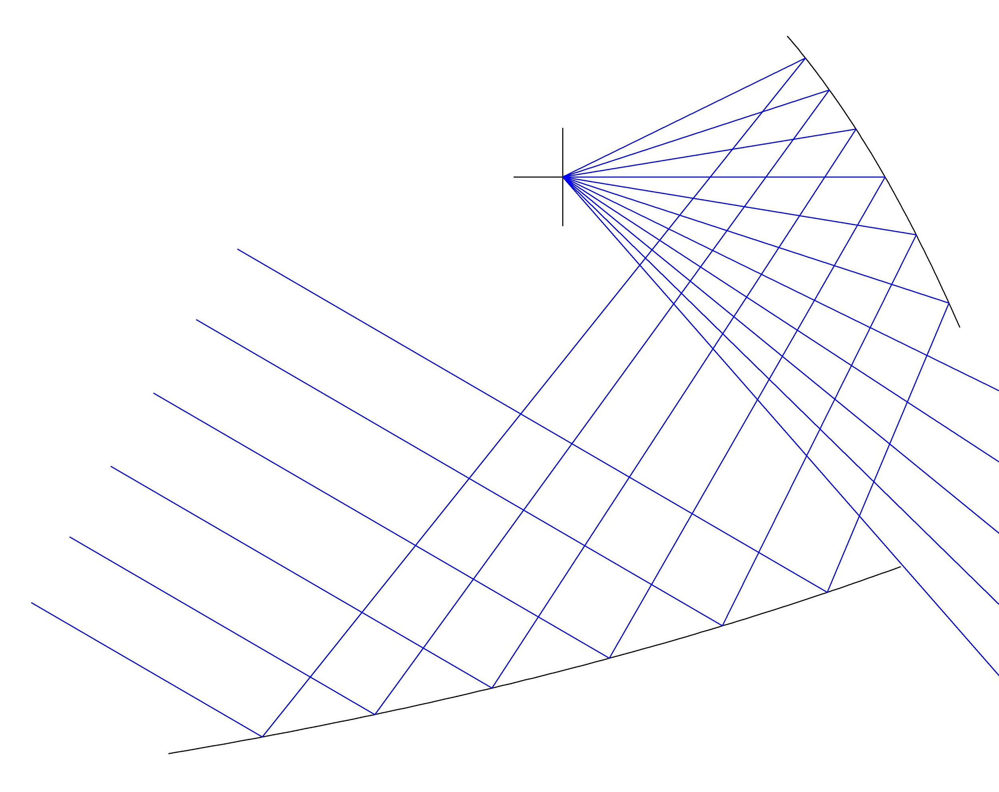
Cross-Dragone
Open-Dragone
Sidelobe
Focal plane
Direct view to sky
Focal plane
Baffles
Baffles

