Slide 1
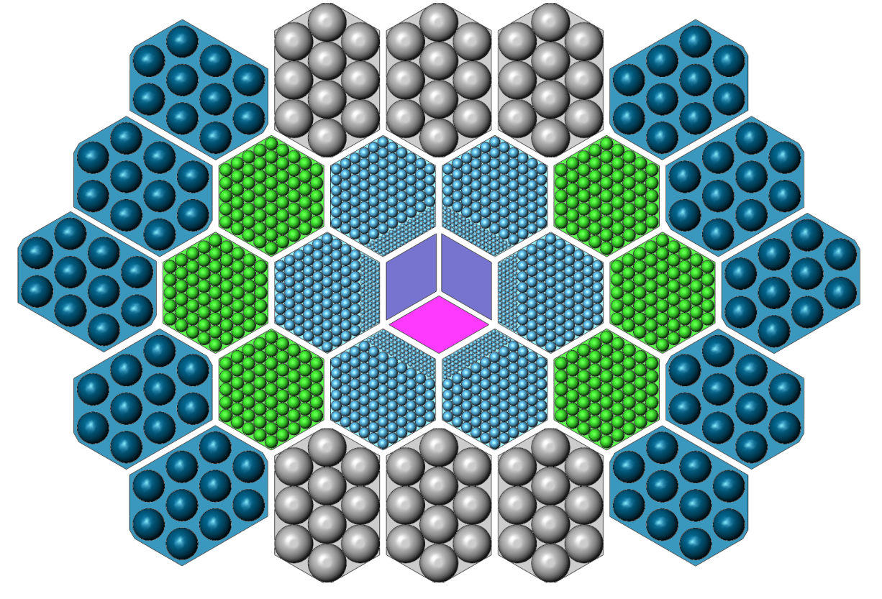
45 cm
69 cm

Slide 2
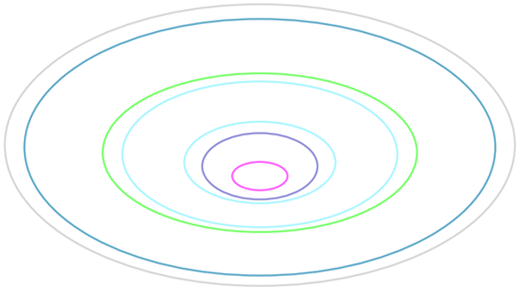
45 cm
69 cm

Slide 3
45 cm
69 cm

