Slide 1
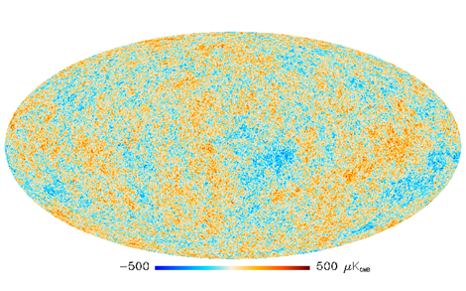
Secondary mirror
Low pass filter
CMB
Primary mirror
ν_{low}
ν_{mid}
Multichroic pixel
ν_{high}
Cold stop and optics box

