Slide 1
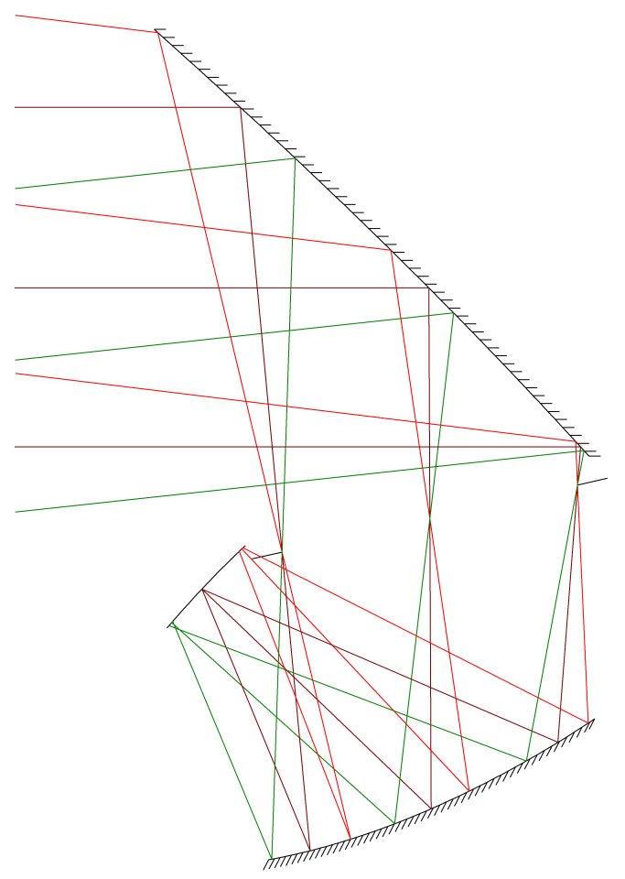
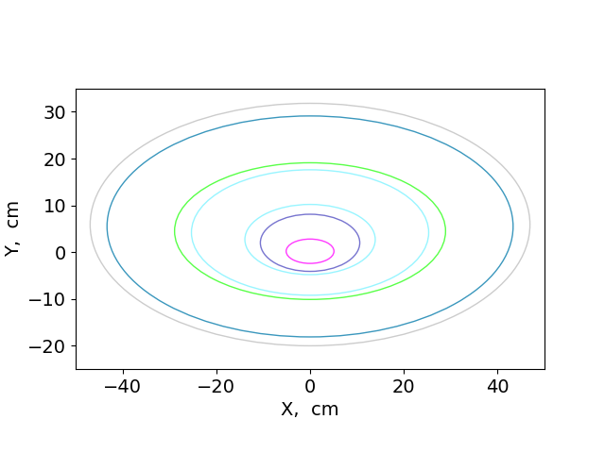
Primary, 40 K
Aperture
Stop, 4 K
Focal Plane, 100 mK
50 cm
Secondary, 4 K

