Slide 1
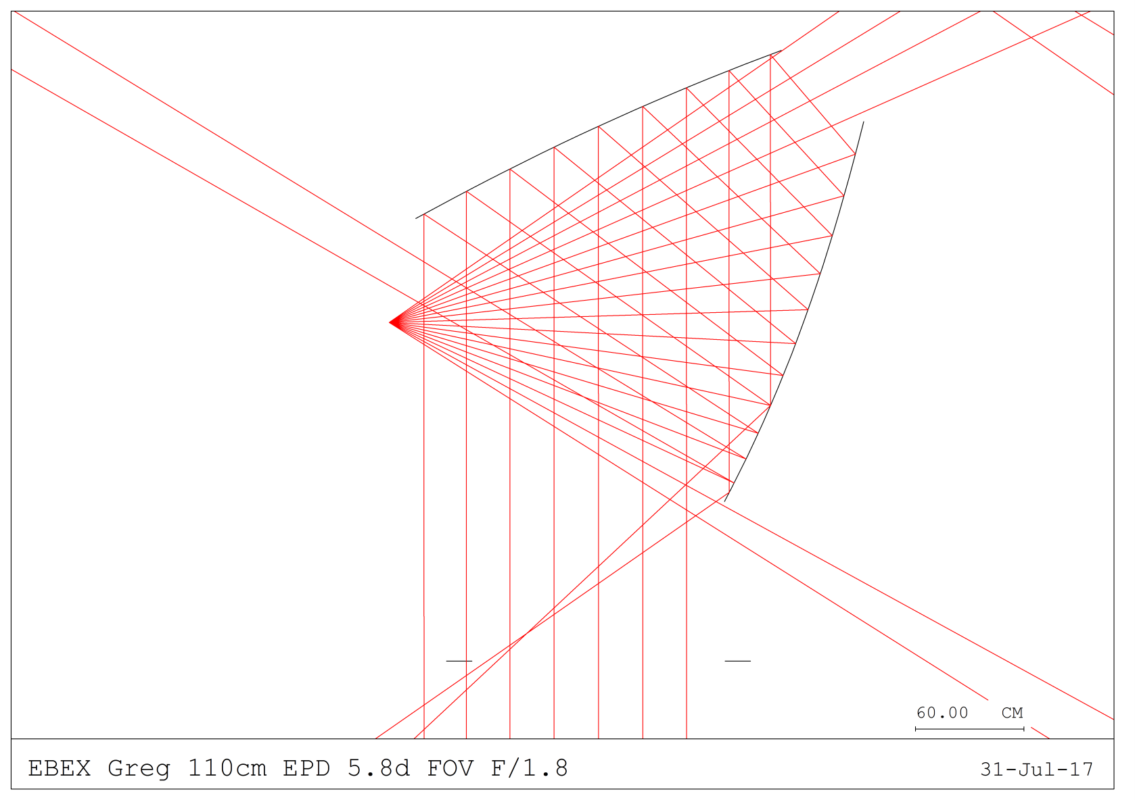
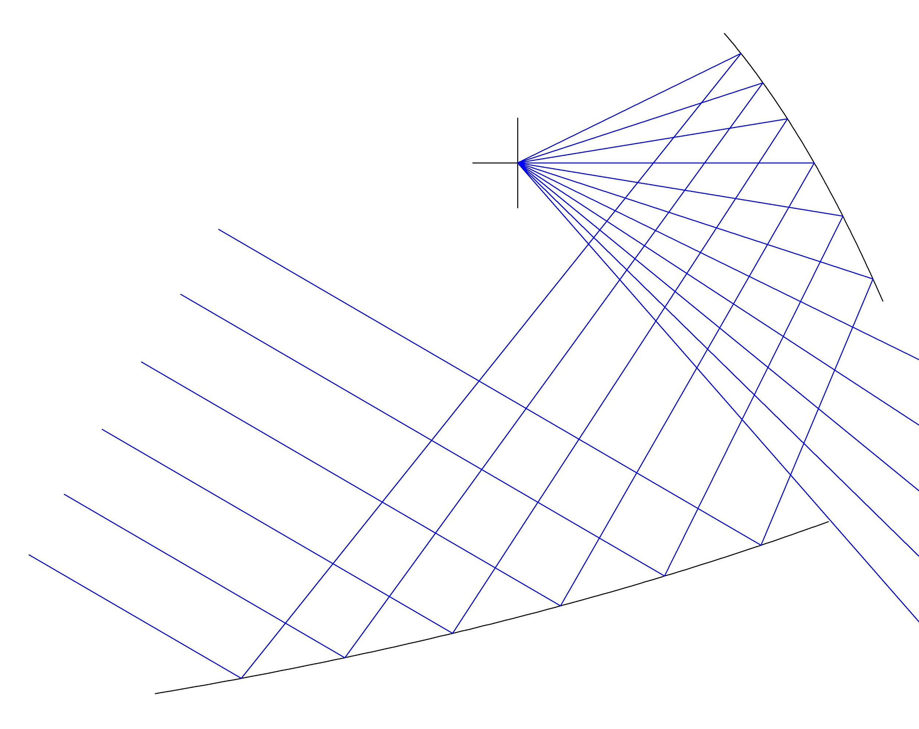
‘Clipping’ sidelobe
Focal plane
Direct view to sky
Focal plane

