Slide 1
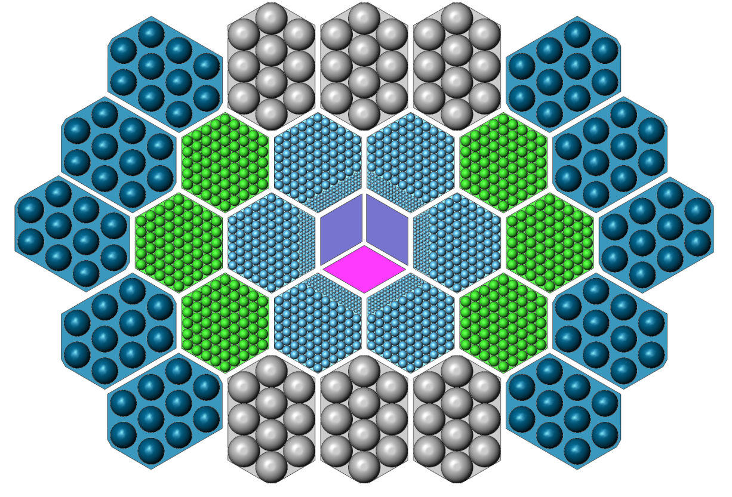
45 cm
69 cm

Slide 2
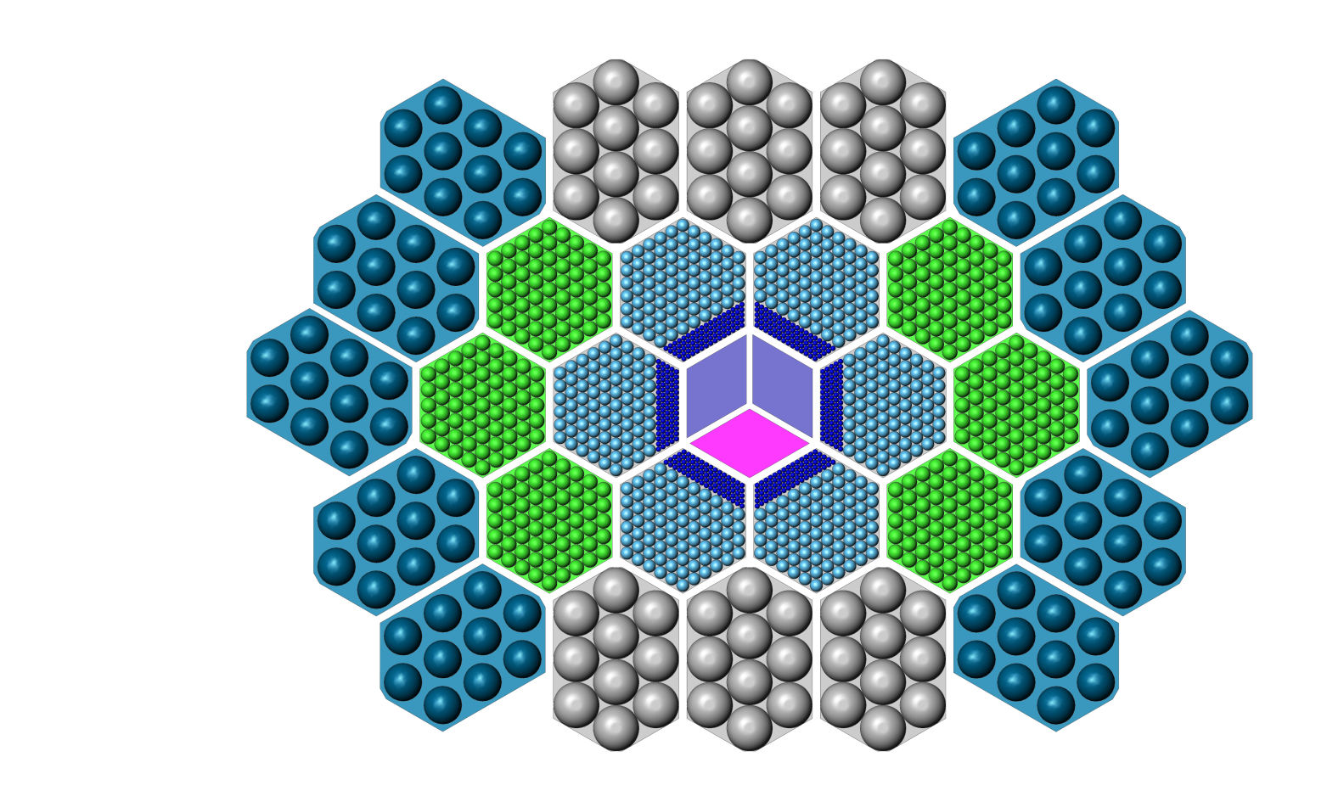
45 cm
69 cm

Slide 3
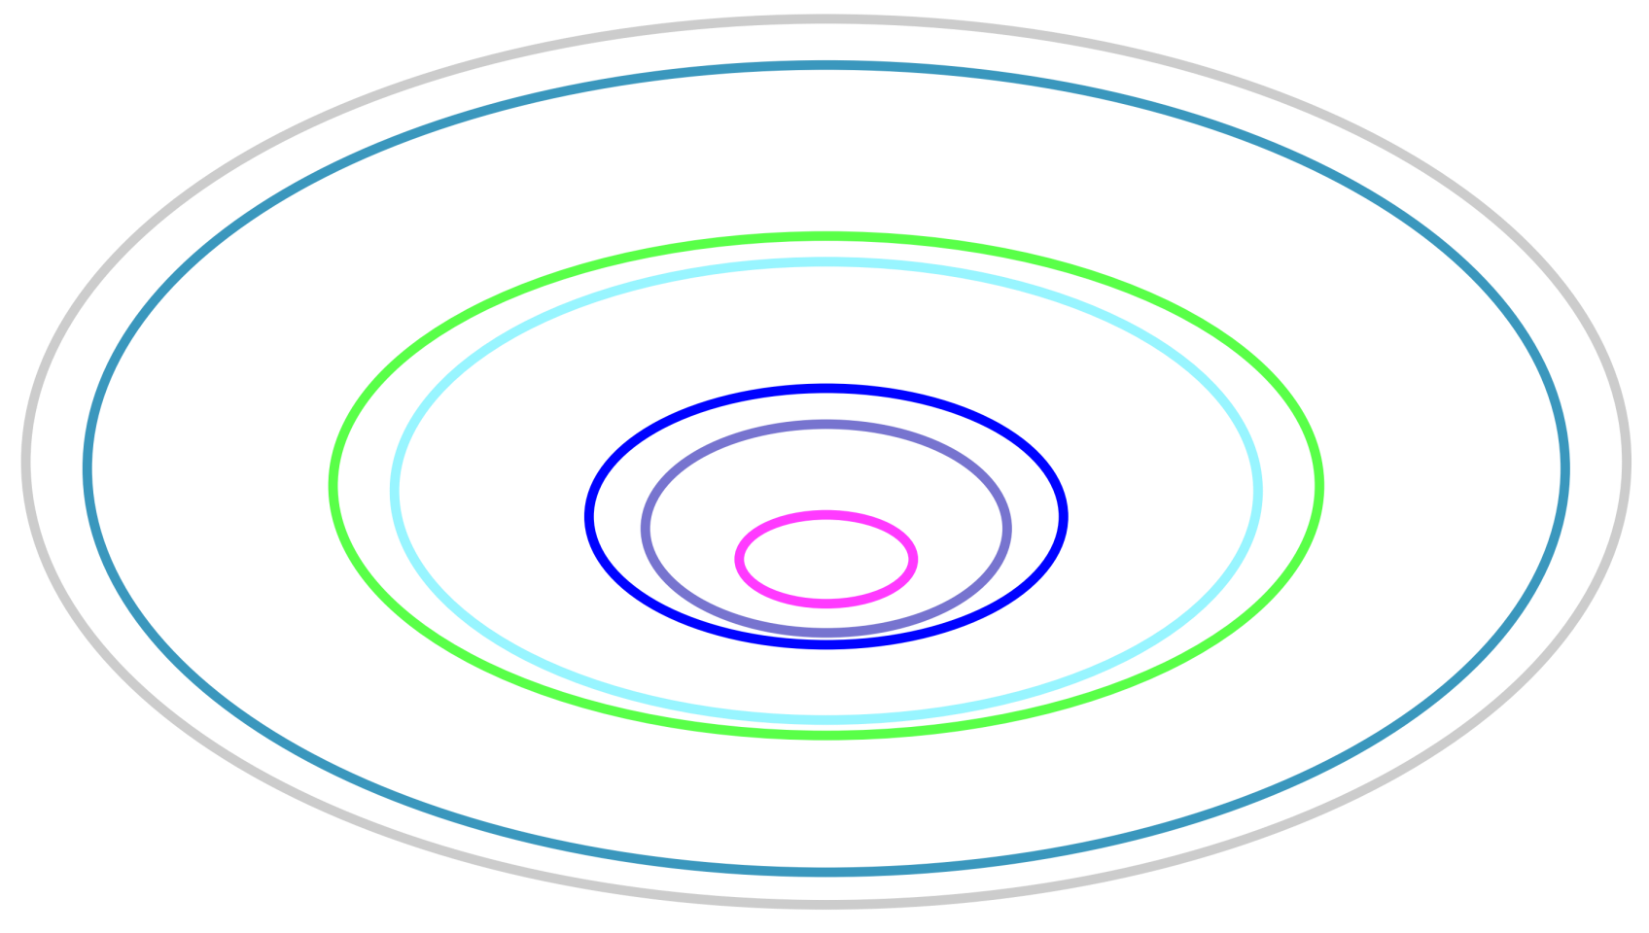
45 cm
69 cm

Slide 4
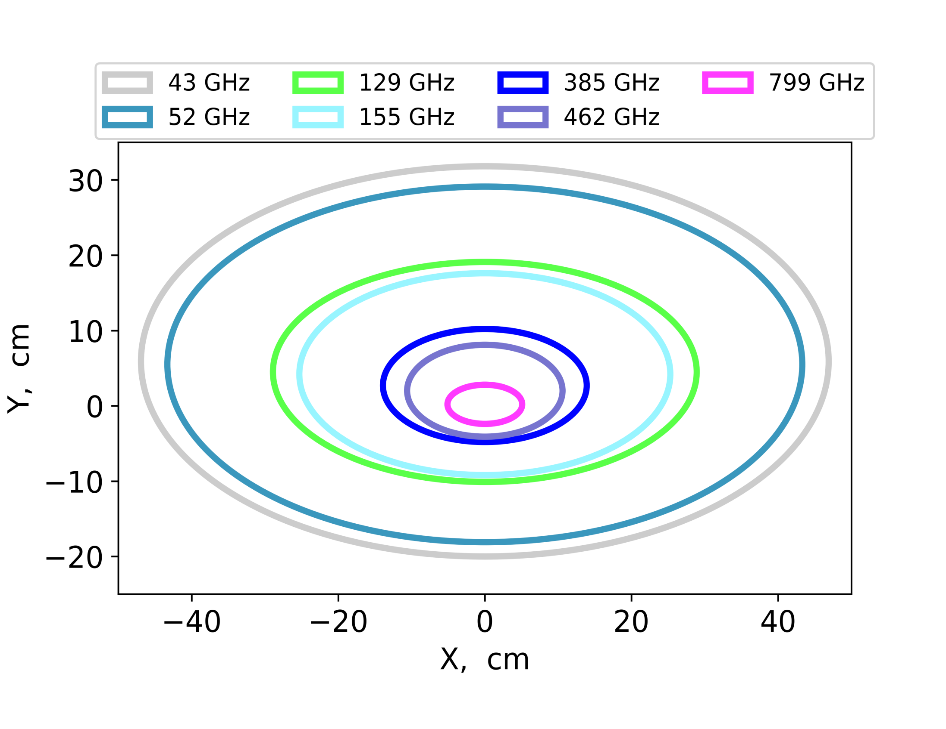
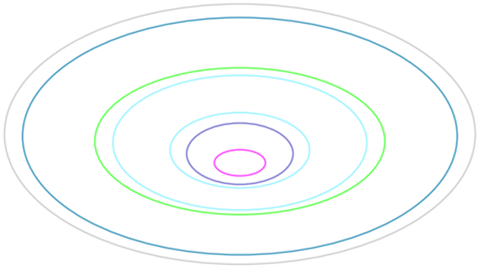
45 cm
69 cm

Slide 5
45 cm
69 cm

