Slide 1
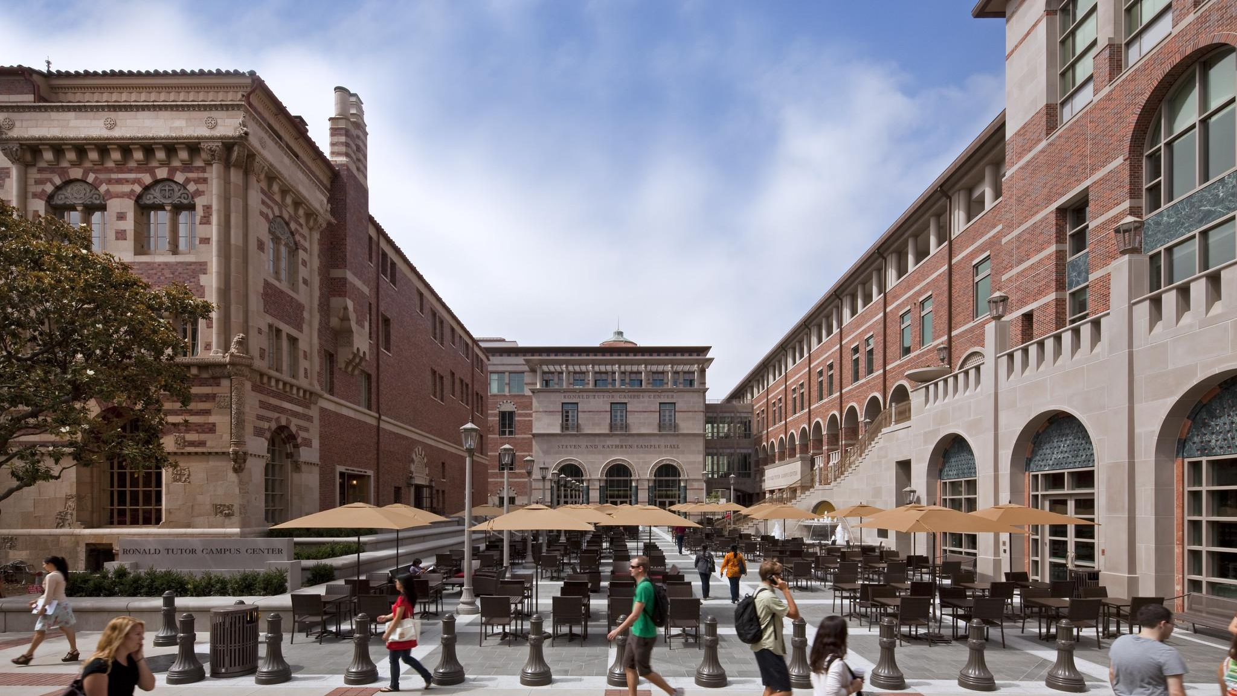

ACCOUNT MANAGEMENT ON LAGUNA
JAMES HONG AND DANI CANNELLA
SUPPORT EMAIL: LAGUNA-SUPPORT@USC.EDU

Slide 2

PRE-REQUISITES
Each PI should contact their local administrator to request for Laguna access. Administrators will provide PIs with a Google form to fill out.
We need your eduPersonPrincipalName (EPPN) and email address for provisioning. Your EPPN will be your Laguna username.
Go to our test page to find the values (may not be what you expect)
https://hpcaccount.usc.edu/static/secure/incommon.php
CARC support will provision the project and PI account.
Once the project is created, PIs can access it in the user portal.
Our Office in New Jersey

Slide 3
COLDFRONT RESOURCE ALLOCATION SYSTEM
Open-source application developed by the University at Buffalo
Adopted by USC in 2020 – heavily customized and integrated
Go to https://hpcaccount.usc.edu/
Select your local IDP and enter your credentials
Find and click on your project
Update Project Information
Add InCommon User – ask users to lookup their EPPN and email
Request Resource Allocations
Laguna Cluster
Project Storage

Slide 4
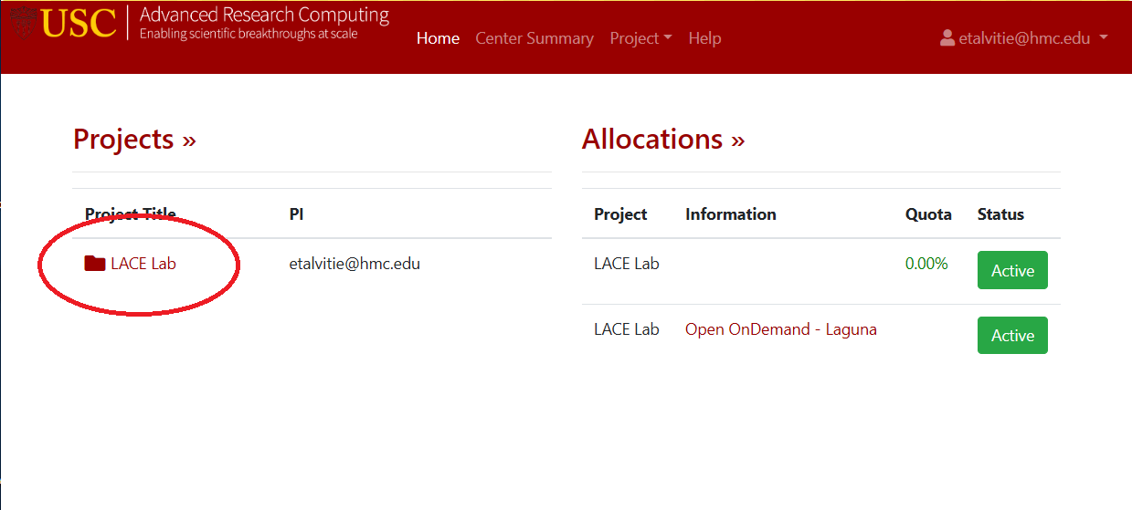
USER PORTAL HOME

Slide 5
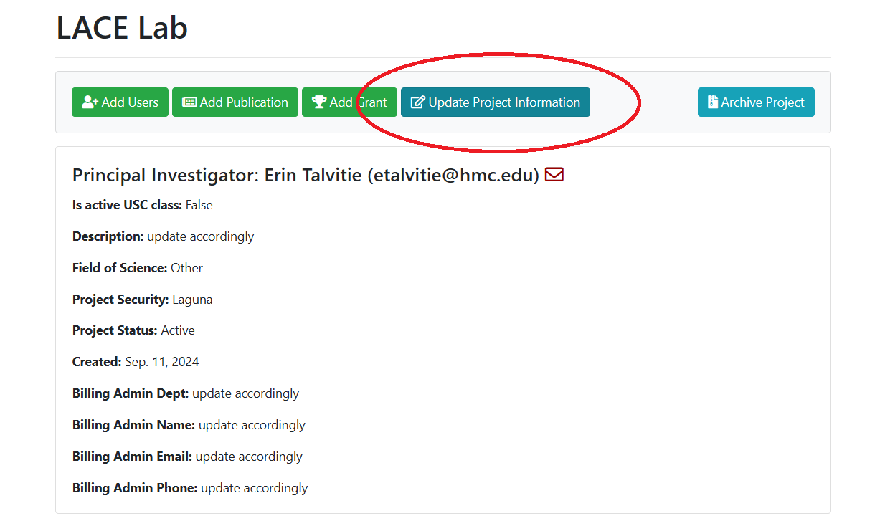
USER PORTAL PROJECT PAGE

Slide 6
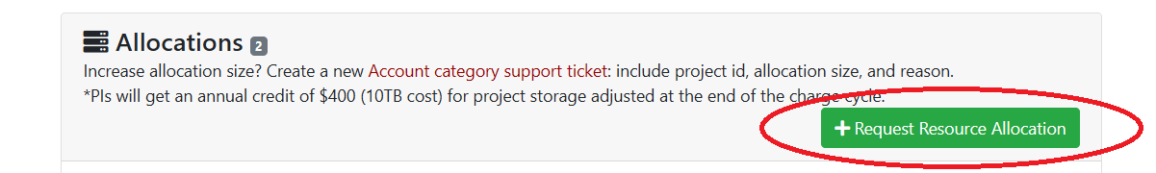
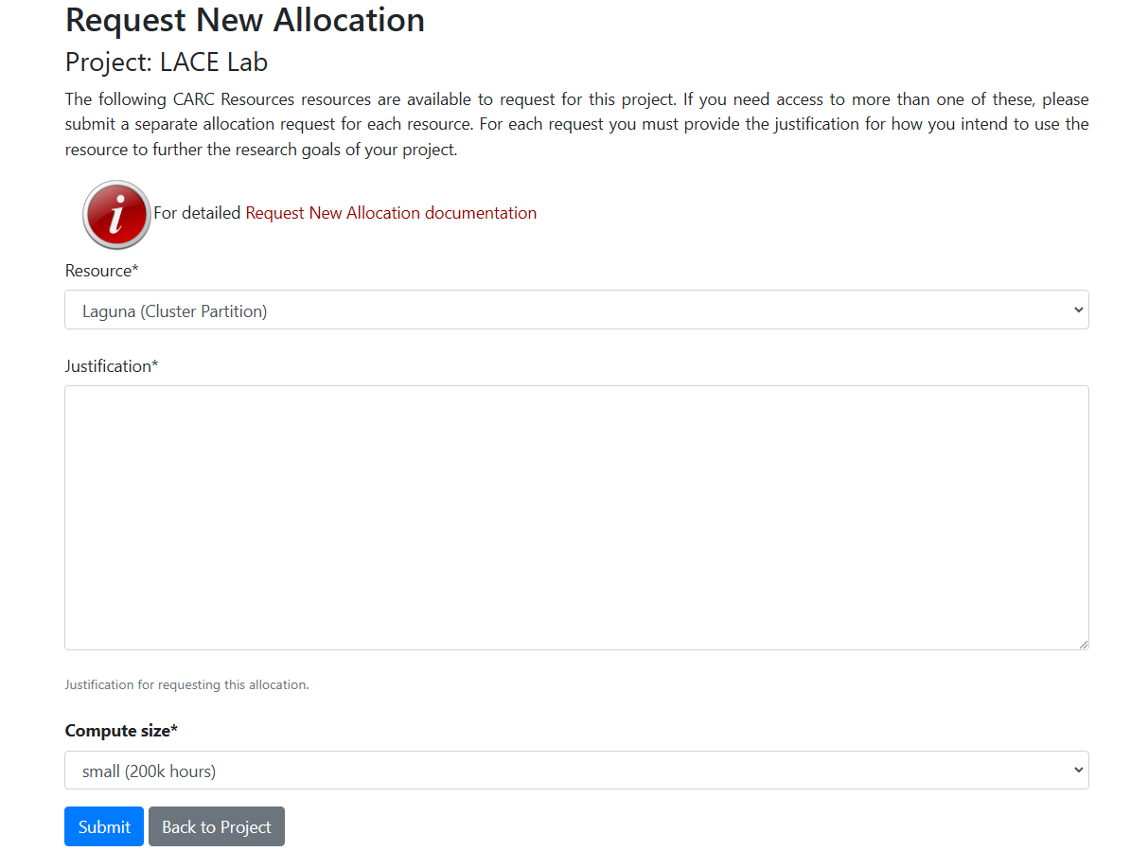
USER PORTAL REQUEST ALLOCATION

Slide 7
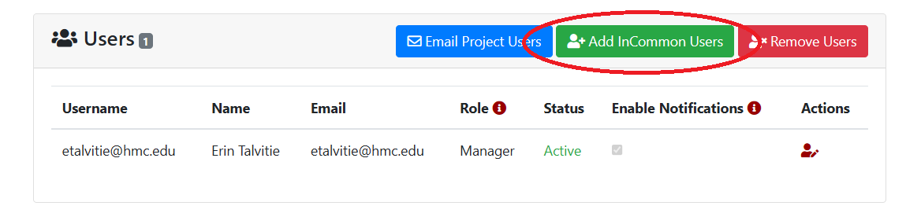
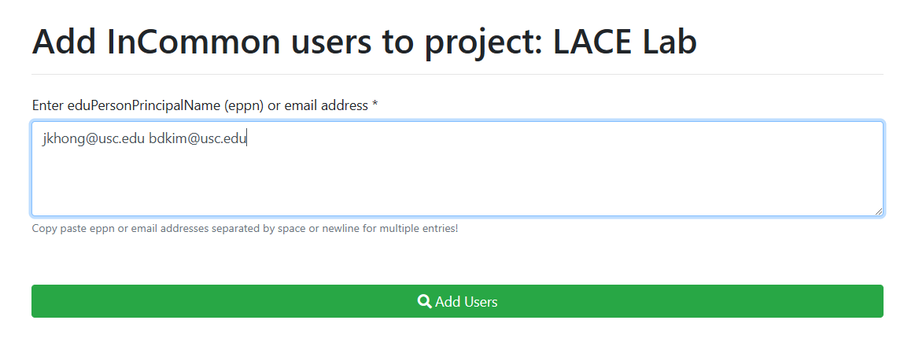
USER PORTAL ADD INCOMMON USERS

Slide 8
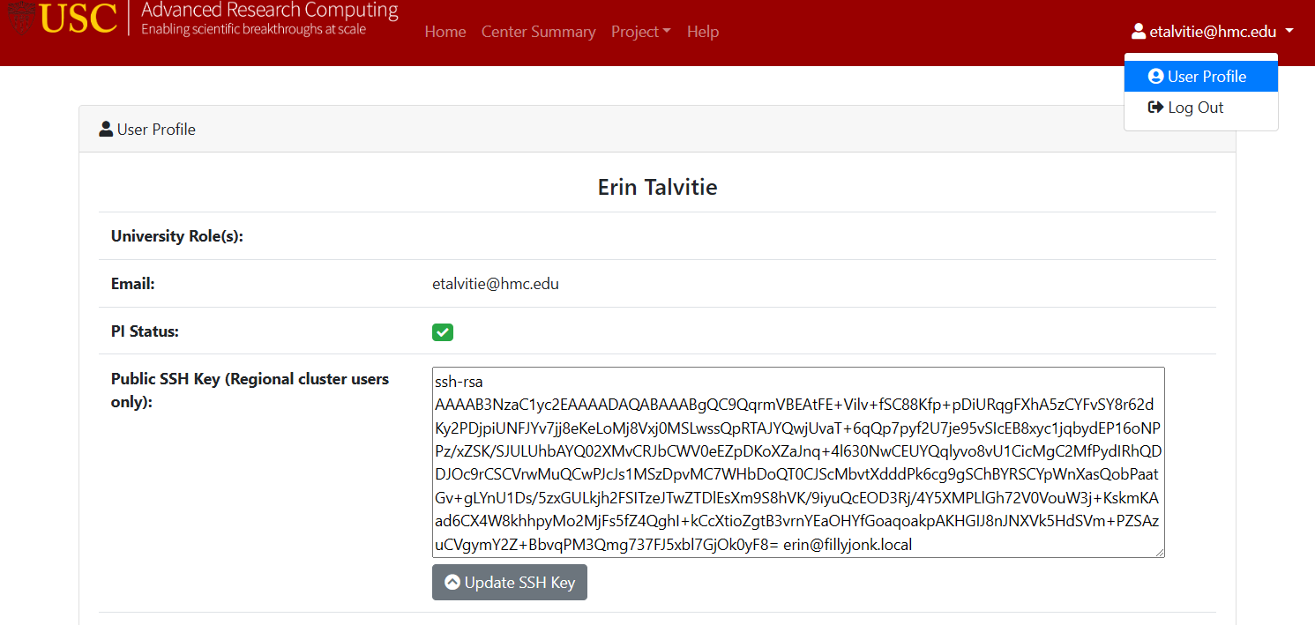
USER PORTAL USER PROFILE

