Slide 1
Create GitHub Authentication Token
Settings (top right) > Developer Settings > Personal access tokens > Generate New Token

Slide 2
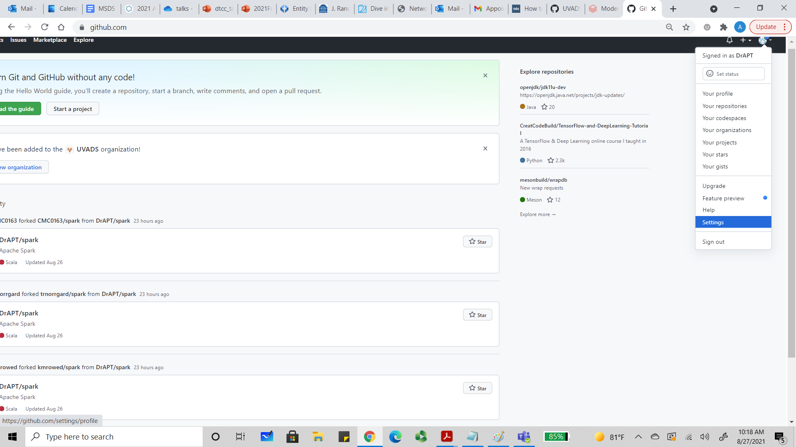

Slide 3
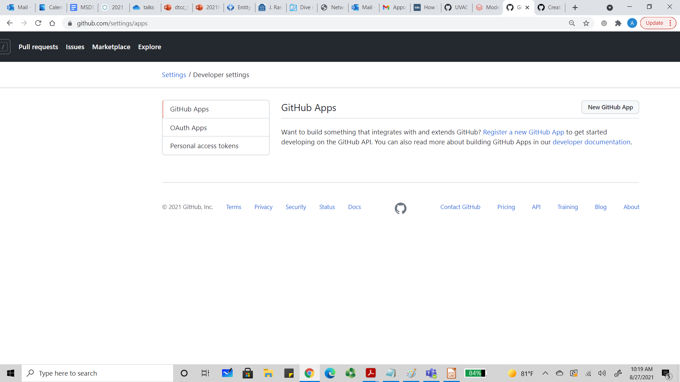

Slide 4
