Slide 1
WomenTechWomenYes (WTWY)
Street Team Placement Recommendations 2021
By Cheryl McGowan 9/17/2021

Slide 2
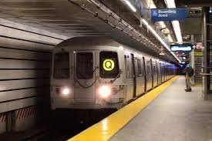
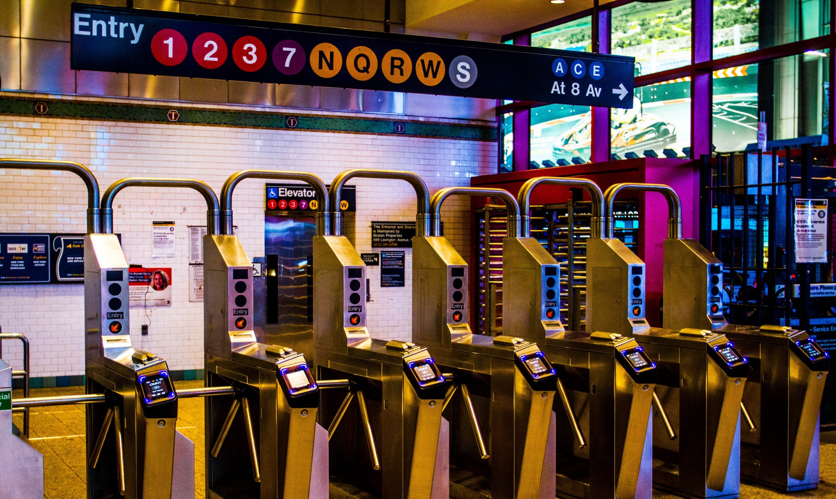
Project Goals
Provide recommendations on the best subway stations to place WTWY street teams at in order to gather email addresses of people interested in attending the annual gala and/or donating to the organization
Identify NYC area MTA subway stations with the most traffic
Compare those stations to Big Tech companies office locations to find target audience
Provide insight into the minimum, maximum and average number of volunteers needed to cover these stations
Photos by ABC7NY.com and Paula Silva on Unsplash

Slide 3
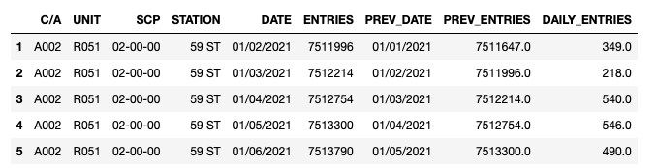
Data Sources and Tools
SQLAlchemy, Pandas and matplotlib were used to analyze, clean, filter, sort and visualize the data.
MTA publicly available data set on daily entries and exits from turnstiles
One feature that describes the data is cumulative daily entries per turnstile and station YTD 9/3/2021.

Slide 4
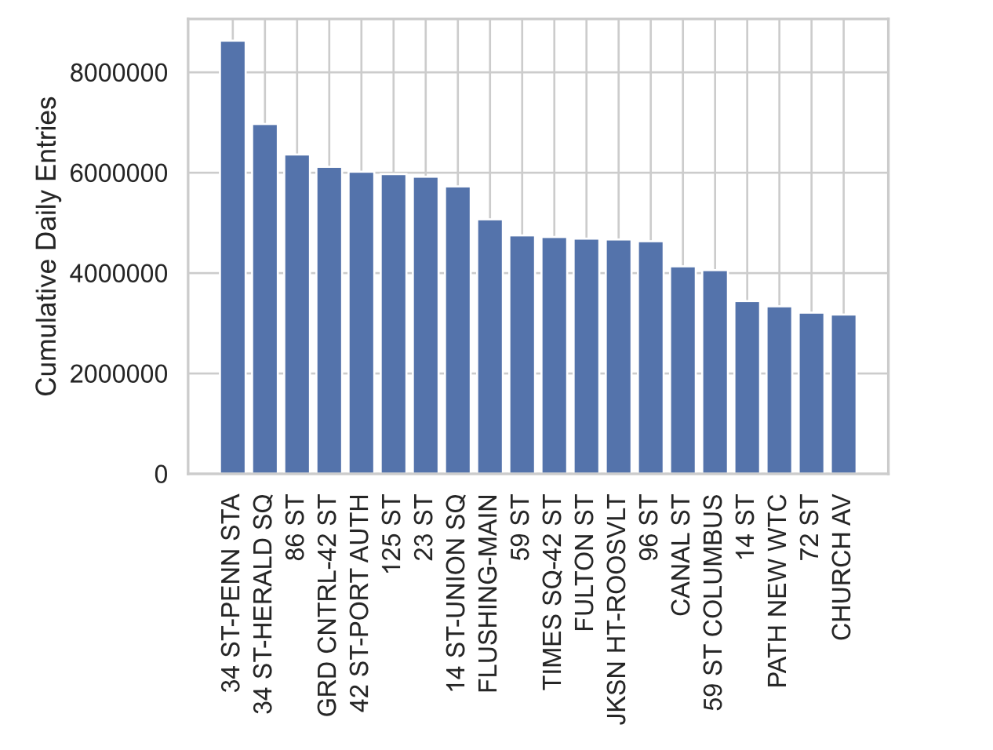
Methodology Examine Station Traffic Volume
Highest volume station is the 34th Street Penn Station.
Positioning volunteers at this station will be important to capturing people interested in supporting women in technology
Facebook leased office space at the post office complex next to Penn Station (1)

Slide 5
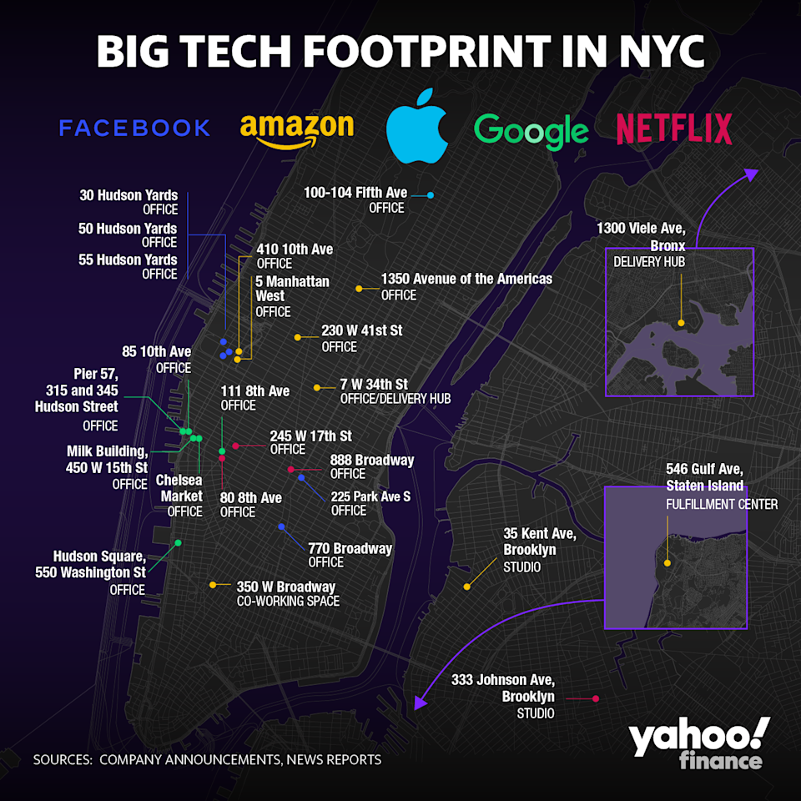
Identify Big Tech Co Office Locations
Why America’s tech giants are flocking to one part of NYC
Shows a concentration of tech workers in Manhattan
Layer on to determine Street Team Placement Recommendations for Big Tech In Priority order
Yahoo Finance article by Sarah Paynter and Krystal Hu from January 5, 2020:

Slide 6
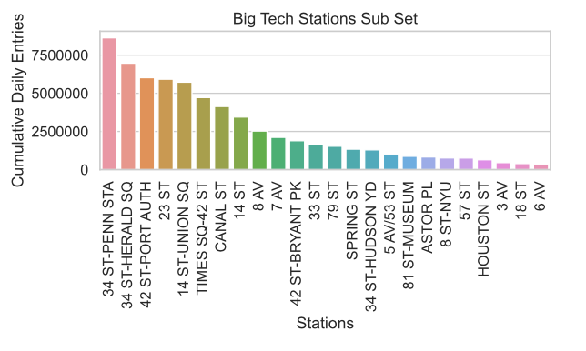
Compare Big Tech Co Office Locations and Station Volume

Slide 7
Street Teams MINIMUM for success = 5
One Street Team at each location
34th and Penn Station – overall busiest and 4 Amazon Offices in the area
14 St / 6 AV – the only location for Apple and 1 location for Netflix
23rd St – 2 locations for Netflix, 1 location for Facebook
34 Hudson Yards Station – 4 locations for Facebook, 1 for Amazon
14 St / 8 AV – 4 Locations for Google, 2 for Netflix
Covers the Big Tech Office Locations

Slide 8
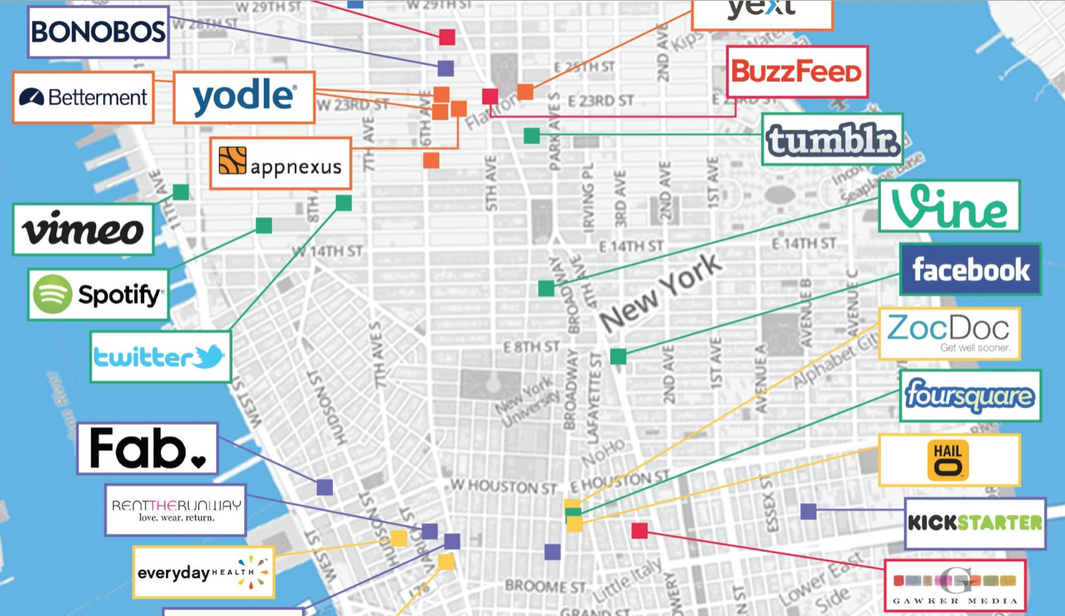
Tech Start Ups
Max # of Street Teams = 35
15 Big Tech + 20 Start Ups
The End of 2018 Marks A Diverse New York Startup Ecosystem
“NYC stands out as one of the most diverse business scenes in the world: 19% of founders are women, compared to the 16% global average, and 25% are immigrant founders, compared to the 19% global average.”
FINSMES Article published Sep 5, 2018
Source: FINSMES – Real Time VC and Private Equity Deals and News
https://www.finsmes.com/2018/09/the-end-of-2018-marks-a-diverse-new-york-startup-ecosystem.html

Slide 9
Street Team Placement Recommendations for Big Tech In Priority order 3 teams per location for top 2 locations 2 team for next 3 busiest stations and Apple location 1 team for remaining 1 location
Optimum # of Street Teams = 15
34th and Penn Station – 3 locations for Amazon
23rd St – 2 locations for Netflix, 1 location for Facebook
34 Hudson Yards Station – 4 locations for Facebook, 1 for Amazon
14 St Union Sq – 1 location for Facebook, 1 for Netflix
14 St / 8 AV – 4 Locations for Google, 2 for Netflix
14 St / 6 AV – the only location for Apple and 1 location for Netflix
18 Street Station – 2 locations for Google and 1 for Netflix

Slide 10

Further Analysis to Improve Outcomes
Start Up Tech Company Analysis similar to the Big Tech analysis, in order to ensure a diverse group is reached
Further Data Segmentation
Segment the data into time intervals of am, pm and lunch intervals to the traffic patterns to further fine tune high traffic times
Days/Weeks/Months - Include graphs for days of the week, weeks of the month and months of the year to determine traffic peaks and valleys
Additional Data Sources
Commercial Real Estate Data, connect to MTA data for easier updates for use in futuer WTWY event planning
Mapping software to improve proximity of station entrances to tech companies
WTWY membership list – compare with Big Tech and Start up lists to see where more awareness is and is needed

Slide 11
Sources
https://www.nytimes.com/2020/10/13/nyregion/big-tech-nyc-office-space.html
https://finance.yahoo.com/news/why-americas-tech-giants-are-flocking-to-one-part-of-nyc-130830663.html
https://data.cityofnewyork.us/Transportation/Subway-Entrances/drex-xx56

Slide 12
Column1 | Column2 | Column3
Big Tech Company | Office Address | Subway Station
Apple | 100 Fifth Ave | 14 st / 6 Av
NetFlix | 888 Broadway | 14 st / 6 Av
Google | 85th 10th Ave | 14 ST / 8 AV
Google | Pier 57 | 14 ST / 8 AV
Google | 450 W 15th Street | 14 ST / 8 AV
Google | Chelsea Market | 14 ST / 8 AV
NetFlix | 80 8th Ave | 14 ST / 8 AV
NetFlix | 245 W17th St | 14 ST / 8 AV
Facebook | 225 Park Ave S | 14 St- Union Sq
NetFlix | 888 Broadway | 14 St- Union Sq
Google | 111 8th Ave | 18 Street Station
Google | 111 8th Ave | 18 Street Station
NetFlix | 245 W17th St | 18 Street Station
Facebook | 225 Park Ave S | 23 St
NetFlix | 245 W17th St | 23 St
NetFlix | 888 Broadway | 23 St
NetFlix | 888 Broadway | 23rd station at 5th ave
NetFlix | 245 W17th St | 23rd Street Station
Facebook | 770 Broadway | 3 Av
Amazon | 7 W 34th St | 33 St
Facebook | 30 Hudson yards | 34-Hudson Yards
Facebook | 50 Hudson yards | 34-Hudson Yards
Facebook | 55 Hudson Yards | 34-Hudson Yards
Amazon | 5 Manhattan West | 34-Hudson Yards
Amazon | 5 Manhattan West | 34th and Penn Station
Amazon | 230 W 41st St | 34th and Penn Station
Amazon | 7 W 34th St | 34th and Penn Station
Amazon | 7 W 34th St | 34th Herald Sq
Amazon | 230 W 41st St | 42 st Bryant Park Station
Amazon | 230 W 41st St | 42nd st port authority
Amazon | 1350 Avenue of the Americas | 5 avenue 53 st station
Amazon | 1350 Avenue of the Americas | 57 Street
Amazon | 1350 Avenue of the Americas | 7 Avenue Station
Amazon | 410 10th Ave | 79th St
Facebook | 770 Broadway | 8 Street Station
Amazon | 410 10th Ave | 81st Museum of Natual History
Facebook | 770 Broadway | Astor Pl
Amazon | 350 W Broadway | Canal St
Google | 315 Hudson Street | Houston St
Google | 345 Hudson Street | Houston St
Google | 550 Washington St | Houston St
Google | 315 Hudson Street | Spring St
Google | 345 Hudson Street | Spring St
Google | 550 Washington St | Spring St
Amazon | 350 W Broadway | Spring St
Amazon | 230 W 41st St | Times Sq 42nd st
Appendix
Big tech office locations and nearest subway stations

