Slide 1



Analysis of Box Office Revenue for the Film Industry
By Cheryl McGowan Nov 2021

Slide 2

The Problem
A movie producer is specifically interested in what type of movie to produce next. Can we predict what features influence a movies success at the Box Office?

Slide 3


Global Entertainment
$100 Billion 2020

Slide 4








Slide 5
Data Box office mojo.com
START
Beautiful Soup
Requests Library
Webscrape the data
RESULT
1991 Observations
10 features

Slide 6

Assumptions
Removed data
Duplicates in Movie Title
Runtime / Budget NaN
Outliers budget over $270,000,000
Multicollinearity
Domestic Total Gross
International total gross

Slide 7

Observation/Rows = 901 Features = 7
Movie Title
$ Budget
Genre
Brand
Franchise
Release Date
Runtime
Target = $ Worldwide Total Gross

Slide 8
Feature Engineering
Dummy Variables
Brand – Yes/No
Franchise Yes/No
Genre increased model complexity and overfitting

Slide 9
Linear Regression Model
Split data into
Train
Test
Validate

Slide 10

Predictions
And
Interpretations

Slide 11


Best Performance
Brand
Franchise
Budget
Runtime
4 features R2 = .425, .433, .395
Budget only R2 = .325, .234, .275

Slide 12
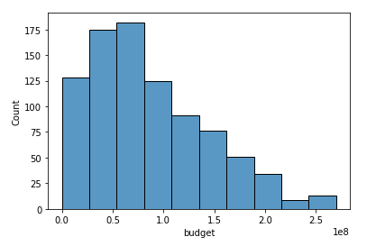

Slide 13
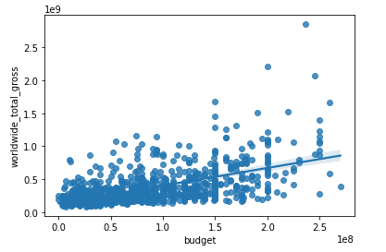
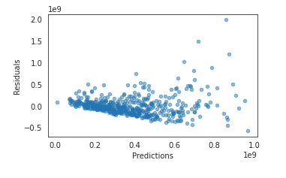
RegPlot – Showing the LR Model Fit
Plot Residuals – Showing Heteroskedasticity

Slide 14
Future Work
Standardize the data
Scale of worldwide gross and runtime is out of proportion which could be affecting the model
Use Log, square root or Box-Cox to transform the target and reduce Heteroskedasticy

Slide 15
Questions?

Slide 16
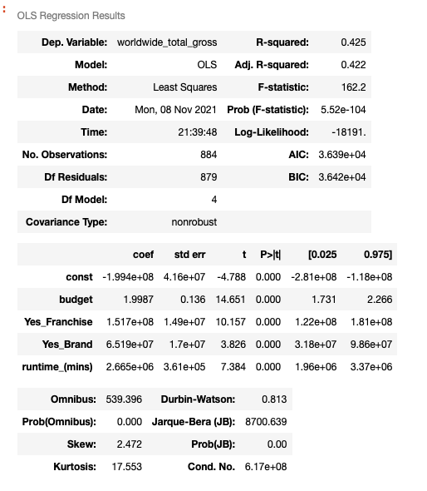
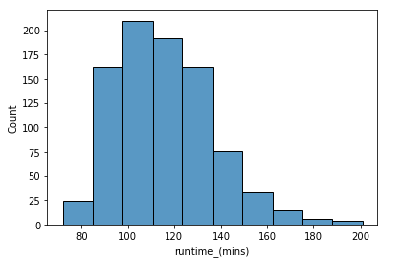

Slide 17
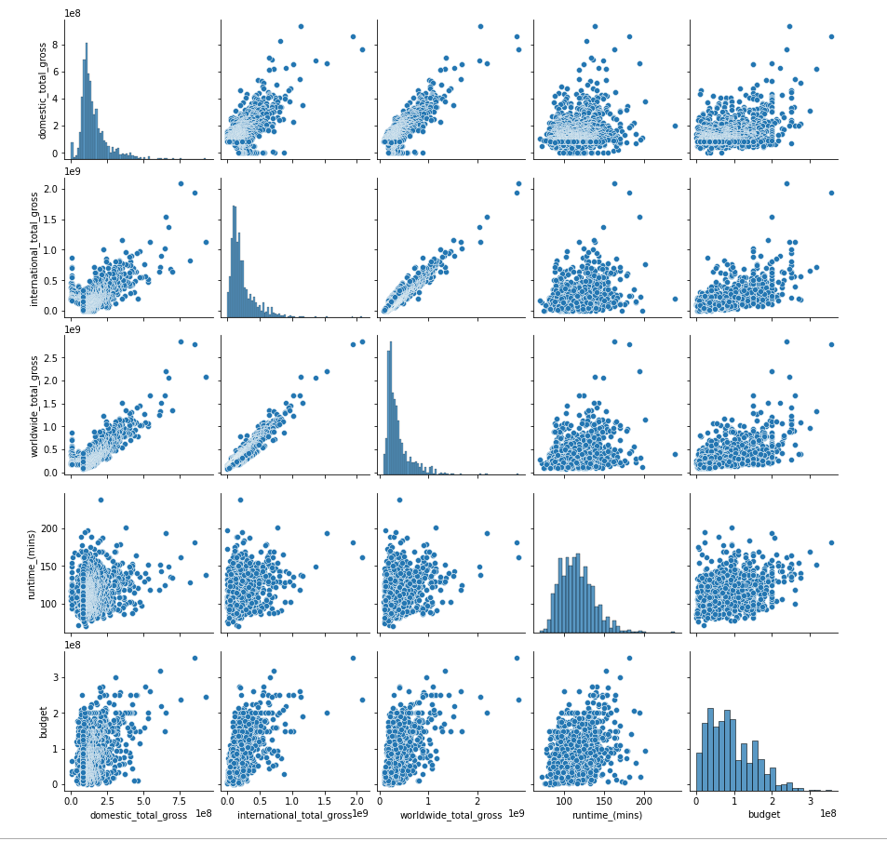
Pairplot
Showing Multicollinearity in
Domestic Gross, International
Gross and Worldwide Gross

Slide 18
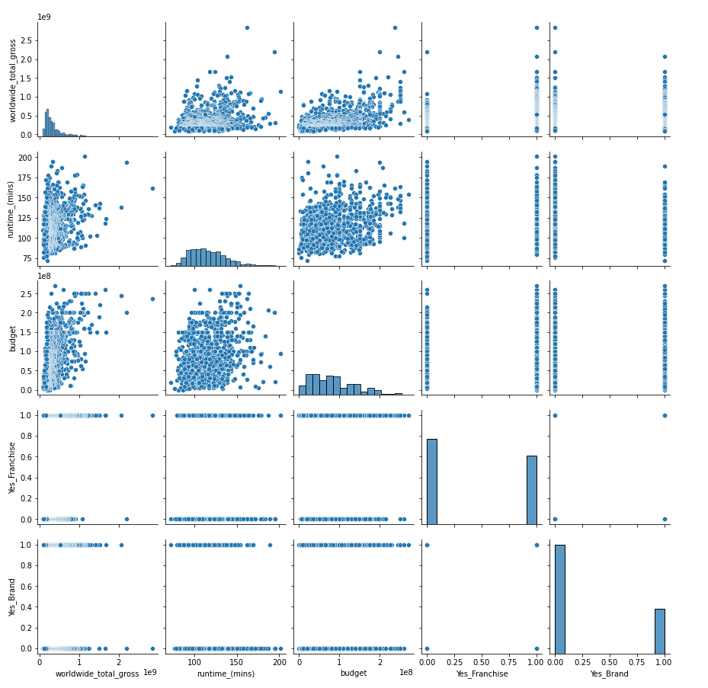
Pairplot
Showing final feature set

Slide 19
Image Credits
Imdb.com
Disneyplus.com
Express.co.uk
En.Wikipedia.org
Collider.com
Cnet.com
Appletreemovies.com

