Slide 1

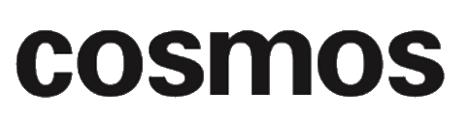

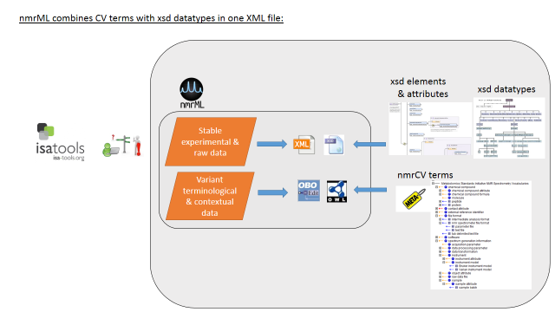
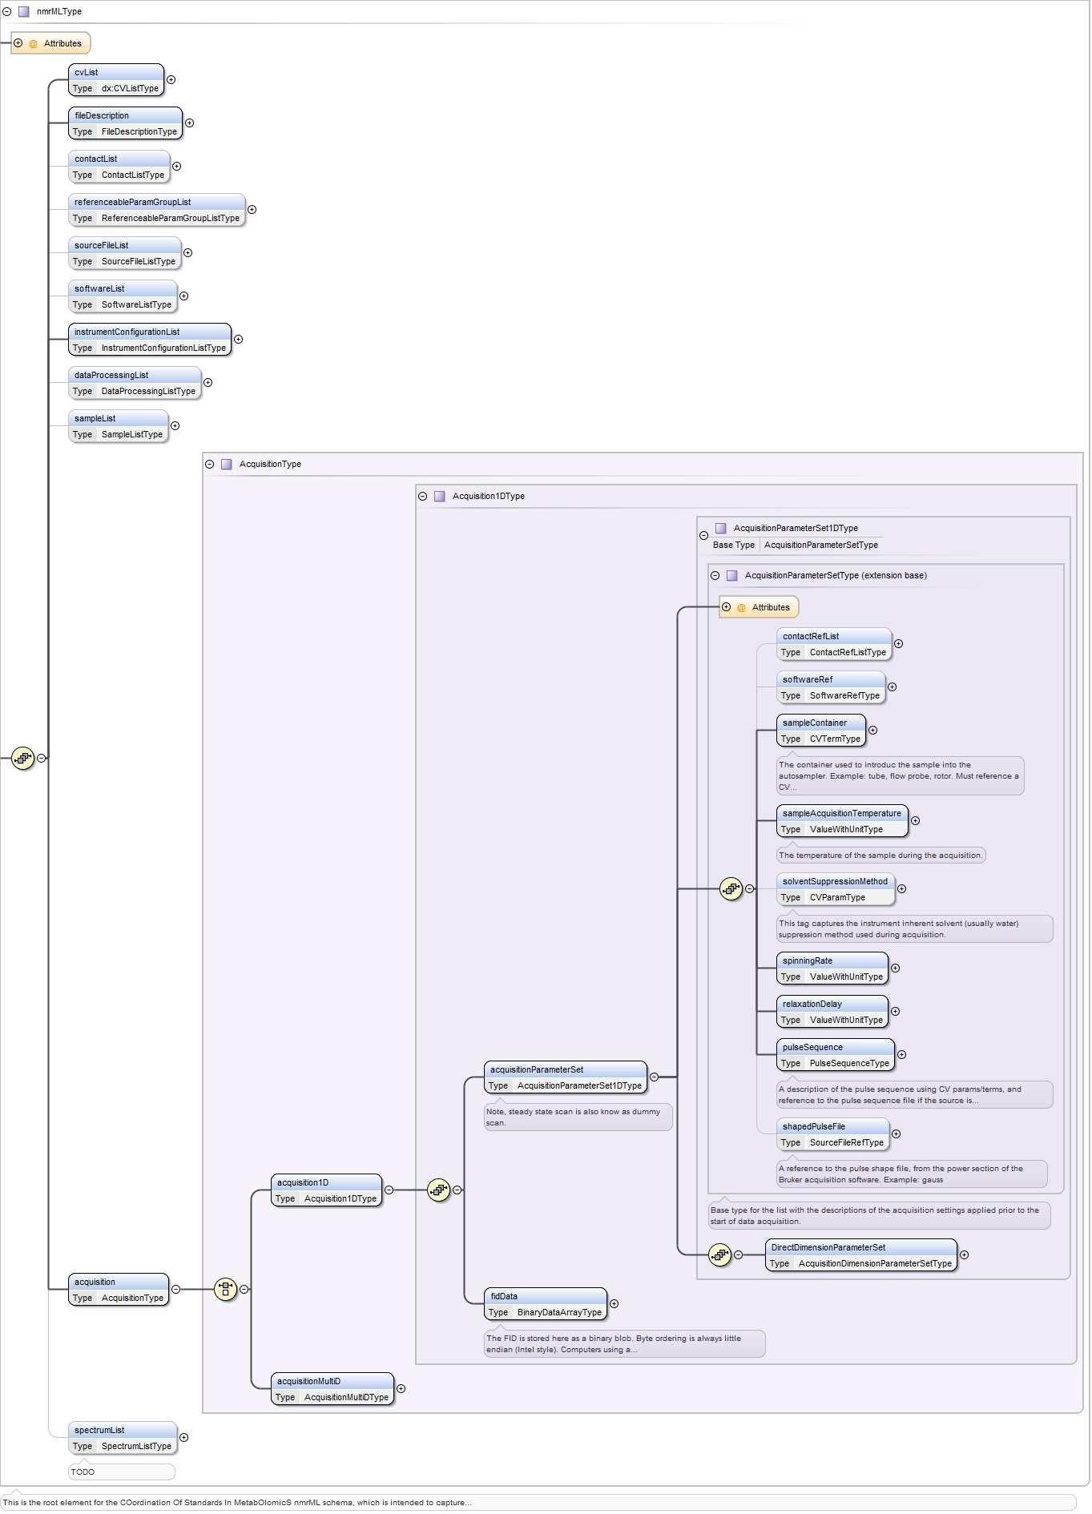
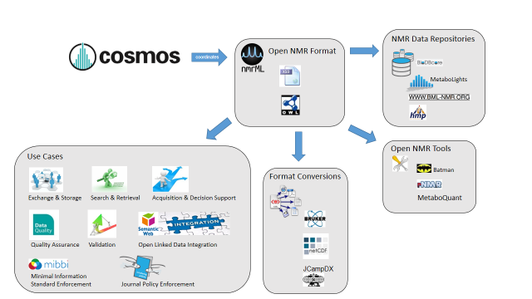
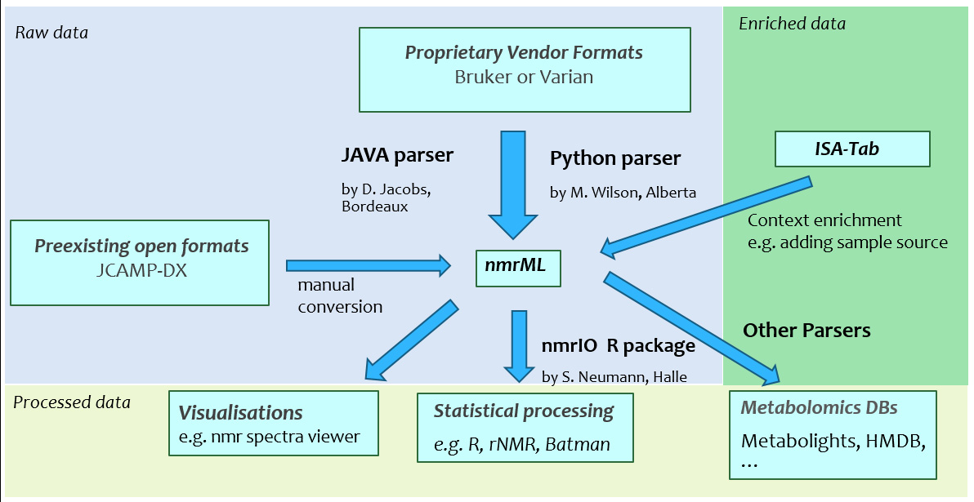
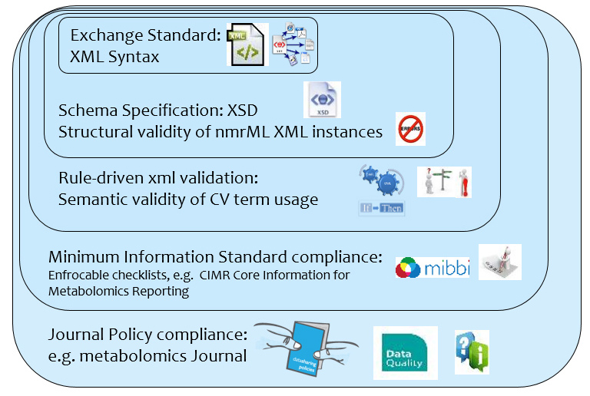
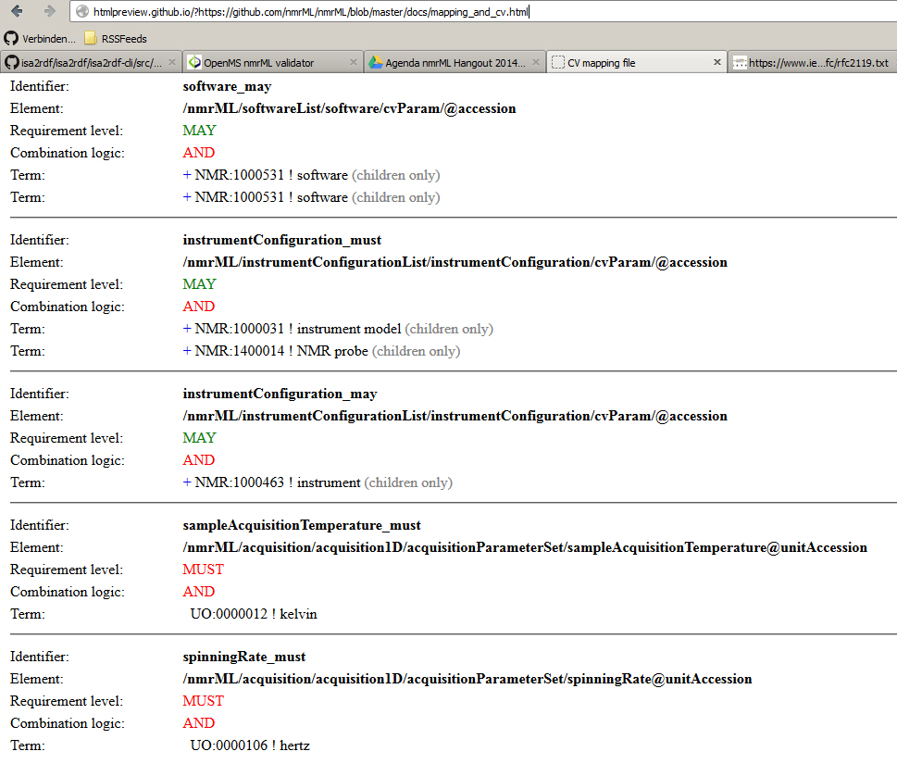
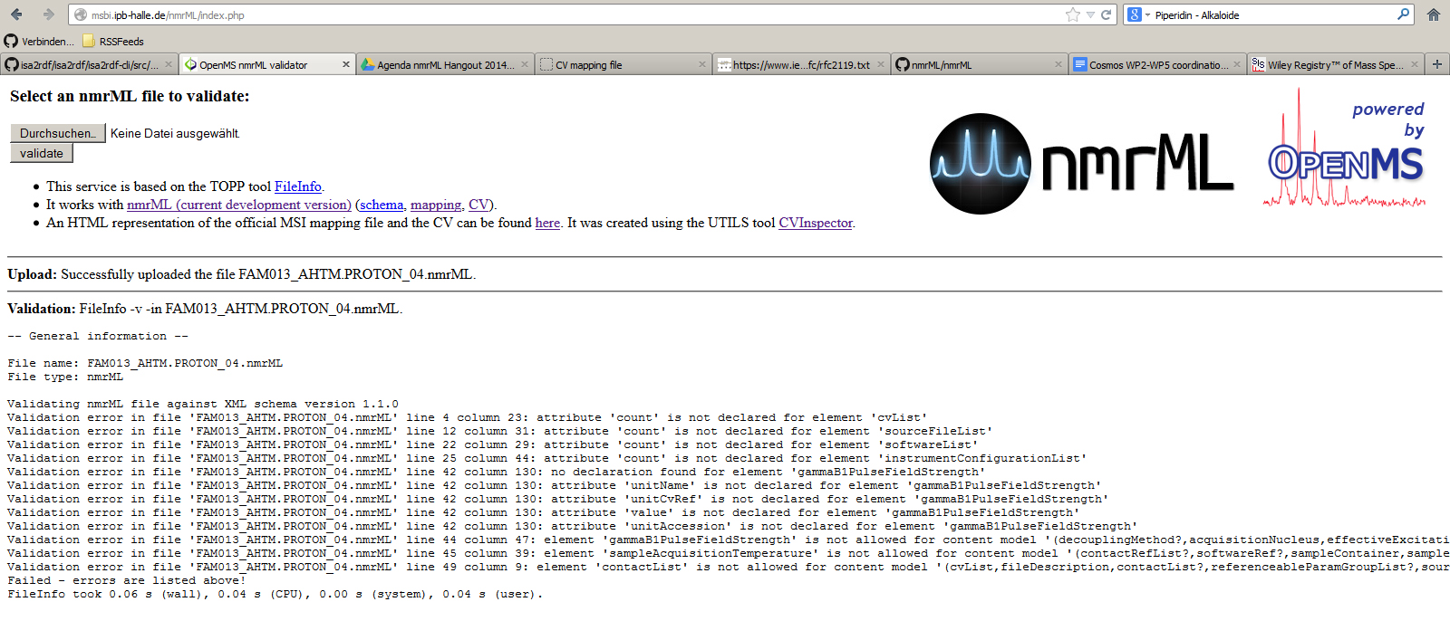



nmrML: an XML-based open standard for
NMR data storage and exchange
Daniel Schober ¹, Michael Wilson², Daniel Jacob³, Annick Moing³, Catherine Deborde³, Luis de Figueiredo⁴, Kenneth Haug⁴,
Philippe Rocca-Serra⁵, John Easton⁶, Christian Ludwig⁷, Antonio Rosato⁸, David Wishart², Christoph Steinbeck⁴, Reza Salek⁴, Steffen Neumann¹
The need for an open NMR standard
NMR data is currently accumulating in local data silos, hindering distribution and secondary data usage. Cross platform NMR data access, integration and comparison is hindered by incompatible vendor formats and the lack of a robust vendor-agnostic NMR data standard. Data in proprietary data formats ages fast, posing the danger of irreproducible data from older studies. An open vendor-neutral storage standard is needed as long-term archival format, if emerging metabolomics repositories are to capture data from all vendor formats in a persistent way, yet supporting the dynamics in this field.
The nmrML setup
nmrML setup
The COordination of Standards in MetabOlomicS, COSMOS EU consortium has teamed up with the metabolomics standards initiative to create an open exchange and storage format for NMR data. We largely follow design principles already established in the Proteomics Standards Initiative (PSI) for the mzML data standard for mass spectrometry. The standard is composed of an XML schema (nmrML.xsd) and an accompanying controlled vocabulary (nmrCV.owl), which ensures update flexibility and schema robustness by allowing to outsource more variant and dynamic descriptors into the vocabulary which is referenced from within an nmrML file.
nmrML XML schema excerpt
nmrML data example
nmrML use cases
Data from a paper: Farag, M., Porzel, A., Schmidt, J. & Wessjohann, L. Metabolite profiling and fingerprinting of commercial cultivars of Humulus lupulus L. (hop) - a comparision of MS and NMR methods in metabolomics, Metabolomics 8, 492-507, (2012)
<nmrML xmlns:xsi="http://www.w3.org/2001/XMLSchema-instance" xsi:schemaLocation="http://nmrml.org/schema ../../../xml-schemata/nmrML.xsd" xmlns="http://nmrml.org/schema" version="1.0.0">
<cvList count="2"> <cv fullName="nmrML Controlled Vocabulary" version="0.0.1" id="NMRCV" URI="http://www.nmrml.org/nmrml-cv.0.0.1.owl"/> <cv fullName="Unit Ontology" version="3.2.0" id="UO" URI="http://unit-ontology.googlecode.com/svn/trunk/uo.owl/"/> </cvList>
<contactList> <contact id="ID004" fullname="Lutger A. Wessjohann" email="Ludger.Wessjohann [a] ipb-halle.de"/> <contact id="ID044" fullname="Mohamed A. Farag" email="mfarag73 [a] yahoo.com"/> </contactList> <sourceFileList count="2"> <sourceFile sha1="fd99c095046e2356c7d31154d45353fa79cbc844"
location=file:///Users/mike/Projects/nmrML/nmrML/examples/IPB_HopExample/FIDs/FAM013_ AHTM.PROTON_04.fid/procpar
id="SOURCE_FILE_0" name="procpar"> <cvTerm cvRef="NMRCV" accession="NMR:1400297" name="Varian VNMR Format"/> <cvTerm cvRef="NMRCV" accession="NMR:1002006" name="acquisition parameter file"/> </sourceFile> <sourceFile sha1="e4ffeb41da28b1e9017e72819252ec6d78f8179f“
location=file:///Users/mike/Projects/nmrML/nmrML/examples/IPB_HopExample/FIDs/FAM013_AHTM.PROTON_04.fid/fid
id="SOURCE_FILE_1" name="fid"> <cvTerm cvRef="NMRCV" accession="NMR:1400297" name="Varian VNMR Format"/> <cvTerm cvRef="NMRCV" accession="NMR:1400119" name="FID file"/> </sourceFile> </sourceFileList> <softwareList count="1"> <software cvRef="NMRCV" accession="NMR:1000277" name="VnmrJ software" version="2.2C" id="SOFTWARE_1"/> </so<instrumentConfigurationList count="4"> <instrumentConfiguration id="INST_CONFIG_1"> <cvTerm cvRef="NMRCV" accession="NMR:1400234" name="Varian NMR instrument"/> <cvTerm cvRef="NMRCV" accession="NMR:1000235" name="Varian probe"/> <cvTerm cvRef="NMRCV" accession="NMR:1400234" name="Varian NMR instrument"/> <cvTerm cvRef="NMRCV" accession="NMR:1000236" name="5mm HCN probe"/> </instrumentConfiguration> </instrumentConfigurationList>
<acquisition> <acquisition1D> <acquisitionParameterSet numberOfScans="160" numberOfSteadyStateScans="0"> <sampleAcquisitionTemperature unitName="kelvin" unitCvRef="UO" value="299.15" unitAccession="UO:0000012"/> <spinningRate unitName="hertz" unitCvRef="UO" value="0" unitAccession="UO:0000106"/> <relaxationDelay unitName="second" unitCvRef="UO" value="22.2737024" unitAccession="UO:0000010"/> <pulseSequence/> <DirectDimensionParameterSet numberOfDataPoints="65536" decoupled="false"> <acquisitionNucleus cvRef="NMRCV" accession="NMR:1400151" name="1H"/> <gammaB1PulseFieldStrength unitName="hertz" unitCvRef="UO" value="34482.7586207" unitAccession="UO:0000106"/> <irradiationFrequency unitName="hertz" unitCvRef="UO" value="599.8311617" unitAccession="UO:0000106"/> </DirectDimensionParameterSet> </acquisitionParameterSet> <fidData byteFormat="Complex128" encodedLength="324160" compressed="true">eJwMl4dfzl8Ux7U3lYZKy0qiomQ […]</fidData> </acquisition1D> </acquisition> </nmrML> ftwareList>
Parsers
To ease format conversions we deliver parsers for Bruker and Varian data formats, which can be incorporated into open NMR processing and analysis software.
Semantic data validation
We also deliver a semantic validator which checks a data file is syntactically well formatted, sufficiently detailed with respect to data content and annotation and that aspects of minimal information requirements, e.g. from the Core Information for Metabolomics Reporting (CIMR) are met.
Validation Layer Onion
Validation rules (html)
Validation webservice & result
Outlook
Project resources
Although coverage is good at raw data capture, the XSD and CV will be expanded for better processed data and quantification data. Our standard is accepted by major open source NMR data processing tools and will serve the MetaboLights repository with a stable storage format.
Website: http://www.nmrML.org
Github: https://github.com/nmrML/nmrML
nmrML validator: http://msbi.ipb-halle.de/nmrML/index.php
Cosmos: http://www.cosmos-fp7.eu/
Email: info@nmrml.org
Google Group: https://groups.google.com/forum/?hl=en#!forum/nmrml/join
¹Leibniz Institute of Plant Biochemistry, Dept. of Stress and Developmental Biology, Weinberg 3, 06120 Halle, Germany
²Department of Computing/Biological Sciences, University of Alberta, Edmonton, Canada
³INRA, Univ. Bordeaux, Metabolome Facility of Bordeaux Functional Genomics Center, 71 av Edouard Bourlaux, F-33140 Villenave d’Ornon, France
⁴European Molecular Biology Laboratory, European Bioinformatics Institute (EMBL-EBI), Wellcome Trust Genome Campus, Hinxton, Cambridge, CB10 1SD, UK
⁵University of Oxford, e-Research Centre, 7 Keble Road, Oxford, OX1 3QG, UK
⁶School of Electronic, Electrical and Computer Engineering, University of Birmingham, Edgbaston, Birmingham, B15 2TT, UK
⁷School of Cancer Sciences, University of Birmingham, Edgbaston, Birmingham, B15 2TT, UK
⁸Magnetic Resonance Center (CERM), University of Florence, 50019 Sesto Fiorentino (FI), Italy
MetaboLights: http://www.ebi.ac.uk/metabolights/
MSI: http://msi-workgroups.sourceforge.net/
CIMR-MI: http://mibbi.sourceforge.net/projects/CIMR.shtml
This project is funded through European Commission COSMOS Grant EC312941
MetaboLights
External Resources

Slide 2
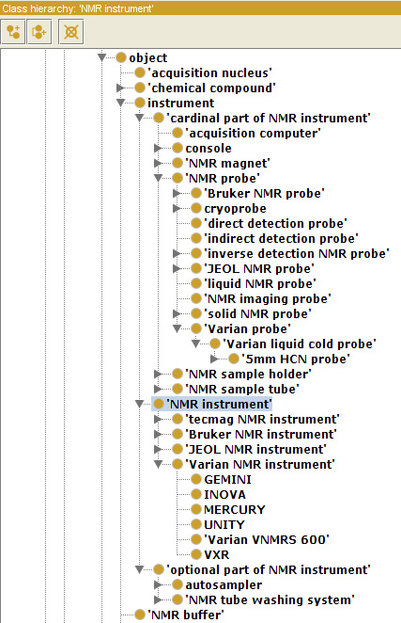

Rule based CV usage validation Example
For the Instrument configuration, the mapping rule file enforces (must) a NMR probe subclass specification via an NMR CV term:
<CvMappingRule id="instrumentConfiguration_must" cvElementPath="/nmrML/instrumentConfigurationList/instrumentConfiguration/cvParam/@accession" requirementLevel="MUST" scopePath="/nmrML/instrumentConfigurationList/instrumentConfiguration/" cvTermsCombinationLogic="AND"> <CvTerm termAccession="NMR:1400059" useTerm="false" termName="NMR instrument“ isRepeatable="false" allowChildren="true" cvIdentifierRef="NMR"/> <CvTerm termAccession="NMR:1400014" useTerm="false" termName="NMR probe" isRepeatable="false" allowChildren="true" cvIdentifierRef="NMR"/> </CvMappingRule>

