Slide 1
COSMOS WP 2 nmrML standard
Annual Report 2014, Wittenberg
Daniel Schober, IPB-Halle

Slide 2
nrmML - current status
First release nmrMLstandard (XSD+CV) Feb 2014
www.nmrML.org
Minor feedback & community involvement
Specification document, XSD, CV & example XML files
Good coverage on raw data, less on multidimensional
Compound Identifiocation & Peak alignments now possible
Automatic script-based information and updating pipelines
Vendor to nmrML Parsers available
nmrML to Open Processing Tools available
Batman, R, Matlab
Validation with rule examples
enforced on obo-conversion of nmrCV
via hacked OpenMS validator
validation of raw data only
MI enforcement follows

Slide 3
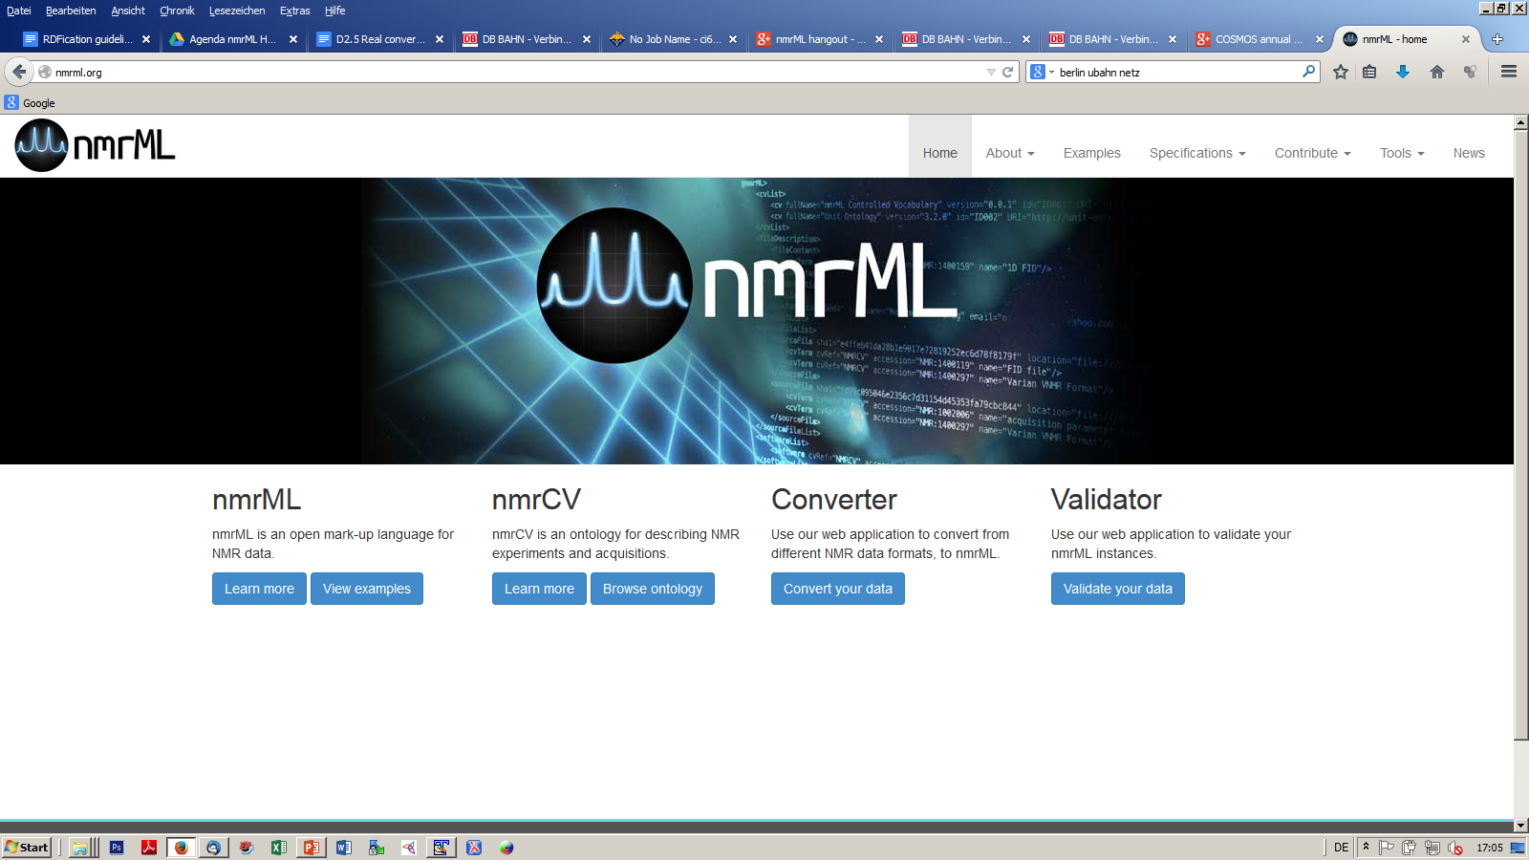
www.nmrML.org complete

Slide 4
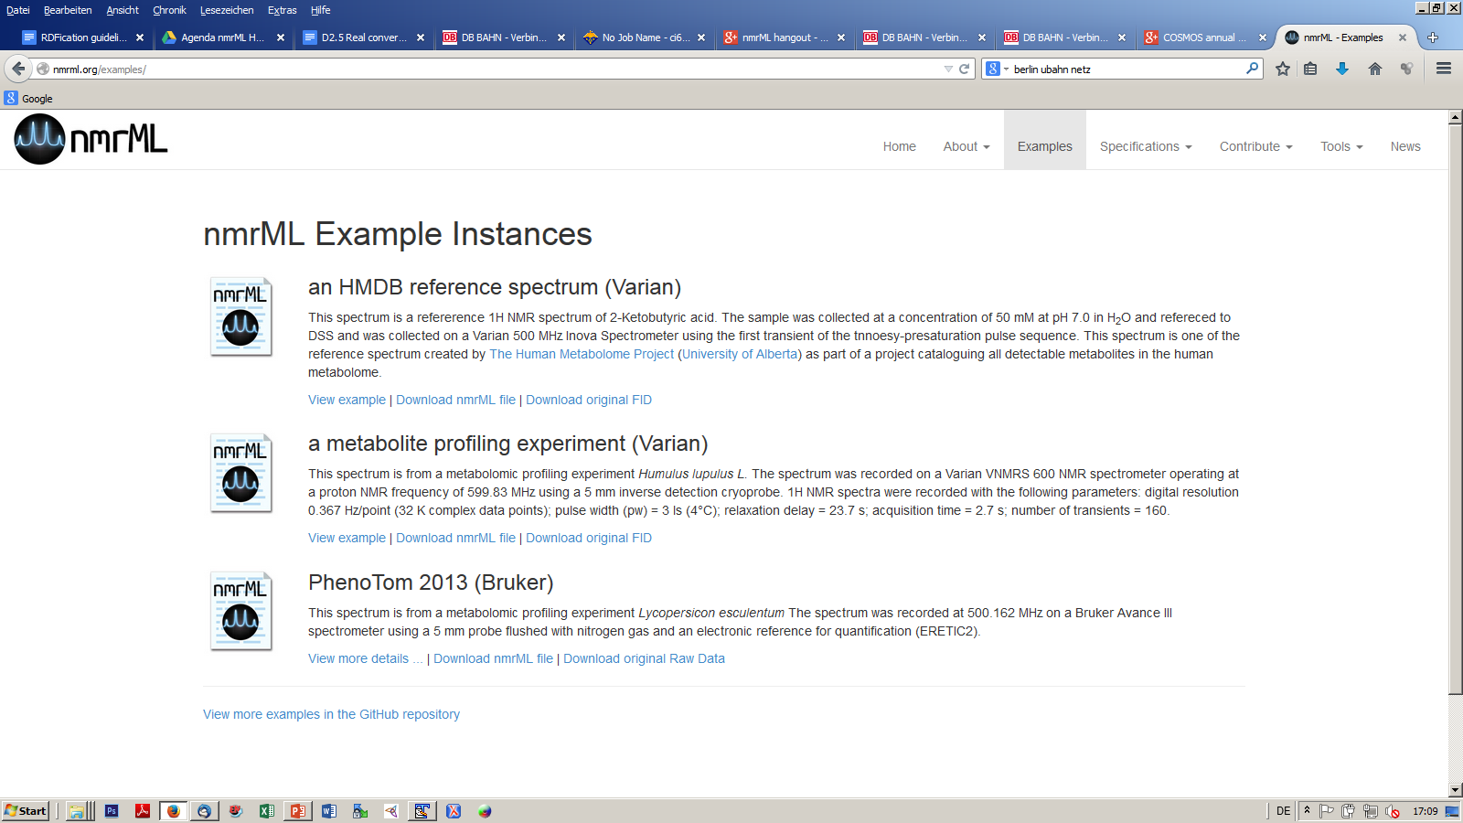
Example Files
+ manually generated JCAMP DX example

Slide 5
nmrCV
Transition in TLO
From Biotop to BFO
Slow incremental bottom-up expansion
CV-coverage currently limited to use cases
~ 750 terms in taxonomic hierarchy
In OWL Syntax but, no DL used
Need to convert into OBO Format to re-use Validator

Slide 6
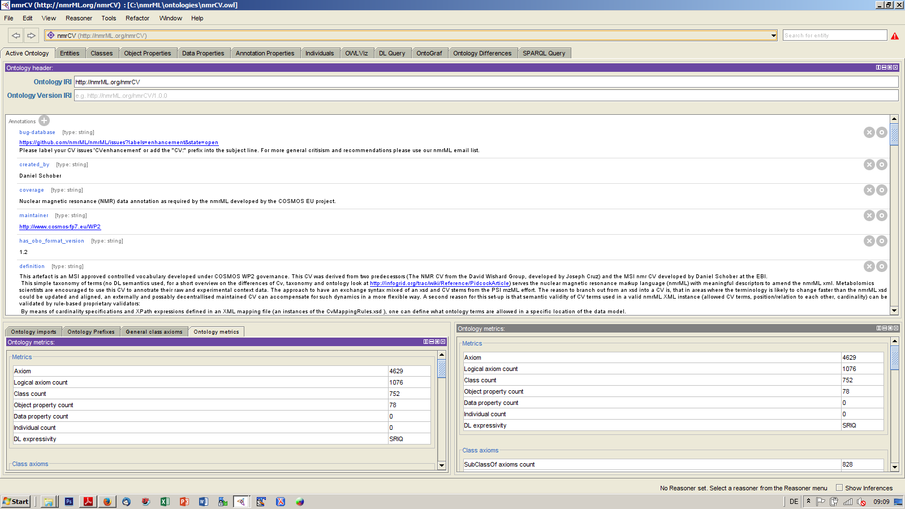
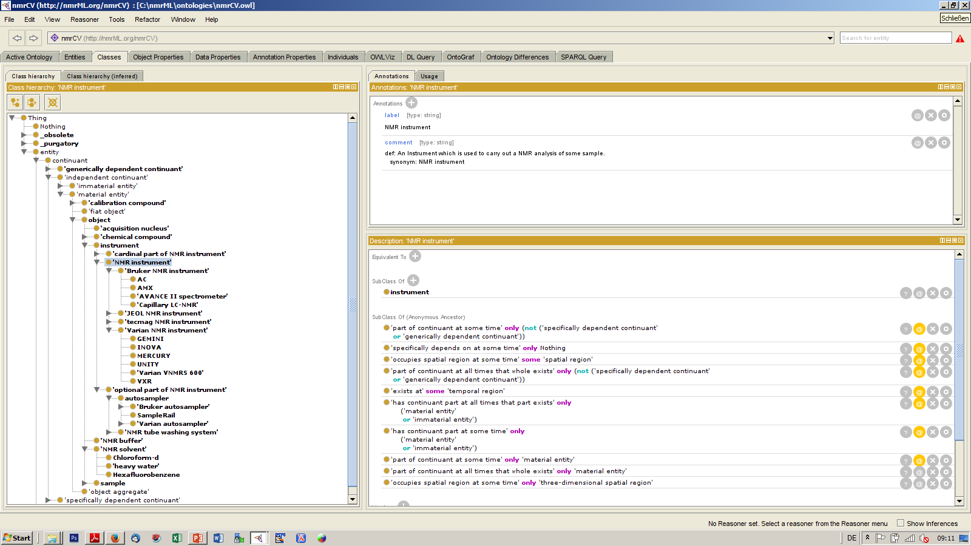

Slide 7
Ident and Quant extensions to nmrML XSD
Copied from CML
CMLSpect captures 2D molecule representations
Atom / bond arrays & assignments
data-driven HMDB use case & easy examples
e.g. Proprionic acid
Input for Wishard Lab HMDB nmr spectrum viewer

Slide 8
Ident/Quant example with Peak assignment
<spectrumAnnotation>
<compound compoundName="alanine" compoundId="CHEBI:16449" >
<atomArray>
<atom id="a1" elementType="C" x2="0.6667733333333334" y2="-0.38490666666666673"/>
<atom id="a2" elementType="C" x2="-0.6667733333333334" y2="-1.1550933333333335"/>
…
<atom id="a8" elementType="H" x2="-1.2303901544895832" y2="0.9487051800384392"/>
<atom id="a9" elementType="H" x2="-3.3341185133717732" y2="0.3852098455104175"/>
<atom id="a10" elementType="H" x2="-2.770623178843752" y2="-1.7185185133717726"/> …
</atomArray>
<bondArray>
<bond atomRefs2="a1 a2" order="1"/>
<bond atomRefs2="a2 a3" order="1"/>
<bond atomRefs2="a1 a4" order="2"/>
…
</bondArray>
</compound> <multiplet center="1.04" >
<equivalentHydrogens atomRefs="a8 a9 a10"/>
<multiplicity cvRef="NMRCV" accession="NMR:1000185" name="triplet feature"/>
<peaks>
<peak center="1.03" amplitude="514.0" />

Slide 9
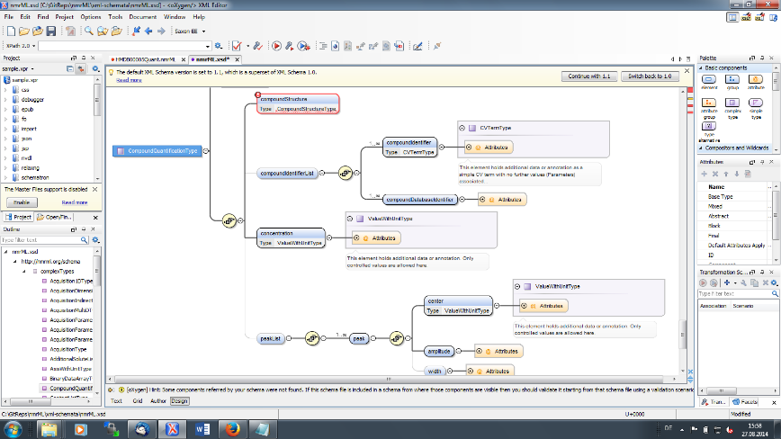
Ident & Quant XSD addition

Slide 10
D2.5 Real converters, parsers & validators (M24, Oct 2014)
No. | Objectives | Yes | No
1 | Deliver software that converts the major proprietary vendor NMR formats into the open nmrML format | X
2 | Deliver parsers that read the open nmrML format and makes its content accessible to open 3rd party processing tools | X
3 | Deliver software that validates existing nmrML files according to quality schemes defined in Minimal Information checklists | X

Slide 11
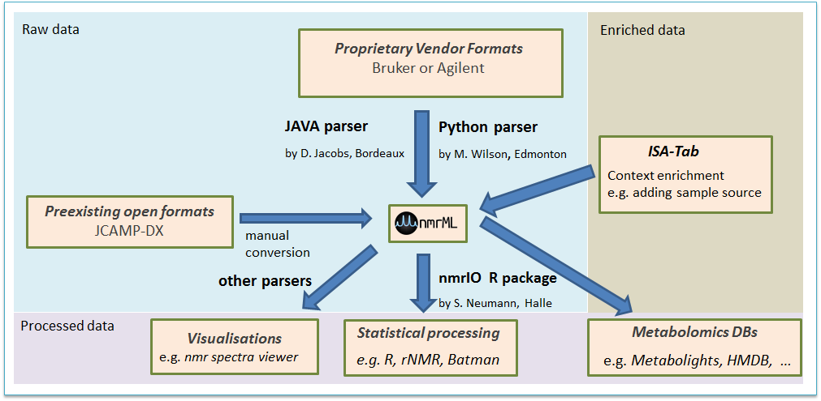
Parsers & Converters
Matlab Parser
By Tim Ebbels & Jie Hao

Slide 12
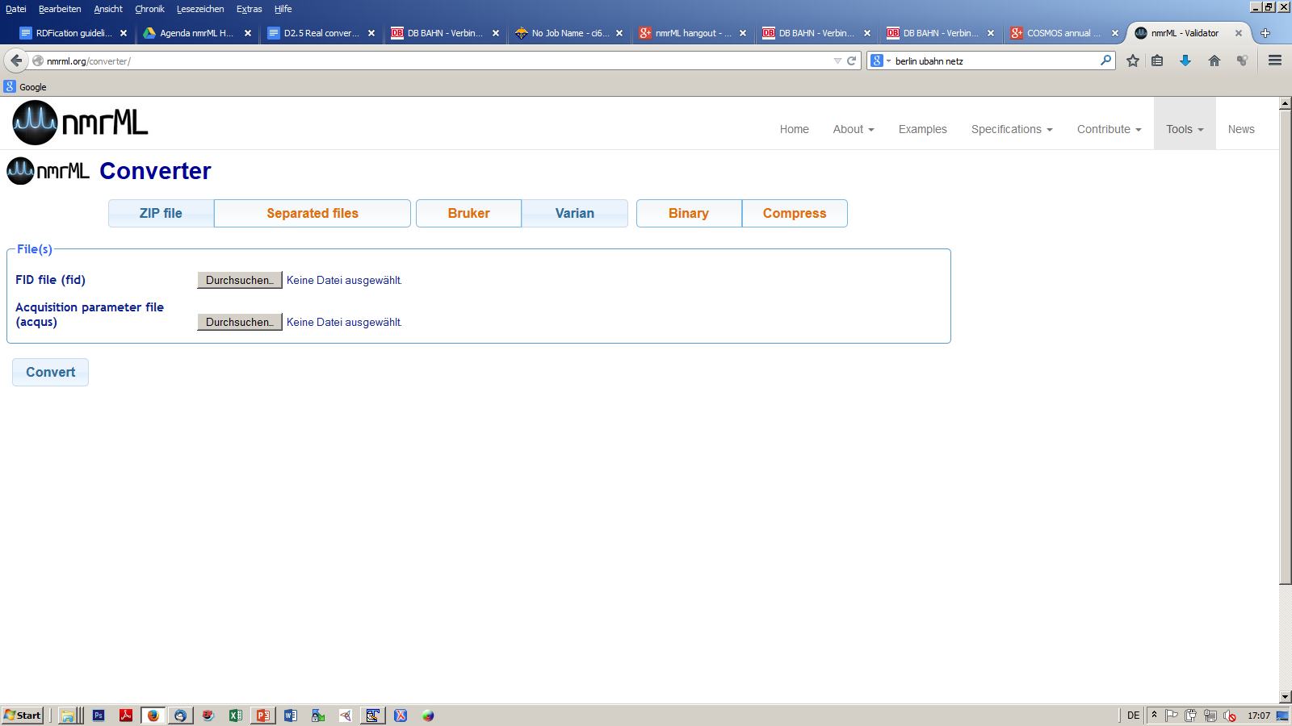
Converter service online

Slide 13
R-Parsers
nmrIO
might end up on CRAN or in Bioconductor

Slide 14
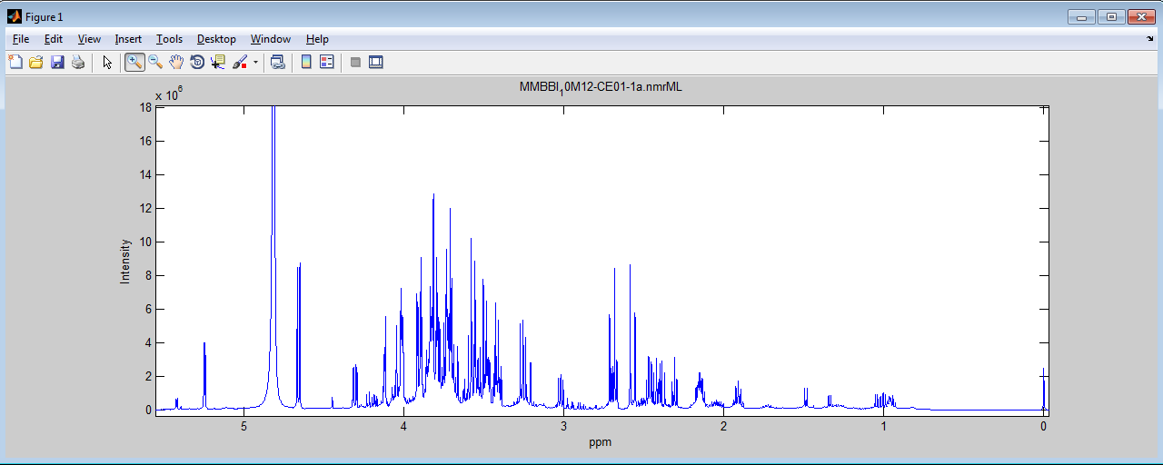
Matlab parser
Reads all fields of nmrML parameters
Decodes FID & spectrum array data
Spectrum plot from ‘MMBBI_10M12-CE01-1a.nmrML’.

Slide 15













Onion model of validation layers
XML Syntax
Structural validity of nmrML XML instances
Semantic validity of CV term usage
Minimum Information Standard compliance
e.g. CIMR Core Information for Metabolomics Reporting
Journal Policy compliance

Slide 16
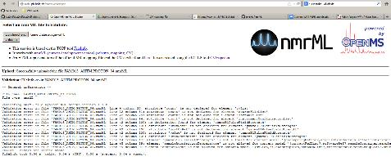
Semantic Validator
Validation and mapping rules
Online validator at http://msbi.ipb-halle.de/nmrML/
Syntax and Schema violation checks work
Rule validation does not yet work, due to an element refactoring /higher element granulatity in our XSD

Slide 17
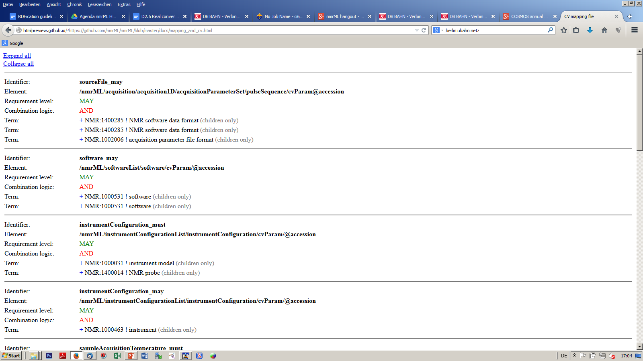
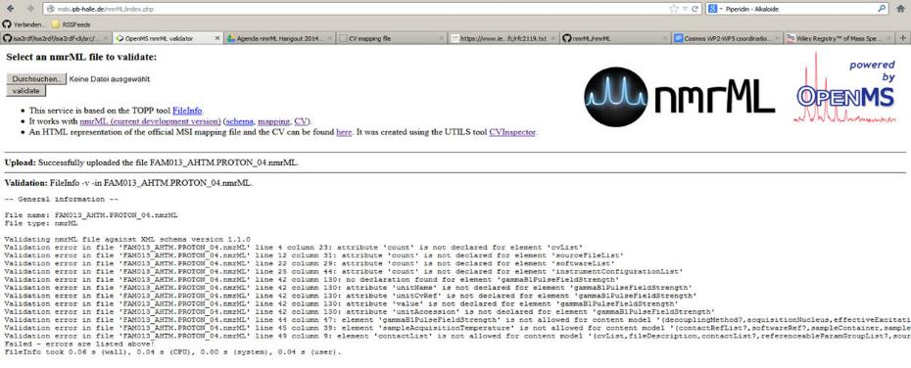
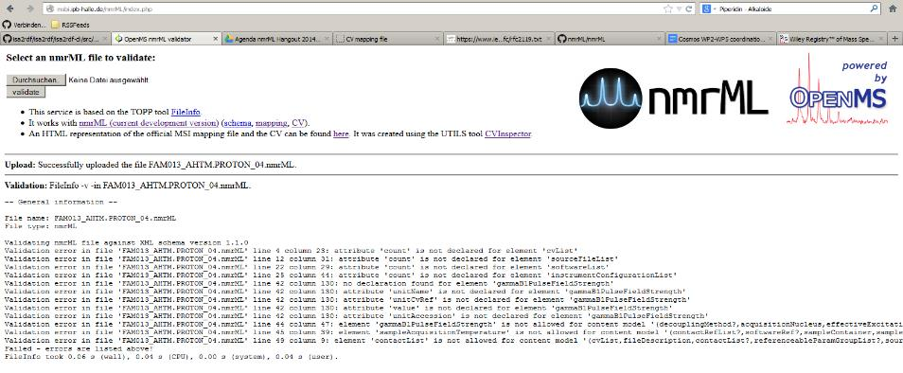
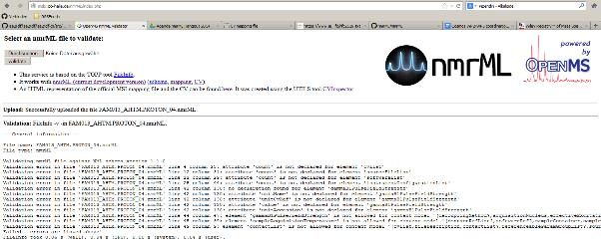

Slide 18
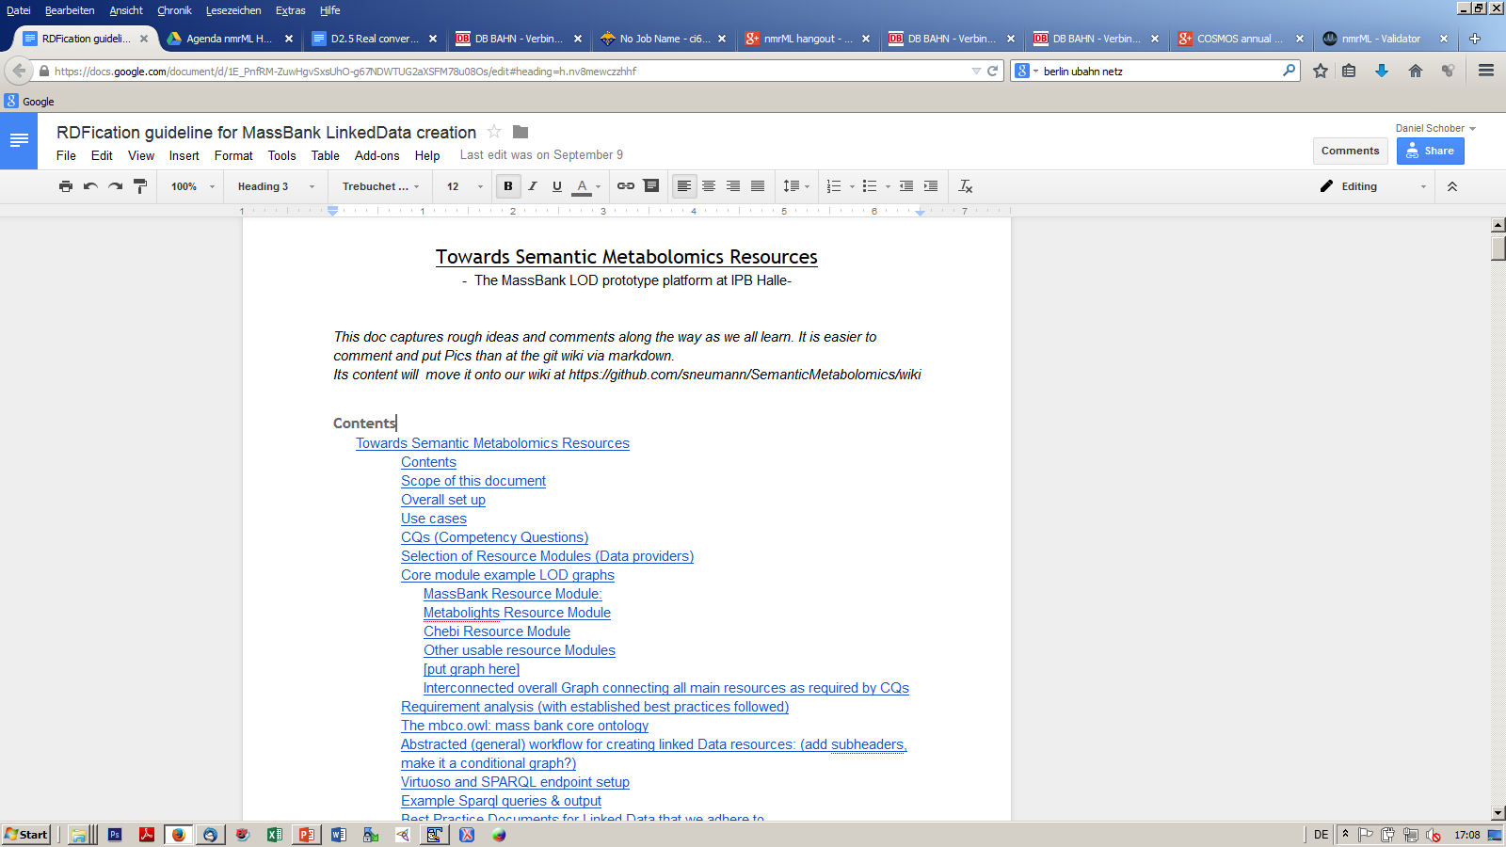
D2.8 Sparql on metabolomics RDF guideline Doc (M24, Oct 2014)

Slide 19
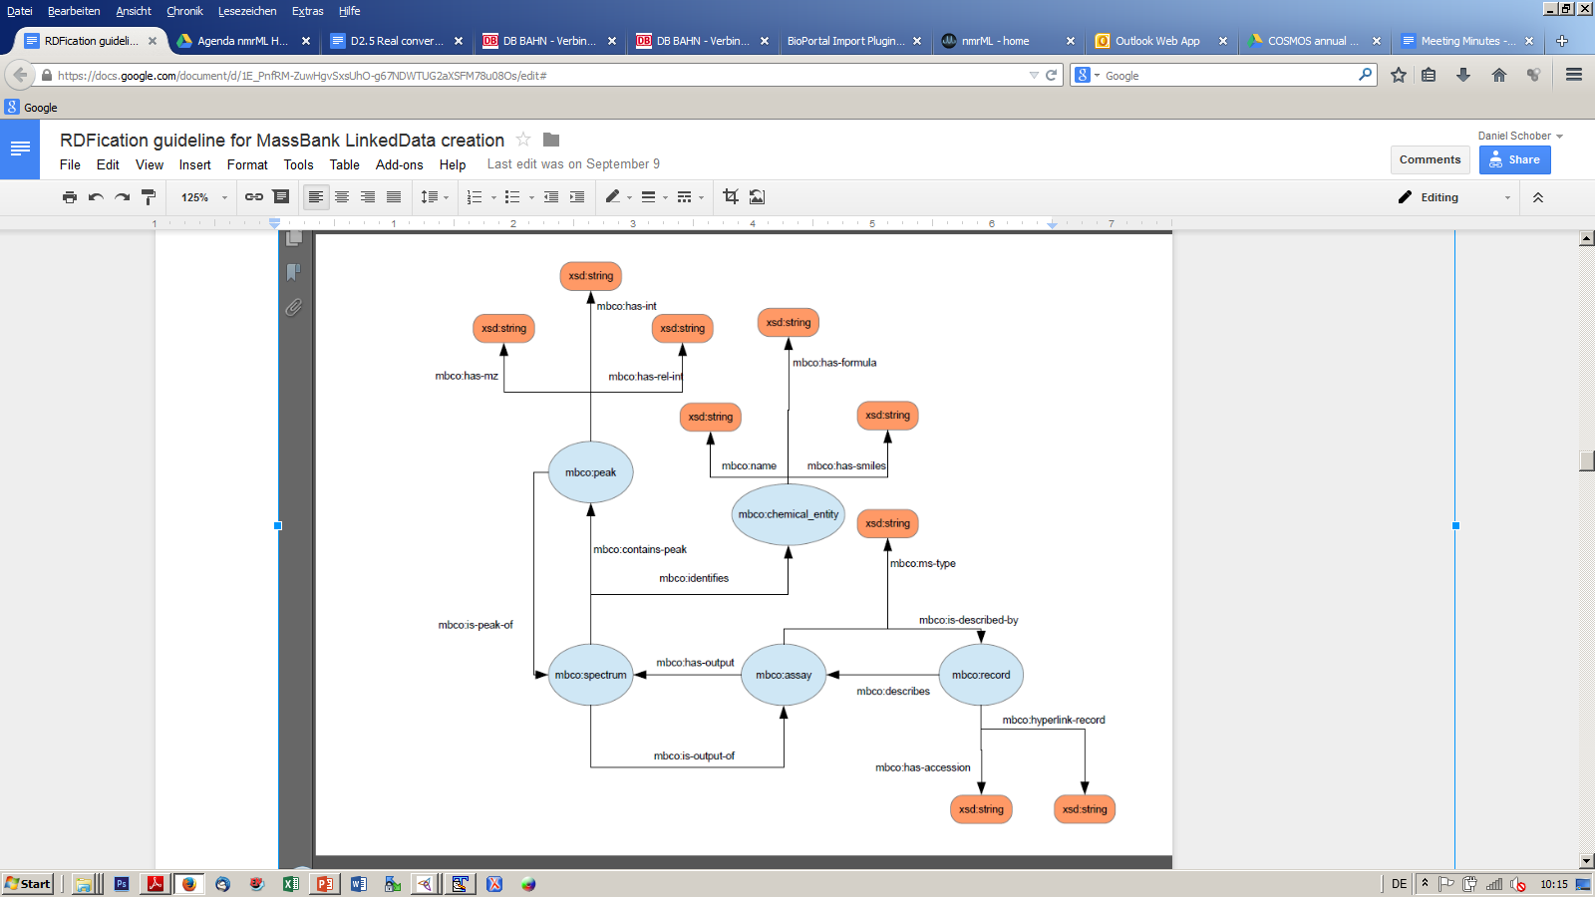


Slide 20
Outreach and Dissemination
Meetings
PSI meeting at Reinhardshausen
Poster at Metabolomics 2014 Japan (June)
Hackathon at TMIC, Edmonton (July)
Vendor buy-in
Chemomix
Bruker
Agilent ?

Slide 21
Papers
ODLS 2014 (accepted)
15 lines for metabonews ?
RS puts up Googledoc for it
nmrML paper draft
Full coverage
XSD core & Ident, CV, parsers/conversion workflows, examples, validators & MIs, DTB support (Metabolights and HMDB), Vendor support (Chenomx, ...), processing tools,
few lines on ISA Tab

Slide 22
Person flux
New partners
Andy Jones (PSI)
NMR Grant
Leaving partners
Mike Wilson

Slide 23
Next Steps
Further testing of XSD
with diverse experimental configurations
to ensure sufficient coverage, also in CV
Keep converters in sync with schema changes
Define rule sets for different validation stringency
ISA Tab specifications for ensuring minimal reporting requirement enforcement (D2.6)
Plan workshops & tutorials on nmrML
Develop maintenance strategy for when project ends
Evaluation strategy ?

Slide 24
Addenum

Slide 25
nmrML example instance
The Full Monty
<nmrML xmlns:xsi="http://www.w3.org/2001/XMLSchema-instance" xsi:schemaLocation="http://nmrml.org/schema ../../../xml-schemata/nmrML.xsd" xmlns="http://nmrml.org/schema" version="1.0.0">
<cvList count="2"> <cv fullName="nmrML Controlled Vocabulary" version="0.0.1" id="NMRCV" URI="http://www.nmrml.org/nmrml-cv.0.0.1.owl"/> <cv fullName="Unit Ontology" version="3.2.0" id="UO" URI="http://unit-ontology.googlecode.com/svn/trunk/uo.owl/"/> </cvList>
<contactList> <contact id="ID004" fullname="Lutger A. Wessjohann" email="Ludger.Wessjohann [a] ipb-halle.de"/> <contact id="ID044" fullname="Mohamed A. Farag" email="mfarag73 [a] yahoo.com"/> </contactList> <sourceFileList count="2"> <sourceFile sha1="fd99c095046e2356c7d31154d45353fa79cbc844"
location=file:///Users/mike/Projects/nmrML/nmrML/examples/IPB_HopExample/FIDs/FAM013_AHTM.PROTON_04.fid/procpar
id="SOURCE_FILE_0" name="procpar"> <cvTerm cvRef="NMRCV" accession="NMR:1400297" name="Varian VNMR Format"/> <cvTerm cvRef="NMRCV" accession="NMR:1002006" name="acquisition parameter file"/> </sourceFile> <sourceFile sha1="e4ffeb41da28b1e9017e72819252ec6d78f8179f“
location=file:///Users/mike/Projects/nmrML/nmrML/examples/IPB_HopExample/FIDs/FAM013_AHTM.PROTON_04.fid/fid
id="SOURCE_FILE_1" name="fid"> <cvTerm cvRef="NMRCV" accession="NMR:1400297" name="Varian VNMR Format"/> <cvTerm cvRef="NMRCV" accession="NMR:1400119" name="FID file"/> </sourceFile> </sourceFileList> <softwareList count="1"> <software cvRef="NMRCV" accession="NMR:1000277" name="VnmrJ software" version="2.2C" id="SOFTWARE_1"/> </softwareList>

Slide 26
<instrumentConfigurationList count="4"> <instrumentConfiguration id="INST_CONFIG_1"> <cvTerm cvRef="NMRCV" accession="NMR:1400234" name="Varian NMR instrument"/> <cvTerm cvRef="NMRCV" accession="NMR:1000235" name="Varian probe"/> <cvTerm cvRef="NMRCV" accession="NMR:1400234" name="Varian NMR instrument"/> <cvTerm cvRef="NMRCV" accession="NMR:1000236" name="5mm HCN probe"/> </instrumentConfiguration> </instrumentConfigurationList>
<acquisition> <acquisition1D> <acquisitionParameterSet numberOfScans="160" numberOfSteadyStateScans="0"> <sampleAcquisitionTemperature unitName="kelvin" unitCvRef="UO" value="299.15" unitAccession="UO:0000012"/> <spinningRate unitName="hertz" unitCvRef="UO" value="0" unitAccession="UO:0000106"/> <relaxationDelay unitName="second" unitCvRef="UO" value="22.2737024" unitAccession="UO:0000010"/> <pulseSequence/> <DirectDimensionParameterSet numberOfDataPoints="65536" decoupled="false"> <acquisitionNucleus cvRef="NMRCV" accession="NMR:1400151" name="1H"/> <gammaB1PulseFieldStrength unitName="hertz" unitCvRef="UO" value="34482.7586207" unitAccession="UO:0000106"/> <irradiationFrequency unitName="hertz" unitCvRef="UO" value="599.8311617" unitAccession="UO:0000106"/> </DirectDimensionParameterSet> </acquisitionParameterSet> <fidData byteFormat="Complex128" encodedLength="324160" compressed="true">eJwMl4dfzl8Ux7U3lYZKy0qiomQ […]</fidData> </acquisition1D> </acquisition> </nmrML>

