Slide 1
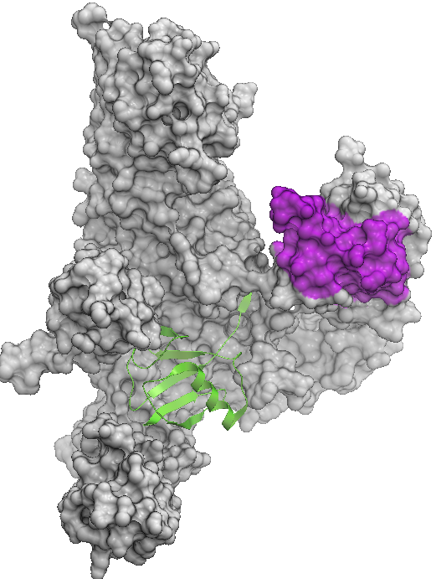
USP5
Zf-UBD: domain that I am targeting with chemical inhibitors. We are optimizing inhibitors for a similar domain in HDAC6 [doi 10.1021/acs.jmedchem.7b00933]
Catalytic site
Interaction of this region with voltage-dependent Ca²⁺ channels leads to inflammatory and neuropathic pain [doi 10.1016/j.neuron.2014.07.036 and 10.1177/1744806916642444]
Ubiquitin

