Slide 1
remove compound

Slide 2
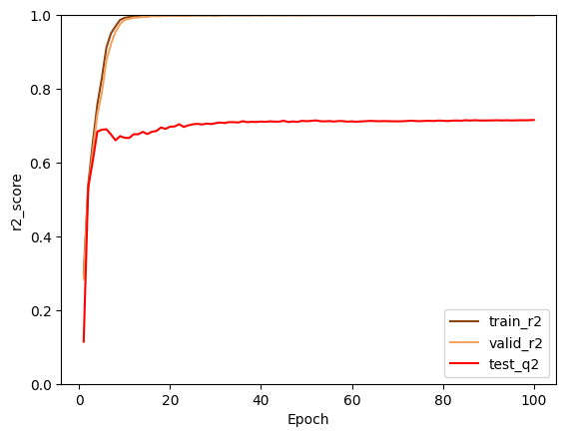
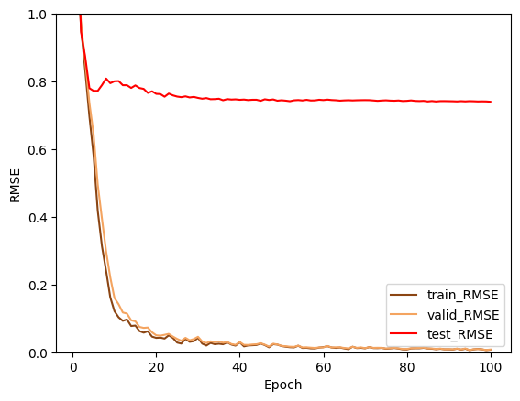
Previous Training result
Best r2
Train: 0.9999
Valid: 0.9999
Test: 0.7156
Best RMSE
Train: 0.0072
Valid: 0.0080
Test: 0.7402

Slide 3
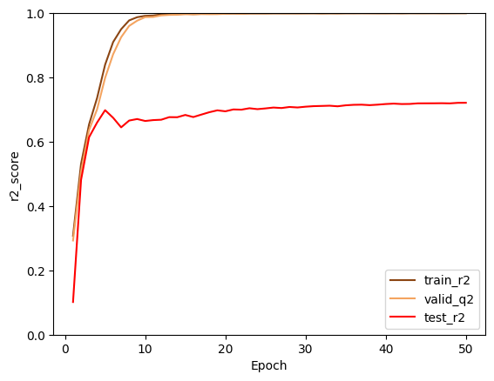
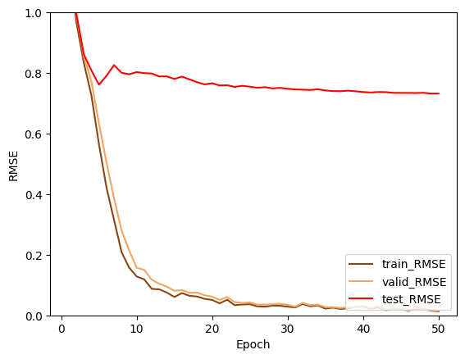
Training result after removing
Best test r2
train: 0.9999
valid: 0.9998
test: 0.7212
Best test rmse
train: 0.0130
valid: 0.0148
test: 0.7321

Slide 4
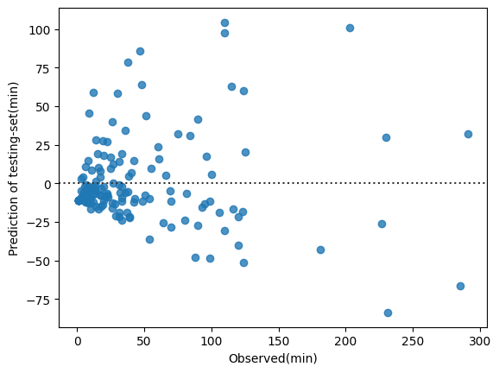
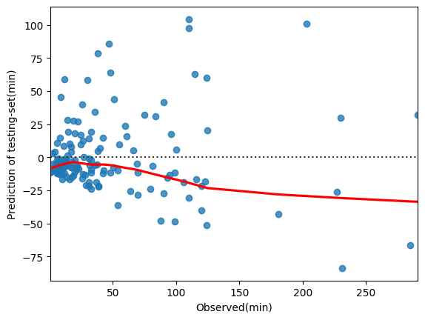
Residual plot of best result
Adding a LOWESS curve
(Fit a lowess smoother to the residual scatterplot.)

Slide 5
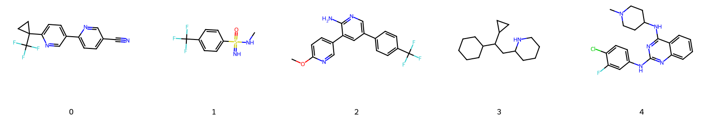
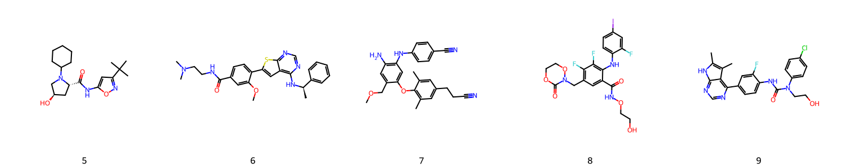
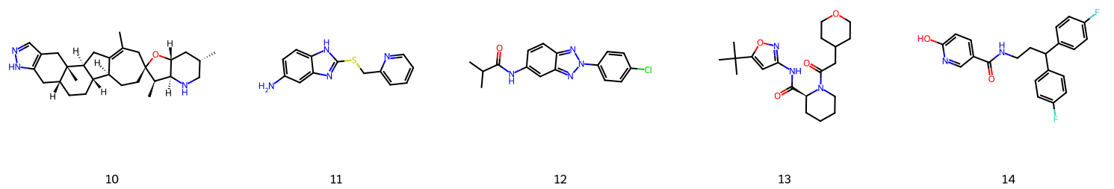
Difference > 60 min between observed & predicted

Slide 6
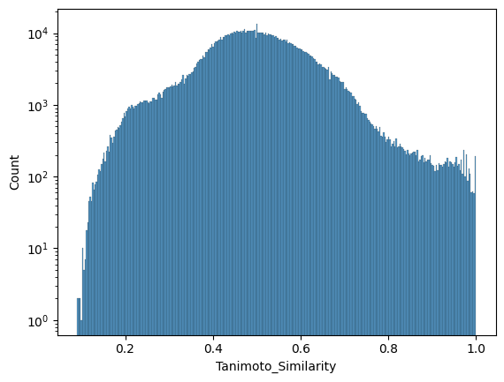
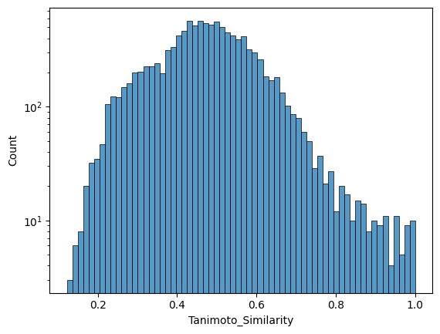
Tanimoto Similarity
Training set
Testing set

Slide 7
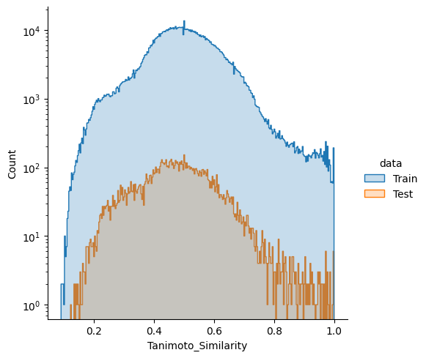
Plot training /testing set’s similarity distribution together

