Slide 1
0731
John

Slide 2
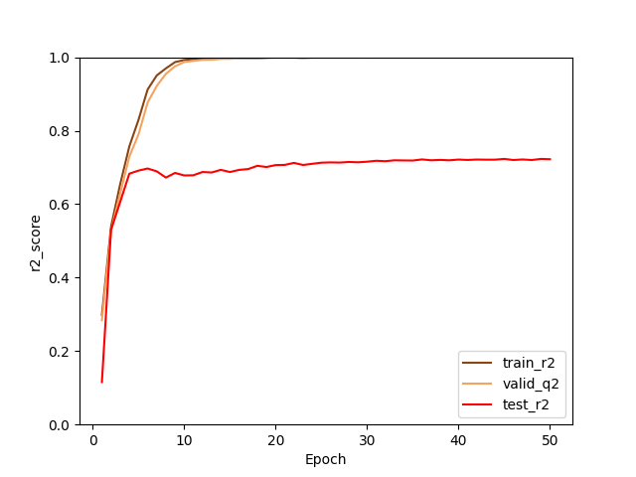
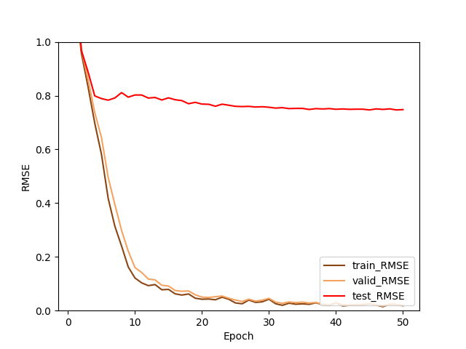
Remove suspect compound
Best r2
Train: 0.9996
Valid: 0.9996
Test: 0.7232
Best RMSE
Train: 0.0256
Valid: 0.0265
Test: 0.7401

Slide 3
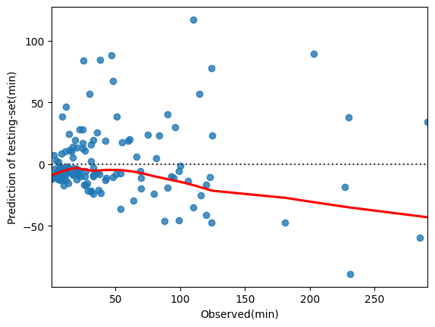
Residual plot
Adding a LOWESS curve
(Fit a lowess smoother to the residual scatterplot.)

Slide 4
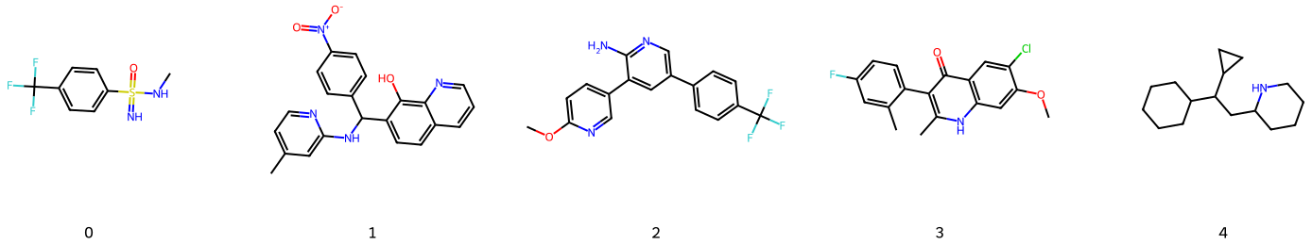
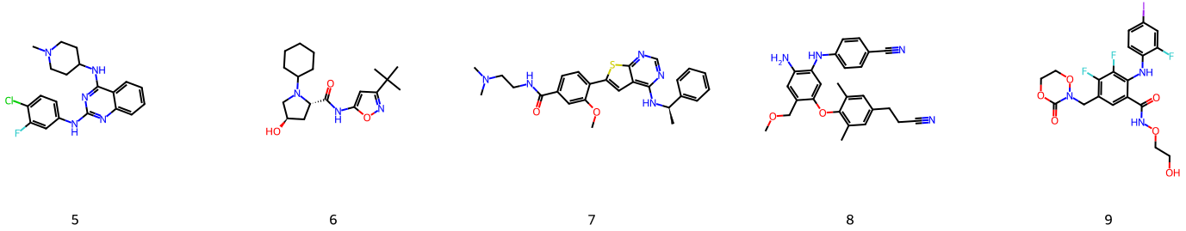
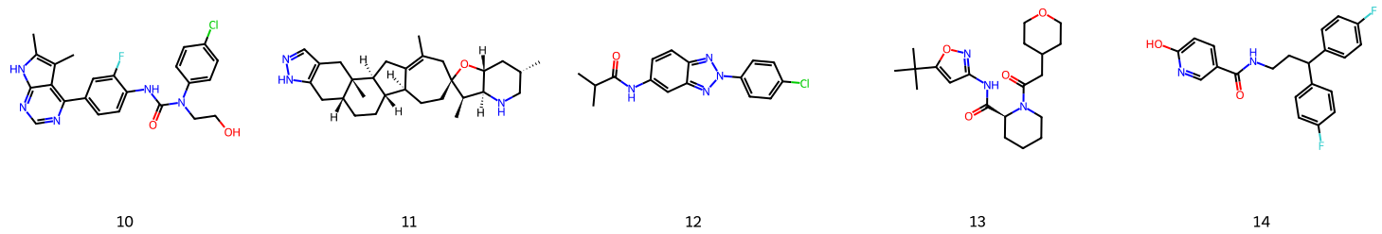

Slide 5
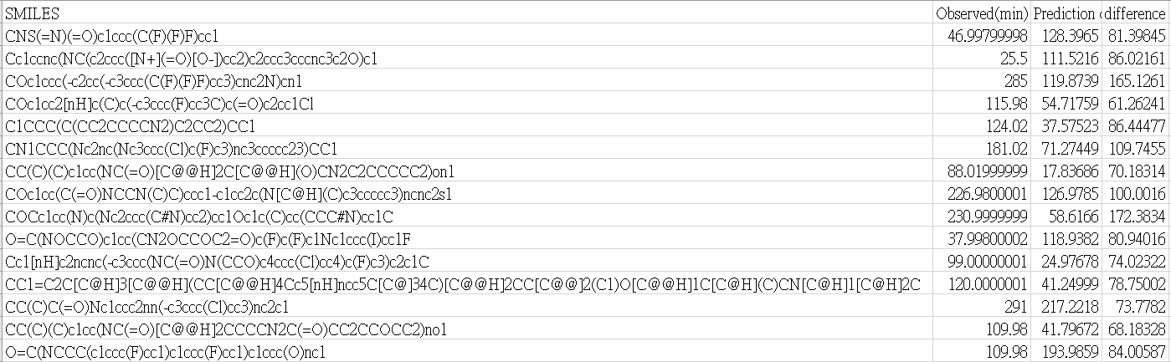

Slide 6

Remove all difference > 60 min compounds
Best r2
Train: 0.9997
Valid: 0.9997
Test: 0.7236
Best RMSE
Train: 0.0225
Valid: 0.0229
Test: 0.7467

Slide 7
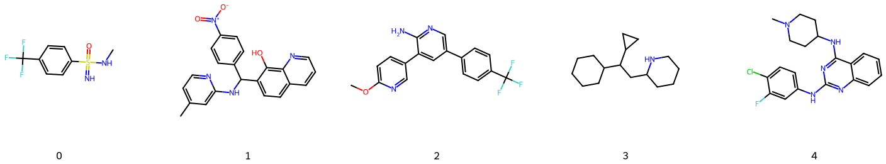
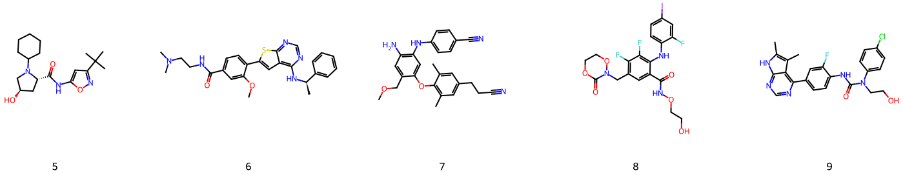
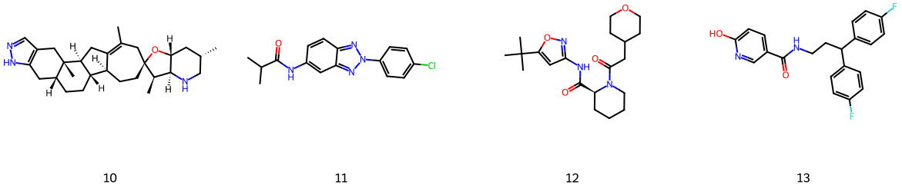

Slide 8
