Slide 1
1125
John

Slide 2
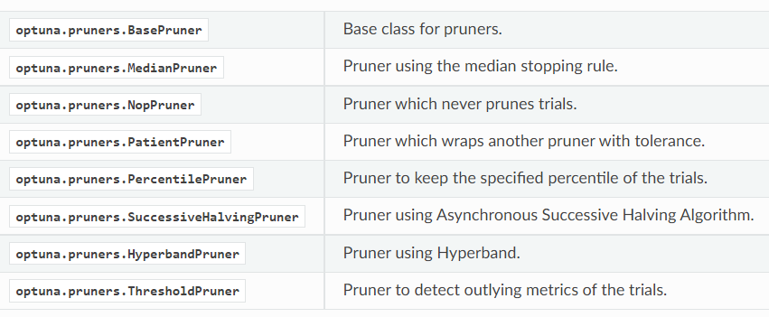
Pruner choice

Slide 3
Search space of SuccessiveHalvingPruner()
batch_size= trial.suggest_int('batch_size',16, 256, step=4),
learning_rate= trial.suggest_loguniform('learning_rate',1e-4, 1e-2),
graph_conv_layers= trial.suggest_categorical('graph_conv_layers',[[64,64],[128,128],[256,256],[64,64,64],[128,128,128],[256,256,256],[32,32,32,32],[64,64,64,64]]),
dense_layer_size= trial.suggest_int('dense_layer_size', 16, 512, step=4),
dropouts= trial.suggest_loguniform('dropouts',1e-3, 1e-2)
Epoch:200

Slide 4
Search space of PatientPruner(*other pruner)
batch_size= trial.suggest_int('batch_size',16, 256, step=4),
learning_rate= trial.suggest_loguniform('learning_rate',1e-4, 1e-2),
graph_conv_layers= trial.suggest_categorical('graph_conv_layers',[[64,64],[128,128],[256,256],[64,64,64],[128,128,128],[256,256,256],[32,32,32,32],[64,64,64,64]]),
dense_layer_size= trial.suggest_int('dense_layer_size', 16, 512, step=4),
dropouts= trial.suggest_loguniform('dropouts',1e-3, 1e-2)
Epoch: 200

Slide 5
Searching cost
SuccessiveHalvingPruner(min_resource=50,reduction_factor=4)
r2: 2 hrs 20 min
PatientPruner()
Use MedianPruner(n_startup_trials=5, n_warmup_steps=30, interval_steps=10)
r2: 5 hrs

Slide 6
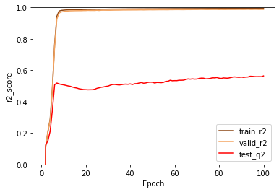
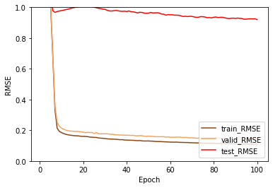
pruners.PatientPruner() pruned by r2
Best:
train_r2: 0.99
valid_r2: 0.99
test_r2: 0.56
Best:
train_loss: 0.11
valid_loss: 0.15
test_loss: 0.92
Best parameter:
batch_size=[244]
graph_conv_layers=[[64,64]]
dense_layer_size=[320]
dropout=[0.001021398675002889]
lr=0.0001484665496409606

Slide 7
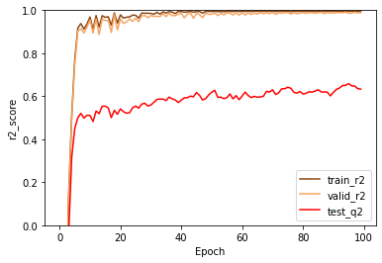
Previous result (HyperbandPruner, same search space)
Strategy: R2
Best parameter:
batch_size = 228
graph_conv_layers = [32,32,32,32]
dense_layer_size = 392
dropout = 0.00589
nb_epoch=100
learning_rate = 0.002968
Best:
Trainset_r2_value: 0.99
Validset_r2_value: 0.99
testset_q2_value: 0.66

Slide 8
Search space of HyperbandPruner
batch_size= trial.suggest_int('batch_size',64, 512, step=4),
learning_rate= trial.suggest_loguniform('learning_rate',1e-4, 1e-2),
graph_conv_layers= trial.suggest_categorical('graph_conv_layers',[[64,64,64,64],[128,128,128,128],[256,256,256,256],[64,64,64,64,64],[128,128,128,128,128],[256,256,256,256,256]]),
dense_layer_size= trial.suggest_int('dense_layer_size', 256, 512, step=4),
dropouts= trial.suggest_loguniform('dropouts',1e-3, 1e-2)
Epoch: 300
Cost: 4 hours

Slide 9
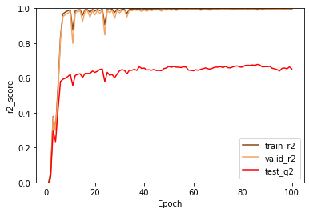
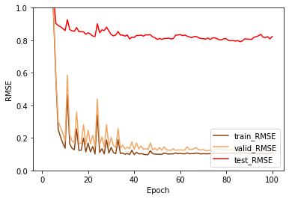
pruners.HyperbandPruner() pruned by r2
Best:
train_r2: 0.99
valid_r2: 0.99
test_r2: 0.68
Best:
train_loss: 0.11
valid_loss: 0.14
test_loss: 0.79
Best parameter:
batch_size=[240]
graph_conv_layers=[[256, 256, 256, 256]]
dense_layer_size=[276]
dropout=[0.002705573716516902]
lr=0.0012318639973244302

Slide 10

SARpy
1. Successfully installed
2. Reading User's Manual
& practicing now
3. Plan to read the benchmark
paper that cited SARpy

Slide 11
Update the ChEMBL datasets
Working on

