Slide 1
12/09
John

Slide 2
ChEMBL
ChEMBL activities with keywords “human liver microsomes” and ‘T1/2(hr)’-> 28018
Filter Homo sapiens -> 9232/ 9,129 (previous)
Problems
e. under phase II environment (glucuronidation, UDPGA)
f. associated with human liver supersomes
g. measured without NADPH
h. in the presence of inhibitor

Slide 3
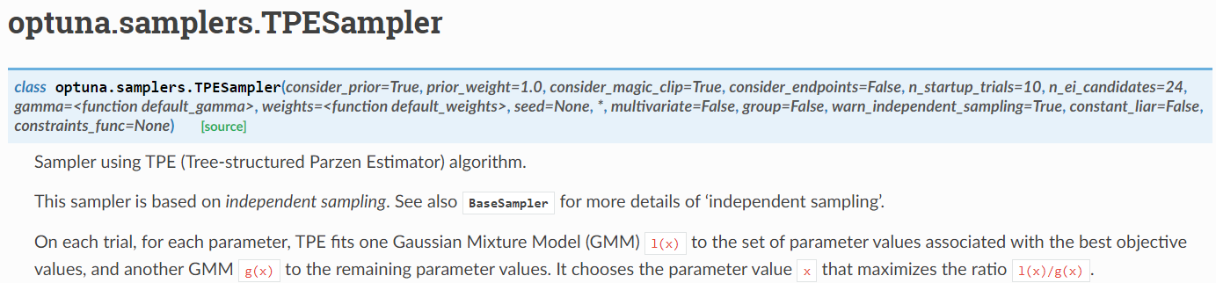
Sampler

Slide 4
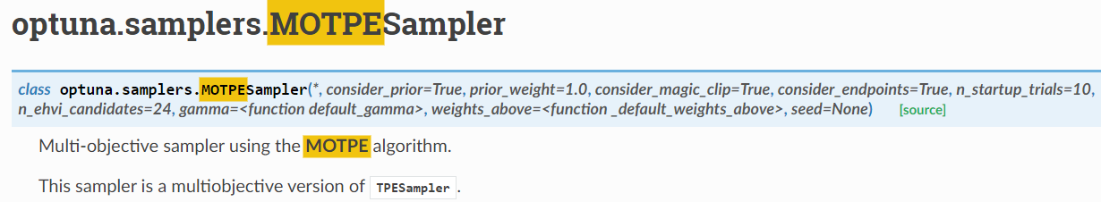
MOTPE sampler

Slide 5
Search space
batch_size= trial.suggest_int (64, 256, step=2),
learning_rate= trial.suggest_loguniform (1e-4, 1e-2),
graph_conv_layers= trial.suggest_categorical ([[64,64,64],[128,128,128],[256,256,256],[512,512,512]]),
dense_layer_size= trial.suggest_int (256, 512, step=4),
dropouts= trial.suggest_loguniform (1e-3, 1e-2)
Epoch: 300

Slide 6
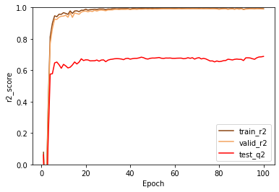
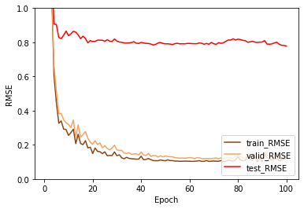
Without sampler
Best
Train 0.994
Valid 0.992
Test 0.684
Best
Train 0.1118
Valid 0.1223
Test 0.7827
batch_size=[84]
graph_conv_layers=[[256, 256, 256]]
dense_layer_size=[328]
dropout=[0.006212106339802373]
lr=0.0003272349488315456
Searching time 2 hrs 30 mins

Slide 7
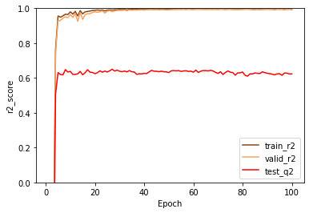
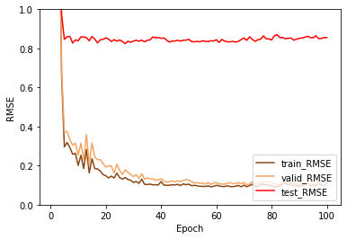
MOTPE sampler
Best
Train 0.995
Valid 0.993
Test 0.644
Best
Train 0.0950
Valid 0.1086
Test 0.8319
batch_size=[100]
graph_conv_layers=[[512, 512, 512]]
dense_layer_size=[292]
dropout=[0.003625872287332087]
lr=0.0003783741460423732
Searching time 2 hrs 46 mins

Slide 8
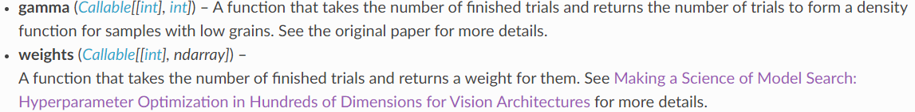
Pass a function as original paper
Weight:
The first modification was to down-weight trials as they age so that old results do not count for as much as more recent ones. We gave full weight to the most recent 25 trials and applied a linear ramp from 0 to 1.0 to older trials.
Gamma:
The second modification was to vary the fraction of trials used to estimate l(x) and g(x) with time. Out of T observations of any given variable, we used the top-performing √T /4 trials to estimate the density of l.

Slide 9
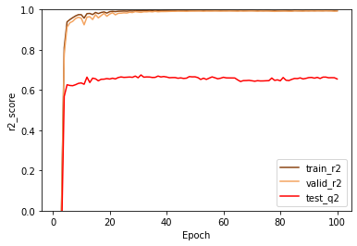
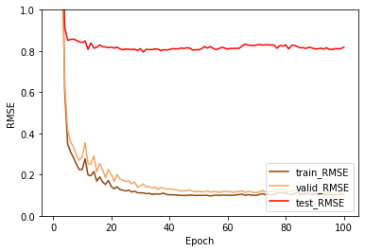
Add new function to TPE sampler
Best
Train 0.994
Valid 0.989
Test 0.669
Best
Train 0.1060
Valid 0.1376
Test 0.8014
batch_size=[90]
graph_conv_layers=[[512, 512, 512]]
dense_layer_size=[368]
dropout=[0.002224542142288216]
lr=0.00015545182368533657
Searching time 2 hrs 56 mins

Slide 10
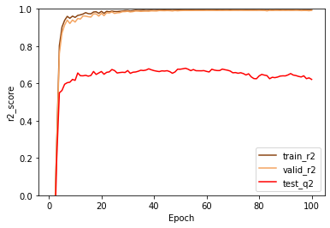
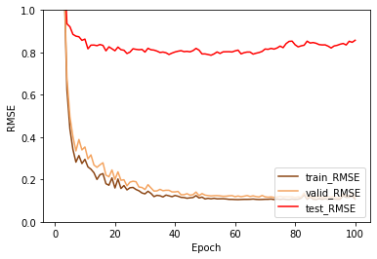
Same New function to MOTPE
Best
Train 0.994
Valid 0.992
Test 0.681
Best
Train 0.1087
Valid 0.1222
Test 0.7867
batch_size=[82]
graph_conv_layers=[[512, 512, 512]]
dense_layer_size=[292]
dropout=[0.005567951210619292]
lr=0.00045485671172924635
Searching time 3 hrs 18 mins

Slide 11
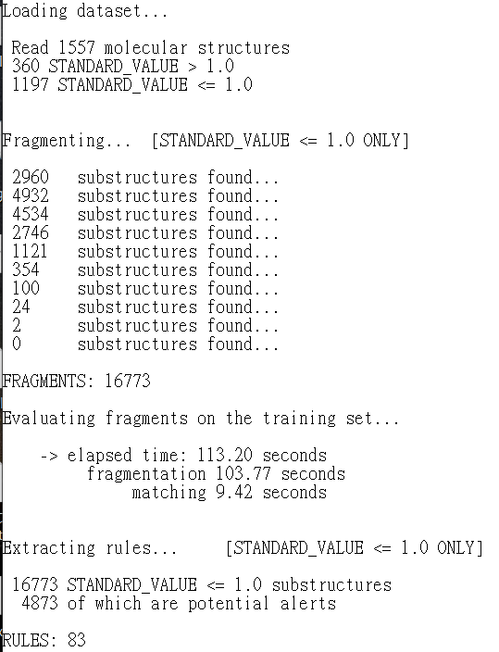
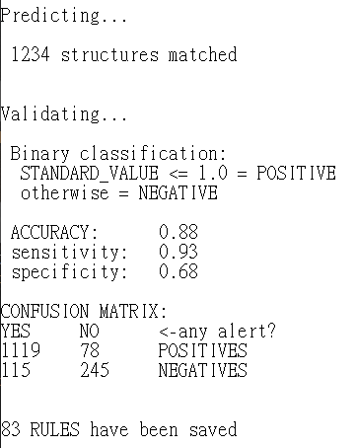
SAPpy result

Slide 12
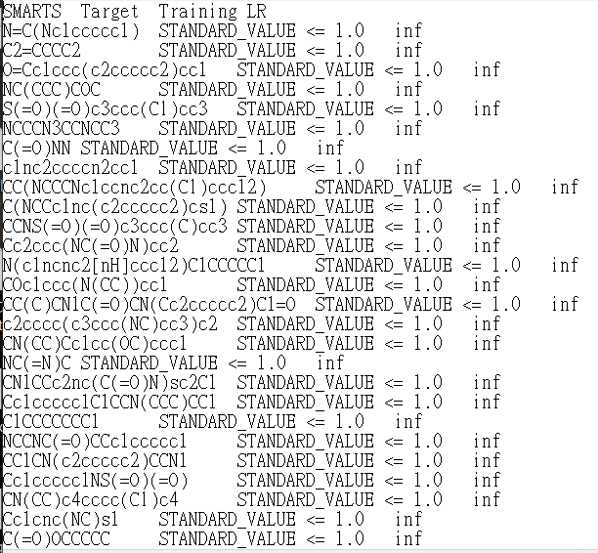
Generated rules

Slide 13
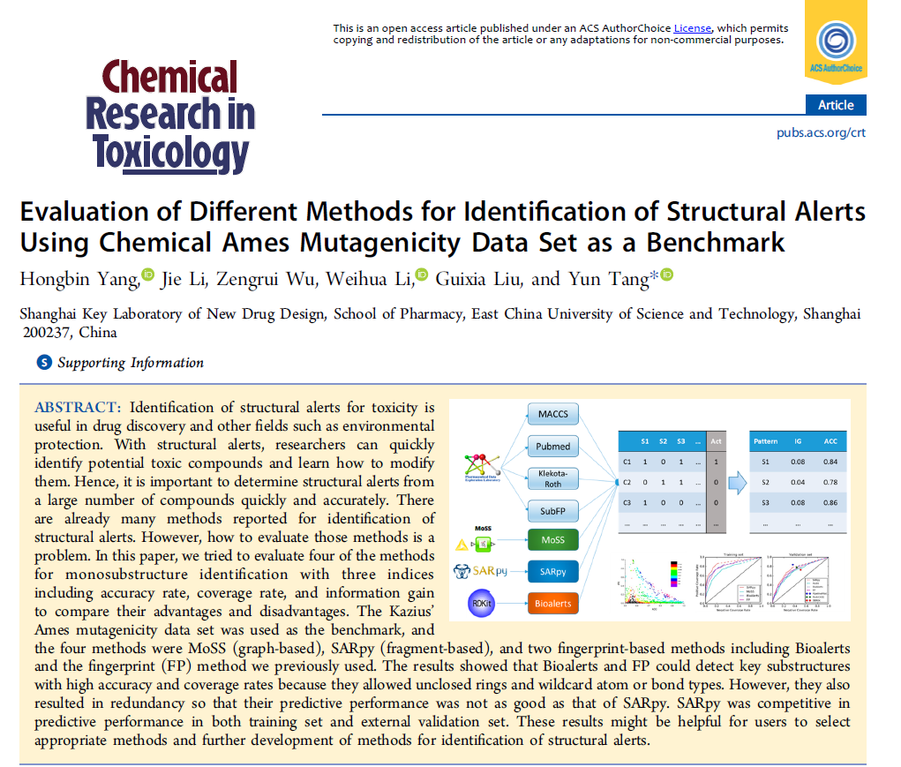
Paper

Slide 14
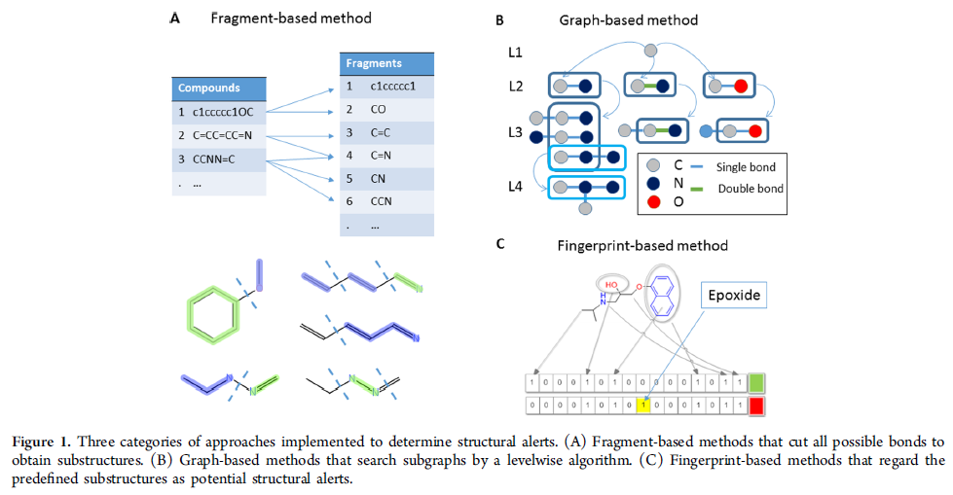
Three kinds of approaches in this paper
MoSS (graph-based)
SARpy (fragment-based)
Bioalerts, and FP
(both fingerprint-based)

Slide 15
MoSS
MoSS is a graph-based method for structural alerts that generates fragments by embedding them in all molecules in parallel throughout the growth process. This search strategy allows for a restricted depth first search algorithm, which results in excellent computing performance and theoretically covers all chemical space.
MoSS was implemented in KNIME (V2.10.4).

Slide 16
SARpy
Uses “String mining” to create substructures from the SMILES notation of training compounds.
Different from other methods, only entire branches or entire cycles are considered as potential structural alerts. SARpy evaluates existing substructures by likelihood ratio, a measure of precision intrinsic to the test.

Slide 17
Bioalerts
A python library for the derivation of structural alerts from toxicity data sets.
It is a fingerprint-based method, which mainly relies on RDkit implementation of Morgan fingerprints. P-value is used in Bioalerts to evaluate the significance of a substructure.

Slide 18
FP
PaDEL-Descriptor was used to calculate the fingerprints of :
MACCS (166 bits), PubChem (889 bits), Klekota-Roth (4860 bits), and Function Group Substructure (307 bits)
After the fingerprints of training compounds were calculated, we could get a matrix(6222 bits) that shows the relationships between the compounds and the substructures defined in the fingerprint dictionary.
Direct deletion of the duplicated substructures ( left 6214 bits) is impractical since we could not automatically determine whether two substructures represented by SMARTS are equivalent.

Slide 19
Example
MACCS63 - “[#7]=[#8]”
KR2380 -“[!#1]N=O”, and KR4117 - “N=O”
All indicate double bond between a nitrogen and an oxygen. Though the meanings of the three SMARTS were different, they were considered to be the same, and the latter two were removed. We assessed and refined them through a threshold of ACC (accuracy rate) > 0.75

Slide 20
Datasets used
Training
Kazius’ dataset, its a subset of Hansen’s benchmark (which contains 6512 compounds)
4069 distinct compounds, 2294 were labeled as mutagens and 1775 as non-mutagens
Validation
To validate the robustness of the methods, the rest of the Hansen’s data set (after removing the compounds in Kazius’ data set) was used as the external validation set to further evaluate the mining methods.
which consisted of 3363 compounds, including 1736 mutagens and 1627 non-mutagens

Slide 21
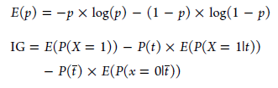
Evaluation metrics
ACC (accuracy rate) = P(X = 1 t)
PR (positive rate) = P(t)
IG(information gain)
Notes:
For a potential structural alert (substructure identified by the four methods) T, we used condition t to define compounds that contain the substructure and used t ̅to define compounds that do not contain the substructure. ACC is the rate between the number of mutagens that contain a certain substructure and the number of all compounds that contain the substructure (eq 1). Positive rate, also called coverage rate, is the probability of compounds containing the substructure (eq 2)
Eq 3 shows the definition of information entropy, in which p means the probability of molecules in one category. Eq 4 shows the formation of IG used in this study.An ideal substructure whose IG is very high can separate the data set into two

Slide 22
Substructure extraction on training set
MoSS: obtained 129 frequent substructures
SARpy: 130 potential structural alerts were found
Bioalerts: detected 1094 patterns, from which we selected 395 unique substructures whose IG values were higher than 0.002
FP: The fingerprints output 6214 bits in total. Then we retained the fragments whose accuracy is higher than 0.75 and discarded the nonsubstructure patterns (e.g., MACCS49 is “[!+0]”). Finally, 173 patterns were left with a manual screening because many patterns were similar

Slide 23
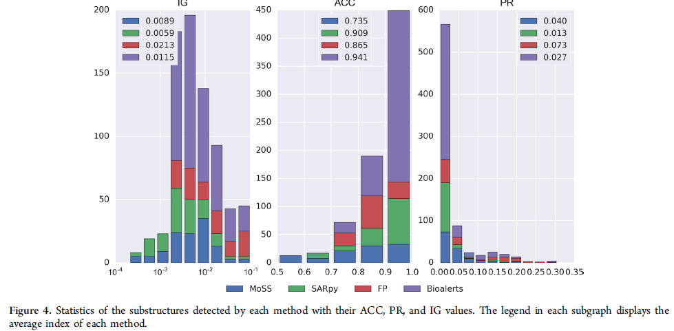
Results
Notes:
SARpy could get the highest accuracy compared to other three methods in both training set and validation set, which illustrated that the
structural alerts identified by SARpy could help predict the toxicity of a compound due to its high accuracy and interpretability.
The performance of FP method and Bioalerts were similar, and FP method had a higher maximum coverage rate (89.4% for training set and 86.2% for validation set). This
implied that the substructures obtained by FP method were more common than the others. As for MoSS, its accuracy was the lowest compared to other methods in both training set and validation set.

Slide 24
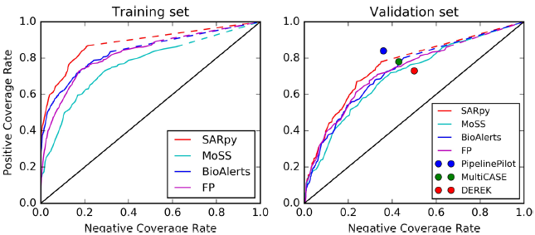
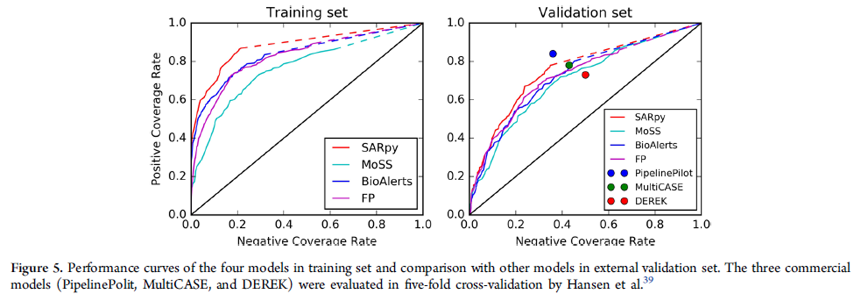

Slide 25
Discussion
Although IG value can be regarded as a comprehensive score in evaluation of a substructure, there are still some shortages. If a substructure has a low ACC value but high PR value, its IG value will be still very high for its commonness. However, if its ACC is too low, the researchers may lose interest in it or doubt the potency.
For example, the substructure allylamine (“N−C−C=C”) had a comparatively high IG score, but its ACC was only 0.698. On one hand, the high occurrence represented the significance of the pattern that deserved to pay attention, on the other hand, the accuracy was too low and the indices illustrated that more than 600 compounds containing the substructure were inactive.

Slide 26
Conclusion
By comparison of the performance of the four methods, we found that fingerprint-based methods demonstrated strong capability in identification of significant structural alerts. They could cover most of the positive sets and the accuracy was acceptable; however, they contained too many redundant patterns and false positives.
MoSS was the fastest and also could identify a lot of significant structural alerts, while its assessment method may result in high false positive and false negative. SARpy could detect highly accurate and specific substructures owing to its assessment of likelihood ratio, and it is more preferable to use its structural alerts to build rule-basedpredictive models.

