Slide 1
02/03
John

Slide 2
TPSA/MW
Drop data beyond 2 sigma
Sample before/ After -> 1556/1491
Train/test-> 9:1
5 fold CV

Slide 3
Hyperparameter
batch_size=[82]
graph_conv_layers=[[512, 512, 512]]
dense_layer_size=[292]
dropout=[0.005567951210619292]
lr=0.00045485671172924635

Slide 4
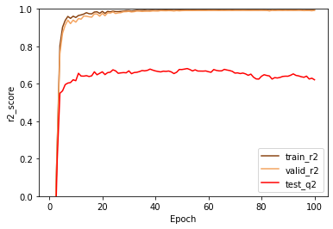
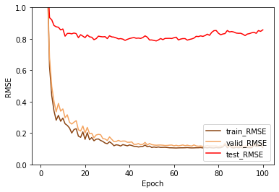
No data filtered
Best
Train 0.994
Valid 0.992
Test 0.681
Best
Train 0.1087
Valid 0.1222
Test 0.7867

Slide 5
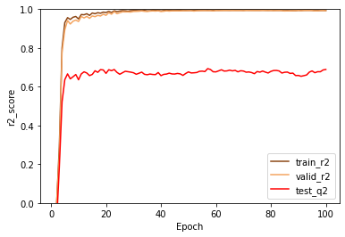
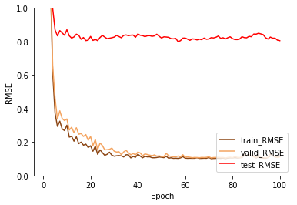
With data filtered
Best
train_r2: 0.995
valid_r2: 0.992
test_r2: 0.693
Best
train_loss: 0.1022
valid_loss: 0.1166
test_loss: 0.7993

