Slide 1
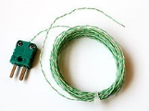
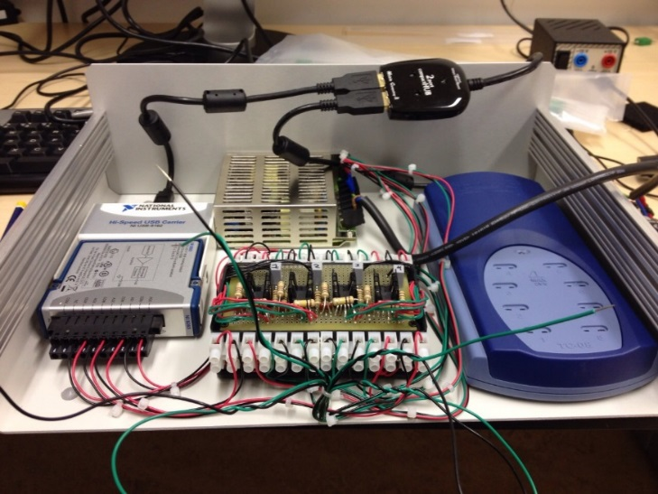
Can we diagnose: -heart attack -recurrence of cancer -antimicrobial resistant bacteria with a simple thermometer?
Dr. Marloes Peeters (www.marloespeeters.nl, @peeters_marloes)
School of Science and Environment
Lecturer Div. of Chemistry & Environmental Science

Slide 2
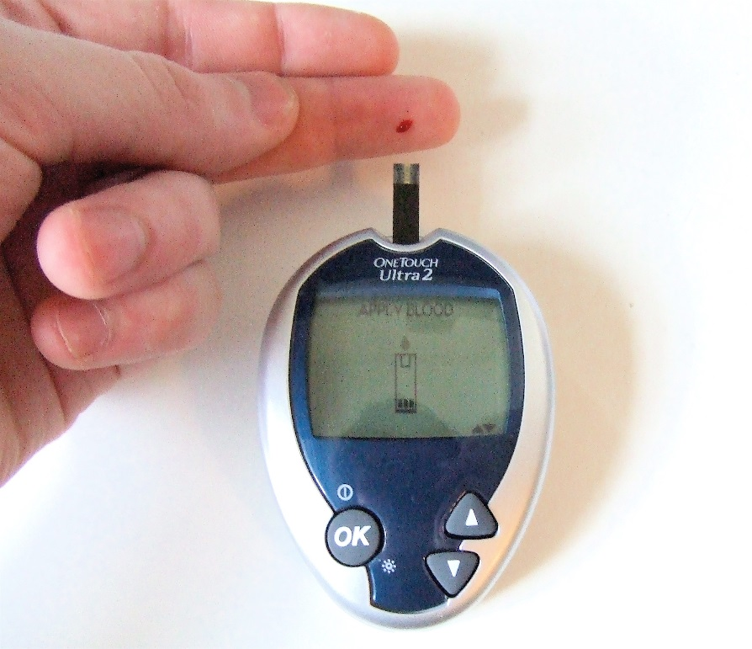
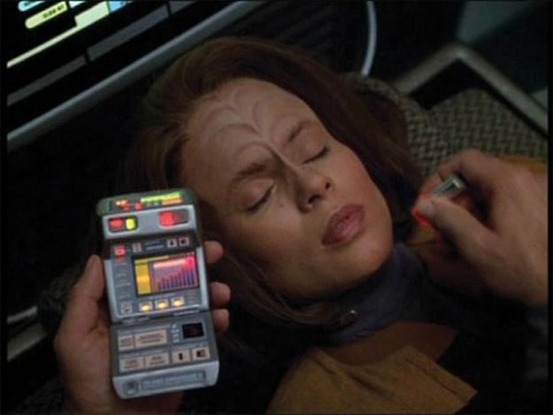
Universal sensor: Sensing future of healthcare
Star Trek predicted tricorder → universal ‘sensor’
What we have: glucose sensor (30% of market)
Sensors: healthcare, early diagnosis / prevention, environmental analysis
80% electrical sensors, thermal (heat) sensors → INNOVATION (patents)
ManMet: multidisciplinary environment and strong record (industrial) sensors
Keywords: low-cost, disposable sensors, portable set up, simple analysis, fast
From measuring 1
compound
To instant diagnosis

Slide 3
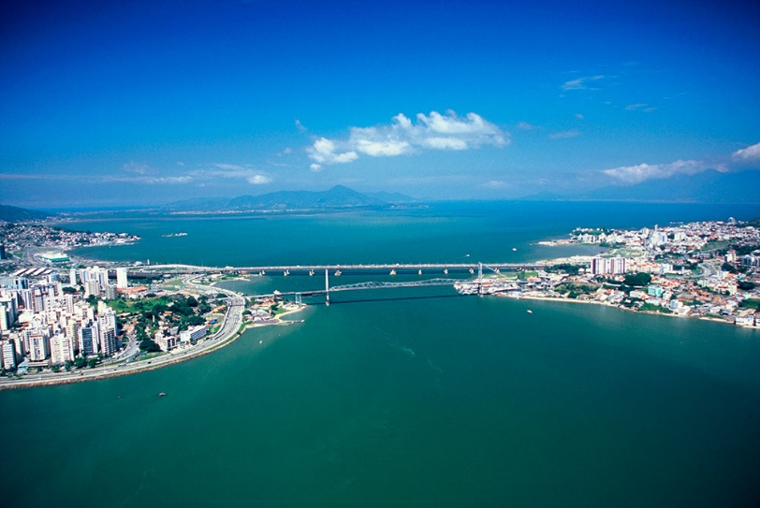
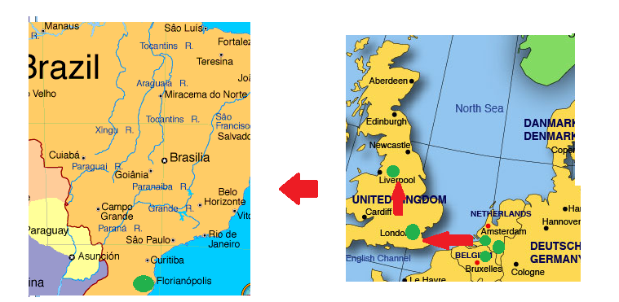
Dr. Marloes Peeters
MSc Eindhoven (Materials Science) - 2009
PhD Hasselt University (Belgium) biosensors - 2013
Fellowship: Development biosensor platforms – 2014
4 patents filed thermal detection
Postdoc Queen Mary University of London - 2015
Currently: Lecturer (2015)
Div. of Chemistry & Environmental Science
Biosensor research group
6 students (PhD, MRes, MSc)

Slide 4
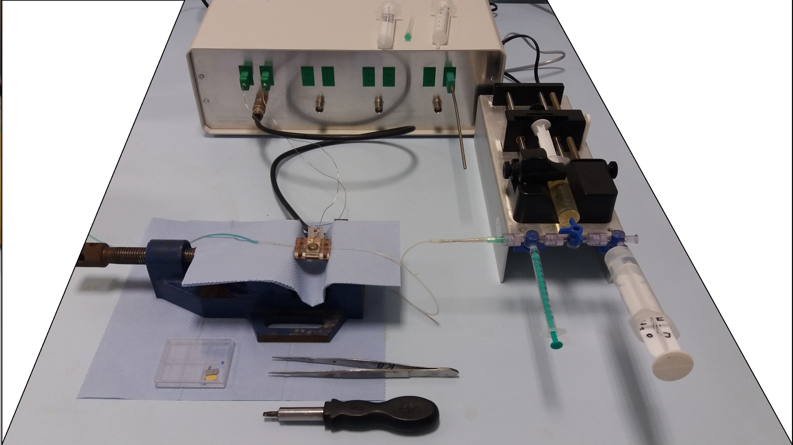
Heat-Transfer (thermometer) patented setup
Pump to administer sample
Device measures temperature
Thermometers
Power (heating up samples)
Cell containing sensor and to which sample is added

Slide 5
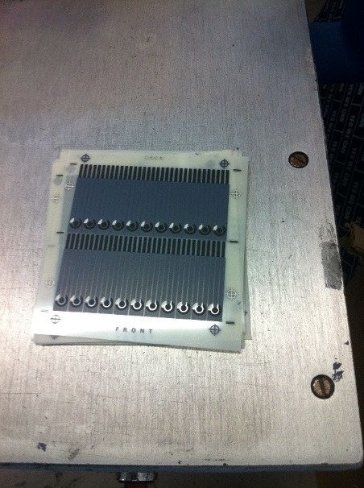
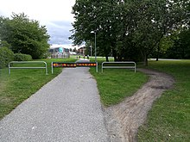
Research concept: thermal sensors
Development novel sensing strategy: Heat-Transfer Method (HTM)
Concept: People find path last resistance, so does heat
Change on surface → relates to change in liquid
fast (<5 min), simple, low-cost, novel sensing strategy
Changes in
4 years
Current sensor vs sensor PhD
1 sensor per min vs 1 per hour
Path least resistance with a bike…

Slide 6
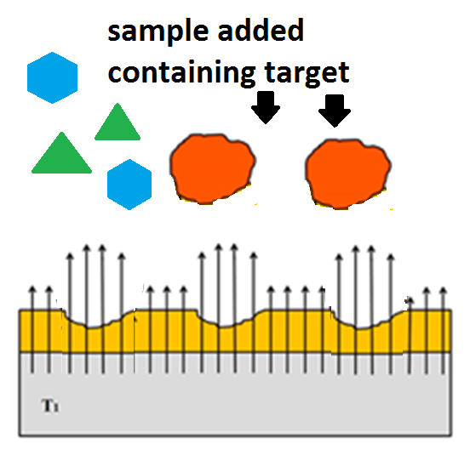
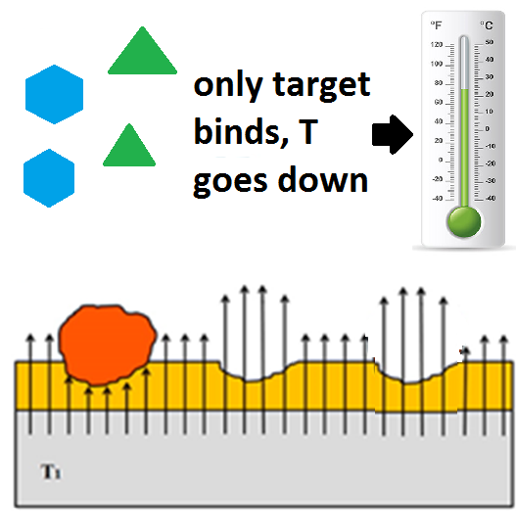
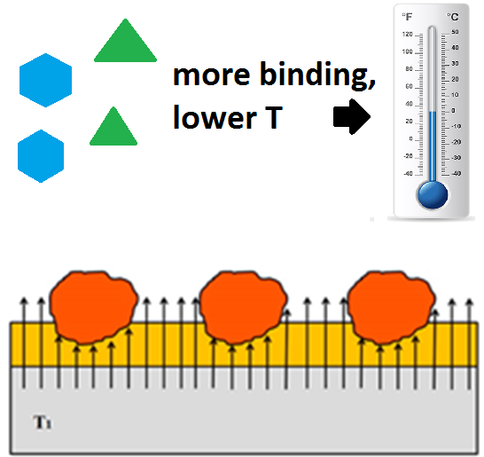
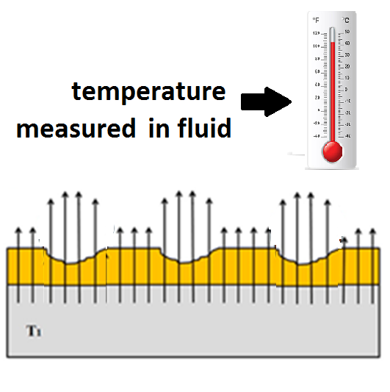

Slide 7
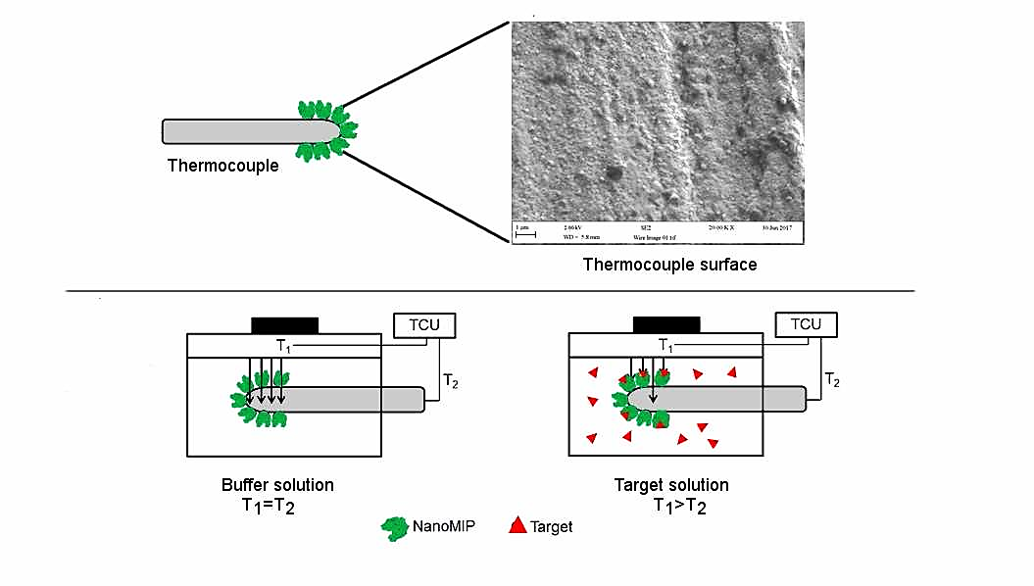

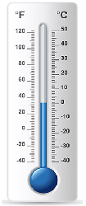
Exciting, multidisciplinary research area
International research community: device only available KU Leuven, Maastricht University
Strengths at ManchesterMet: 3D printing, screen-printing, electrochemical sensors
Disposable sensor chip: aimed at £1/measurement
Versatile → adapt sensor to virtually EVERY TARGET
Attachment target to “functionalized” thermometer → clear decrease in temperature
Temperature
before (high)
Temperature
after binding (low)

Slide 8
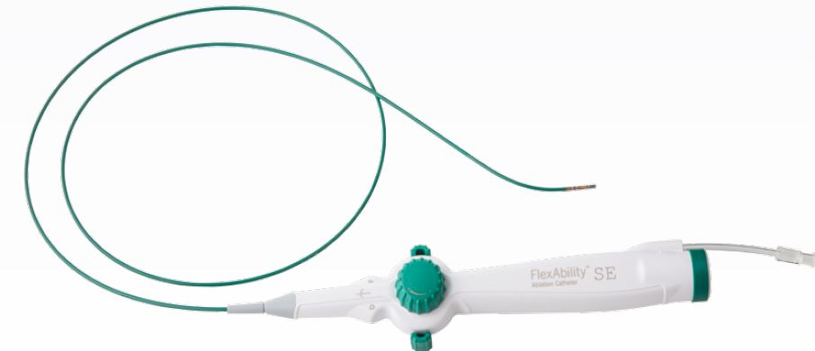
Biomedical device with KU Leuven
Biomedical device
Incorporation ManMet sensors in catheters
Measurements in body at KU Leuven
First application thermal sensors in-vivo
→ idea of my PhD put into practice
Commercial/clinical applications
Collaboration MIPDiagnostics (company) high affinity nanoparticles
Knowledge Transfer Partnership in preparation Cambridge MedTech (2 projects, 3 years)
Clinical partnership with Manchester Royal Infirmary
Sponsors Royal Society, Royal Society of Chemistry & Newton fund

Slide 9
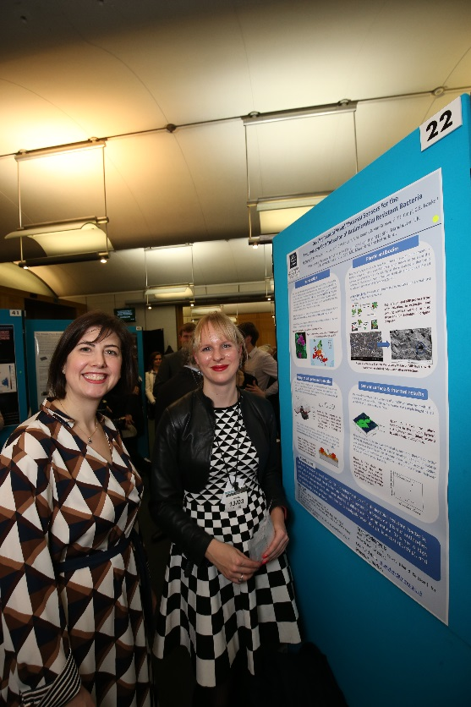
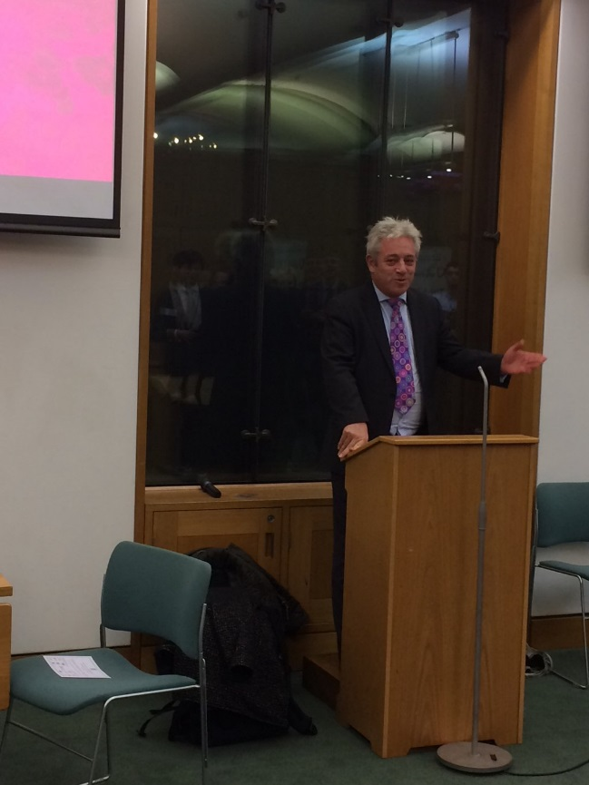

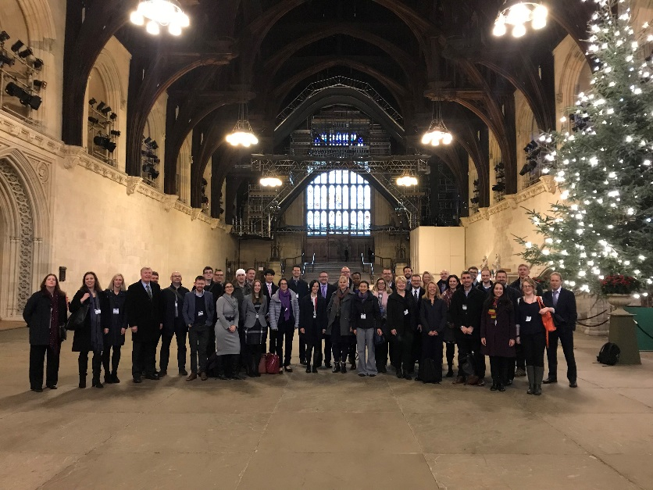
Impact work : applications
Intellectual property
4 patents by myself on heat-transfer applications, 10 in total in area
Knowledge exchange
Organization Bioinspired Materials conference (80 internationals 2017)
Week in Westminster (4 days parliament, paired senior policy officer DEFRA)
Ben Rayner (ManchesterMet graduate) return visit
Public Engagement Champion (Soapbox Science, Women in Engineering Day)
IUPAC: Polymer Division (IV), secretary local division Royal Society of Chemistry

Slide 10
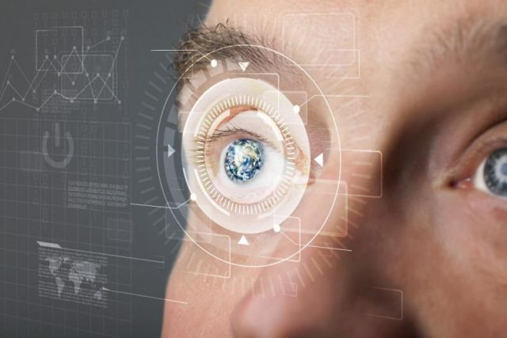
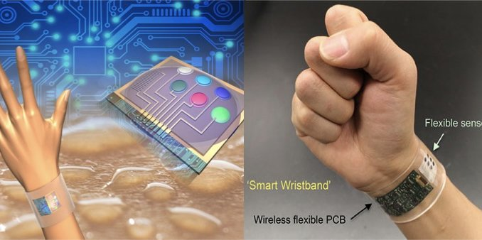
My ultimate goal….
Development of a universal thermal biosensor
that can be operated by everyone in a home-setting
Future opportunities: apply for IP new sensing strategy
Find software support → app to connect to Bluetooth of device
Commercial prototyping→ consultancy/engineers

Slide 11
References (www.marloespeeters.nl)
SMALL. MOLECULES:
[1] M. Peeters, F.J. Troost, R. Mingels et al., Anal Chem., 2013, 85, 1475-1483.
[2] M. Peeters, P. Csipai, B. Geerets et al., Anal. Bioanal. Chem., 2013, 405, 6453-6460.
[3] M. Peeters, S. Kobben, L. Jimenez-Monroy et al., Sens. Actuat. B:Chem, 2014, 203, 527-535.
[4] G. Wackers, T. Vandenryt, P. Cornelis et al., Sensors, 2014, 14, 11016-11030.
[5] M. Peeters, B. van Grinsven, C.W. Foster et al., Molecules, 2016, 21: 552-565.
[6] S. Casadio, J.W. Lowdon, K. Betlem et al., accepted Chem. Eng. J. DOI: 10.1016/j.cej/2017.01.050 (Peeters senior author) 4* paper
[7] H. Dilien, M. Peeters, J. Royakkers, J.A.W. Harings, P. Cornelis, P. Wagner, E. SteenRedeker, C.E. Banks, K. Eersels, B. van Grinsven, T.J. Cleij, ACS Sens. 2017 Apr 28; 2(4): 583–589.
[8] F. Canfarotta, J. Czulak, K. Betlem, K. Eersels, B. van Grinsven, T. Cleij, M.Peeters, accepted in Nanoscale (December 2017) 4* paper
BACTERIA:
[9] B. van Grinsven, K. Eersels, O. Akkermans et al.,ACS Sensors, 2016, 1, 1140-1147.
[10] E. SteenRedeker, K. Eersels, O. Akkermans, J. Royakkers, S. Dyson, K. Nurekeyeva, B. Ferrando, P. Cornelis, M. Peeters, P. Wagner, H. Dilien, B. van Grinsven, T. J. Cleij, ACS Infect. Dis., 2017, 3 (5), pp 388–397. DOI: 10.1021/acsinfecdis.7b00037 4* paper

Slide 12
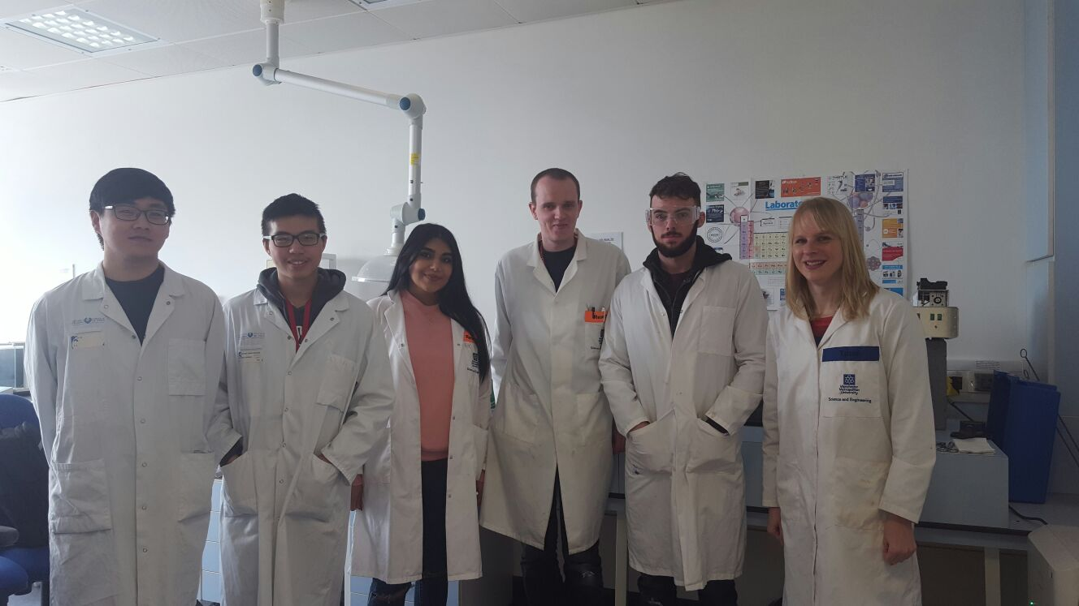




Thanks to….
Group members & partners
Kai Betlem (PhD), Nikki Mansouri & Thomas Dunbar (MRes)
Sacha Hoksbergen and Raquel Debroi (exchange students)
William Battell and Oliver Jamieson (MChem students)
Francesco Canfarotta (MIPDiagnostics)
Partners KU Leuven/ Maastricht University / Universidade de São Paulo
Engineering & Materials Centre MMU
Royal Society of Chemistry / Royal Society / Newton fund / Erasmus scheme

